Slide 1
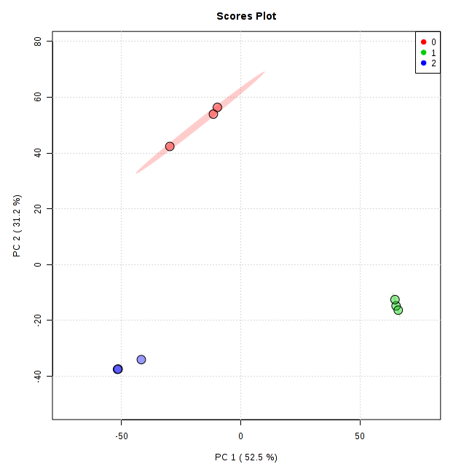
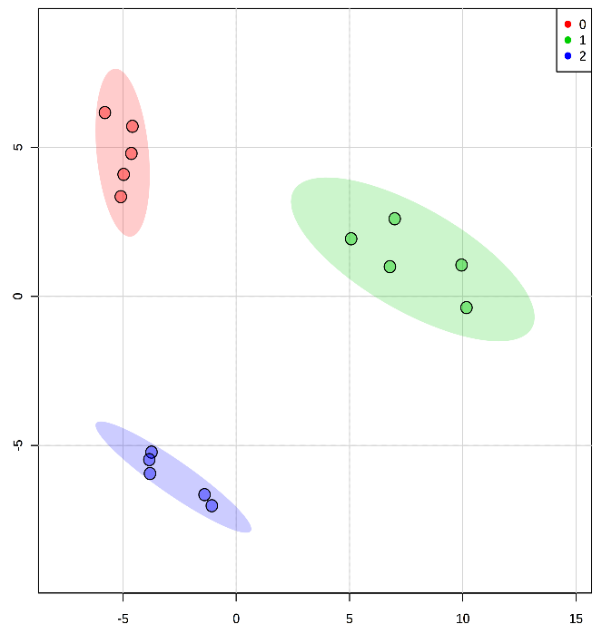
Figure 1
A)
RNA-seq
B)
Metabolic profile (negative ion mode)
Component 2 (31.2 %)
Component 2 (23.3 %)
Component 1 (52.5 %)
Component 1 (36.2 %)
Svevo
Zavitan
Chinese Spring
Figure 1. Overview of the three wheat transcriptomic and metabolomic datasets. A) PCA plot of 42,474 genes identified by transcript profiling (RNA-seq) of the three wheat genotypes: Svevo, Zavitan, and Chinese Spring at 11-day-old seedlings. B) PCA of 878 mass features (negative ion modes) identified by LC-qTOF-MS. Ovals indicate 95% confidence intervals.

Slide 2
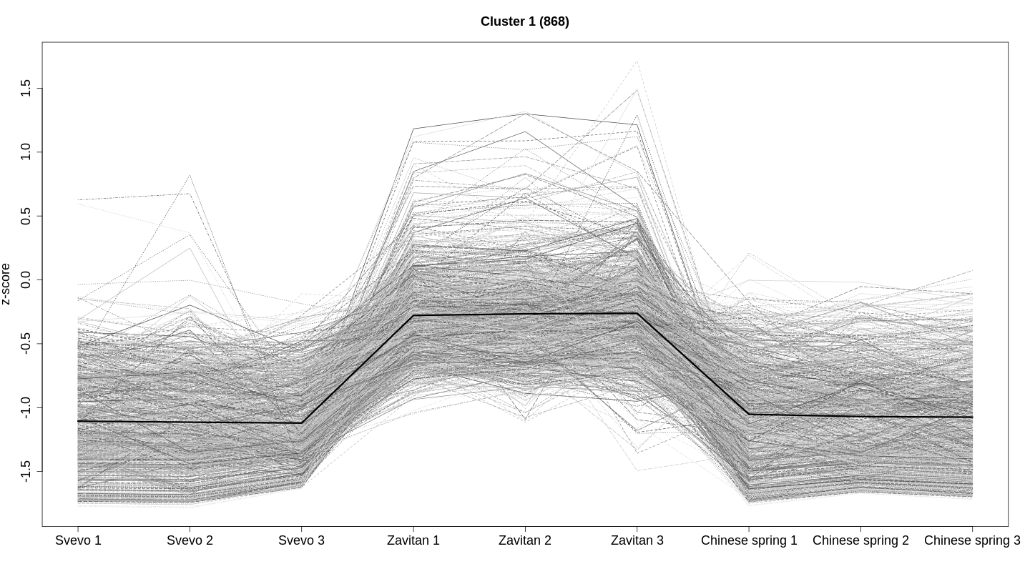
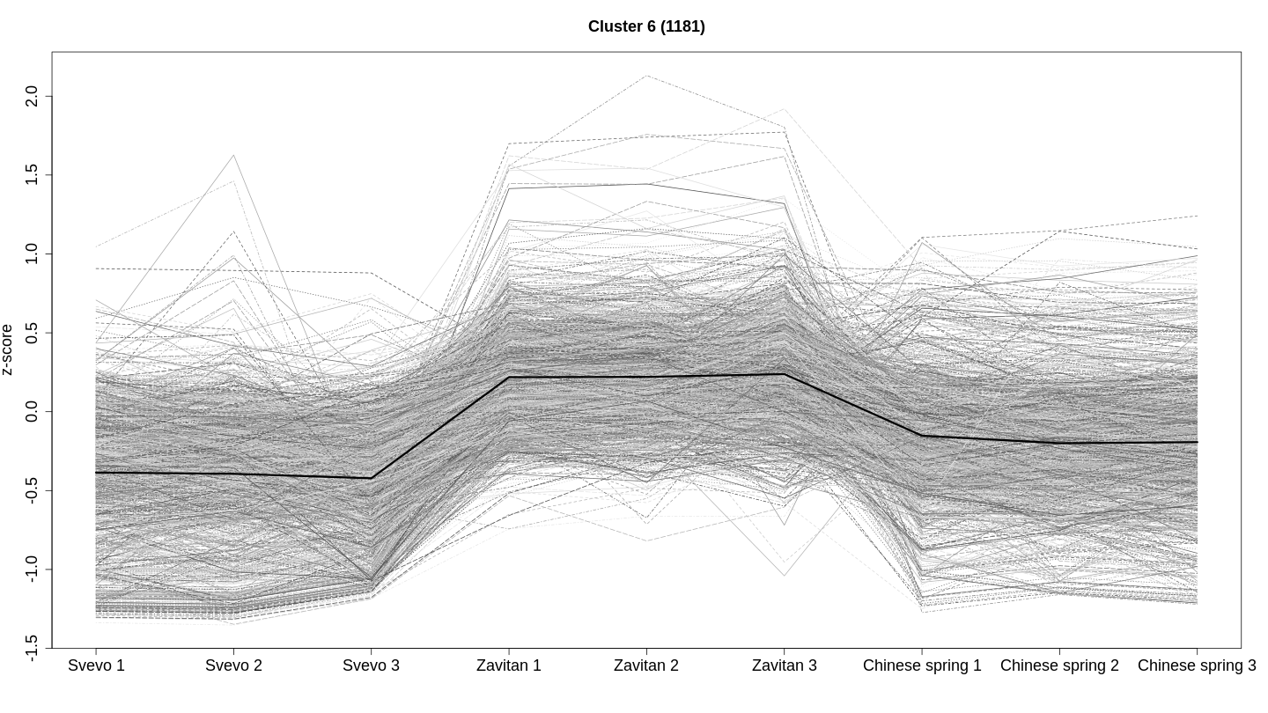
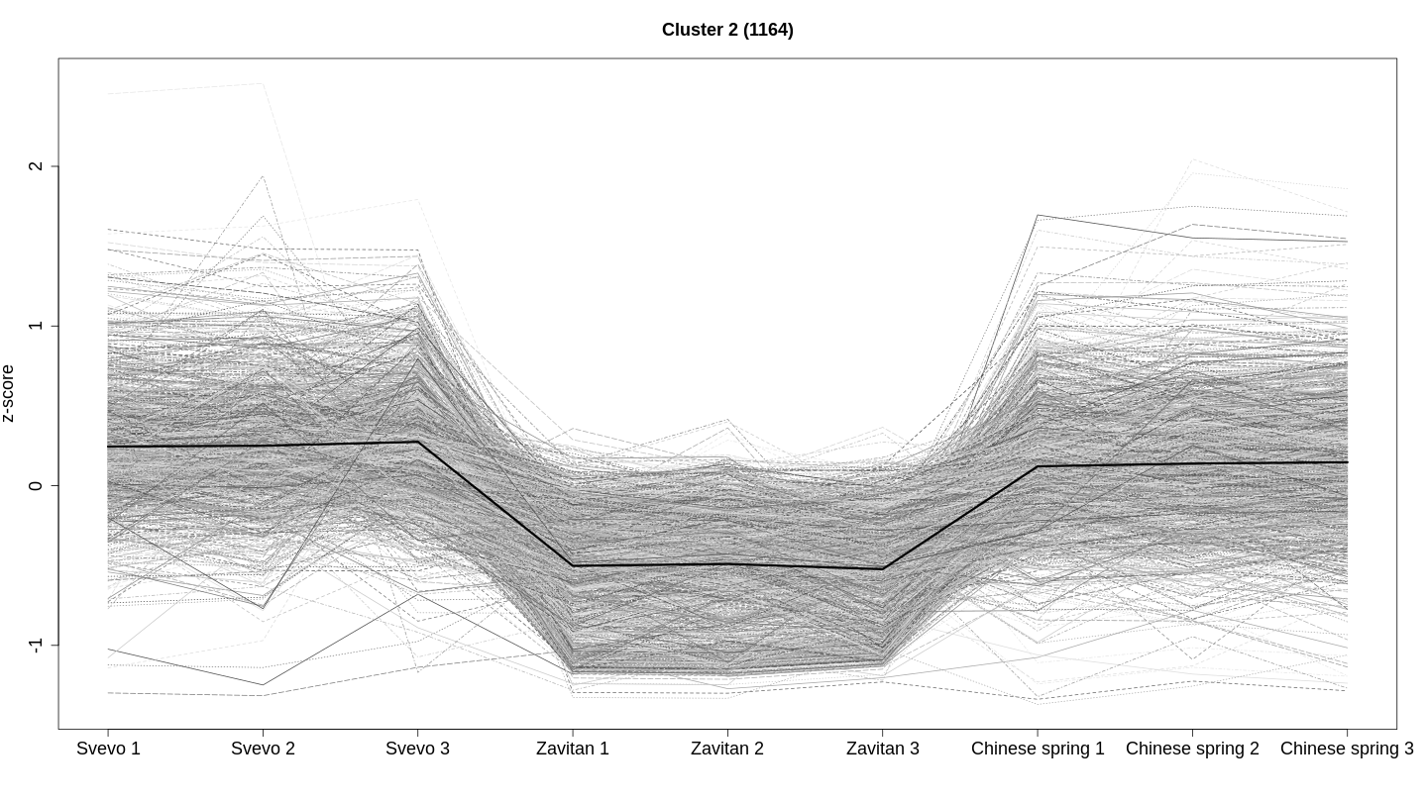
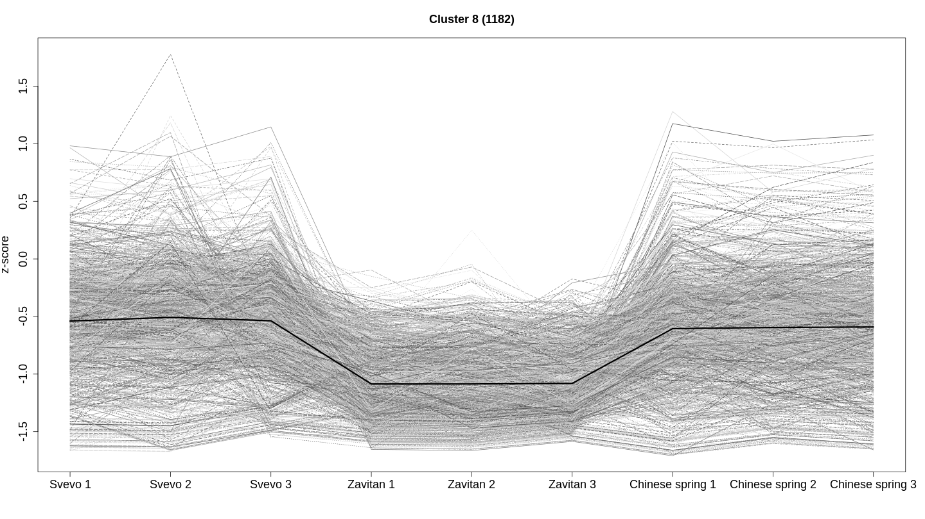
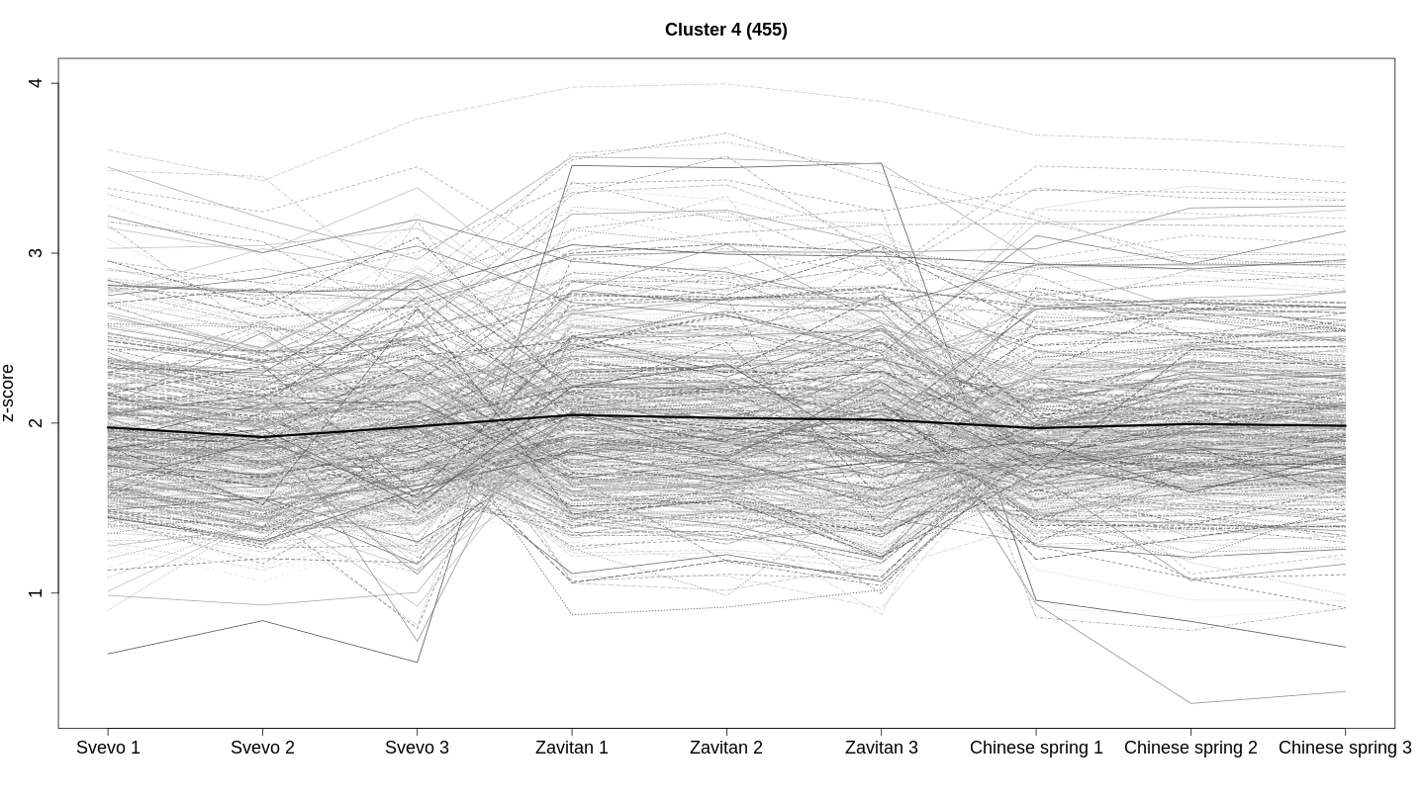
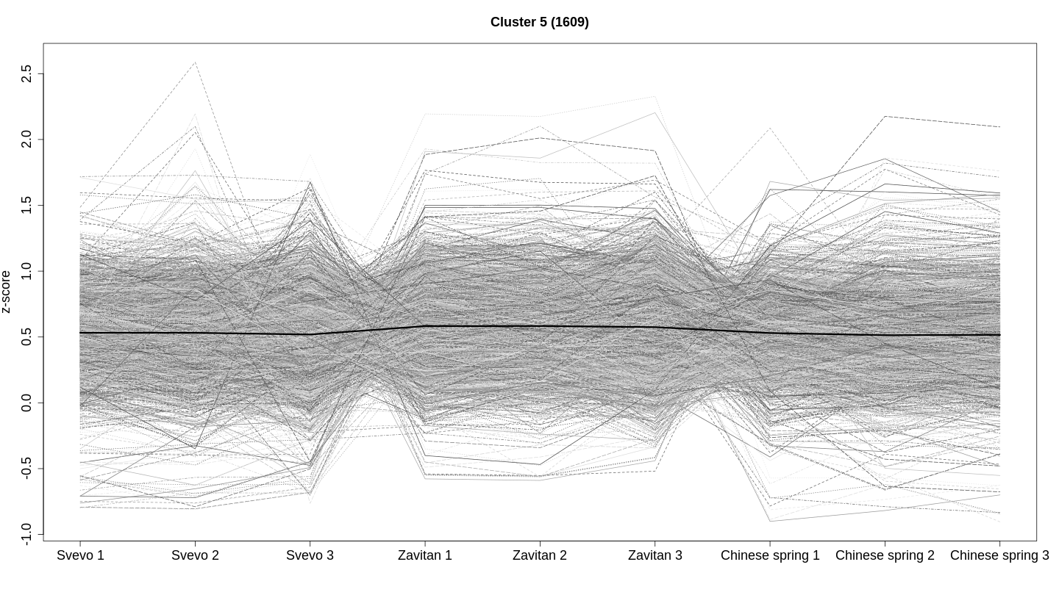
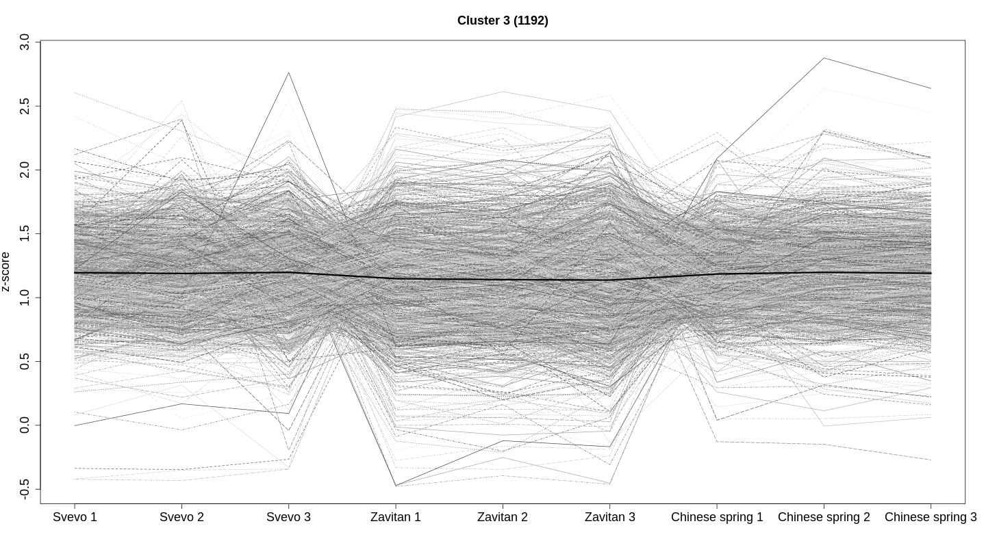
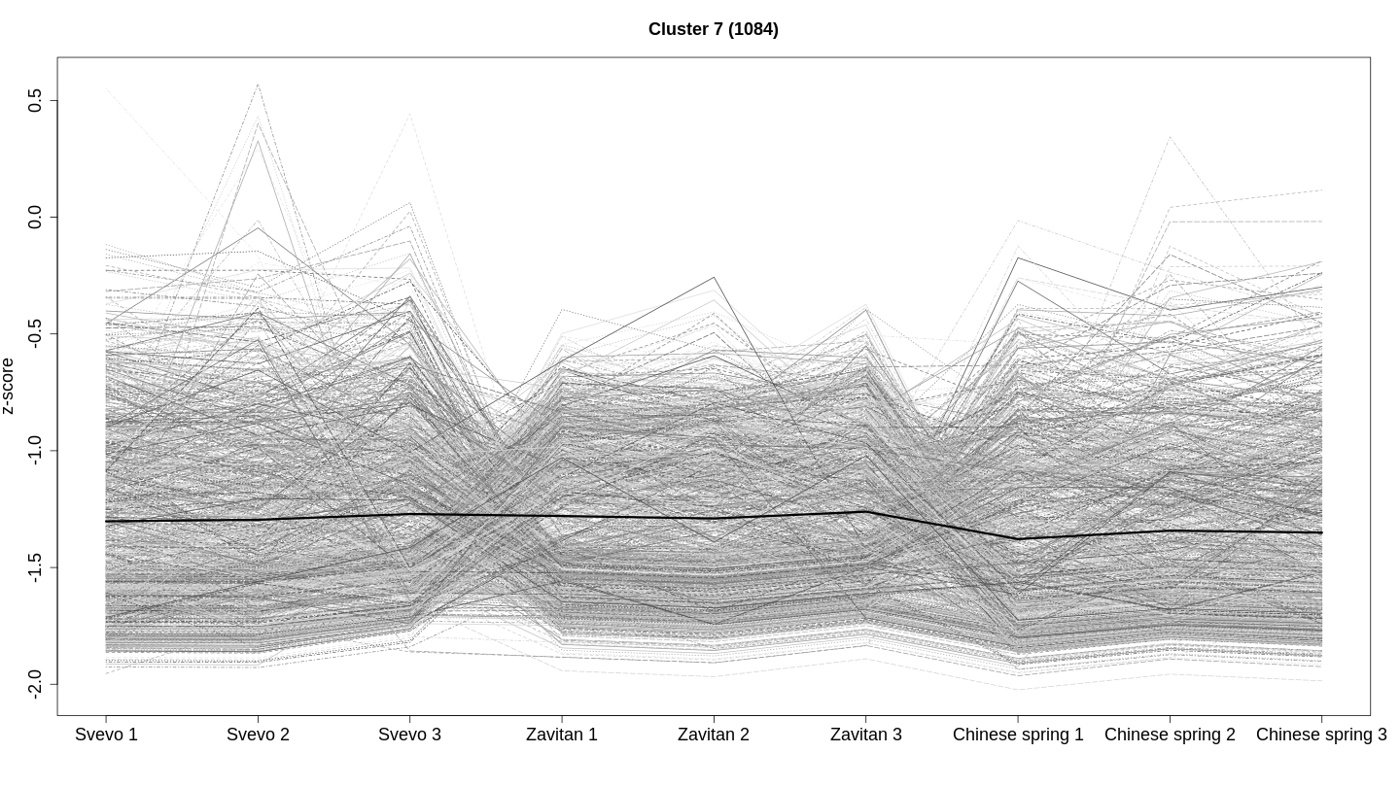
Figure 2
High in Zavitan
Cluster 1 (868 genes)
Cluster 2 (1181 genes)
1.5
2.0
1.0
1.5
0.5
1.0
Z- score
0.5
0.0
0.0
-0.5
-0.5
-1.0
-1.0
-1.5
-1.5
Low in Zavitan
Cluster 3 (1164 genes)
Cluster 4 (1182 genes)
2.0
1.5
1.0
1.0
0.5
Z- score
0.0
0.0
-0.5
-1.0
-1.0
-1.5
Slightly low in Svevo
4.0
Cluster 5 (455 genes)
2.5
Cluster 6 (1609 genes)
3.0
2.0
Z- score
1.5
2.0
1.0
0.5
1.0
0.0
-0.5
-1.0
Sv1 Sv2 Sv3 Zv1 Zv2 Zv3 CS1 CS2 CS3
Slightly low
in Zavitan
3.0
Cluster 7 (1192 genes)
Figure 2. Overview of gene expression clusters calculated by k-means clustering. A one-way ANOVA was performed, which revealed a total of 8,735 unique transcripts with significant expression profile changes for at least one genotype. The total number of transcripts in each cluster is indicated, and the data for individual genes are shown in light gray. In black, the expression responses for each cluster are shown in black.
2.5
Z- score
2.0
1.5
1.0
0.5
0.0
-0.5
Slightly low in Chinese Spring
Cluster 8 (1084 genes)
0.5
0.0
Z- score
-0.5
-1.0
-1.5
-2.0
Sv1 Sv2 Sv3 Zv1 Zv2 Zv3 CS1 CS2 CS3

Slide 3
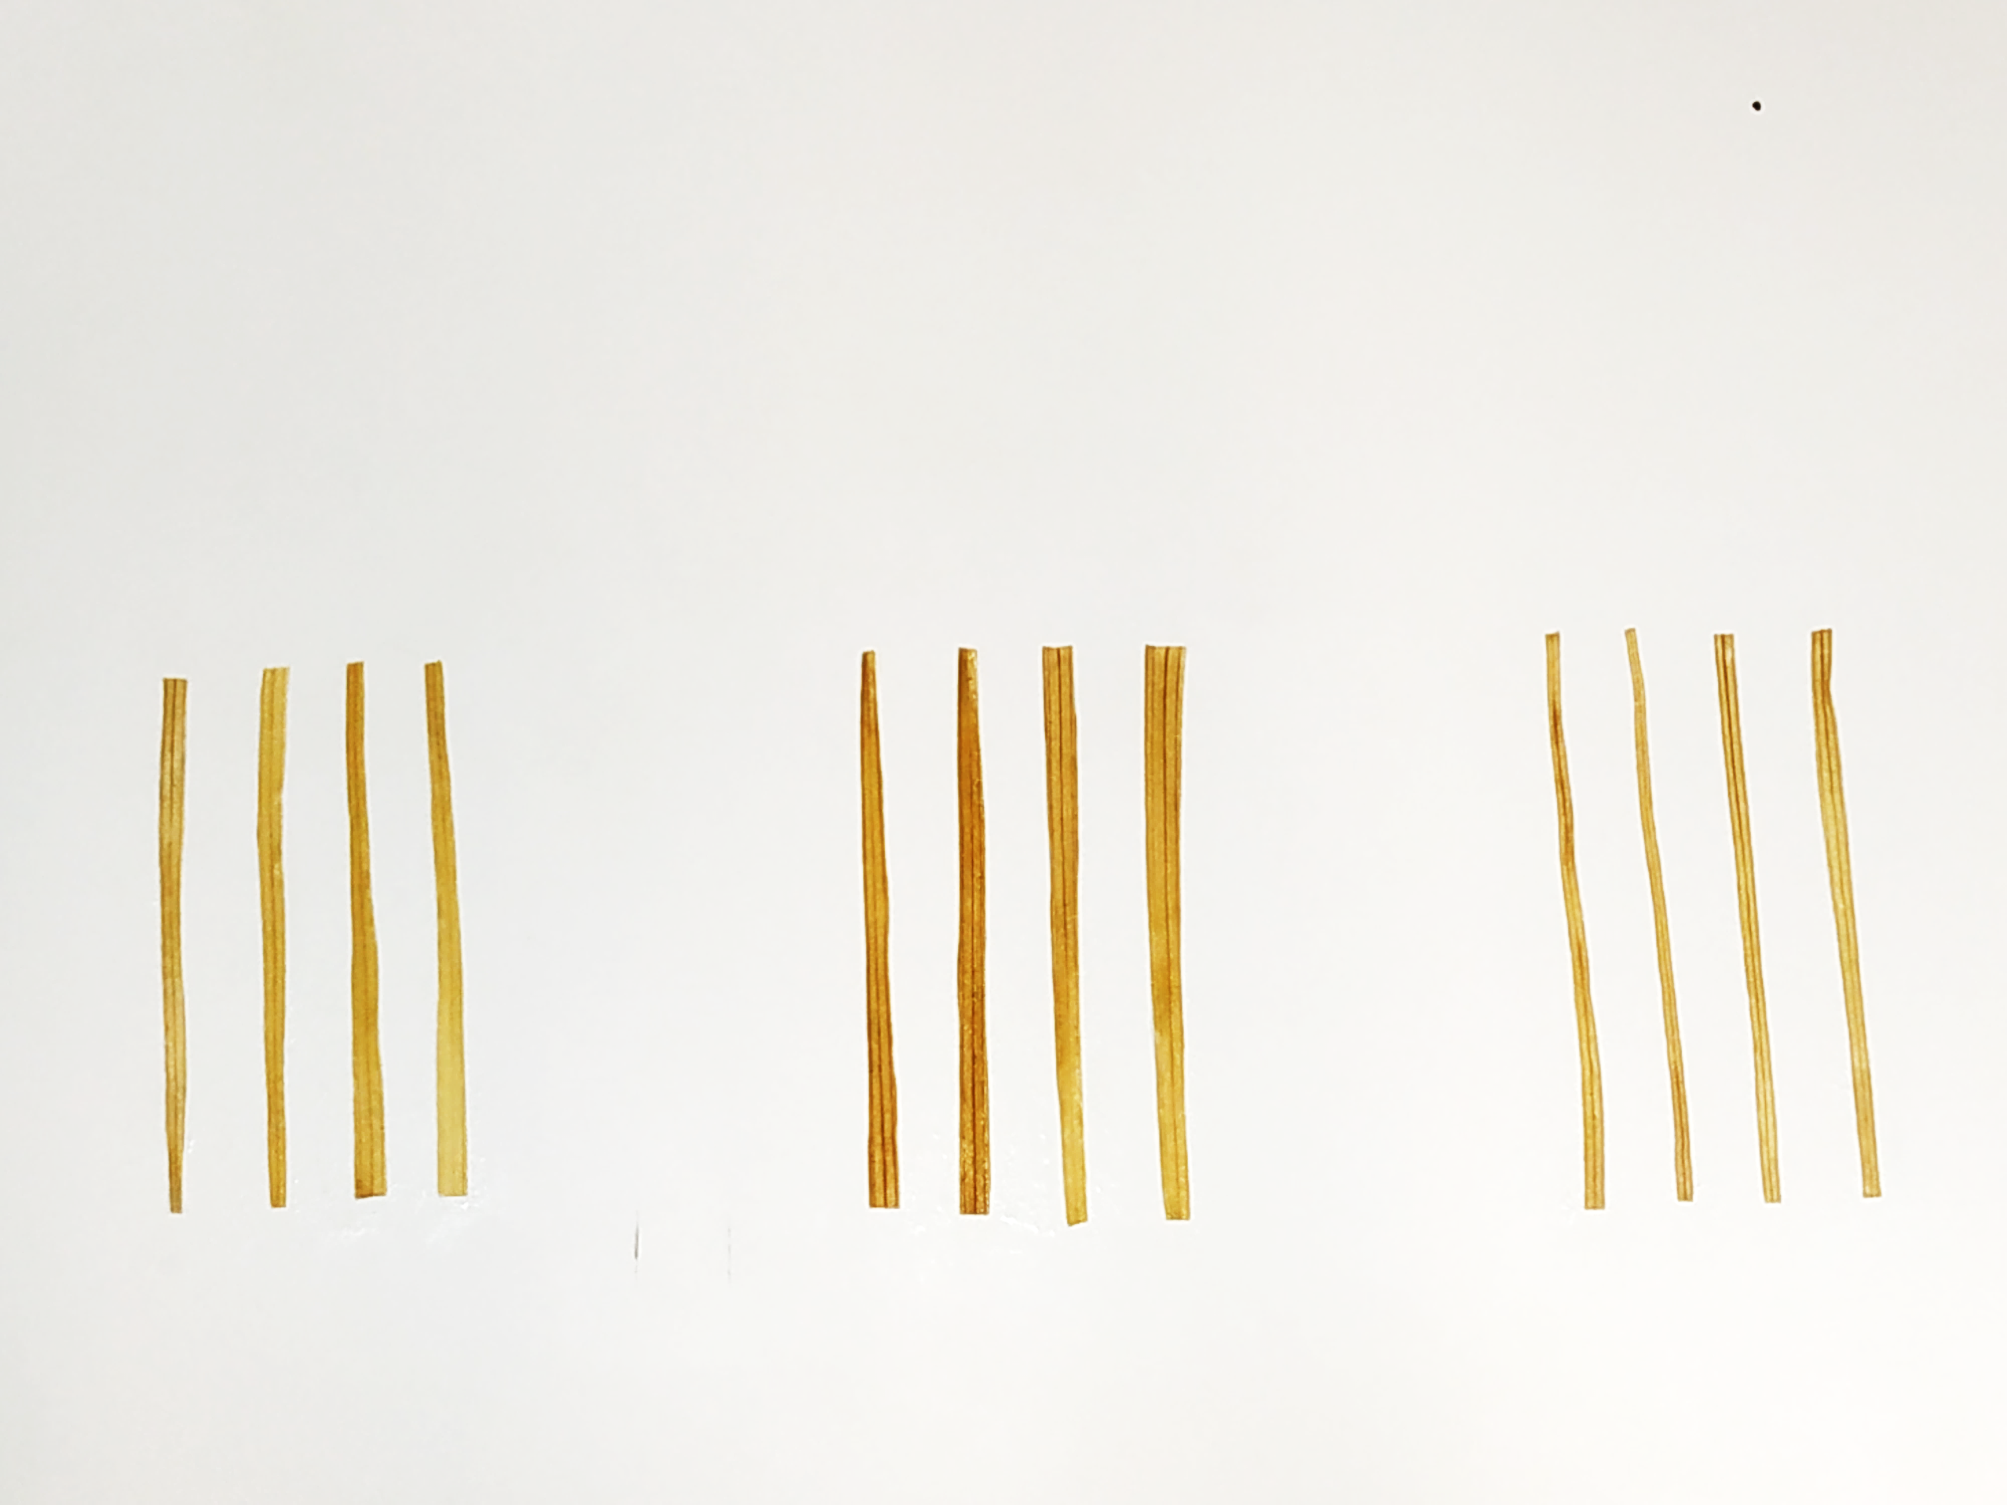
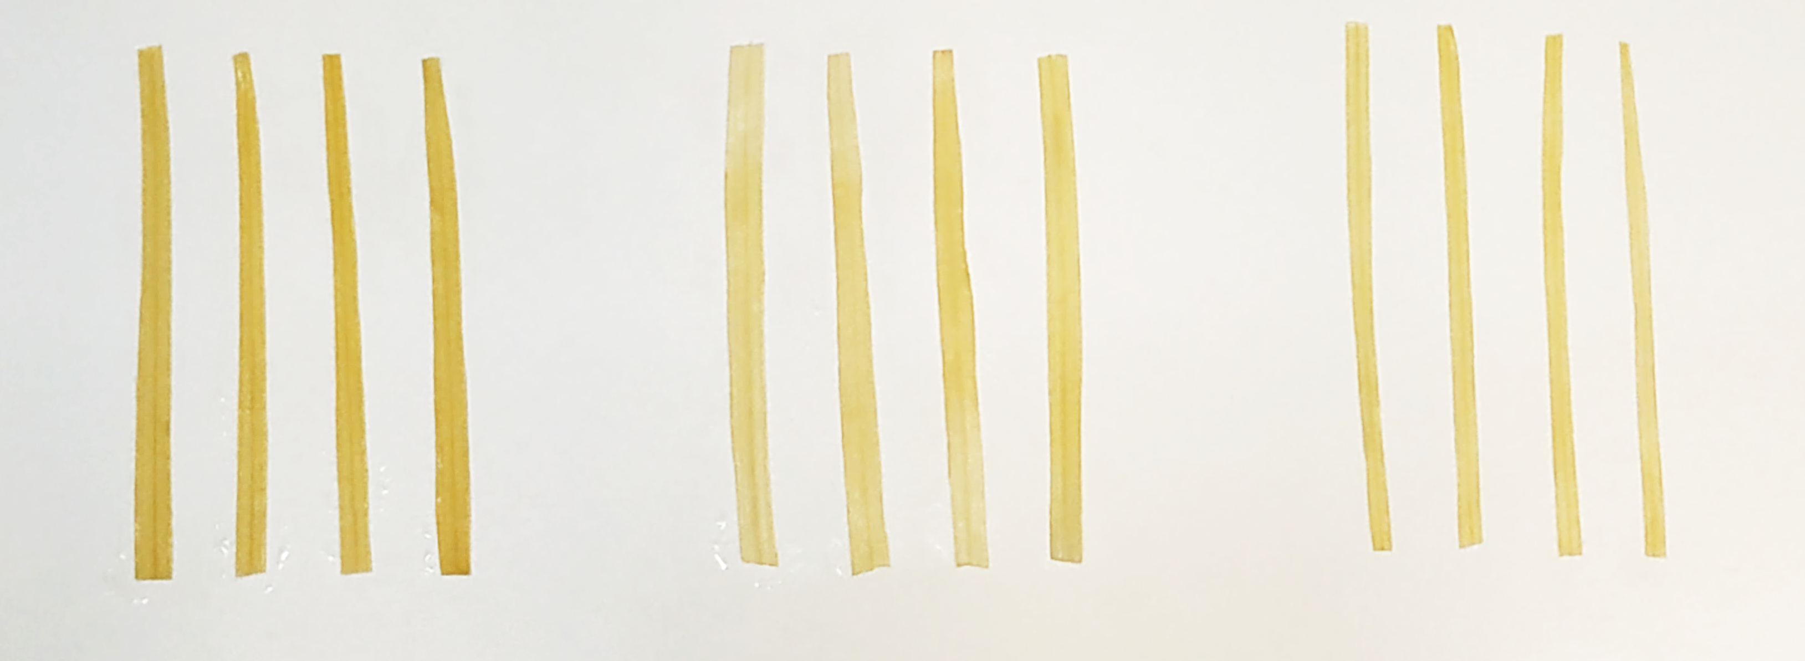
Figure 3
A)
DAB staining
solution
Na2HPO4
Svevo Zavitan Chinese Spring
B)
C)
A
A
A
B
B
B
Figure 3. Physiological characterization of the three genotypes. A) DAB staining of hydrogen peroxide levels in the wheat leaves. Upper panel: DAB solution, and lower panel: Na₂HPO4 solution was applied as a control treatment. B) Total chlorophyll content in leaves of wheat plants (mean ± SE, n = 5). C) The relative water content of three wheat cultivars (mean values ± SE, n = 5). Different letters above the bars indicate significant differences (P value < 0.05), one-way ANOVA using the Tukey-Kramer HSD test.

Slide 4
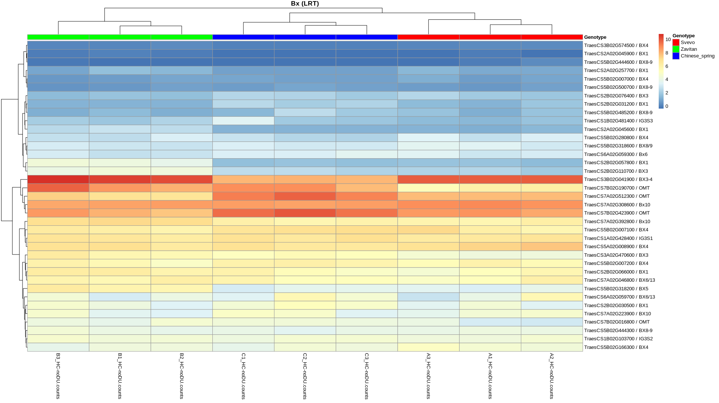
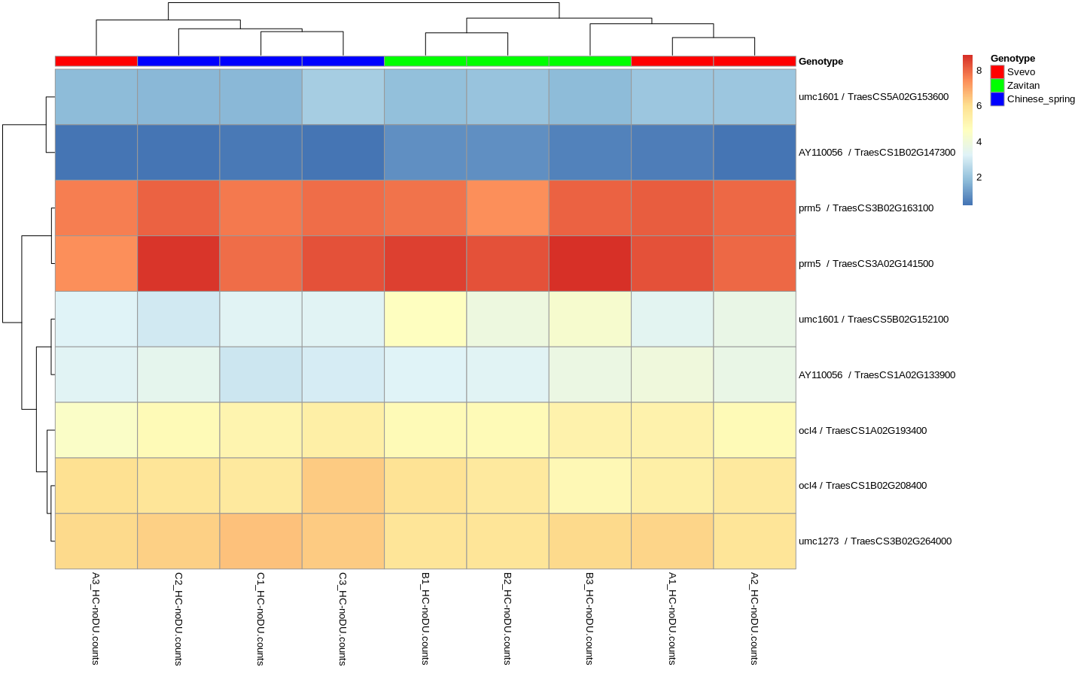
Figure 4
A)
Benzoxazinoid genes
Zavitan3
Zavitan1
Zavitan2
Svevo3
Svevo1
Svevo2
Chinese Spring2
Chinese Spring1
Chinese Spring3
B)
Trichome genes
Zavitan3
Zavitan2
Zavitan1
Svevo3
Svevo1
Svevo2
Chinese Spring1
Chinese Spring3
Chinese Spring2
Figure 4. Heatmap of genes from two selected pathways: A) benzoxazinoids and B) trichome formation.

Slide 5
Figure 5
A)
A)
*
ND ND ND
*
B)
B)
*
*
*
ND ND ND
C)
ND ND
Days after germination
Figure 5. The BXD levels in three selected wheat genotypes. Leaves were harvested 11, 15 and 18 days after germination, and the samples were analyzed using HUPLC (mean ± SE, n = 5-8). ND, not detected. Asterisks above the bars indicate significant differences (Statistics Student’s t-test (P value < 0.05). A) 2,4-dihydroxy-7-methoxy-1,4-benzoxazin (DIMBOA), B) 2,4-dihydroxy-7,8-dimethoxy-1,4- benzoxazin-3-one glucoside (DIM2BOA-Glc), C) Total unknown BXD.

Slide 6
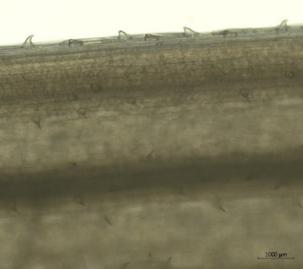
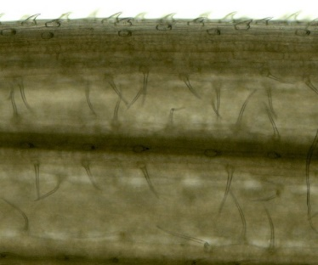
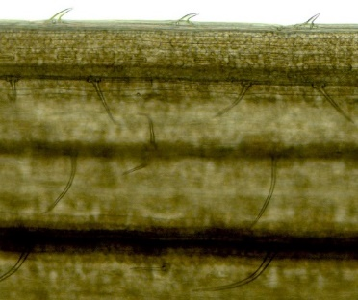
Figure 6
A)
Edge
A
A
A
B
B
B
B
C
B
0.53
0.65
15
18
B)
A
Surface
A
A
B
B
B
C
C
C
15 18
Days after germination
C)
edge
surface
Svevo
Zavitan
Chinese Spring
Figure 6. Trichomes on wheat seedlings. Bars represent the average number of edge trichomes (A) and density ± SE of surface trichomes (B) (mean +/- SE, n = 6-8). Different letters above the bars indicate significant differences, P value < 0.05, ANOVA followed by Tukey’s HSD test.

Slide 7
Figure 7
R. padi aphid reproduction
A
A
B
Aphid fecundity mean ± s.e.
(total * four days⁻¹)
A
A
B
Days after germination
Figure 7. Aphid reproduction on wheat seedlings. The total number of R. padi aphids was counted and calculated per apterous adult aphids after 96 h of infestation. Bars represent the average number of aphid reproduction per adult (mean ± SE, n = 5-21). Different letters above the bars indicate significant differences, P value <0.05, one-way analysis of variance (ANOVA) followed by Tukey’s HSD test.

Slide 8
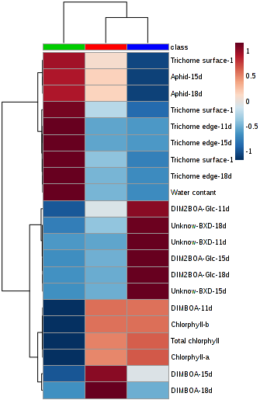
Figure 8
Zavitan
Svevo
Chinese Spring
Figure 8. A summary heatmap of all the physiological parameters and plant defense data used in this study. The euclidean distance with Ward's minimum variance method was designed using the default parameters of the MetaboAnalyst software.

