Slide 1
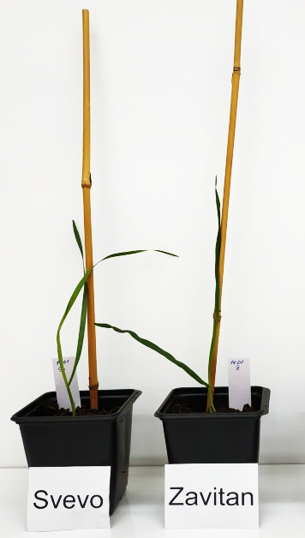
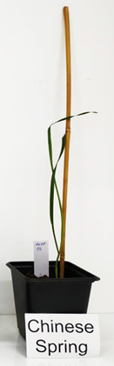
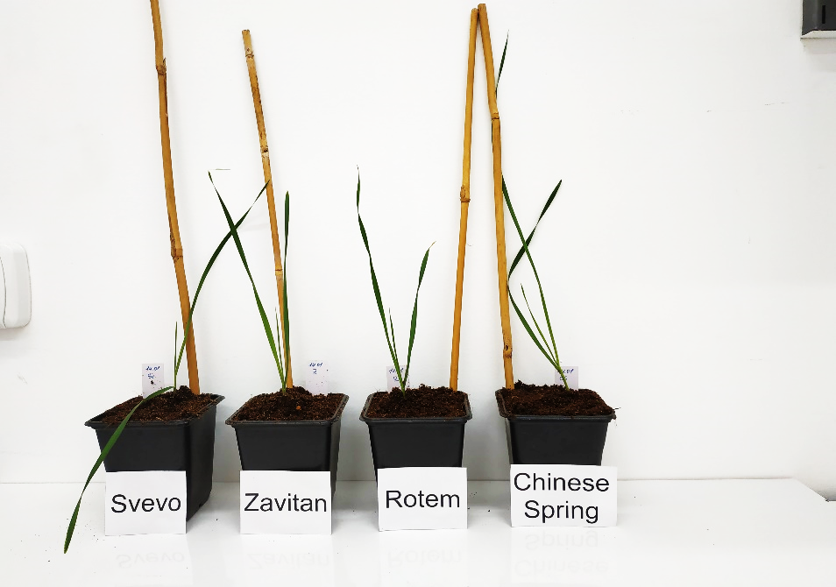
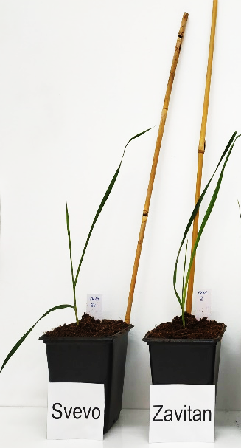
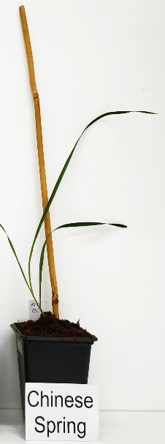
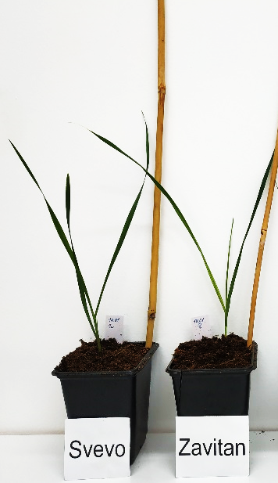

Figure S1
11 days
14 days
15 days
18 days
Supplementary Figure S1. Phenology of the three wheat genotypes used for this research over 11–18 days after germination.

Slide 2
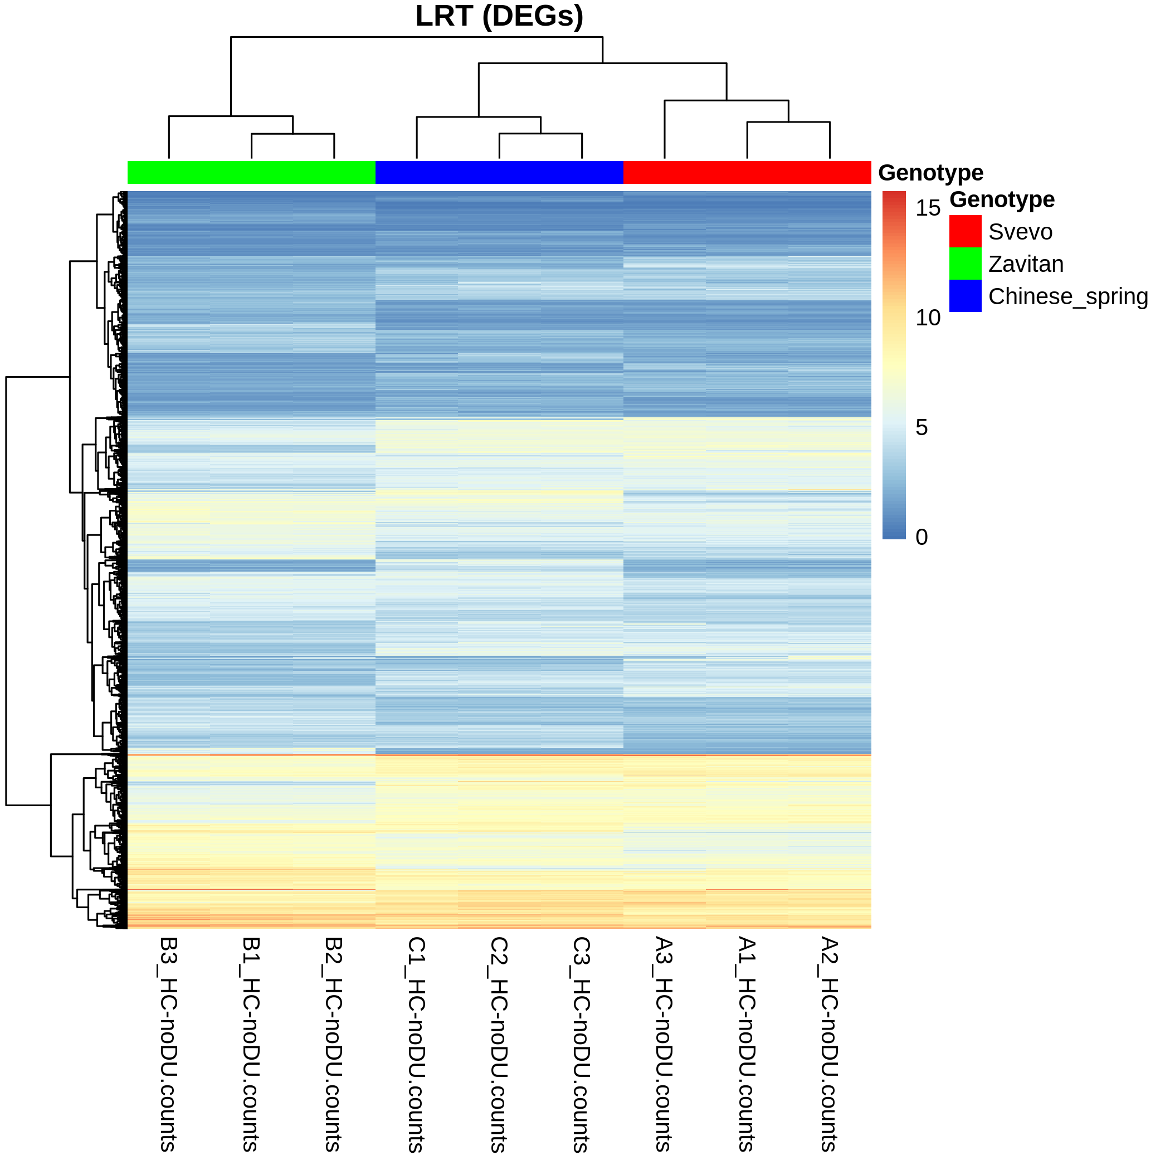
Figure S2
Supplementary Figure S2. A DESeq2 output of the LRT process was subjected to rlog transformation, and the resulting heatmap clearly divided the overall transcriptional profiles of the two tetraploids from the hexaploid.

Slide 3
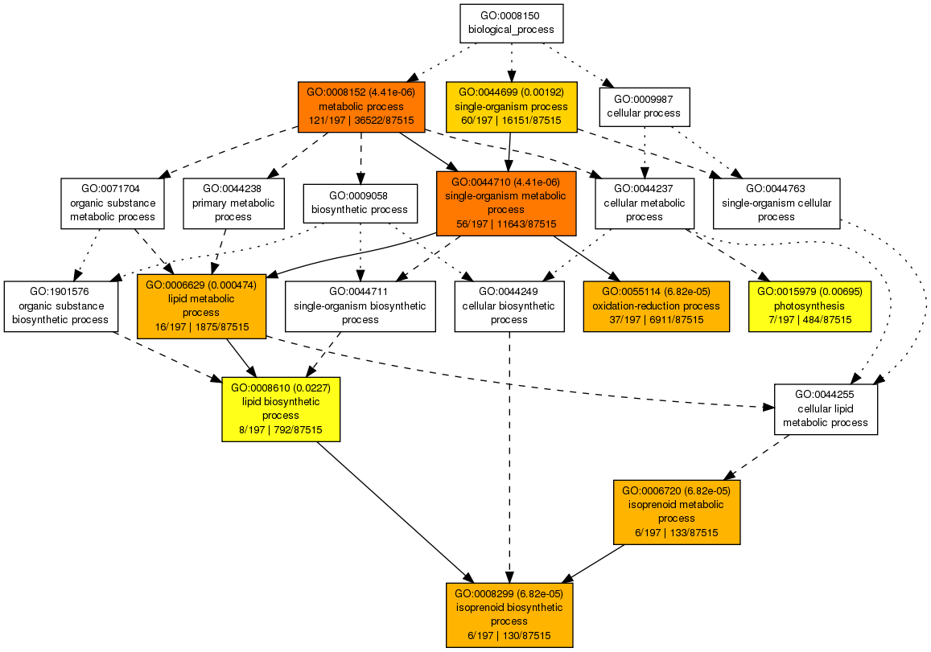
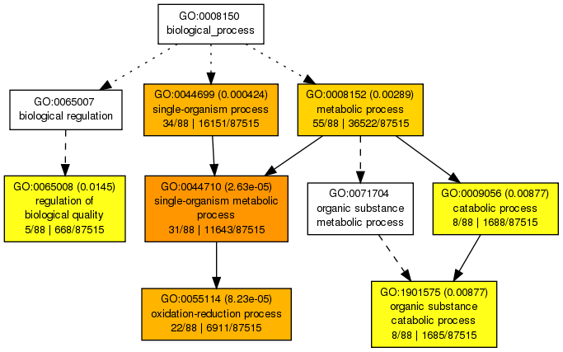
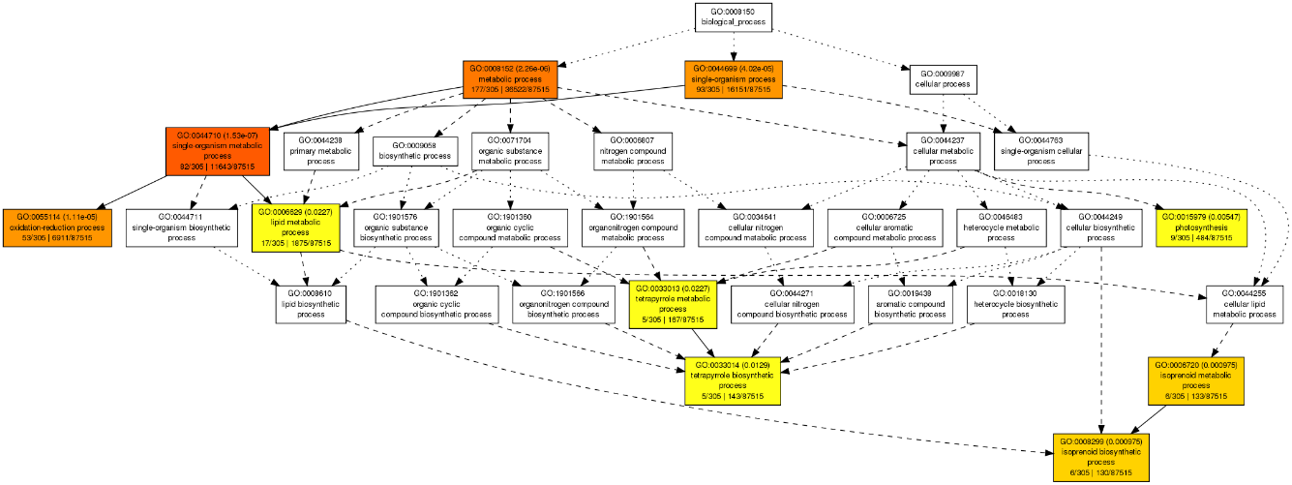
Figure S3
A)
B)
C)
Supplementary Figure S3. Biological process using GO term map of genes grouped in cluster 5. The genes from cluster 5 were subjected to t-test analysis: A) Svevo versus Chinese Spring; B) Zavitan versus Chinese Spring. C) Zavitan versus Svevo.

Slide 4
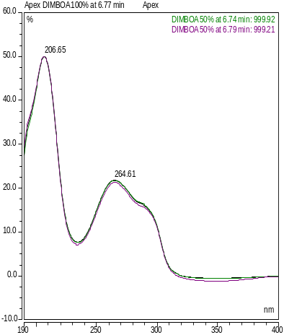
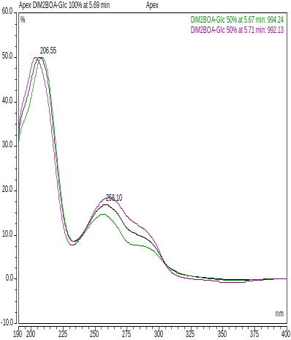
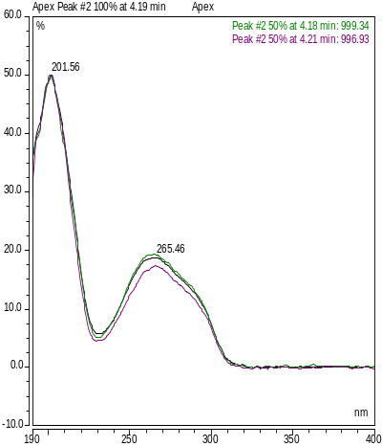
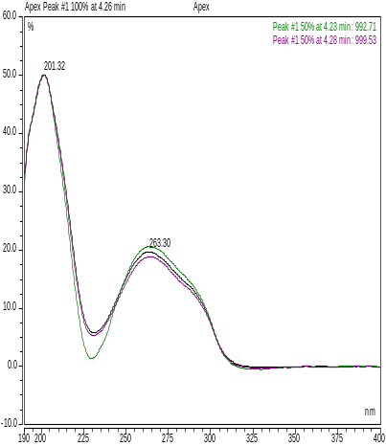
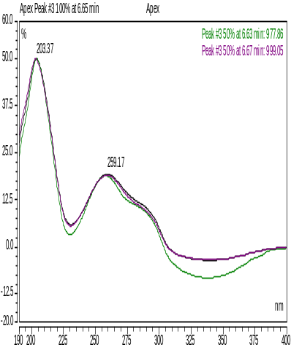
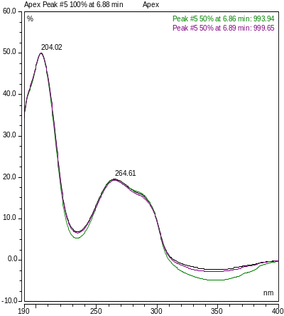
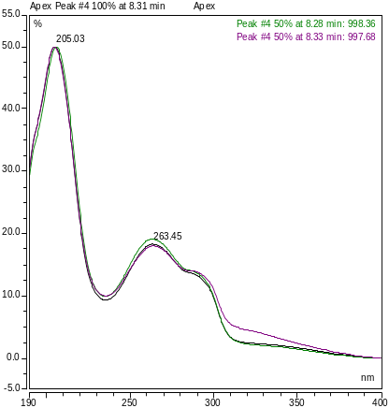
Figure S4
DIMBOA
DIM2BOA-Glc
Unknown 4.19
Unknown 4.22
Unknown 6.3
Unknown 6.8
Unknown 8.3
Supplementary Figure S4. The UV spectra of known and unknown BXDs detected in wheat leaves.

