Slide 1
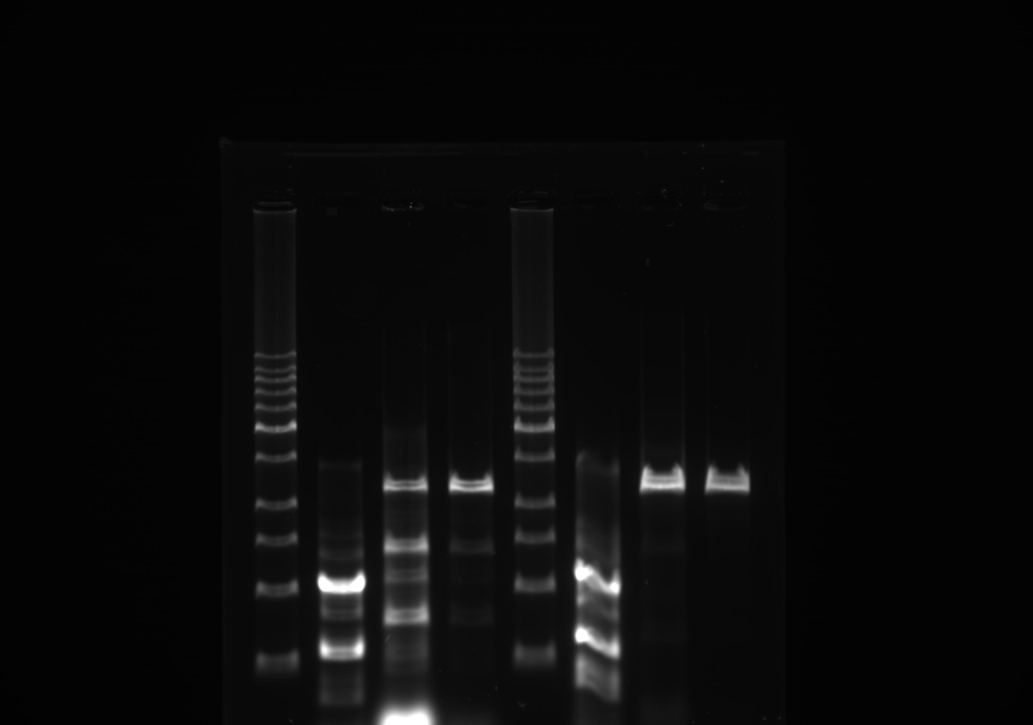
Fig 1 (b)

Slide 2
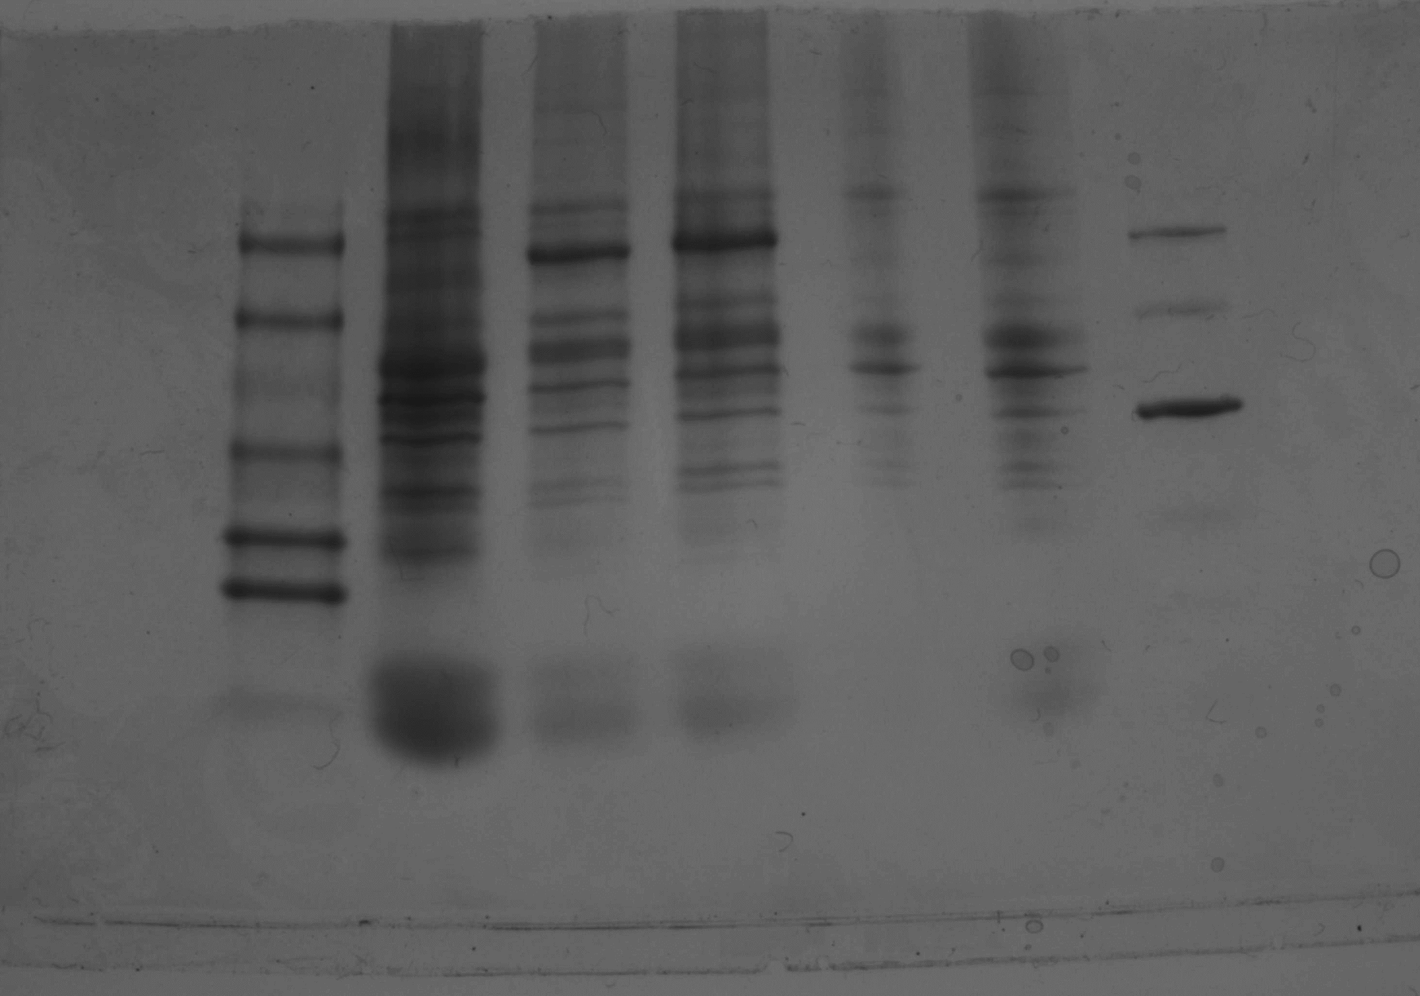
Fig 2 (a)

Slide 3
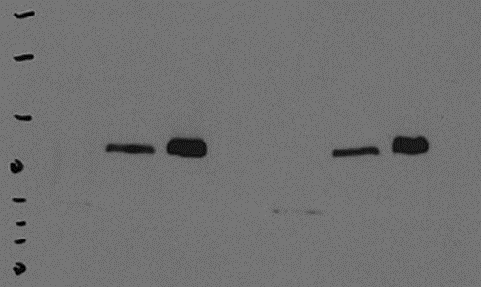
Fig 2 (b)

