Slide 1
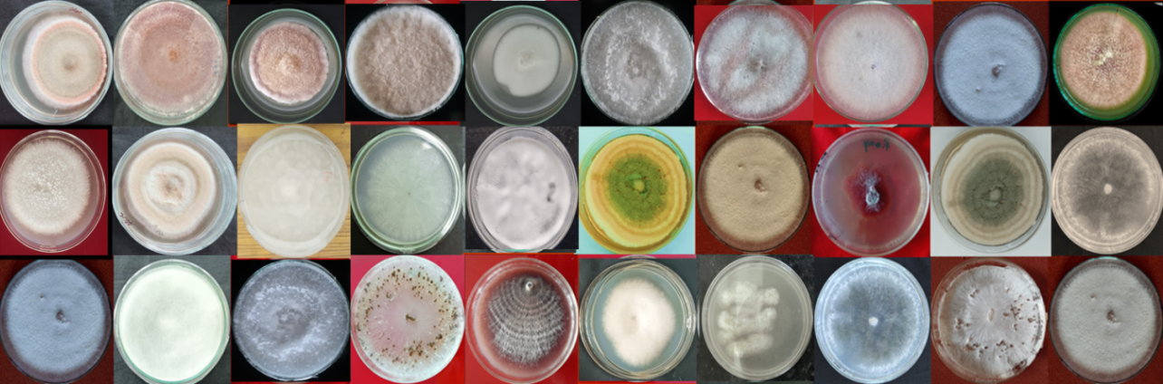
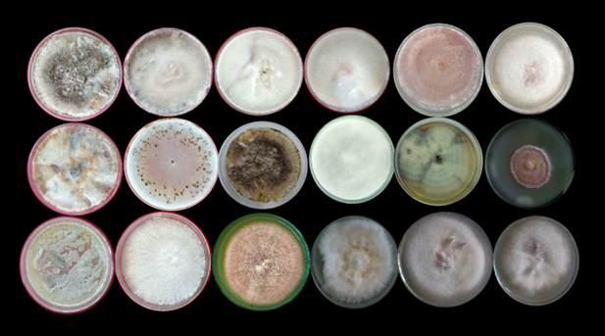
a. Pathogen isolates (27 No.) recovered from sub-humid region
b. Pathogen isolates (18 No.) recovered from dry temperate region
Fig. 1 Diversity and distribution of pathogens associated with pea root rot/wilt complex in (a. sub-humid and b. dry temperate regions) Himachal Pradesh

Slide 2
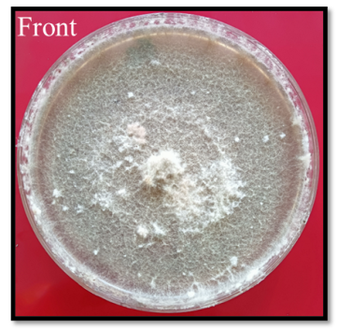
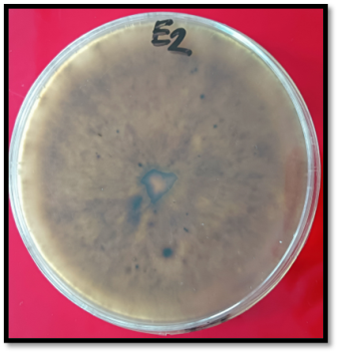
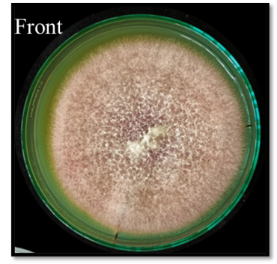
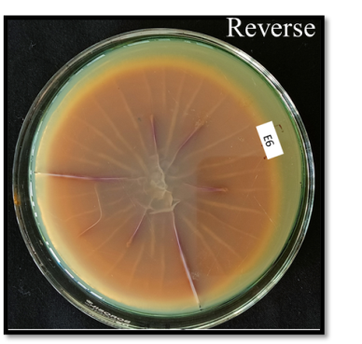
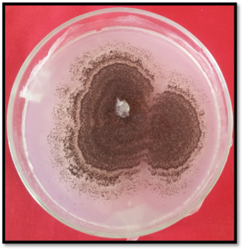
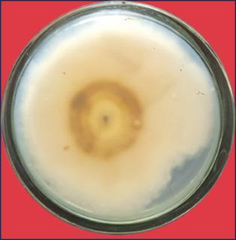
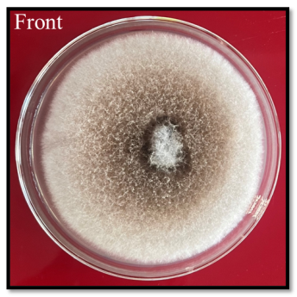
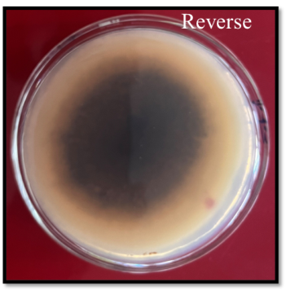
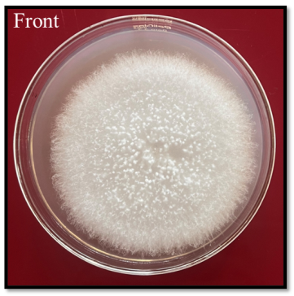
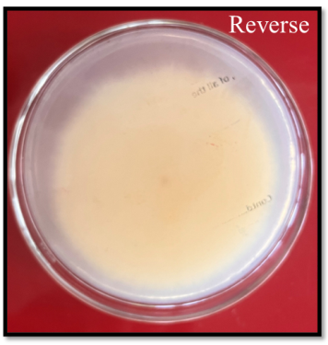
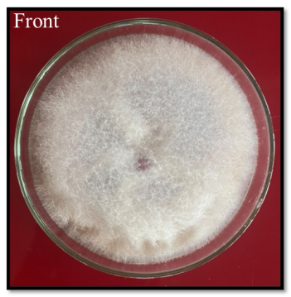
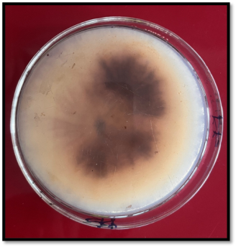
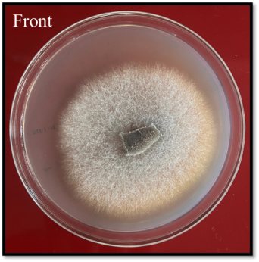
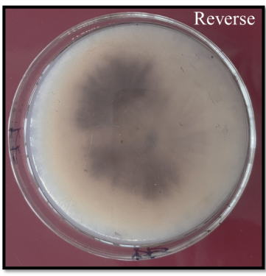
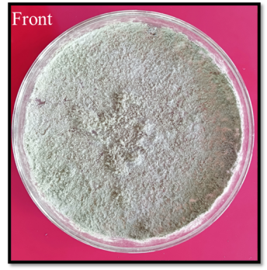
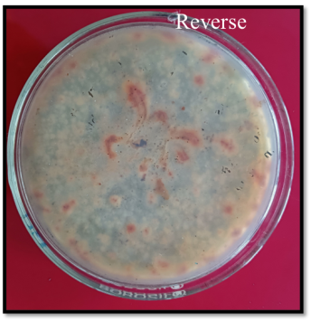
Reverse
(a)
(b)
(c)
(d)
(e)
(f)
(g)
(h)
Fig. 2 Pure cultures of fungal endophytes on Potato Dextrose Agar (PDA) medium [a Epicoccum sp. isolate JPE2, b Fusarium oxysporum isolate JPE6, c Aspergillus sp. isolate JPE7, d Epicoccum sorghinum isolate JPE13, e Schizophyllum sp. isolate JPE19, f Fusarium solani isolate JPE20, g Fusarium sp. isolate JPE23, h Talaromyces purpureogenus isolate JPE38
(Right- front side, Left- reverse side)

Slide 3
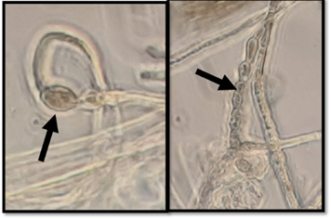
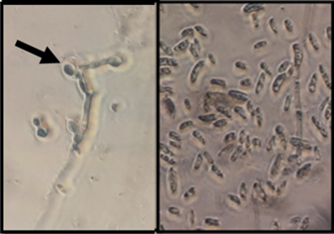
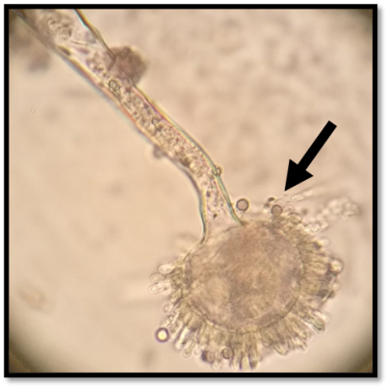
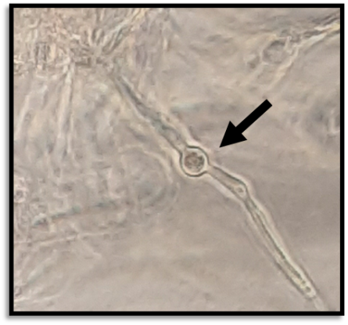
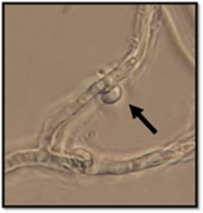
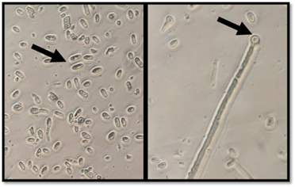
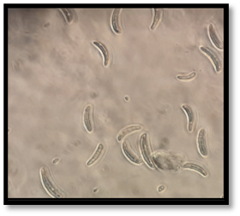
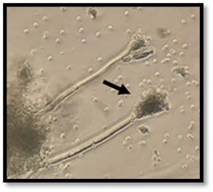
a. Epicoccum sp. isolate JPE2 (Formation of chlamydospore and chain of conidia)
b. Fusarium oxysporum isolate JPE6
(Microconidia formation)
c. Aspergillus sp. isolateJPE7
(Formation of conidiophore)
d. Epicoccum sorghinum isolateJPE13
(Presence of chlamydospore)
e. Schizophyllum sp. isolateJPE19
(Formation of clamp connection)
f. Fusarium solani isolateJPE20
(Presence of microconidia and chlamydospore)
g. Fusarium sp. isolateJPE23
(Macroconidia formation)
h. Talaromyces purpureogenus isolateJPE38
(Brush-like conidiophore)
Fig. 3 Microscopic features of selected endophytes observed at 40 X magnification

Slide 4
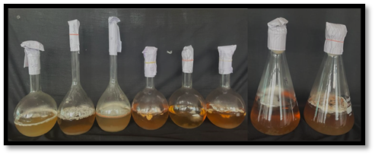
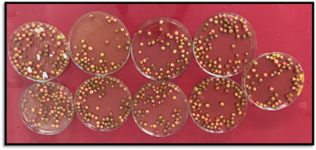
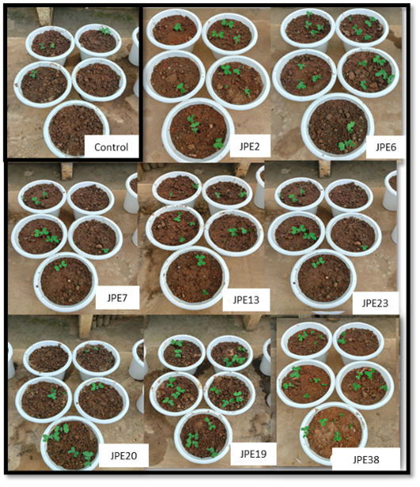
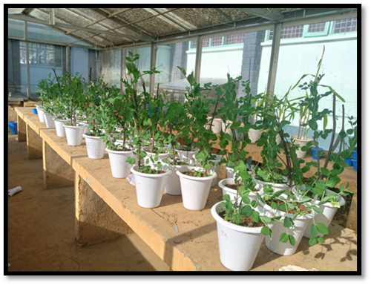
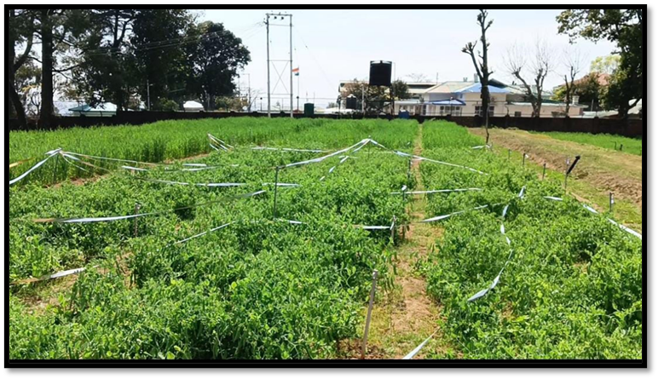
(a)
(b)
(c)
(d)
(e)
Fig. 4 Evaluation of liquid formulations of endophytic fungi under in vivo and field conditions [(a) Liquid based bio formulations of efficient endophytic fungi (b) Seed treatment with fungal endophytic formulations (c) Germinated pea seedlings (d) Pot experiment (e) Field evaluation trial of endophytic fungi conducted at Experimental Research Farm, Department of Plant Pathology, CSKHPKV Palampur]

Slide 5
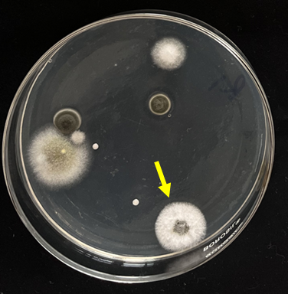
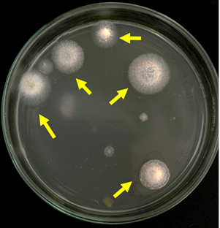
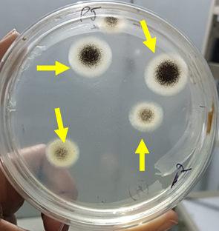
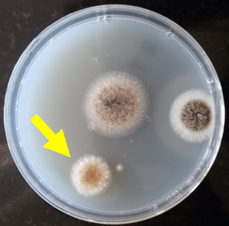
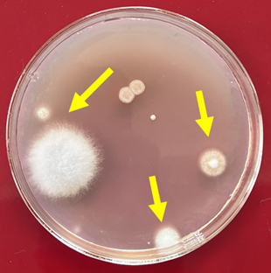
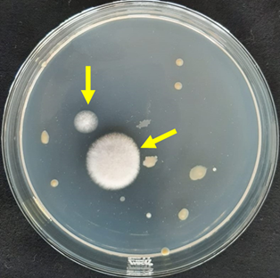
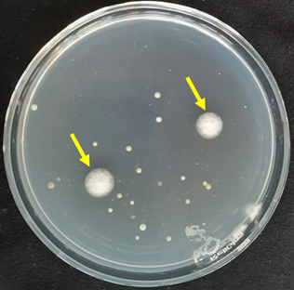
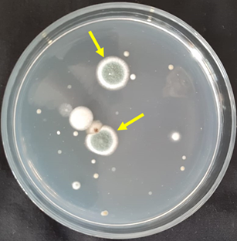
(a)
(b)
(c)
(d)
(e)
(f)
(g)
(h)
Fig. 5 Enumeration of recovered endophytic fungal population (10²cfu/g root samples) after treatment with endophytic formulation [a Epicoccum sp. isolate JPE2, b Fusarium oxysporum isolate JPE6, c Aspergillus sp. isolate JPE7, d Epicoccum sorghinum isolate JPE13, e Schizophyllum sp. isolate JPE19, f Fusarium solani isolate JPE20, g Fusarium sp. isolate JPE23, h Talaromyces purpureogenus isolate JPE38

