Slide 1
Table S1. List of primers used for partial nucleotide sequencing of PerMV RNAs 1, 2, 3a, 3b, and 4
Target | Primer name | Sequence (5' to 3') | Polarity | Ntª | Purpose
All segments | PerMV-5'ter-11mer-fw | AGTAGTTATCT | forward |  | cDNAs synthesis
 | PerMV-3'ter -11mer-rv | AGTAGTTTTGC | reverse
RNA1 | BamHI-PerMV-RNA1-1fw | TCCGGATCCAGTAGTTATCTAATTTAAAATC | forward | 1–22 | PCR amplification
 | BamHI-PerMV-RNA1-7291rv | TCCGGATCCAGTAGTTTTGCTAATTTAAAAT | reverse | 7291–7270
 | PerMV-RNA1-3364fw | ATCATCTGAATGCACAAG | forward | 3364–3381 | Sequencing
 | PerMV-RNA1-3734fw | GCTGACCATTTTGATGCATC | reverse | 3734–3753
 | PerMV-RNA1-3753rv | GATGCATCAAAATGGTCAGC | reverse | 3753–3734
RNA2 | BamHI-Oba-RNA2-1fw | TCCGGATCCAGTAGTTATCTTGCATTAAAAC | forward | 1–22 | PCR amplification
 | BamHI-Oba-RNA2-2092rv | TCCGGATCCAGTAGTTTTGCTTGCATTAAAA | reverse | 2092–2071
 | PerMV-RNA2-1258fw | TTATCTTCATTACTTCATGTGACTG | forward | 1258–1282 | Sequencing
 | PerMV-RNA2-1369rv | GAAGAAAACAATGTCCAGGT | reverse | 1369–1350
 | PerMV-RNA2-948fw | ACAGGTTCAATTATTAAATCCC | forward | 948–969 | PCR to amplify the region nts 948–1369
 | PerMV-RNA2-1369rv | GAAGAAAACAATGTCCAGGT | reverse | 1369–1350
 | PerMV-RNA2-1258fw | TTATCTTCATTACTTCATGTGACTG | forward | 1258–1282 | PCR to amplify the region nts1258–1714
 | PerMV-RNA2-1714rv | TCAGTGTGCAAATTGATATCA | reverse | 1714–1693
RNA3a | PerMV-RNA3a-381fw | ACAACCTTTGCAATTATATTCTTTGC | forward | 381–406 | PCR amplification and sequencing
 | PerMV-RNA3a-980rv | GAAAATAAAGAGGTATTCAGGGAAGA | reverse | 980–955
RNA3b | PerMV-RNA3b-379fw | CACAATTTTCGCGATTATGTTTTT | forward | 379–402 | PCR amplification and sequencing
 | PerMV-RNA3b-978rv | AAAATAAAGAGGTATTCAGGTAAAACTAC | reverse | 978–950
RNA4 | BamHI-PerMV-RNA4-1fw | TCCGGATCCAGTAGTTATCTCACTTACAAAC | forward | 1–22 | PCR amplification
 | BamHI-PerMV-RNA4-1294rv | TCCGGATCCAGTAGTTTTGCTCACTTACAAT | reverse | 1294–1273
 | PerMV-RNA4-507fw | ACAAATGCTTTCATGATGCTTTC | forward | 507–529 | Sequencing
 | PerMV-RNA4-1094rv | AATCAATGTTGCGAATTGGAAC | reverse | 1094–1073
ª Nucleotide position based on the RNA segments of perilla mosaic virus isolate Kochi_Nankoku_2011 (Accession Nos. NC_078367–NC_078371)
Supplementary Table S1
Nucleotide sequence survey of perilla mosaic virus isolates in Japan unvails complex genetic structure and conserved RNA segments encoding homologous protein groups
Journal of General Plant Pathology
Yuya Chiaki and Kenji Kubota* (Institute for Plant Protection, NARO)
*Corresponding author: kubotak@affrc.go.jp

Slide 2
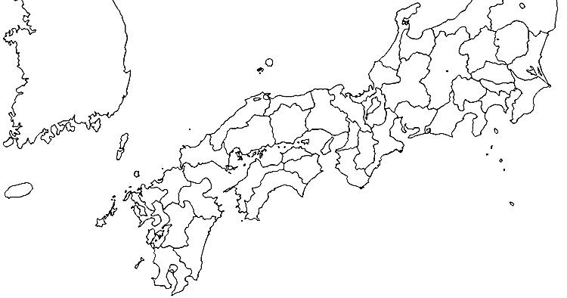
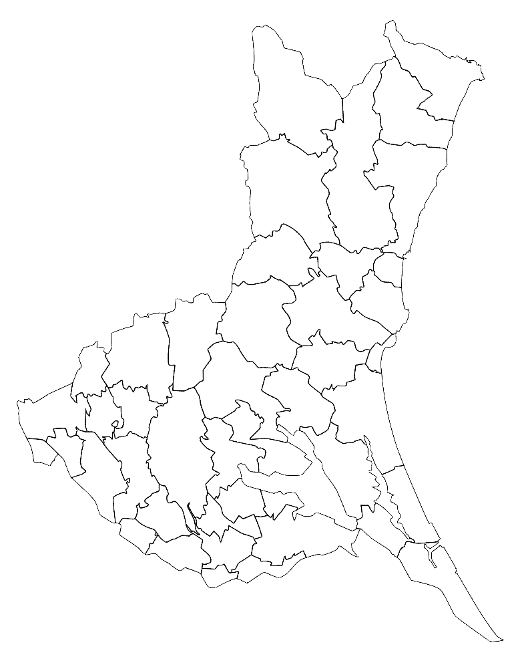
South
Korea
Iseo-Myeon
Japan
Ibaraki Pref.
Tsukuba
Toyohashi,
Aichi Pref.
Namegata
Nankoku,
Kochi Pref.
200 km
Oita,
Oita Pref.
Ushiku
Miho
Supplementary Fig. S1: Geographical map of Japan and South Korea, indicating locations where isolates of perilla mosaic virus (PerMV) were collected previously or in this study (listed in Table 1). The dots are colored in the same way as in Figures 1 and 2.
Supplementary Fig. S1
Nucleotide sequence survey of perilla mosaic virus isolates in Japan unvails complex genetic structure and conserved RNA segments encoding homologous protein groups
Journal of General Plant Pathology
Yuya Chiaki and Kenji Kubota* (Institute for Plant Protection, NARO)
*Corresponding author: kubotak@affrc.go.jp

