Slide 1
Supplementary materials for “Siberian Greening Enhances Coastal Spring Chlorophyll in Western North America”
Young-Min Yang¹, Jae-Heung Park², Mi-Kyung Sung³, Soon-Il An⁴, Sang-Wook Yeh⁵, Eun-Young Kwon^{6,7}, June-Yi Lee^{6,7}, Bin Wang^{1,8}, Tim Li^{1,8}, and Jong-Yeon Park⁹
¹Department of Atmospheric Sciences and International Pacific Research Center, University of Hawaii, Honolulu HI 96822, USA. ²School of Earth and Environmental Sciences, Seoul Natioanl University, Seoul, South Korea. ³Climate and Environmental Research Institute, Korea Institute of Science and Technology, Seoul, Republic of Korea. ⁴Department of Atmospheric Sciences and Irreversible Climate Change Research Center, Yonsei University, Seoul 03722, Korea. ⁵Department Marine Sciences and Convergent Technology, Hanyang University, ERICA, South Korea. ⁶Research Center for Climate Sciences, Pusan National University, Busan, South Korea. ⁷Center for Climate Physics, Institute for Basic Science, Busan, South Korea.. ⁸Key Laboratory of Meteorological Disaster, Ministry of Education (KLME)/Joint International Research Laboratory of Climate and Environment Change (ILCEC)/Collaborative Innovation Center on Forecast and Evaluation of Meteorological Disasters (CIC-FEMD), Nanjing University of Information Science and Technology, Nanjing, 210044, China. ⁹Department of Earth and Environmental Science, Jeonbuk National University, Jeonju 54896, Korea. * indicates a corresponding author; e-mail: ymyang@hawaii.edu

Slide 2
Supplementary Fig. S1 Trends in spring Siberian Terrestrial GPP. Interannual variability (solid line) and trends (dotted line) in March-April terrestrial productivity in eastern Siberia (55°N-70°N, 100°E-130°E). The linear slopes and P-value (two-sided t-test) are indicated.

Slide 3
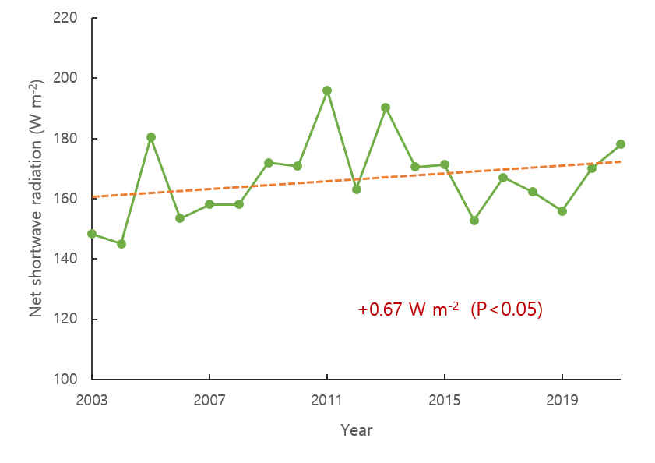
Supplementary Fig. S2 Trends in spring Siberian net shortwave radiation Interannual variability (solid line) and trends (dotted line) in spring net shortwave radiation in eastern Siberia (55°N-70°N, 100°E-130°E) The linear slopes and P-value (two-sided t-test) are indicated.

Slide 4
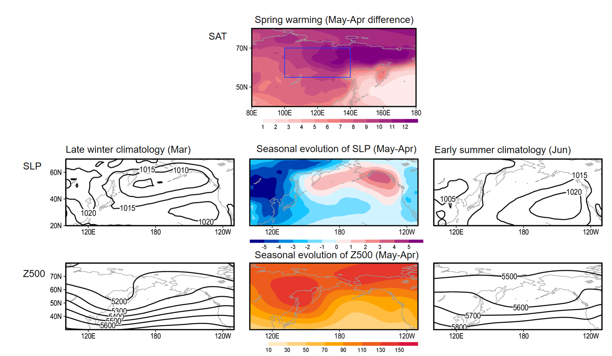
a.
b.
c.
d.
e.
f.
g.
Supplementary Fig. S3 Seasonal Changes in Siberia and Northern Pacific Climate. a Horizontal map of spring surface warming (difference in surface temperature between May and April) during the years 2003-2021. b March sea-level pressure (SLP) climatology. c Seasonal evolution of SLP (differences in SLP between May and April). d Early summer (June) climatology of SLP. e March geopotential height climatology at 500 hPa. f Seasonal evolution of geopotential height at 500 hPa (differences in geopotential height between May and April). g Early summer (June) climatology of geopotential height at 500 hPa. The data from 2003 to 2021 are utilized.

Slide 5
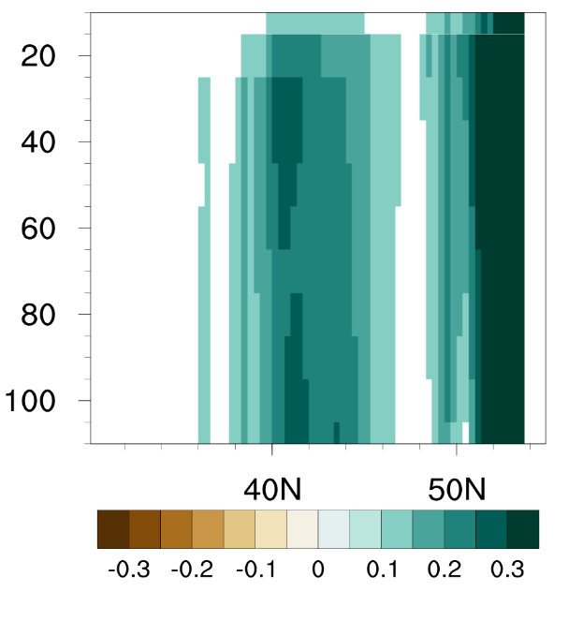
a Ocean vertical velocity
b Ocean Nutrients
Depth (m)
+0.157 mg m⁻³ yr⁻¹ (P=0.01)
Ocean vertical velocity (cm day⁻¹ yr⁻¹ )
Supplementary Figure 4 Trends in atmospheric circulation and ocean ecosystem. a Vertical structure of trends in zonally averaged (120°W-130°W) ocean vertical velocity (cm day⁻¹ yr⁻¹) in coastal California. b Interannual variability (solid line) and trends (dotted line) of nitrate nutrients (NO3) in coastal California (35°-45°N,125°W-130°W) from CalCOFi sampling data (see Methods). Linear slopes and P-value (two-tailed t-test) are shown. Bars shows maximum and minimum of each year’s data among the CalCOFi sampling data. The bars show the maximum and minimum of the data for each year of the CalCOFi sampling data.

Slide 6
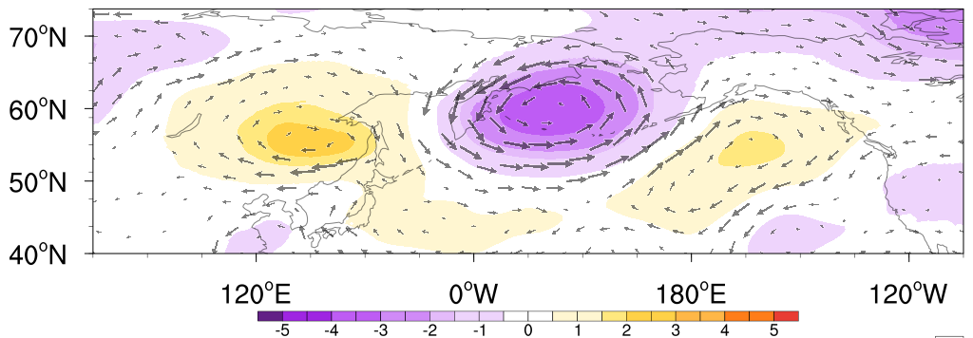
Supplementary Fig. S5 Sensitivity of Californian chlorophyll to Siberian GPP. a Horizontal map of differences of geopotential height and wind at 500 hPa and between SIGPPx1.5 and SIGPPx0.5 experiment. Only 95% significant area are shown.

Slide 7
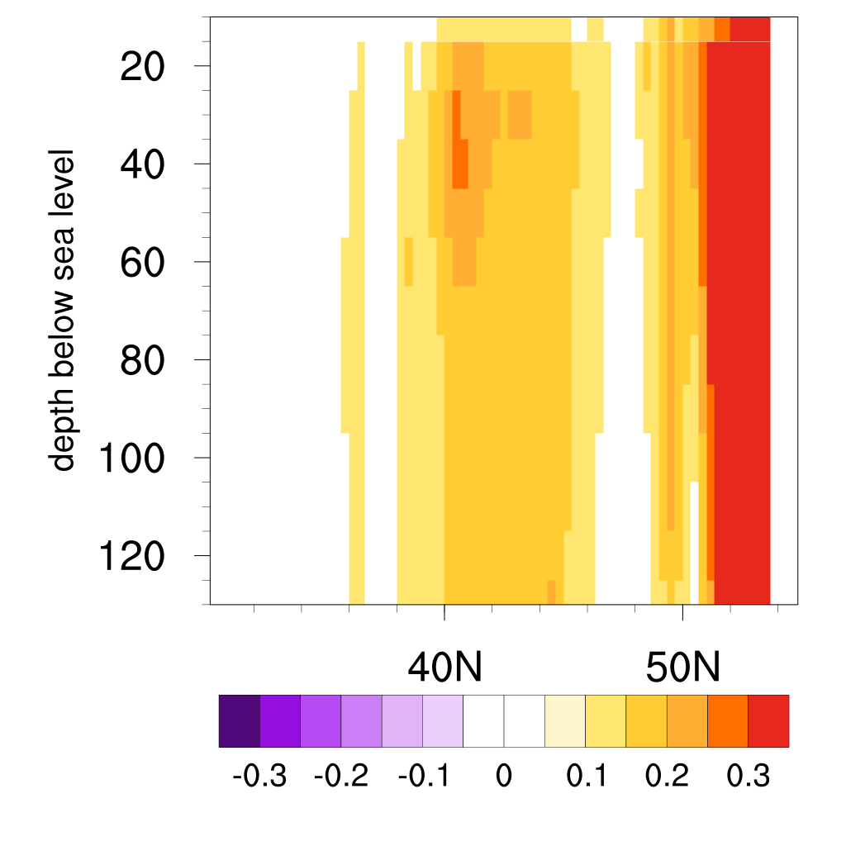
a ocean vertical velocity
b ocean nutrients
Ocean vertical velocity (cm day⁻¹ )
Supplementary Figure. 6 Sensitivity of Californian chlorophyll to Siberian GPP. a Vertical structure of differences in zonally averaged (120°W-130°W) chlorophyll between the SIGPPx1.5 and SIGPPx0.5 experiments. Only 95% significant areas are shown. Vertical structure of differences of nitrate nutrients (NO3, 40-50N, 120°W-130°W) between SIGPPx1.5 and SIGPPx0.5 experiment. The horizontal bar represents the ensemble spread. 30 years of averaged data are used for all figures.

Slide 8
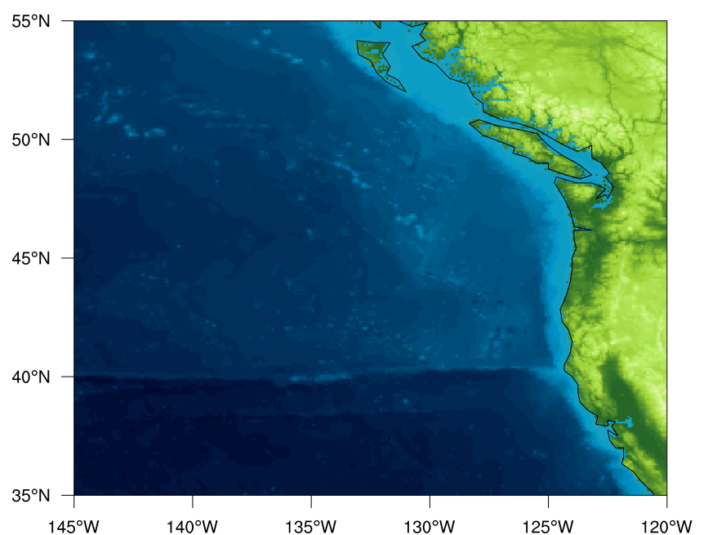
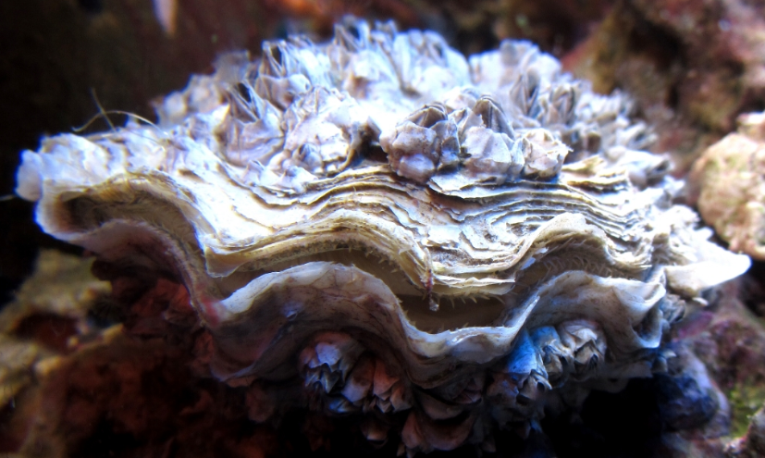
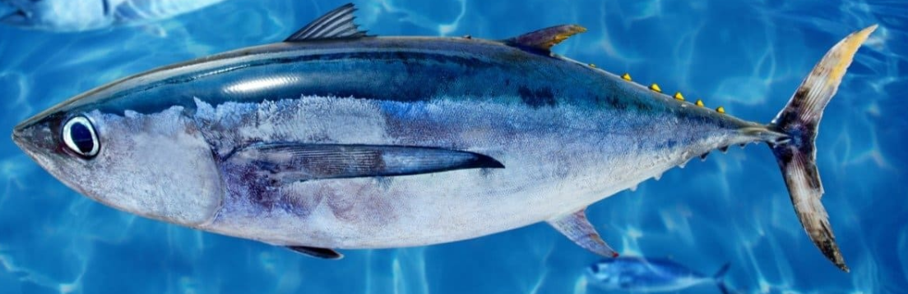
Pacific cupped oyster
16.8%
Albcore
6.5%
3.8%
Supplementary Fig. S7 Trends in US west fishery. a Interannual variability of major fish catch in spring of US west coast (upper) and dissolved oxygen. Circle represent portion of total fish catch. The dotted slopes and P-value (two-sided t-test) are indicated.

