Slide 1
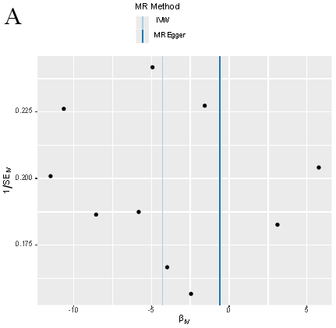
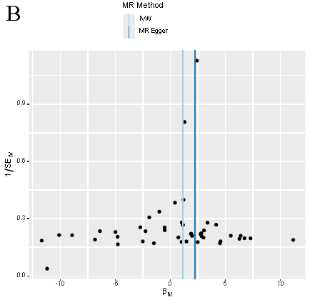
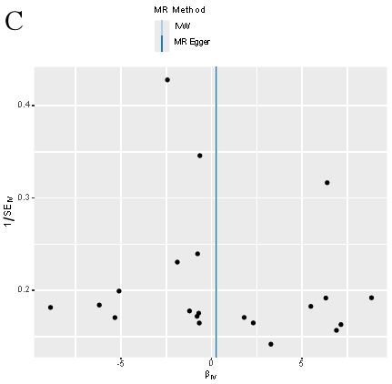
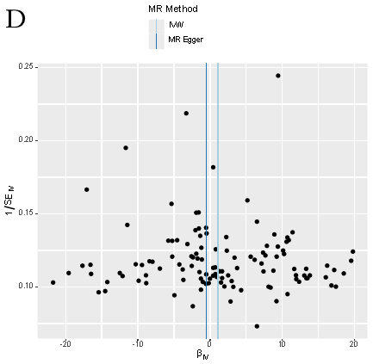
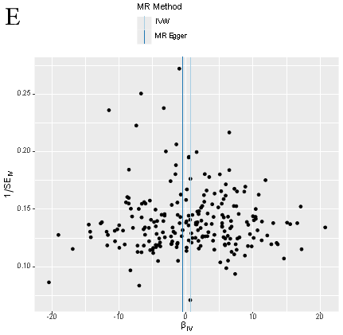
Supplementary Figure 1 Funnel plots to show symmetrical distribution of individual variant estimates around the point estimate. The x-axis represents the MR estimate of individual variants; the y-axis represents the inverse of their standard error. (A) Age of initiation of regular smoking; (B) Average number of cigarettes smoked per day; (C) Smoking cessation; (D) Smoking index; (E) smoking initiation (yes or no).

