Slide 1
Original uncropped gel images
“Emetine dihydrochloride inhibits invasiveness and motility of hepatocellular carcinoma cells by blocking the MAPK pathway and inducing destabilization of Twist1”
Haelim Yoon, Sayeon Cho*

Slide 2
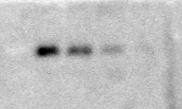
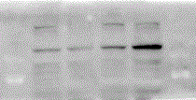


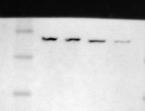

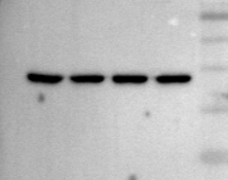
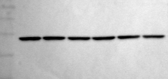
Original gel images of Figure 3.
The red boxes indicate the figures in the main text.
Original gel images of Figure 4.
The red boxes indicate the figures in the main text.
A
EDH (nM)
CON
50
100
200
B
EDH (nM)
Twist1
25
CON
50
100
200
130
63
E-cadherin
β-actin
100
48
75
35
130
(kDa)
E-cadherin
100
75
Vimentin
63
C
48
MG132 (10 μM)
-
-
-
+
+
+
EDH (nM)
-
100
200
-
100
200
35
63
Twist1
25
β-actin
48
35
β-actin
63
(kDa)
48
35
(kDa)

Slide 3
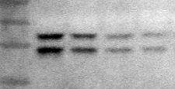
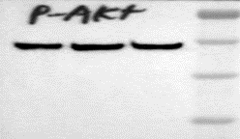

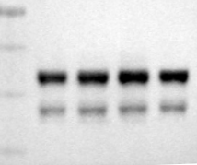
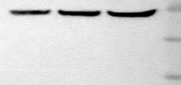
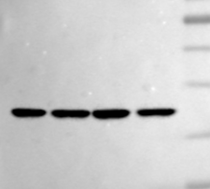
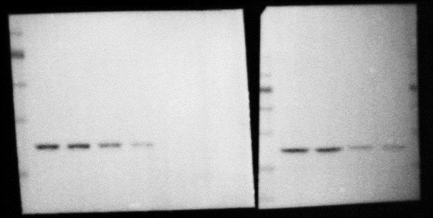
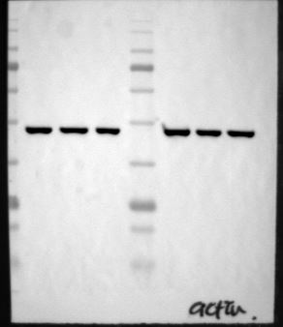
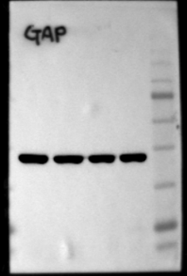
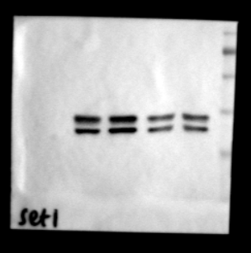
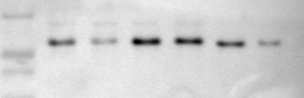



Original gel images of Figure 5.
The red boxes indicate the figures in the main text.
B
C
EDH (nM)
EDH (nM)
JNKi (10uM)
-
+
-
-
A
CON
50
100
200
CON
50
100
200
p38i (5uM)
-
-
+
-
63
63
EDH (200nM)
-
-
-
+
p-JNK
48
p-AKT
48
35
35
Twist1
25
63
JNK
48
AKT
63
35
48
63
63
35
β -actin
48
p-p38
48
β-actin
63
35
35
48
63
35
p38
48
D
35
FLAG-Twist1
WT
S68A
63
EDH (nM)
-
200
-
200
p-ERK
48
35
35
FLAG
25
63
ERK
48
35
β -actin
63
63
48
β-actin
48
35
35
(kDa)

Slide 4


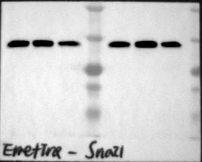


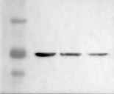
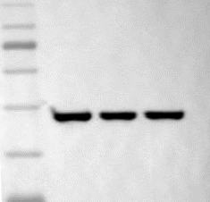
Original gel images of Supplementary Figure 4.
The red boxes indicate the figures in the main text.
Original gel images of Supplementary Figure 5.
The red boxes indicate the figures in the main text.
Hep3B
EDH (nM)
SNU886
EDH (nM)
EDH (nM)
CON
100
200
CON
100
200
CON
100
200
Twist
25
Twist
25
Snail1
35
25
β-actin
63
63
48
β-actin
48
ZEB1
135
SNU449
EDH (nM)
PLC-PRF-5
EDH (nM)
CON
100
200
CON
100
63
200
β-actin
48
Twist
25
Twist
25
35
63
63
β-actin
48
β-actin
48
35

Slide 5
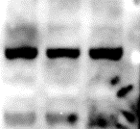
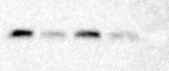
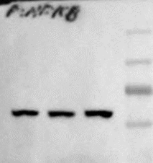
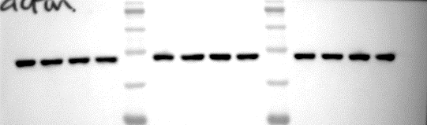
Original gel images of Supplementary Figure 6.
The red boxes indicate the figures in the main text.
Original gel images of Supplementary Figure 7.
The red boxes indicate the figures in the main text.
EDH (nM)
D
CON
100
200
SOR (10 uM)
-
-
+
+
100
EDH (100 nM)
-
+
-
+
p-Stat3
75
75
Twist1
25
p-NFκB
63
63
β -actin
63
β -actin
48
48
35
35

