Slide 1
Digging deeper into the impacts of different soil water systems on the date palm root architecture and associated fungal communities
Symbiosis
Authors: Alexandre Robin-Soriano¹, Bryan Vincent¹, Kenji Maurice¹, Stéphane Boivin², Vincent Battesti⁴, Hassan Boukcim^{2,3}, Marc Ducousso¹, Muriel Gros-Balthazard⁵
Affiliations:
¹ LSTM, Univ Montpellier, CIRAD, INRAE, IRD, SupAgro, Montpellier, France
² Department of Research and Development, VALORHIZ, Montferrier sur Lez, France
³ ASARI, Mohammed VI Polytechnic University, Laâyoune, Morocco
⁴ Éco-anthropologie, CNRS, MNHN, University Paris Cité, Paris, France
⁵ DIADE, Univ Montpellier, CIRAD, IRD, Montpellier, France
Corresponding author: Alexandre Robin-Soriano: alexandrerobinsoriano@gmail.com

Slide 2
Flooding |  | Trophic Mode | Guild |  | Detailed bibliography
Kraurogymnocarpa | 20.725 | Saprotroph | Undefined Saprotroph |  | Nguyen et al. 2011. In roots of Larrea tridentata in the Mojave desert. De castro et al. 2008 in soils of a savanna like region in brazil. Al-Mazraoui :detected in Organic compost from Oman
Rhizophagus | 20.28125 | Symbiotroph | Arbuscular Mycorrhizal
Calvatia | 16.71875 | Saprotroph | Soil Saprotroph |  | Edible mushrooms
Cladosporium | 8.85 | no data | no data |  | Several species referenced as Plant growth promoting agent. Răut et al. 2021. Hamayun et al. 2009. Chen et al. 2022
Burgoa | 5.09375 | Pathotroph | Lichen Parasite | data on Burgoa angulosa | Parasite of lichen
Drip
Rhizophagus | 31.183333 | Symbiotroph | Arbuscular Mycorrhizal
Glomus | 22.541666 | Symbiotroph | Arbuscular Mycorrhizal
Burgoa | 11.083333 | Pathotroph | Lichen Parasite | data on Burgoa angulosa | Parasite of lichen
Calvatia | 10.658333 | Saprotroph | Soil Saprotroph | Calvatia gigantea | medicianal edible mushroom, saprotrophic
Melampsora | 8.5833333 | Pathotroph | Plant Pathogen | melampsora larici populina | plant pathogen in poplar
Pseudocolus | 8.0083333 | Saprotroph | Undefined Saprotroph
Natural
Ophiosphaerella | 31.6 | Saprotroph | Undefined Saprotroph | Ophiospharella herpotricha | Plant pathogen in bermudagrass
Glomus | 9.247368421 | Symbiotroph | Arbuscular Mycorrhizal
Sclerocystis | 8.589473684 | Symbiotroph | Arbuscular Mycorrhizal
Nowakowskiella | 7.563157895 | Pathotroph | Plant Pathogen |  | no data
Melampsora | 6.247368421 | Pathotroph | Plant Pathogen | melampsora larici populina | plant pathogen in poplar
Burgoa | 5.652631579 | Pathotroph | Lichen Parasite | data on Burgoa angulosa | Parasite of lichen
Rhizophagus | 5.626315789 | Symbiotroph | Arbuscular Mycorrhizal
Septoglomus | 5.605263158 | Symbiotroph | Arbuscular Mycorrhizal
Abandoned
Ophiosphaerella | 18.61428571 | Saprotroph | Undefined Saprotroph | Ophiospharella herpotricha | Plant pathogen in bermudagrass
Trichocladium | 14.85714286 | Saprotroph | Undefined Saprotroph | Trichocladium achrasporum | marine fungi
Exophiala | 11.57142857 | Pathotroph | Animal Pathogen | data on Exophiala angulospora | animal (fish pathogen)
Funneliformis | 11.12857143 | Symbiotroph | Arbuscular Mycorrhizal
Cladosporium | 9.28571429 | no data | no data |  | Several species referenced as Plant growth promoting agent. Răut et al. 2021. Hamayun et al. 2009. Chen et al. 2022
Pseudospiromastix | 8.58571429 | no data | no data |  | no data
Kraurogymnocarpa | 7.81428571 | Saprotroph | Undefined Saprotroph |  | Nguyen et al. 2011. In roots of Larrea tridentata in the Mojave desert. De castro et al. 2008 in soils of a savanna like region in brazil. Al-Mazraoui :detected in Organic compost from Oman
Scopulariopsis | 6.2 | Pathotroph | Plant Pathogen | data on Scopulariopsis brevicaulis | human pathogen/ plant pathogen
Table S1 Dominant genus (> 5% of reads) found in each Soil water system

Slide 3
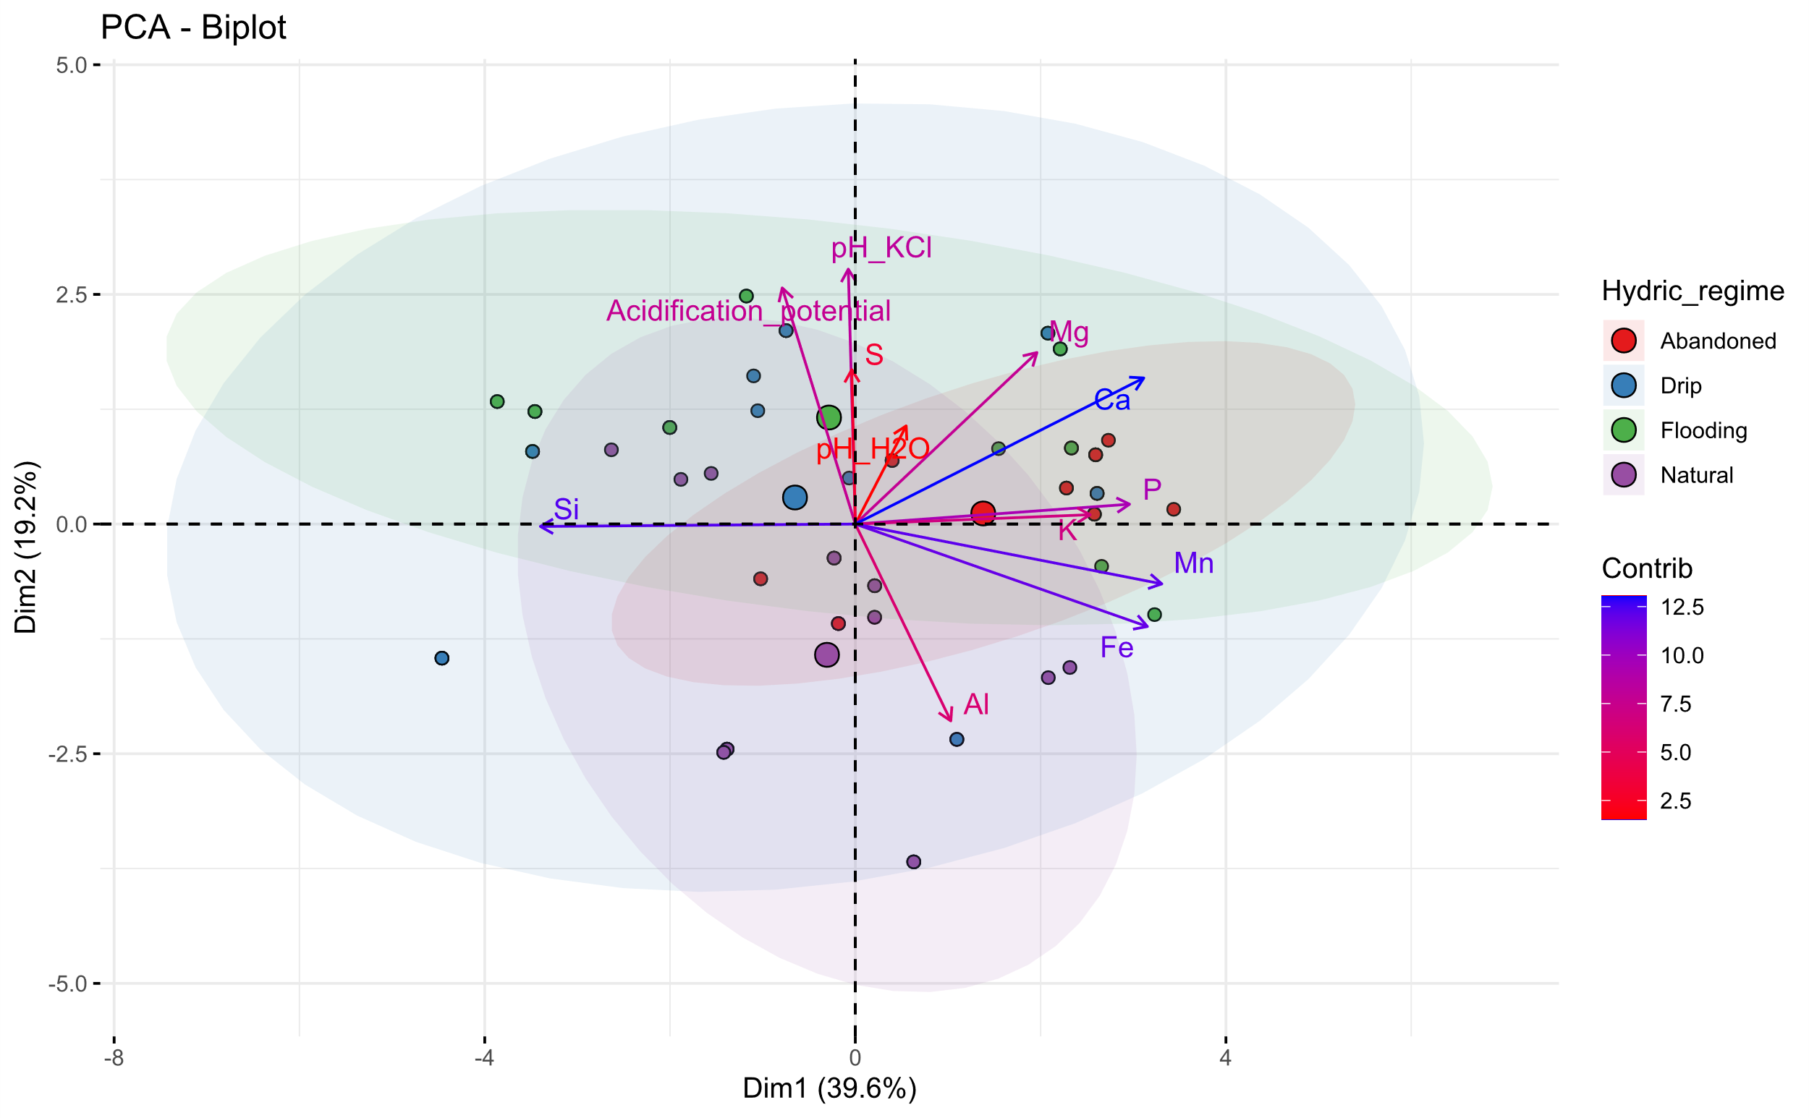
Fig. S1 PCA of the soil parameters between the hydric regime group samples.

Slide 4
Parameters | Flooding n = 19 | Drip n = 20
pH_H2O | 8.82 ± 0.38 a | 8.00 ± 0.63 b
pH_KCl | 8.77 ± 0.18 a | 8.01 ± 0.20 b
AP | -0.05 ± 0.29 a | 0.02 ± 0.29 a
Mg (%) | 3.59 ± 1.64 a | 3.35 ± 1.24 b
Al (%) | 7.23 ± 3.34 a | 9.46 ± 3.53 b
Si (%) | 82.56 ± 10.07 a | 77.73 ± 10.11 a
P (%) | 0.070 ± 0.050 a | 0.071 ± 0.057 a
K (%) | 1.03 ± 0.77 a | 1.34 ± 0.84 a
Ca (%) | 3.13 ± 2.96 a | 4.91 ± 4.71 a
Fe (%) | 1.84 ± 1.14 a | 2.41 ± 1.68 a
S (%) | 0.036 ± 0.048 a | 0.107 ± 0.159 a
Mn (%) | 0.025 ± 0.023 a | 0.025 ± 0.019 a
Table S2 pH and atomic abundances in soils of flooding and drip pits. Results are expressed as: mean ± standard deviation. Significant groups are measured with ANOVAs for each parameter. For the atomic abundances, values were centered log ratio before the ANOVAs. AP is the acidification potential.

Slide 5
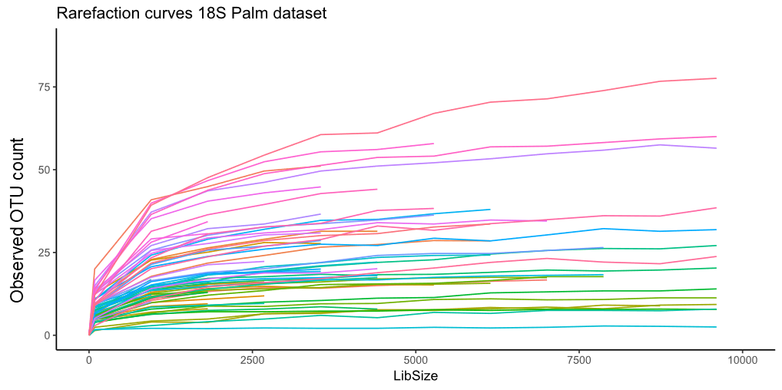
Fig. S2 Rarefaction plots for the date palm dataset. Obtained with mrlyn package

