Slide 1
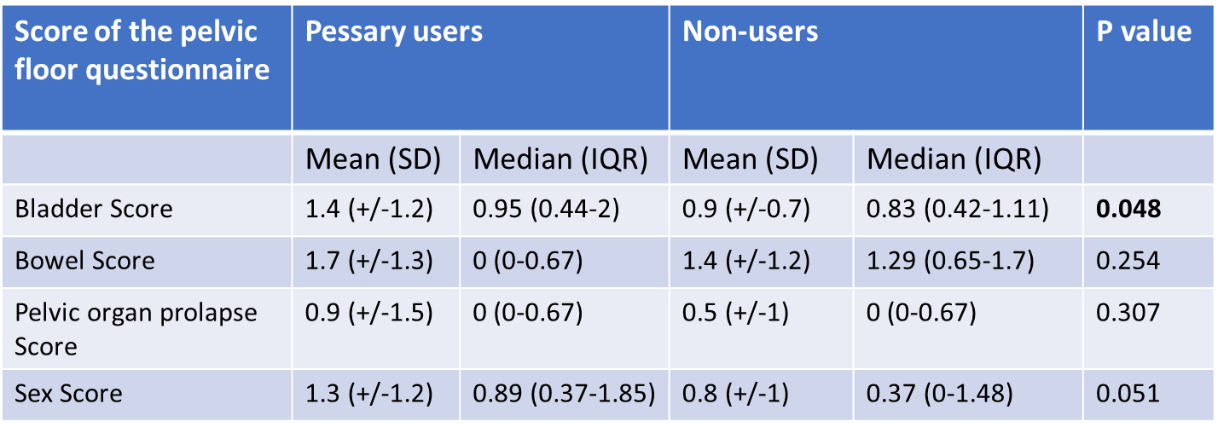
Table 3. Scores of the German Pelvic Floor Questionnaire for pregnant and postpartum women after 12 months postpartum of pessary users and non-users in N=98 women who still completed the questionnaire 12 months postpartum.

