Slide 1
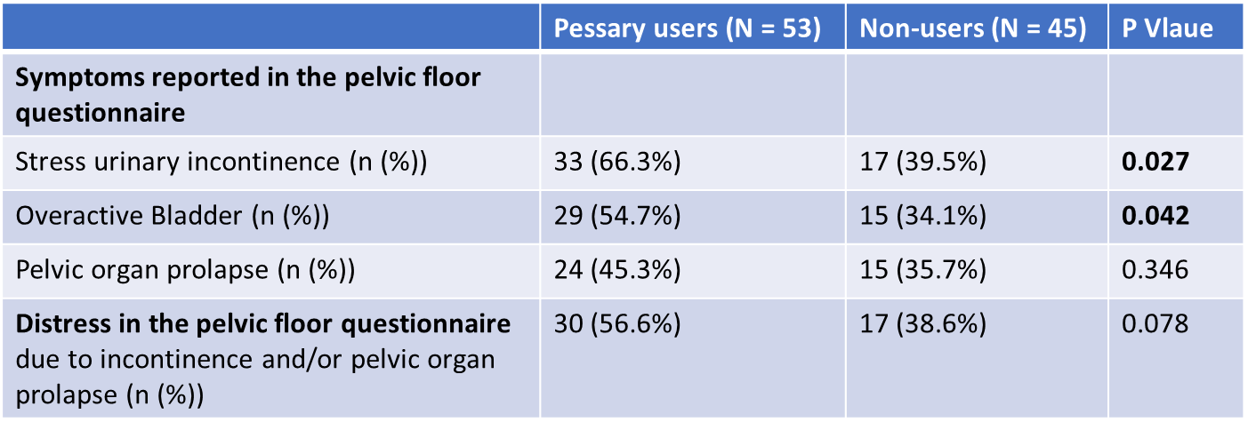
Table 5. Symptoms and distress reported in the German Pelvic Floor Questionnaire for pregnant and postpartum women after 12 months postpartum of pessary users and non-users

