Slide 1
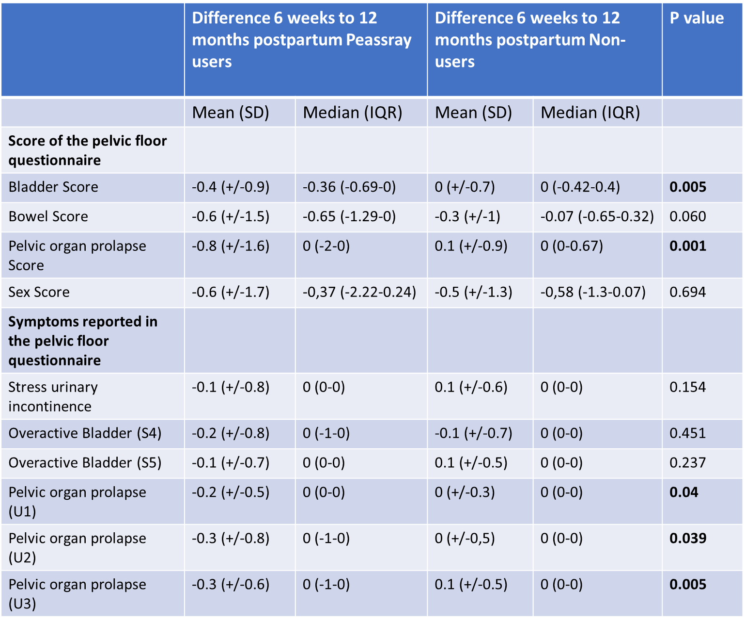
Table 4. Difference 6 weeks to 12 months postpartum of score and symptoms in the German Pelvic Floor Questionnaire for pregnant and postpartum women of pessary users and non-users.

