Slide 1
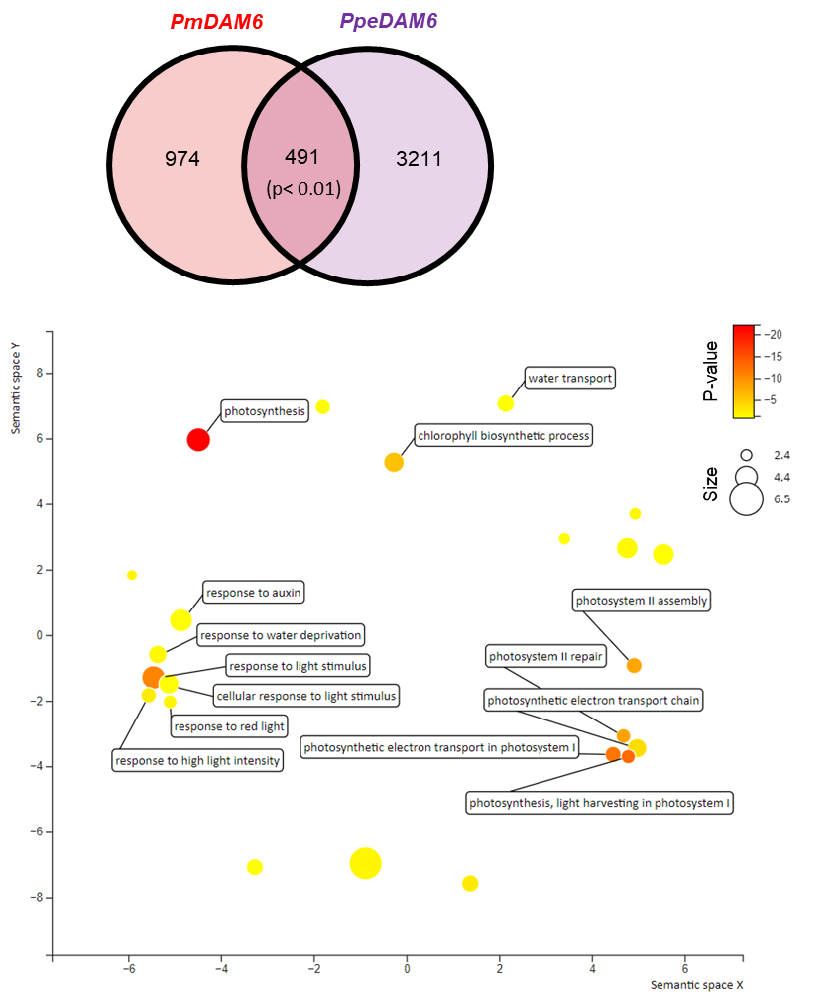
Supplementary Fig. S1
(A)
(B)
Supplementary Fig. S1. Genes significantly down-regulated in DEX-treated 35S:PmDAM6-GR apple and 35S:PpeDAM6 European plum leaves and the associated enriched GO terms
a Venn diagram of the down-regulated orthogroups in DEX-treated 35S:PmDAM6-GR transgenic apple and 35S:PpeDAM6 transgenic European plum leaves. b Visualization of the results of the GO enrichment analysis of commonly down-regulated DEGs by the Revigo platform (http://revigo.irb.hr/).

Slide 2
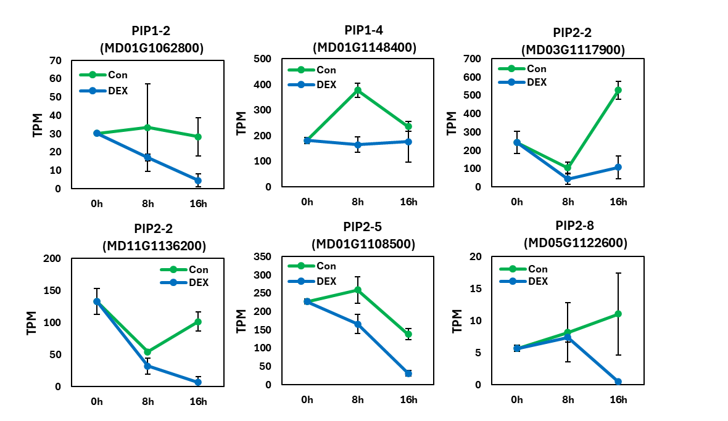
Supplementary Fig. S2
Supplementary Fig. S2. Changes in AQP expression in 35S:PmDAM6-GR transgenic apple leaves treated with DEX
Expression of AQP genes (MD01G1148400, MD03G1117900, MD01G1108500, MD01G1062800, MD11G1136200, and MD05G1122600) at 0, 8, and 16 h after 35S:PmDAM6-GR transgenic apple leaves were treated with DEX (control levels are also provided). Data are presented as the mean ± standard error (n = 2–3).

Slide 3
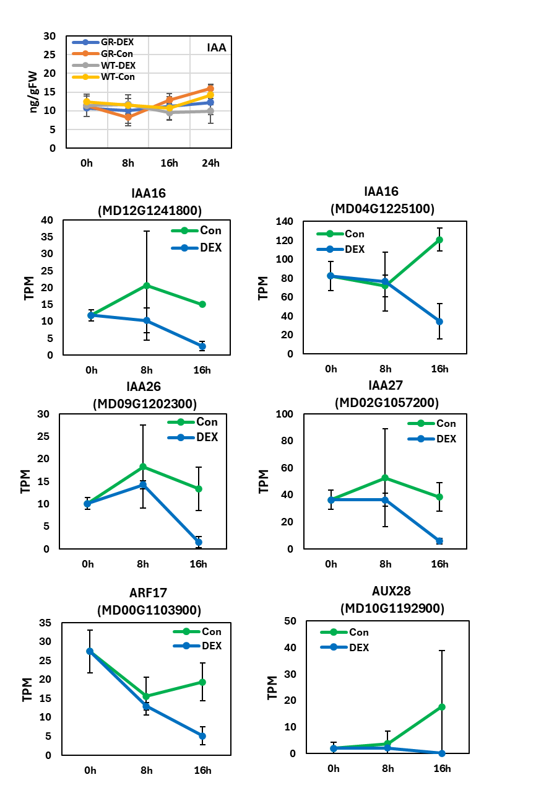
Supplementary Fig. S3
(A)
(B)
(C)
Supplementary Fig. S3. Accumulation of indole-3-acetic acid (IAA) and changes in IAA signaling-related gene expression in 35S:PmDAM6-GR transgenic apple leaves treated with DEX
a IAA accumulation at 0, 8, 16, and 24 h in control and DEX-treated WT and 35S:PmDAM6-GR transgenic apple leaves. Data are presented as the mean ± standard error (n = 3). b Expression of auxin-responsive protein-encoding genes (MD04G1225100, MD12G1241800, MD02G1057200, and MD09G1202300) at 0, 8, and 16 h after 35S:PmDAM6-GR transgenic apple leaves were treated with DEX (control levels are also provided). Data are presented as the mean ± standard error (n = 2–3). c Expression of AUXIN RESPONSE FACTOR (ARF) genes (MD00G1103900 and MD10G1192900) at 0, 8, and 16 h after 35S:PmDAM6-GR transgenic apple leaves were treated with DEX (control levels are also provided). Data are presented as the mean ± standard error (n = 2–3).

Slide 4
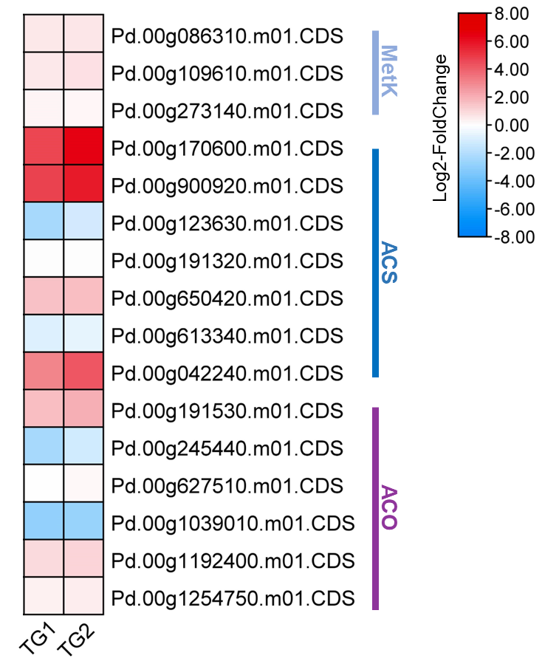
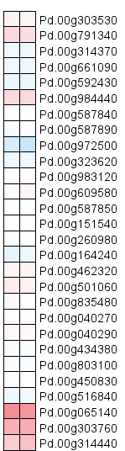
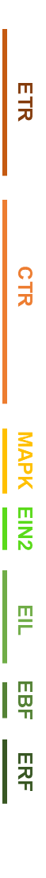
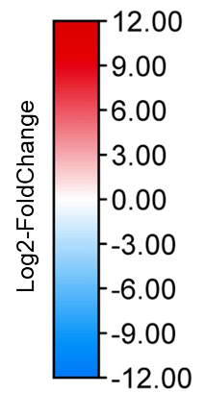
Supplementary Fig. S4
(A)
(B)
TG1
TG2
TG1
TG2
Supplementary Fig. S4. Expression of genes related to ethylene biosynthesis and signaling in 35S:PpeDAM6 transgenic European plum leaves (relative to control levels) (Lloret et al., 2021)
a Expression of ethylene biosynthesis-related genes in 35S:PpeDAM6 transgenic European plum leaves (Lloret et al., 2021). b Expression of ethylene signaling-related genes in 35S:PpeDAM6 transgenic plum leaves. TG1 and TG2 represent two 35S:PpeDAM6 European plum transgenic lines. The heat map presents log₂(fold-change) values (expression levels in 35S:PpeDAM6 transgenic European plum/wild-type leaves; n = 3).

Slide 5
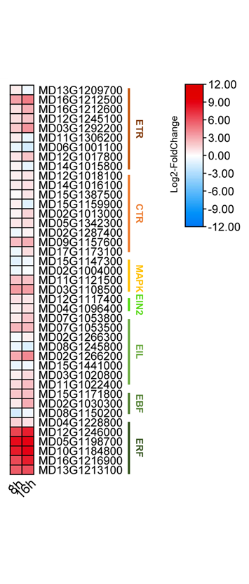
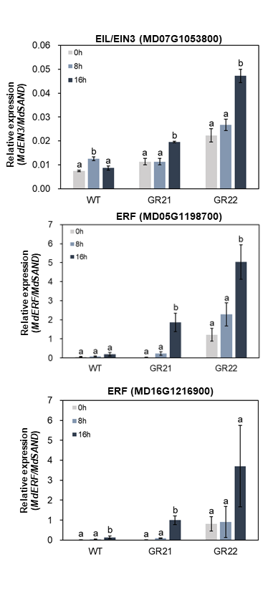
Supplementary Fig. S5
(A)
(B)
Supplementary Fig. S5. Changes in ethylene signaling-related gene expression in 35S:PmDAM6-GR transgenic apple leaves treated with DEX
a Expression of ethylene biosynthesis-related genes at 8 and 16 h after 35S:PmDAM6-GR transgenic apple leaves were treated with DEX. The heat map presents log₂(fold-change) values (expression levels in 35S:PmDAM6-GR transgenic apple/control leaves; n = 2–3). b Changes in ethylene signaling-related gene expression at 0, 8, and 16 h after the leaves of two 35S:PmDAM6-GR transgenic apple lines (GR21 and GR22) were treated with DEX (as determined by qRT-PCR).

Slide 6
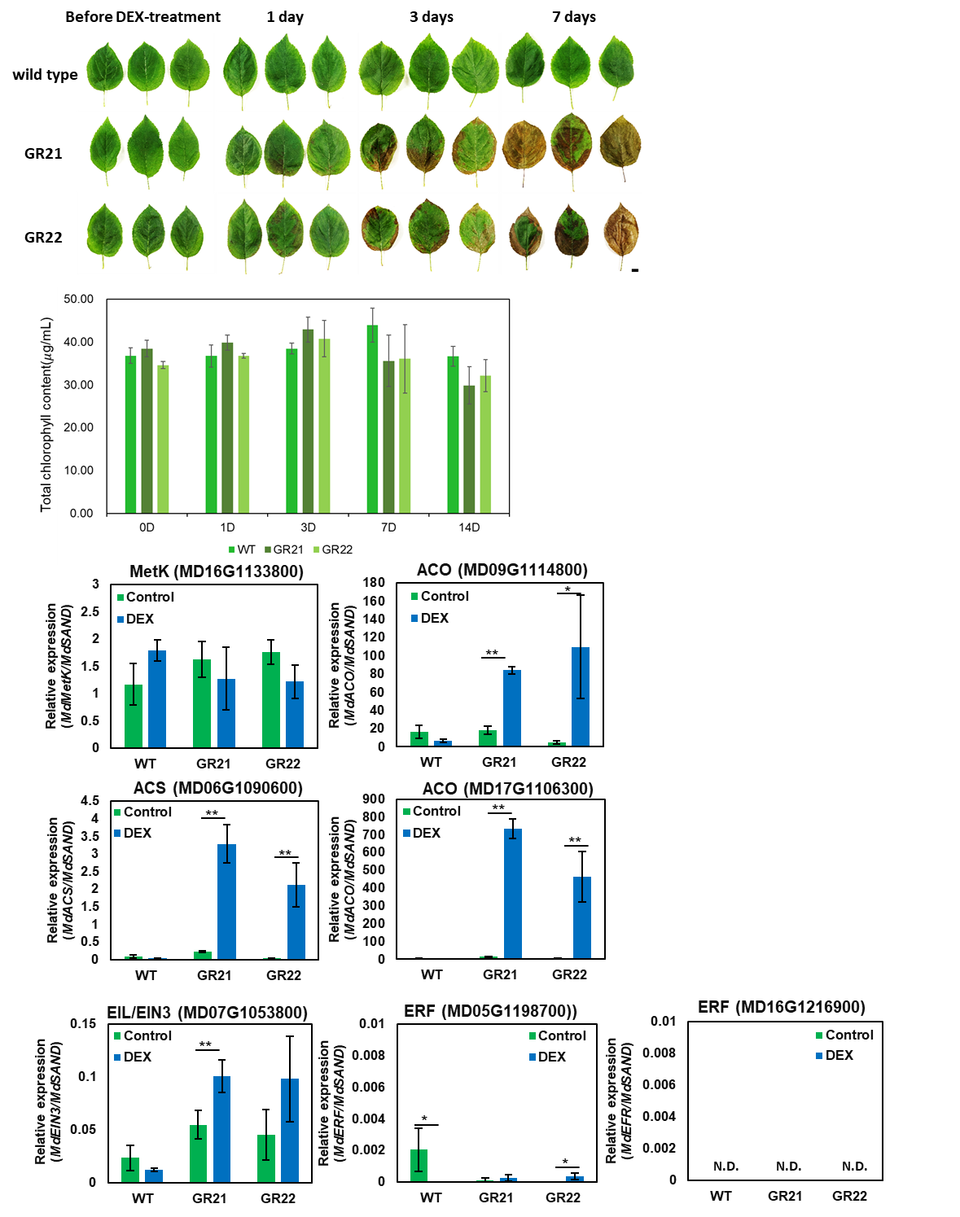
Supplementary Fig. S6
(A)
(B)
(C)
(D)

Slide 7
Supplementary Fig. S6. Effects of a DEX treatment in summer on the phenotype of 35S:PmDAM6-GR transgenic apple leaves
a Appearance of control and DEX-treated leaves of WT and two 35S:PmDAM6-GR transgenic lines (GR21 and GR22). Scale bar = 1 cm. b Total chlorophyll content of control and DEX-treated leaves of WT and two transgenic lines (GR21 and GR22). c–d Expression of genes related to ethylene biosynthesis and signaling in WT leaves as well as GR21 and GR22 leaves at 24 h after the DEX treatment (as determined by qRT-PCR).

Slide 8
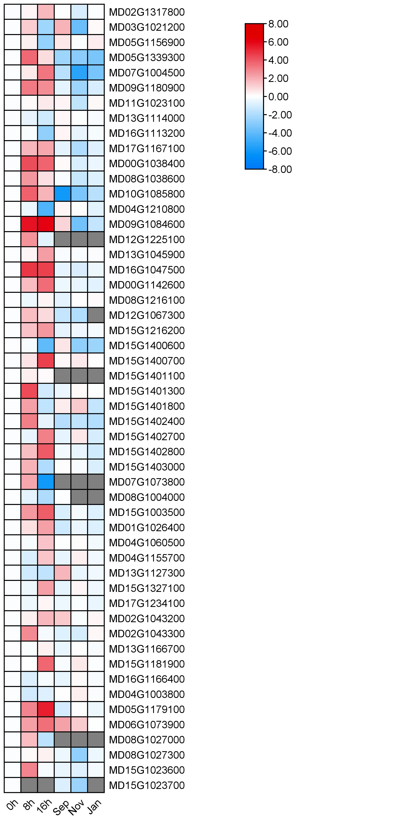
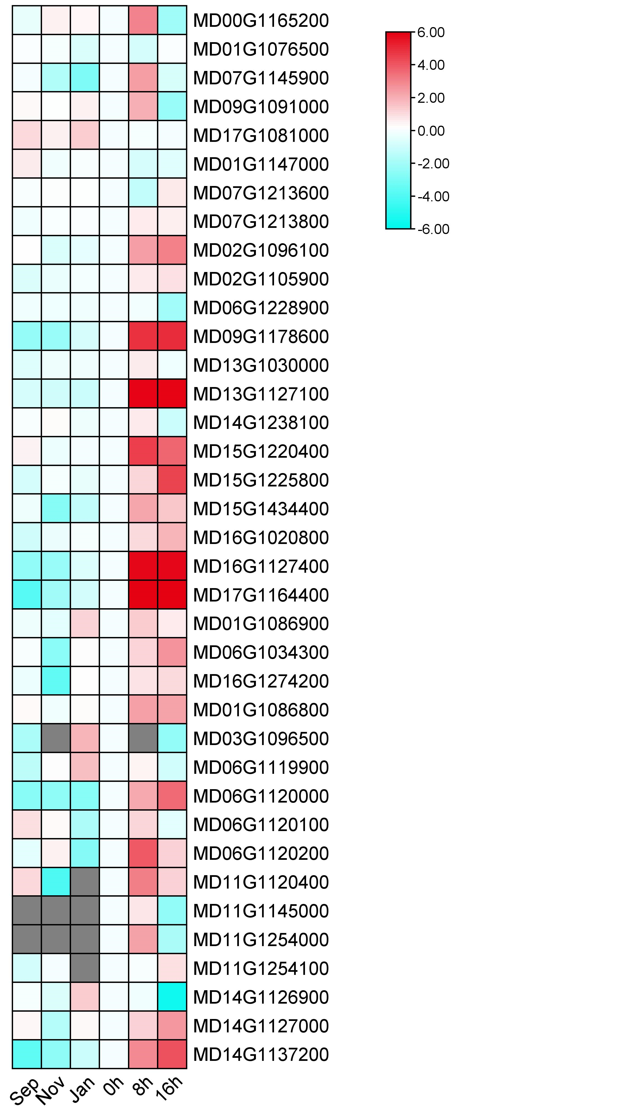
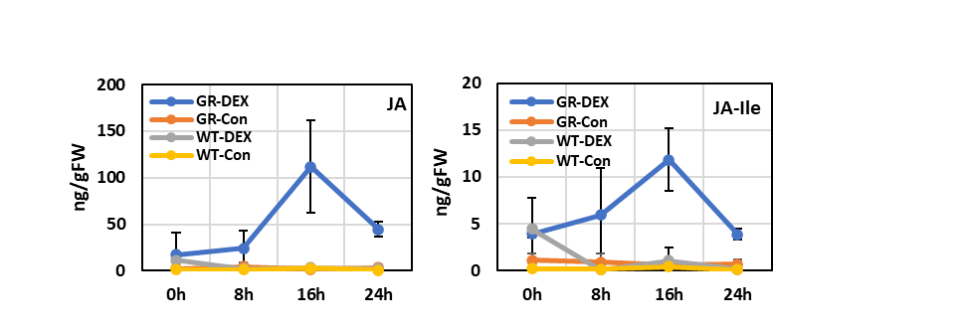
Supplementary Fig. S7
(A)
(B)
JAR1
LOX2S
log2-FoldChange
log2-FoldChange
COI1
AOS
JAZ
AOC
OPR
MYC2
OPCL1
ACOX
16h
MFP2
8h
ACAA1
JMT
16h
8h
(C)
Supplementary Fig. S7. Changes in the expression of genes related to jasmonic acid (JA) biosynthesis and signaling in 35S:PmDAM6-GR transgenic apple leaves treated with DEX
a–b Expression of genes related to JA biosynthesis and signaling at 8 and 16 h after 35S:PmDAM6-GR transgenic apple leaves were treated with DEX. The heat map presents the log₂(fold-change) values (expression levels in 35S:PmDAM6-GR transgenic apple/control leaves; n = 2–3). c Determination of JA and jasmonoyl-isoleucine (JA-Ile) levels in 35S:PmDAM6-GR transgenic apple and WT leaves after the treatment. Data are presented as the mean ± standard error (n = 3).

Slide 9
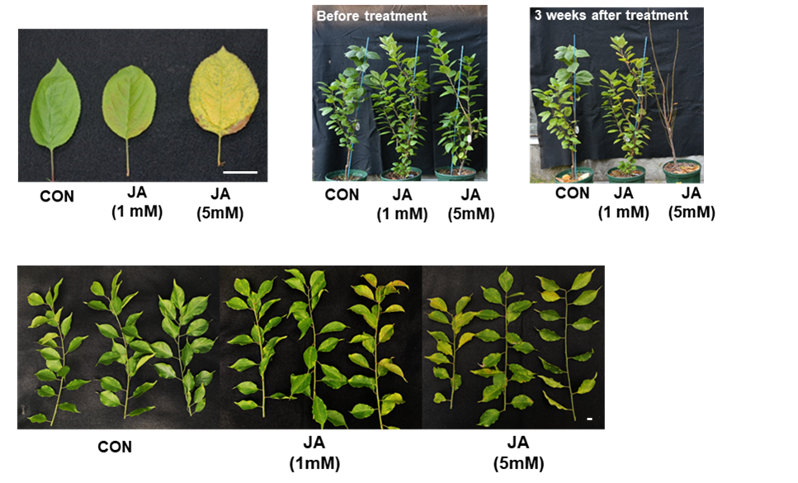
Supplementary Fig. S8
(A)
(B)
(C)
Supplementary Fig. S8. Effects of a jasmonic acid (JA) treatment on leaf senescence and abscission in apple ‘JM2’ and P. mume ‘Nanko’
a–b Appearance of control leaves, leaves treated with 1 or 5 mM JA, and plants at 21 days post-treatment. . Scale bar = 2 cm and 30 cm, respectively. c Appearance of control P. mume branches and branches treated with 1 or 5 mM JA at 21 days post-treatment. Scale bar = 2 cm.

Slide 10
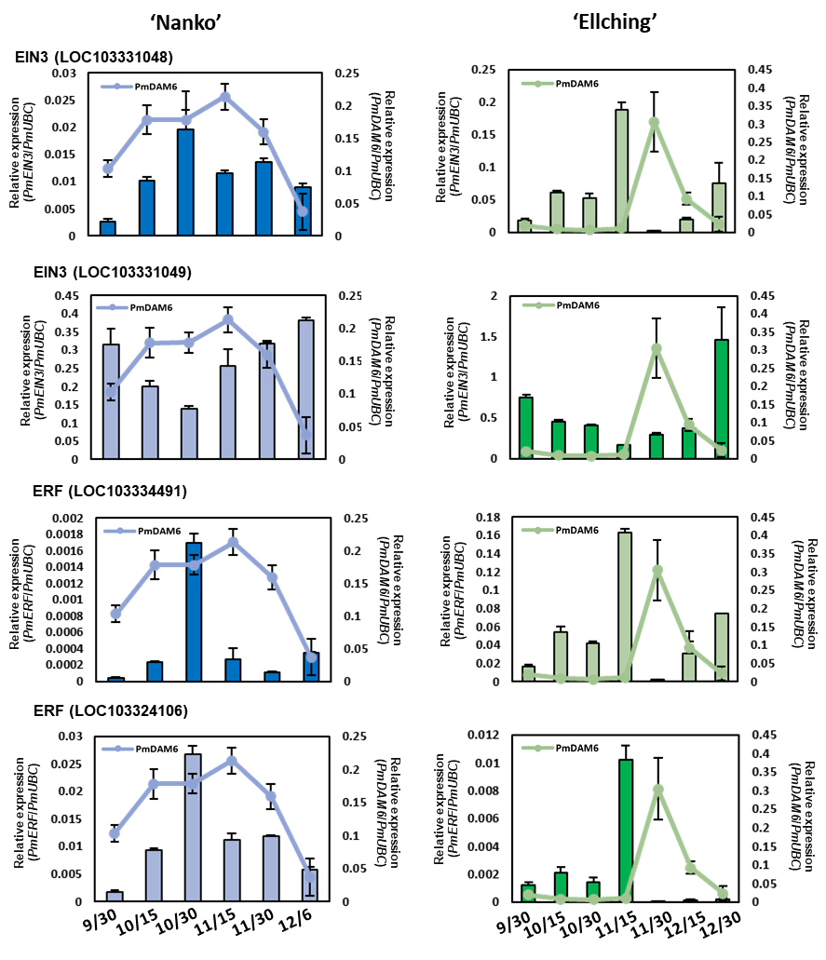
Supplementary Fig. S9
(A)
(B)
(C)
(D)
Supplementary Fig. S9. Seasonal changes in the expression of ethylene signaling-related genes and PmDAM6 in the leaves of P. mume ‘Nanko’ and ‘Ellching’
a–b Seasonal expression of two ETHYLENE-INSENSITIVE3 (EIN3) genes (LOC103331048 and LOC103331049). c–d Seasonal expression of two ETHYLENE RESPONSE FACTOR (ERF) genes (LOC103334491 and LOC103324106). Data are presented as the mean ± standard error (n = 3). Left and right Y-axes present the relative expression levels of ethylene signaling-related genes and PmDAM6, respectively.

Slide 11
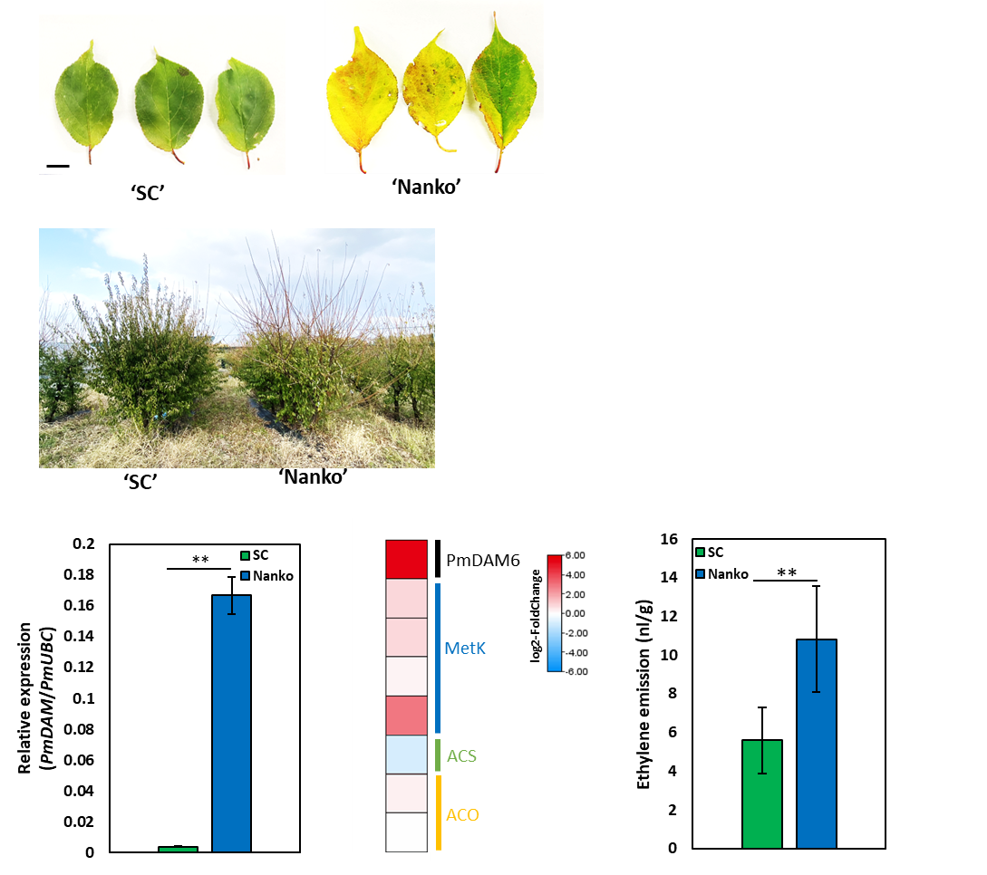
Supplementary Fig. S10
(A)
(B)
(C)
(D)
(E)
Supplementary Fig. S10. Seasonal changes in leaf senescence, expression of ethylene biosynthesis-related genes, and ethylene emission in two P. mume cultivars with contrasting leaf abscission characteristics
a–b Appearance of the leaves and whole plants of two P. mume cultivars (‘Nanko’ and ‘SC’) with contrasting PmDAM6 expression levels. Scale bar = 2 cm. c PmDAM6 expression in the leaves of P. mume cultivars ‘Nanko’ and ‘SC’. d Differences in the expression of ethylene biosynthesis-related genes between ‘Nanko’ and ‘SC’. The heat map presents log₂(fold-change) values [expression levels in Nanko (high-chill)/SC (low-chill); n = 3]. e Ethylene accumulation in the leaves of the Japanese apricot cultivars ‘Nanko’ and ‘SC’. Samples were collected on November 23, 2023 at the Kyoto University Kizu experimental farm. Data are presented as the mean ± standard error (n = 3–7). Asterisks indicate significant differences (t-test, p < 0.01).

