Slide 1
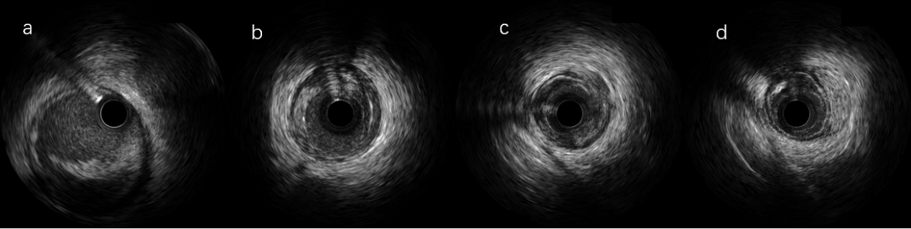
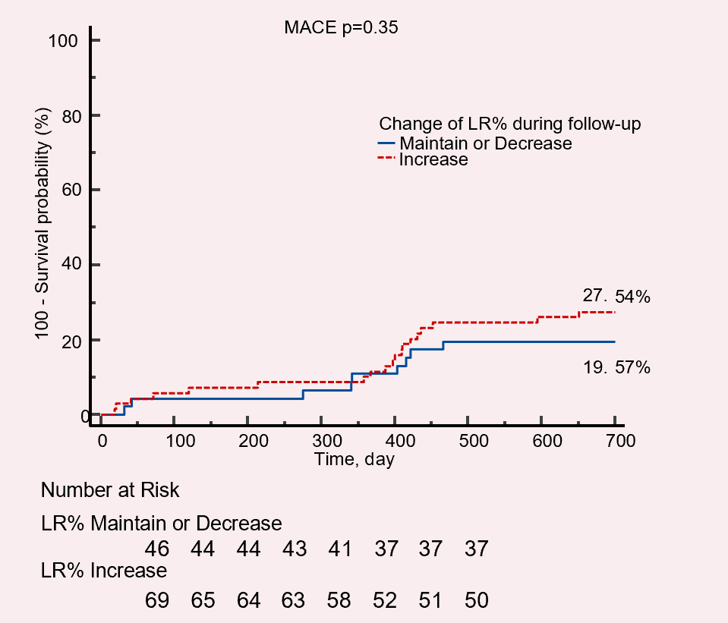
The association between the extent of dissection observed by intravascular ultrasound and long-term progression of vessel lesions after drug-coated balloon angioplasty in patients with de novo coronary artery disease
Methods and cohort
CONCLUSION
progression group (n=51)
The type of dissection was found to be associated with the LPVL.
Patients were included (n=115)
Analyze and reclassify the type of dissection in IVUS image
Analyze the coronary angiogram, post DCB angiogram and follow-up
LPVL<5%
non-progression group (n=64)
There was a significant difference in the treatment of SVD and NSVD with DCBs in relation to LPVL, but it was not an independent predictor for LPVL
Outcomes
For the evaluation of de novo coronary vessels after DCB angioplasty, IVUS is recommended
Dissection type (odds ratio: 1.73; 95% CI: 1.13-2.66; p=0.0124) was identified as an independent predictor of LVPL

