Slide 1
Supplementary Tables

Slide 2
Row Labels | Grade 1, 2 | Grade 3, 4 | Total | %
Rash | 5 | 5 | 10 | 37%
Metabolic Abnormalities | 7 | 2 | 9 | 33%
Elevated liver transaminases | 6 | 1 | 7 | 26%
Fatigue | 6 | 1 | 7 | 26%
Diarrhea | 7 | 0 | 7 | 26%
Endocrine abnormalities | 2 | 2 | 4 | 15%
Nausea | 3 | 1 | 4 | 15%
Hyperglycemia | 4 | 0 | 4 | 15%
Anorexia | 2 | 1 | 3 | 11%
Creatinine increased | 2 | 1 | 3 | 11%
Mucositis oral | 3 | 0 | 3 | 11%
Proteinuria | 3 | 0 | 3 | 11%
Pruritus | 3 | 0 | 3 | 11%
Vomiting | 3 | 0 | 3 | 11%
Lymphocyte count decreased | 0 | 2 | 2 | 7%
Anemia | 1 | 1 | 2 | 7%
Bullous dermatitis | 1 | 1 | 2 | 7%
Lipase increased | 1 | 1 | 2 | 7%
Chills | 2 | 0 | 2 | 7%
Cough | 2 | 0 | 2 | 7%
Fever | 2 | 0 | 2 | 7%
Hematuria | 2 | 0 | 2 | 7%
Abdominal infection | 0 | 1 | 1 | 4%
Hypotension | 0 | 1 | 1 | 4%
Arthralgia | 1 | 0 | 1 | 4%
Back pain | 1 | 0 | 1 | 4%
Blood bilirubin increased | 1 | 0 | 1 | 4%
Dehydration | 1 | 0 | 1 | 4%
Dizziness | 1 | 0 | 1 | 4%
Dry mouth | 1 | 0 | 1 | 4%
Dysgeusia | 1 | 0 | 1 | 4%
Dyspnea | 1 | 0 | 1 | 4%
Gastroesophageal reflux disease | 1 | 0 | 1 | 4%
Headache | 1 | 0 | 1 | 4%
Hypoglycemia | 1 | 0 | 1 | 4%
Localized edema | 1 | 0 | 1 | 4%
Rectal Bleeding | 1 | 0 | 1 | 4%
Serum amylase increased | 1 | 0 | 1 | 4%
Sinus bradycardia | 1 | 0 | 1 | 4%
Sinus tachycardia | 1 | 0 | 1 | 4%
Vitiligo skin hypopigmentation | 1 | 0 | 1 | 4%
Supplementary Table 1

Slide 3
Supplementary Table 2:
Outcomes | All Patients N = 25 (%) |  | Melanoma N = 10 (%) |  | Prostate N = 11 (%) |  | Other N = 4 (%)
 | Prior PD1 Exposure | NO prior PD1 Exposure | Prior PD1 Exposure | NO prior PD1 Exposure | Prior PD1 Exposure | NO prior PD1 Exposure | Prior PD1 Exposure | NO prior PD1 Exposure
Patients evaluable for response | 16 | 9 | 10 | 0 | 2 | 9 | 4 | 0
Response by RECIST 1.1
Partial Response | 1 (6) | 2 (22) | 1 (10) | 0 | 0 | 2 (22) | 0 | 0
Stable Disease | 6 (38) | 4 (44) | 4 (40) | 0 | 1 (50) | 4 (44) | 1 (25) | 0
Progressive Disease | 9 (56) | 3 (33) | 5 (50) | 0 | 1 (50) | 3 (33) | 3 (75) | 0
Clinical benefit (CR+PR + SD ≥6 mos) | 2 (13) | 3 (33) | 2 (20) | 0 | 0 | 3 (33) | 0 | 0
Patients on treatment > 12 mos | 2 (13) | 2 (22) | 2 (20) | 0 | 0 | 2 (22) | 0 | 0

Slide 4
Supplementary Table 3:
Table ID | Primary Cancer Type | Prior AntiPD1 y/n | PTEN Loss Determination | Starting Dose GSK | Clinical Benefit | RECIST1.1 Response | Phospho PRAS40 H score change from baseline | PTEN H Score Change from baseline | change in % CD8 | VEGF Hscore change from baseline
1 | Breast | y | NGS | 300 | n | PD | N/A | N/A | N/A | N/A
2 | Melanoma | y | NGS | 300 | n | PD | N/A | N/A | N/A | N/A
3 | Prostate | y | NGS | 300 | n | ineval | Decrease | N/A | Decrease | Increase
4 | Melanoma | y | IHC | 300 | n | SD | N/A | Decrease | Decrease | Increase
5 | Melanoma | y | IHC | 300 | n | PD | N/A | N/A | N/A | N/A
6 | Melanoma | y | NGS | 200 | y | SD | N/A | N/A | N/A | N/A
7 | Breast | y | IHC | 400 | n | PD | N/A | Increase | Increase | Decrease
8 | Melanoma | y | IHC | 400 | n | PD | N/A | N/A | N/A | N/A
9 | Lung | y | NGS | 400 | n | SD | N/A | N/A | N/A | N/A
10 | Melanoma | y | NGS | 400 | n | SD | N/A | N/A | N/A | N/A
11 | Colon | y | NGS | 400 | n | ineval | N/A | N/A | N/A | N/A
12 | Prostate | n | IHC | 200 | y | SD | No Change | No Change | Increase | Increase
13 | Prostate | n | NGS & IHC | 200 | y | PR | N/A | N/A | N/A | N/A
14 | Prostate | n | IHC | 200 | n | PD | Decrease | Decrease | Increase | Decrease
15 | Melanoma | y | IHC | 200 | n | PD | N/A | N/A | N/A | N/A
16 | Prostate | n | IHC | 200 | n | PD | Decrease | Increase | Increase | Decrease
17 | Prostate | n | NGS | 200 | n | PD | N/A | N/A | N/A | N/A
18 | Melanoma | y | IHC | 200 | n | PD | Decrease | Decrease | Increase | Decrease
19 | Prostate | y | NGS | 200 | n | PD | N/A | N/A | N/A | N/A
20 | Melanoma | y | IHC | 200 | y | PR | N/A | No Change | N/A | N/A
21 | Prostate | n | IHC | 200 | n | SD | N/A | N/A | N/A | N/A
22 | Prostate | n | IHC | 200 | n | SD | Decrease | No Change | Increase | Decrease
23 | Melanoma | y | IHC | 200 | n | SD | N/A | N/A | N/A | N/A
24 | Prostate | n | NGS | 200 | n | SD | N/A | N/A | N/A | N/A
25 | Endometrial | y | NGS | 200 | n | PD | Increase | Increase | Increase | Increase
26 | Prostate | n | IHC | 200 | y | PR | N/A | N/A | N/A | N/A
27 | Prostate | y | NGS | 200 | n | SD | N/A | N/A | N/A | N/A

Slide 5
Supplementary Table 4:
Markers (Type) | MC38 7 days p value control vs |  |  |  |  |  | MC38 14 days p value control vs |  |  |  |  |  | B16 7 days
 |  |  |  |  |  |  |  |  |  |  |  |  | p value control vs
 | Spleen |  |  | Tumor |  |  | Spleen |  |  | Tumor |  |  | Spleen |  |  | Tumor
 | BYL | Anti-PD-1 | Combination | BYL | Anti-PD-1 | Combination | BYL | Anti-PD-1 | Combination | BYL | Anti-PD-1 | Combination | BYL | Anti-PD-1 | Combination | BYL | Anti-PD-1 | Combination
CD8+ (T cells) | NC | NC | NC | NC | NC | NC | NC | NC | NC | NC | NC | NC | NC | NC | NC | NC | NC | NC
CD8+ (T cells mg/tumor) | N/A | N/A | N/A | NC | NC | NC | N/A | N/A | N/A | NC | NC | Up** | N/A | N/A | N/A | NC | NC | Up**
CD4+ (T cells) | NC | NC | NC | NC | NC | NC | NC | NC | NC | NC | NC | NC | NC | NC | NC | NC | NC | NC
CD4+ (T cells mg/tumor) | N/A | N/A | N/A | NC | NC | NC | N/A | N/A | N/A | NC | NC | NC | N/A | N/A | N/A | NC | NC | NC
CD19+ (B cells) | NC | NC | NC | NC | NC | NC | NC | NC | NC | NC | NC | NC | NC | NC | NC | NC | NC | NC
CD8+ Ki67+ (T Proliferation) | NC | NC | NC | NC | NC | NC | NC | NC | NC | NC | NC | NC | Down*** | NC | NC | NC | NC | NC
CD4+ Ki67+ (T Proliferation) | NC | Up*** | NC | NC | NC | NC | NC | NC | NC | NC | NC | NC | Down*** | NC | NC | NC | NC | NC
CD4+ Ki67+ Foxp3+(Tregs) | NC | Up** | Up* | NC | NC | NC | NC | NC | NC | NC | NC | NC | NC | NC | NC | NC | NC | NC
CD19+ Ki67 (B prolifeation) | NC | NC | NC | NC | NC | NC | NC | NC | NC | NC | NC | NC | Down*** | NC | NC | NC | NC | NC
CD8+ CD62L- CD44+ (Effector) | NC | NC | NC | NC | NC | NC | NC | NC | NC | NC | NC | NC | NC | NC | NC | NC | NC | NC
CD8+ CD62L+ CD44+ (Memory) | NC | NC | NC | NC | NC | NC | NC | NC | NC | NC | NC | NC | NC | NC | NC | NC | NC | NC
CD8+ CD62L+ CD44- (Naive) | NC | NC | NC | NC | NC | NC | NC | NC | NC | NC | NC | NC | NC | NC | NC | NC | NC | NC
CD4+ CD62L- CD44+ (Effector) | NC | NC | NC | NC | NC | NC | NC | NC | NC | NC | NC | NC | NC | NC | NC | NC | NC | NC
CD4+ CD62L+ CD44+ (Memory) | NC | NC | NC | NC | NC | NC | NC | NC | NC | NC | NC | NC | NC | NC | NC | NC | NC | NC
CD4+ CD62L+ CD44- (Naive) | NC | Down* | NC | NC | NC | NC | NC | NC | NC | NC | NC | NC | NC | NC | NC | NC | NC | NC
NK1.1 (NK cells) | NC | NC | NC | NC | NC | NC | NC | NC | NC | NC | NC | NC | NC | NC | NC | NC | NC | NC
CD11b+ (Myeloid cells) | NC | NC | NC | NC | NC | NC | NC | NC | NC | NC | NC | NC | NC | NC | NC | NC | NC | NC
CD11c+ (DC cells) | NC | NC | NC | NC | NC | Down* | NC | NC | NC | NC | NC | NC | NC | NC | NC | NC | NC | NC
CD11b+ Ly6g+ (MDSC) mg/tumor | NC | NC | NC | NC | NC | NC | NC | NC | NC | NC | NC | Down* | NC | NC | NC | NC | NC | NC
F4/80+ (macrophage) | NC | NC | NC | NC | NC | NC | NC | NC | NC | NC | NC | NC | NC | NC | NC | NC | NC | NC

Slide 6
Supplementary Table 5:
Markers (Type) | MC38 7 days |  |  |  |  |  | MC38 14 days |  |  |  |  |  | B16 7 days
 | p value control vs |  |  |  |  |  | p value control vs |  |  |  |  |  | p value control vs
 | Spleen |  |  | Tumor |  |  | Spleen |  |  | Tumor |  |  | Spleen |  |  | Tumor
 | GSK | Anti-PD-1 | Combination | GSK | Anti-PD-1 | Combination | GSK | Anti-PD-1 | Combination | GSK | Anti-PD-1 | Combination | GSK | Anti-PD-1 | Combination | GSK | Anti-PD-1 | Combination
CD8+ (T cells) | NC | NC | NC | NC | NC | NC | NC | NC | NC | NC | NC | NC | NC | NC | NC | NC | NC | NC
CD8+ (T cells mg/tumor) | N/A | N/A | N/A | NC | NC | NC | N/A | N/A | N/A | NC | NC | NC | N/A | N/A | N/A | NC | NC | NC
CD4+ (T cells) | NC | NC | NC | NC | NC | NC | NC | NC | NC | NC | NC | NC | NC | NC | NC | NC | NC | NC
CD4+ (T cells mg/tumor) | N/A | N/A | N/A | NC | NC | NC | N/A | N/A | N/A | NC | NC | NC | N/A | N/A | N/A | NC | NC | NC
CD19+ (B cells) | NC | NC | NC | NC | NC | NC | NC | NC | NC | NC | NC | NC | NC | NC | NC | NC | NC | NC
CD8+ Ki67+ (T Proliferation) | NC | NC | NC | NC | NC | NC | NC | NC | NC | NC | NC | NC | NC | NC | NC | NC | NC | NC
CD4+ Ki67+ (T Proliferation) | NC | Up** | Up* | NC | NC | NC | NC | NC | NC | NC | NC | NC | NC | NC | NC | NC | NC | NC
CD4+ Ki67+ Foxp3+(Tregs) | NC | Up* | NC | NC | NC | NC | NC | NC | NC | NC | NC | NC | NC | NC | NC | NC | NC | NC
CD19+ Ki67 (B prolifeation) | NC | NC | NC | NC | NC | NC | NC | NC | NC | NC | NC | NC | NC | NC | NC | NC | NC | NC
CD8+ CD62L- CD44+ (Effector) | NC | NC | NC | NC | NC | NC | NC | NC | NC | NC | NC | NC | NC | NC | NC | NC | NC | NC
CD8+ CD62L+ CD44+ (Memory) | NC | NC | NC | NC | NC | NC | NC | NC | NC | NC | NC | NC | NC | NC | NC | NC | NC | NC
CD8+ CD62L+ CD44- (Naive) | NC | NC | NC | NC | NC | NC | NC | NC | NC | NC | NC | NC | NC | NC | NC | NC | NC | NC
CD4+ CD62L- CD44+ (Effector) | NC | NC | NC | NC | NC | NC | NC | NC | NC | NC | NC | NC | NC | NC | NC | NC | NC | NC
CD4+ CD62L+ CD44+ (Memory) | NC | NC | NC | NC | NC | NC | NC | NC | NC | NC | NC | NC | NC | NC | NC | NC | NC | NC
CD4+ CD62L+ CD44- (Naive) | NC | NC | NC | NC | NC | NC | NC | NC | NC | NC | NC | NC | NC | NC | NC | NC | NC | NC
NK1.1 (NK cells) | NC | NC | NC | NC | NC | NC | NC | NC | NC | NC | NC | NC | NC | NC | Up* | NC | NC | NC
CD11b+ (Myeloid cells) | NC | NC | NC | NC | NC | NC | NC | NC | NC | NC | NC | NC | NC | NC | NC | NC | NC | NC
CD11c+ (DC cells) | NC | NC | NC | NC | NC | NC | NC | NC | NC | NC | NC | NC | NC | NC | NC | NC | NC | NC
CD11b+ Ly6g+ (MDSC) | NC | NC | NC | NC | NC | NC | NC | NC | NC | NC | NC | NC | NC | NC | NC | NC | NC | NC
F4/80+ (macrophage) | NC | NC | NC | NC | NC | NC | NC | NC | NC | NC | NC | NC | NC | NC | NC | NC | NC | NC

Slide 7
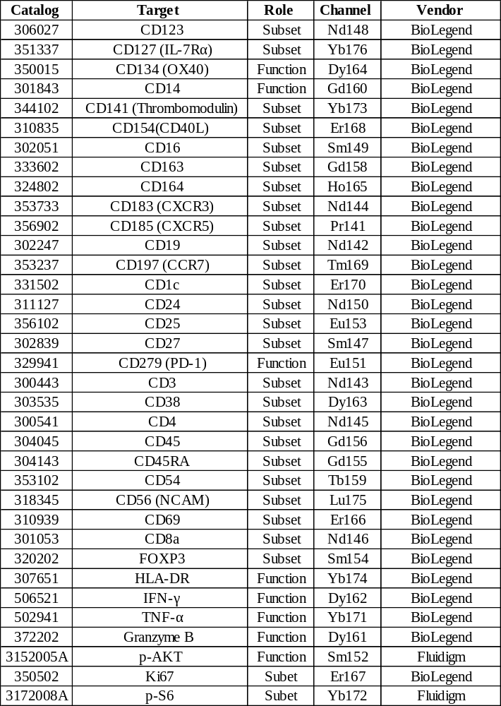
Supplementary Table 6:

Slide 8
Supplementary Table 7:
Target gene | Catalog# | Target Sequence
Pik3ca | V2LMM_41778 | 5' CAGATGTACTGCTTAGTAA
Pik3ca | V2LMM_52415 | 5' GAATCCTAGTGGAATGTTT
Pik3ca | V2LMM_44292 | 5' CTTTCAATCTGCTCTGTTA
Pik3ca | V3LMM_430644 | 5' AGCAGAGCAATGTATGTCT
Pik3cb | V2LMM_189078 | 5' TATCTTTGACCGATGTGAG
Pik3cb | V2LMM_189160 | 5' CTGGAGAACTTGGAAGATA
Pik3cb | V2LMM_47870 | 5' GAAGCTACCATTTCTTATA
Pik3cb | V3LMM_423457 | 5'TGGAGAACTTGGAAGATAA
Pik3cg | V2LMM_22640 | 5' CTCAAGAACGGAGATGAAA
Pik3cd | V2LMM_59653 | 5' GCTACTGTGTGGCCACATA
Pik3cd | V3LMM_507804 | 5' AGCTGGAAAACCAAAGTCA
Pik3cd | V3LMM_507808 | 5' AAGACCAAGTTTGGAATCA
Non-target Control (NT) | RHS4346

Slide 9
Supplementary Table 8 :
Target gene | Clone ID | Target Sequence
Pik3ca | PIK3CA-C1 | 5' GCTTCACCATGCCGTCATACT
Pik3ca | PIK3CA-C2 | 5' AGCAGAGCAATGTATGTCT
Pik3ca | PIK3CA-C3 | 5' GCTTGAAGAGTGTCGAATTAT
Pik3ca | PIK3CA-C4 | 5' GAAATCCCTCTGGGTCATAAA
Pik3cb | PIK3CB-C1 | 5' CTCACATCGGTCAAAGATA
Pik3cb | PIK3CB-C2 | 5' GCATAGCTGGTCTTCGTTTCC
Pik3cg | PIK3CG-C1 | 5' CTCAAGAACGGAGATGAAA
Pik3cg | PIK3CG-C2 | 5' GACGATCTCGTATTGAGTATC
Pik3cd | PIK3CD-C1 | 5' GCTACTGTGTGGCCACATA
Pik3cd | PIK3CD-C2 | 5' GCTACTGTGAACGAGCCTATA
Non-target Control (NT) | NT | 5' CAACAAGATGAAGAGCACCAA

Slide 10
Supplementary Table 9:
Catalog# | Target | Vendor | Purpose
48-0042-82 | CD4 | eBioscience | Flow cytometry
60-0081-U100 | CD8 | TONBO biosciences | Flow cytometry
65-0251-U100 | CD25 | TONBO biosciences | Flow cytometry
550992 | CD19 | BD biosciences | Flow cytometry
550627 | NK1.1 | BD Pharmingen | Flow cytometry
48-0112-82 | CD11b | eBioscience | Flow cytometry
60-1276-U100 | Ly6G | TONBO biosciences | Flow cytometry
50-4801-U100 | F4/80 | TONBO biosciences | Flow cytometry
11-5698-82 | Ki67 | invitrogen | Flow cytometry
12-5773-82 | FOXP3 | eBioscience | Flow cytometry
65-0621-U100 | CD62L | TONBO biosciences | Flow cytometry
20-0114-U100 | CD11c | TONBO biosciences | Flow cytometry
35-0441-U500 | CD44 | TONBO biosciences | Flow cytometry
560626 | Caspase-3 | BD biosciences | Flow cytometry
4249 | p110⍺ | Cell signaling | Western blot
PA5-79821 | p110β | Invitrogen | Western blot
5405 | p110𝛾 | Cell signaling | Western blot
34050 | p110δ | Cell signaling | Western blot
4060 | pAkt (S473) | Cell signaling | Western blot
2865 | pAkt(T308) | Cell signaling | Western blot
4691 | Akt | Cell signaling | Western blot
4970 | β- actin | Cell signaling | Western blot

Slide 11
Supplementary Figures

Slide 12
Supplementary Figure 1:

Slide 13
Supplementary Figure 2:

Slide 14
Supplementary Figure 3:

Slide 15
Supplementary Figure 4:

Slide 16
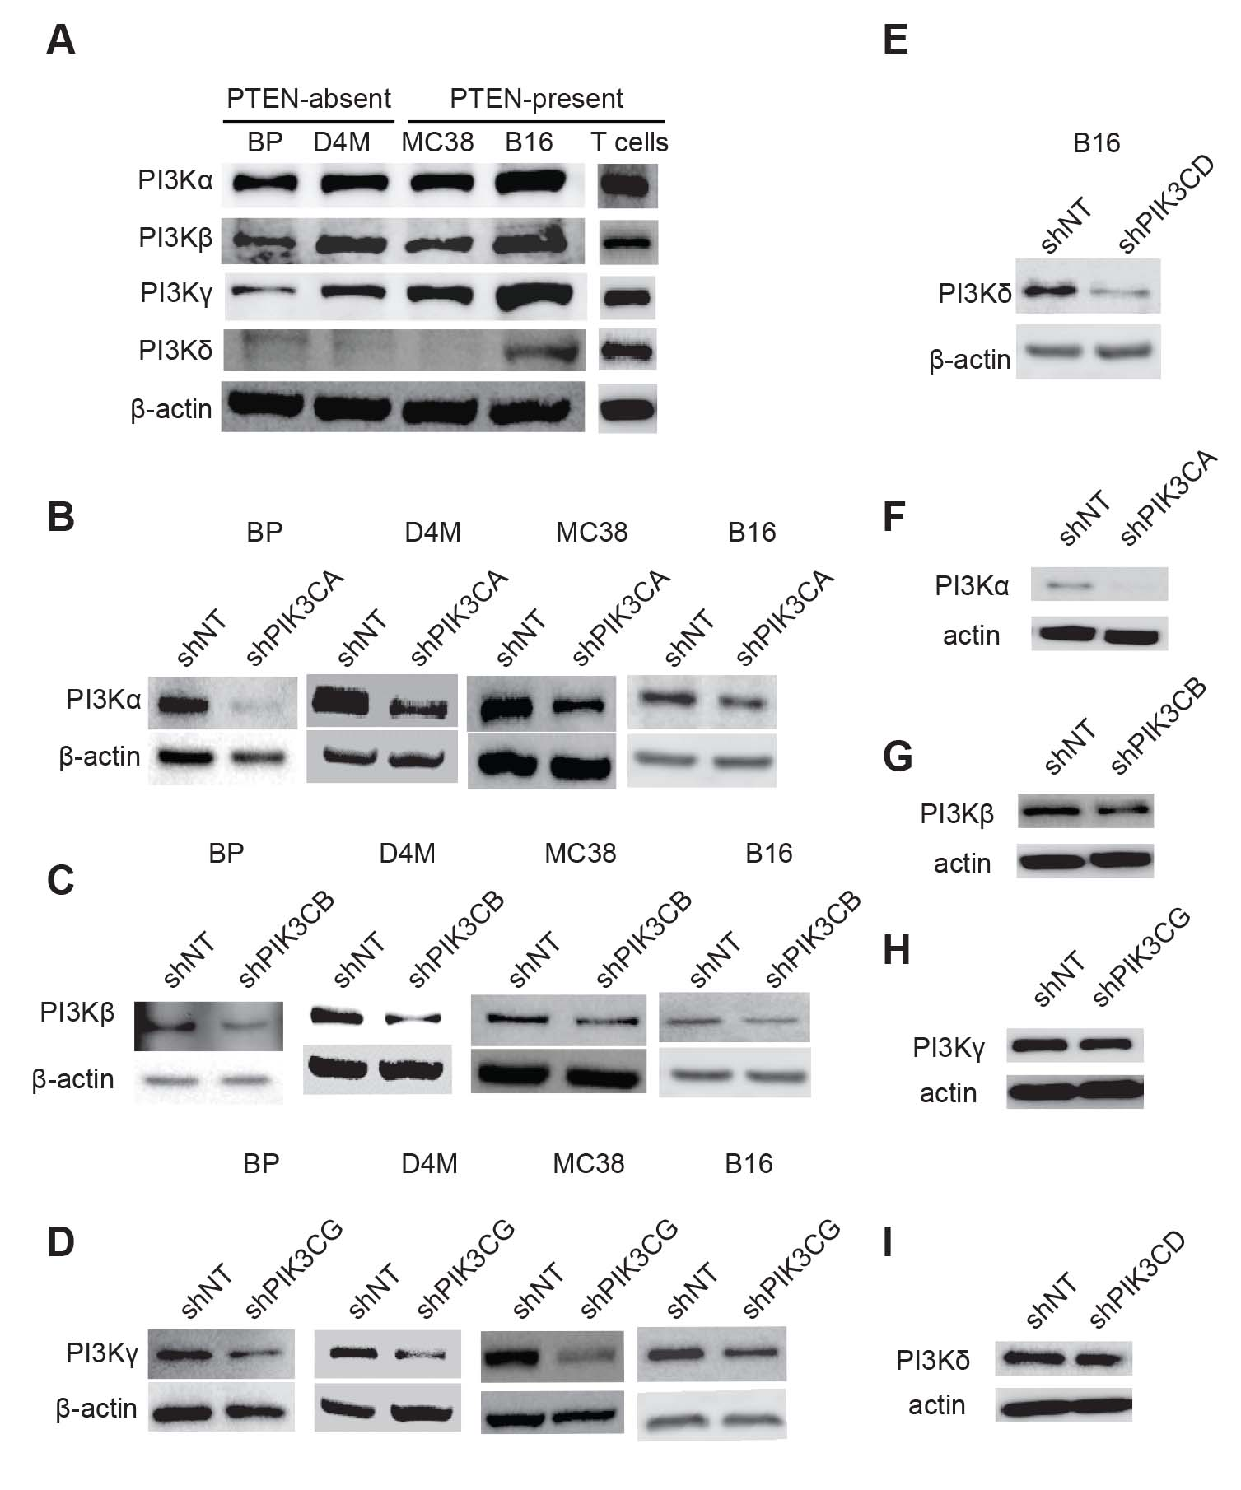
Supplementary Figure 5:

Slide 17
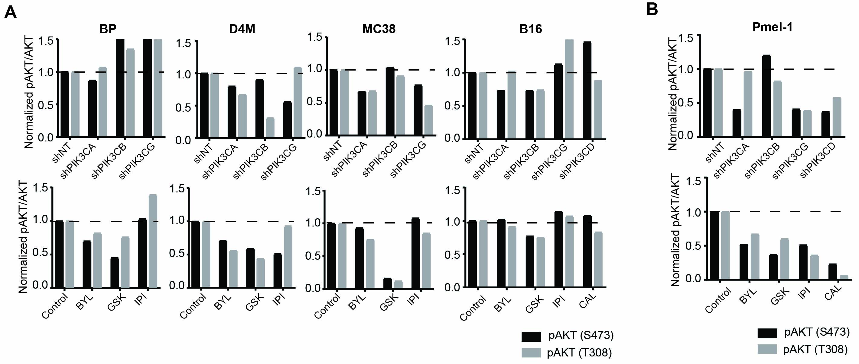
Supplementary Figure 6:

Slide 18
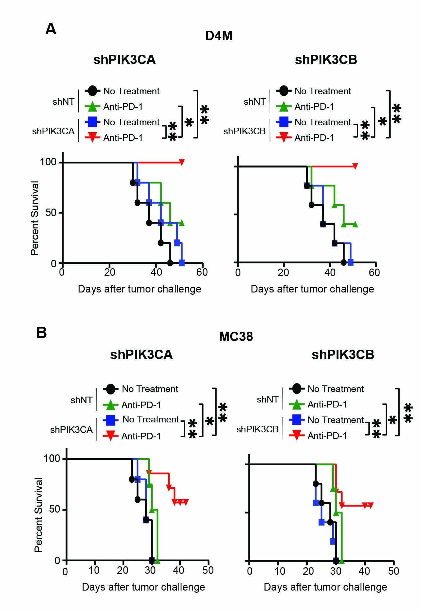
Supplementary Figure 7

Slide 19
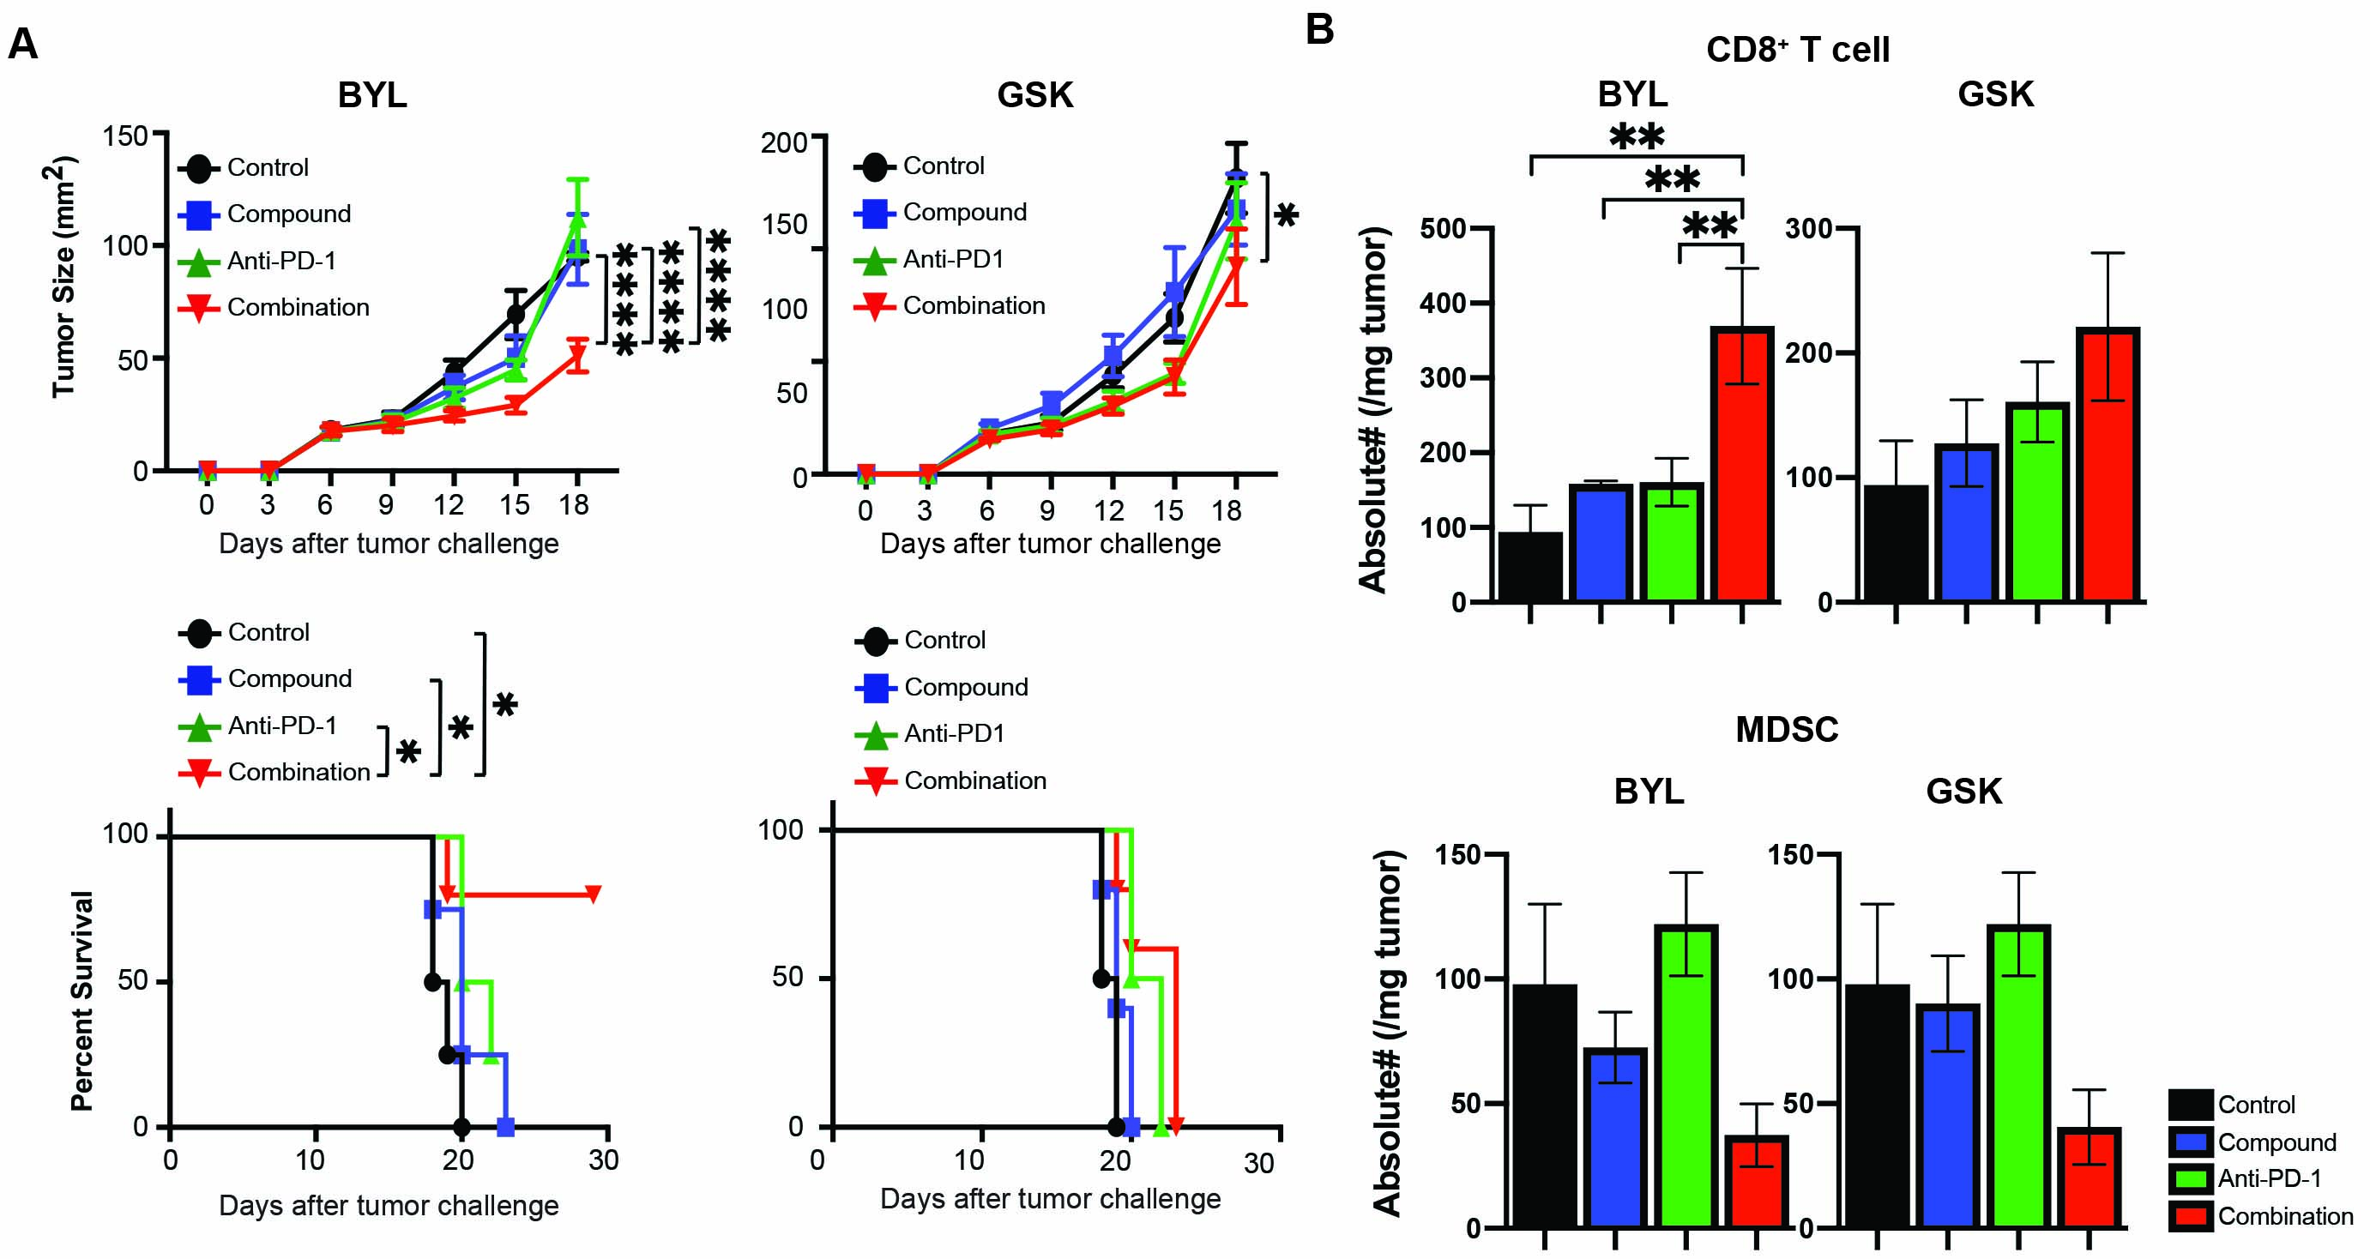
Supplementary Figure 8

Slide 20
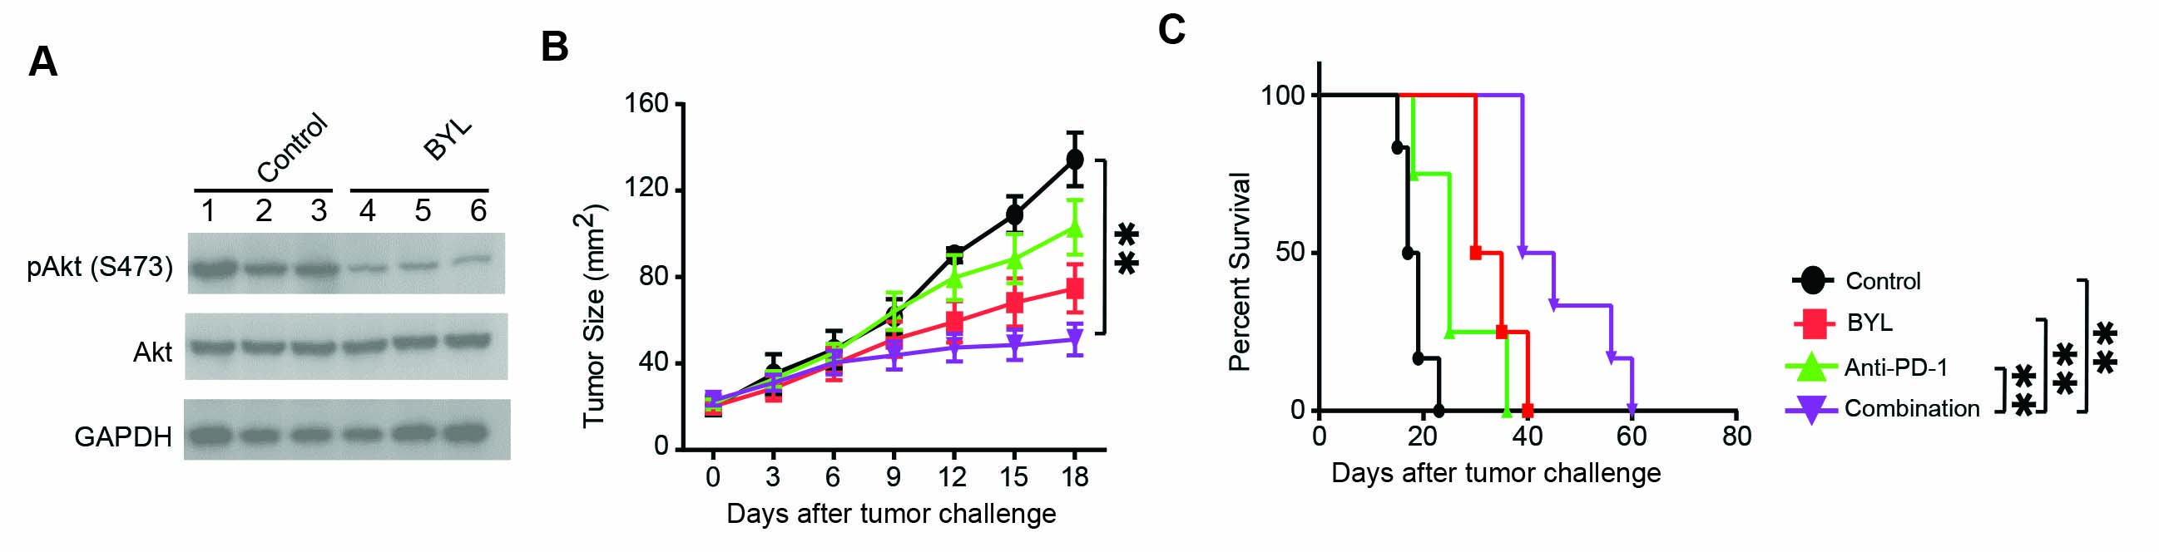
Supplementary Figure 9

Slide 21
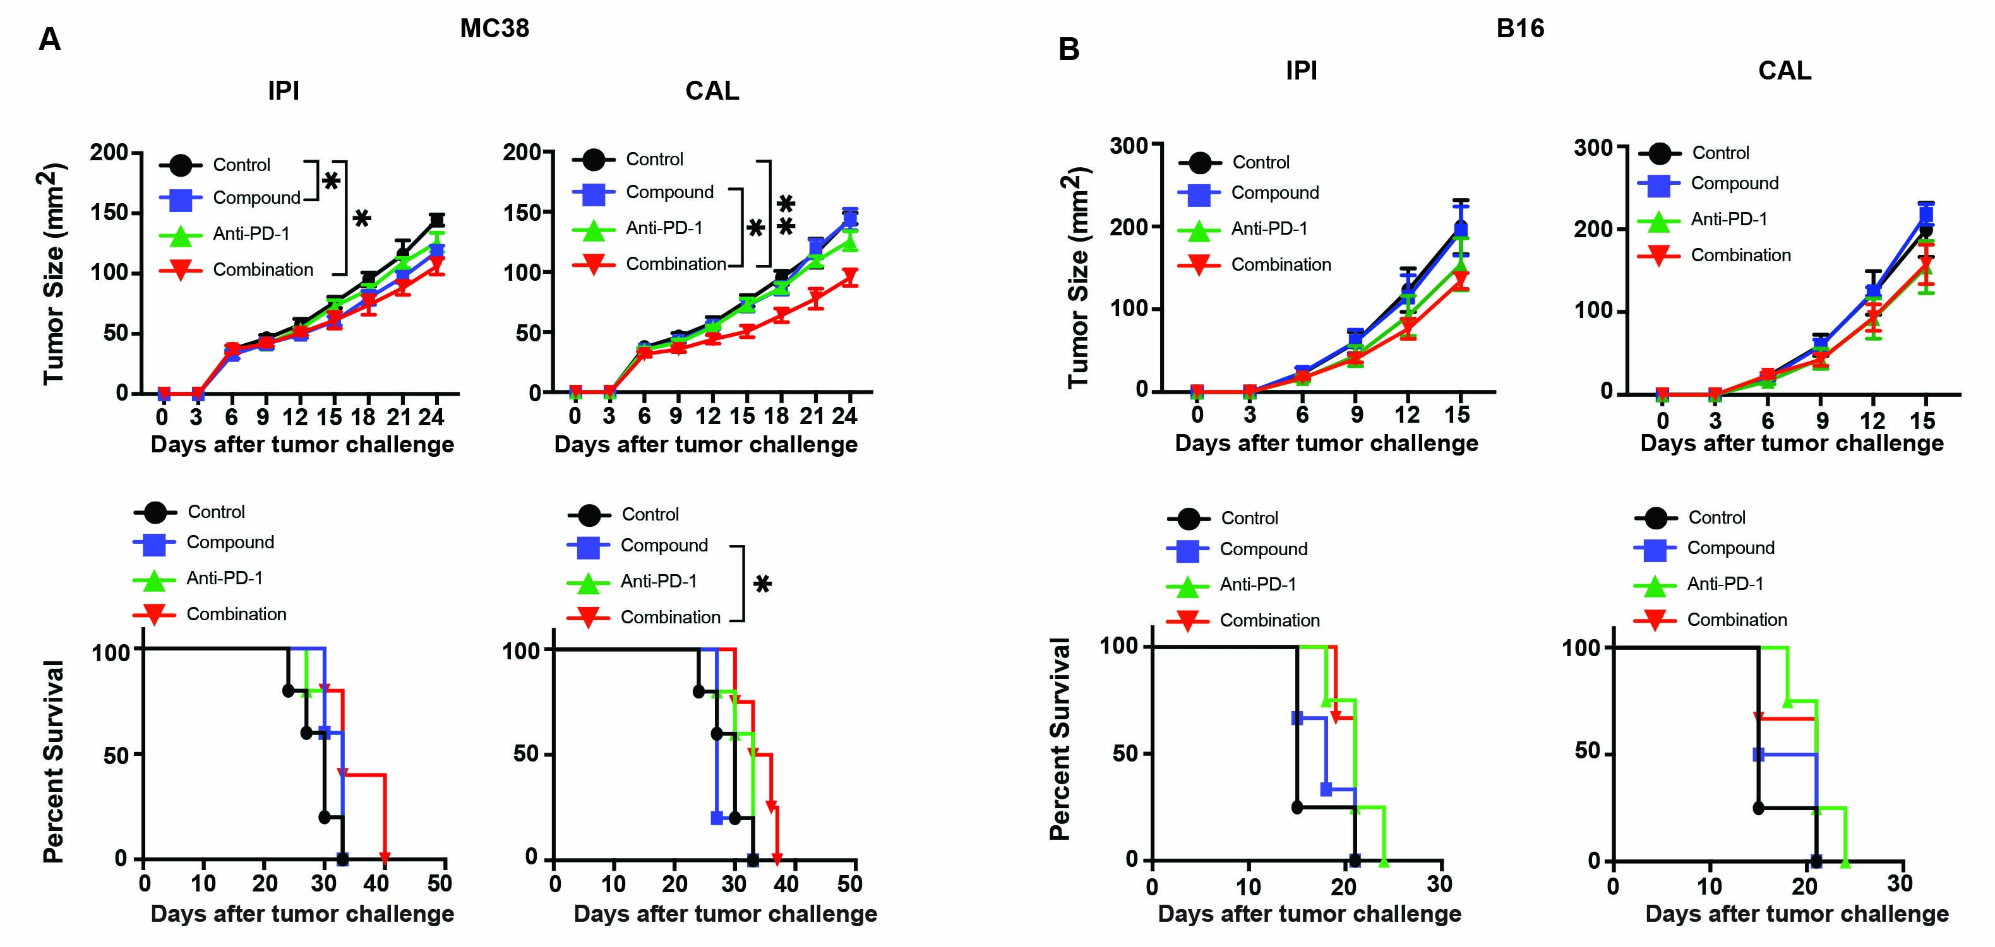
Supplementary Figure 10:

Slide 22
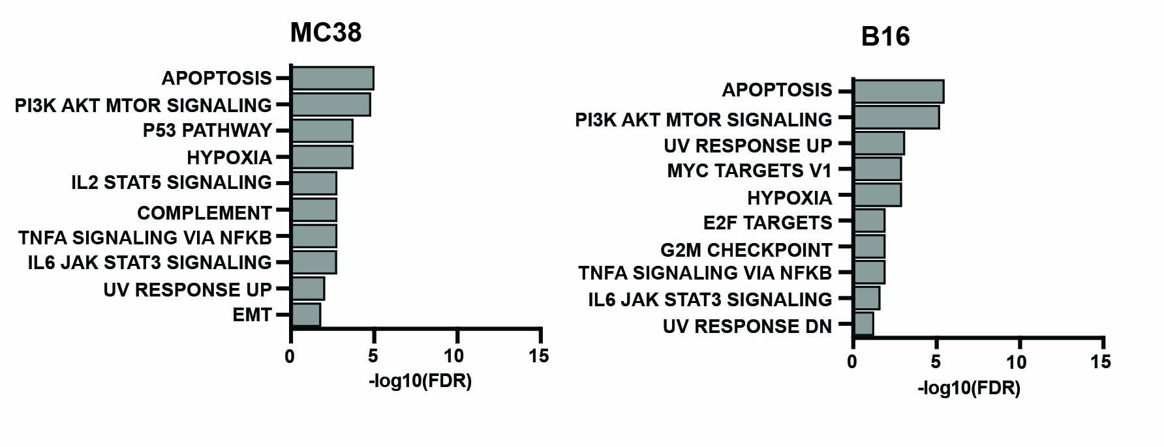
Supplementary Figure 11:

Slide 23
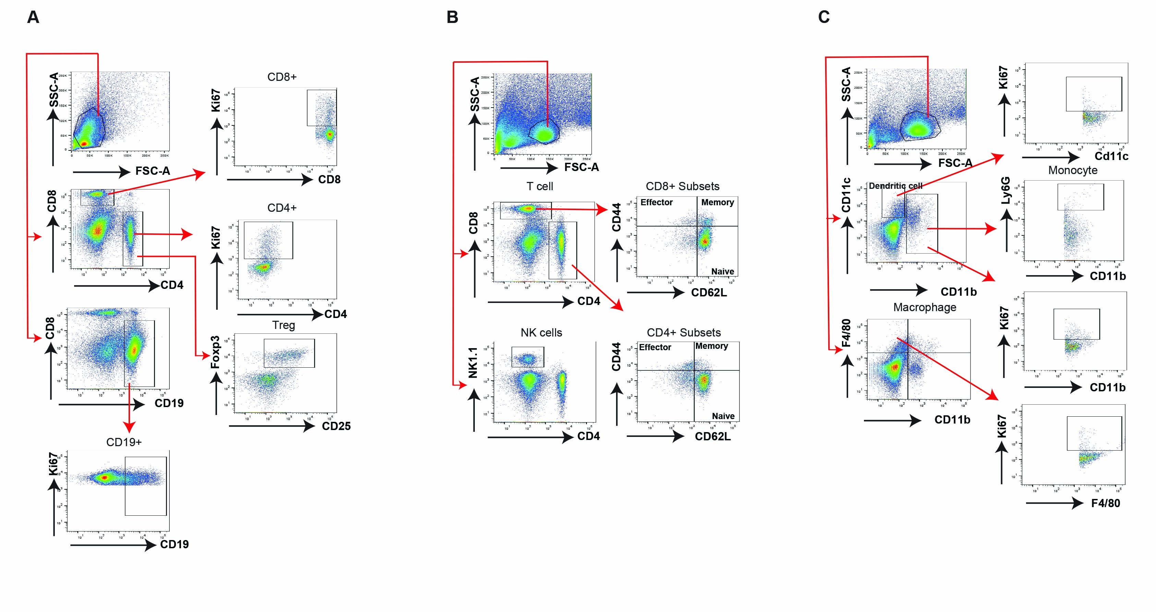
Supplementary Figure 12:
Supplementary Figure 12. Gating strategies for immune profiling. Gating strategies to evaluate the abundancy and proliferation of T and B cell subsets (A); Memory T cell subsets and NK subset (B) and monocytes and macrophages (C).

