Slide 1
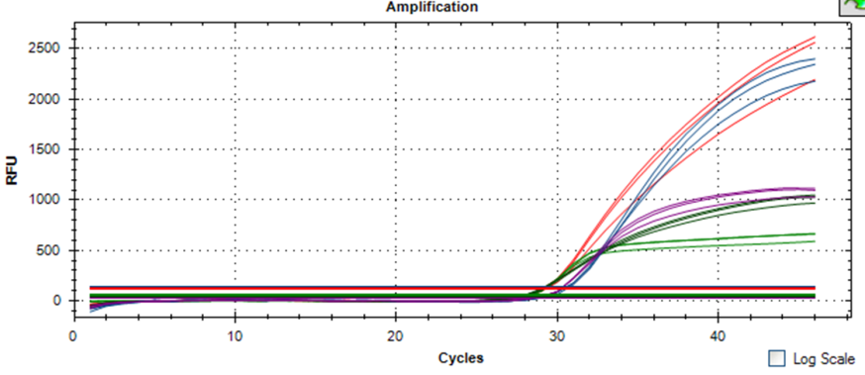
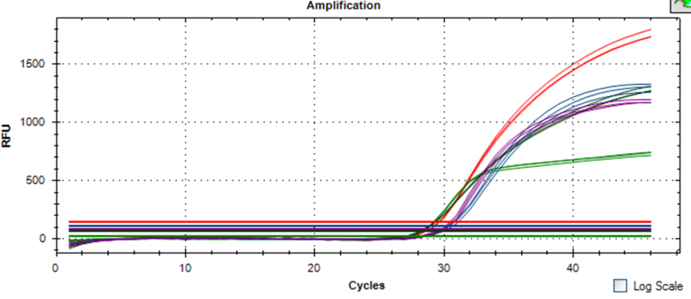
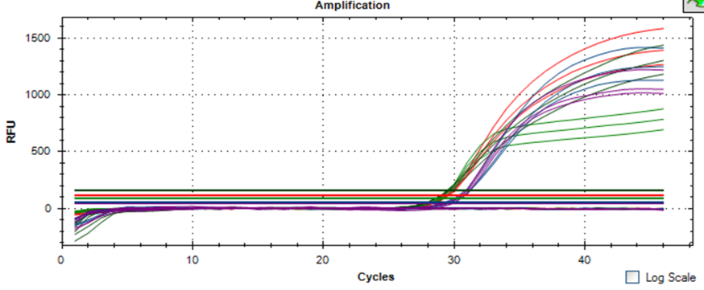
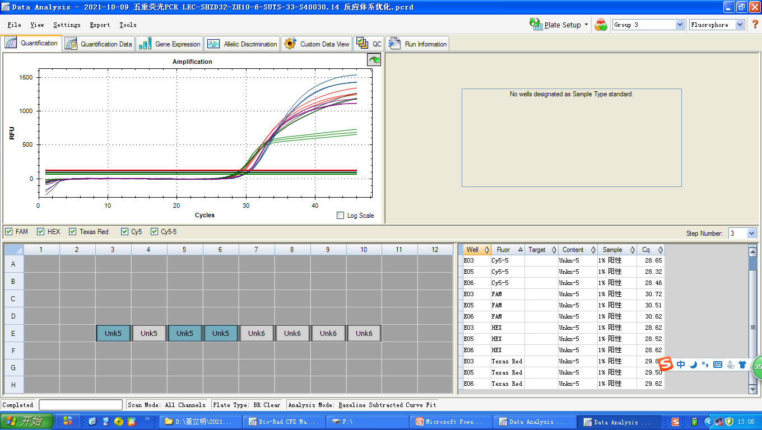
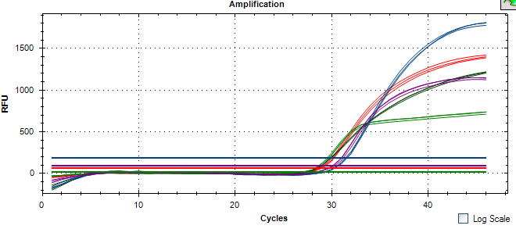
A
B
C
D
E
Fig. S1 The amplification results for primer concentration optimization
in the 5-plex qPCR assays.

Slide 2
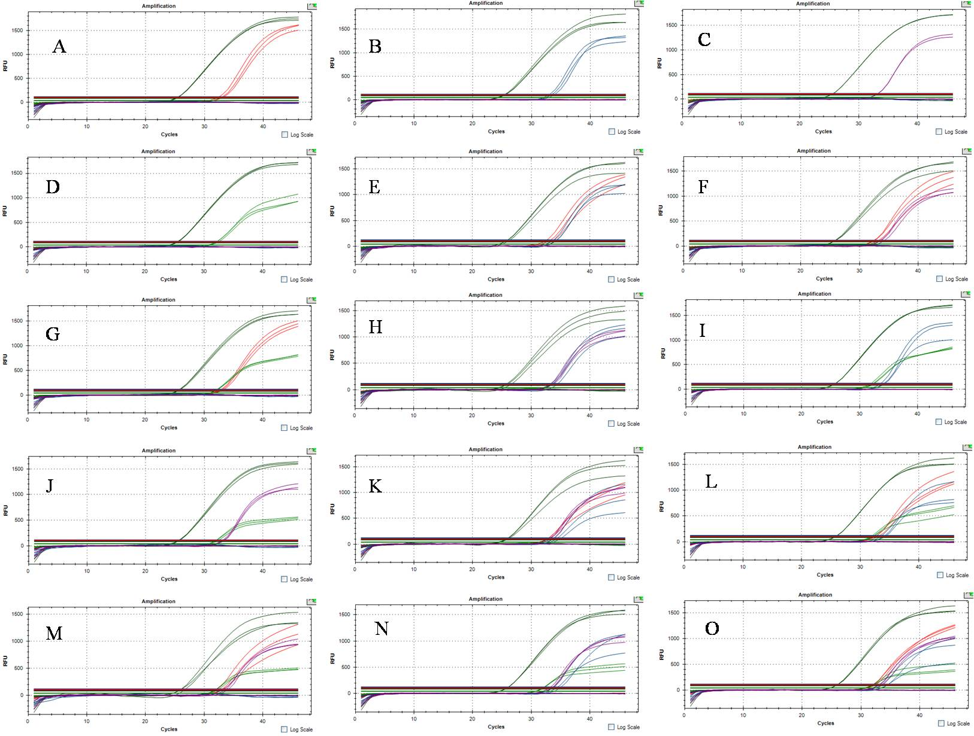
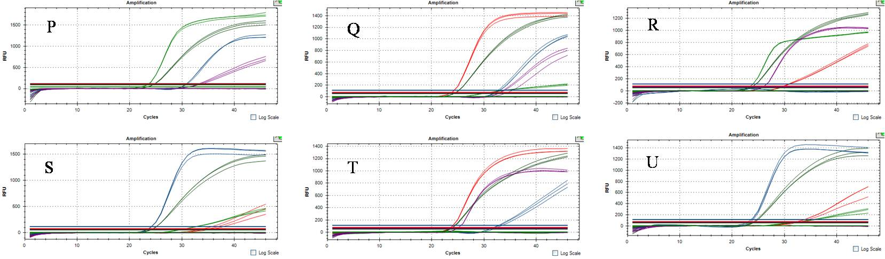
Fig. S2 The applicability of detecting specific-transgenic soybeans in various mixed samples

Slide 3
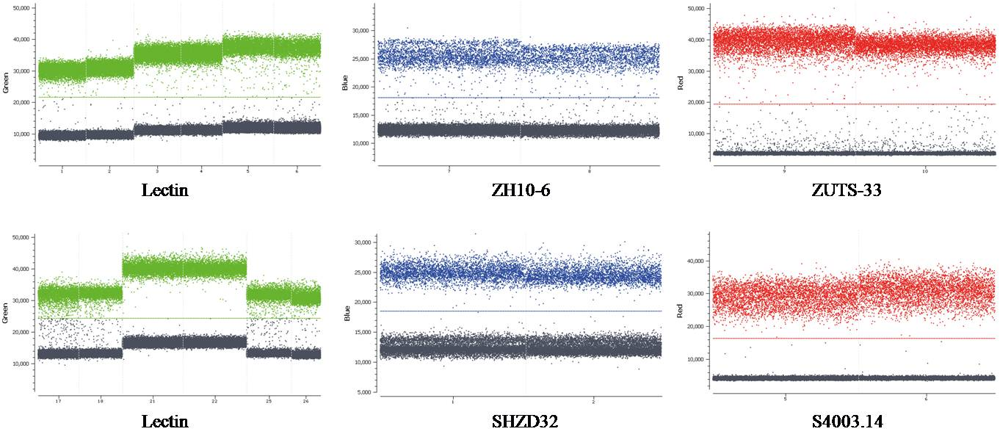
A
B
C
D
E
F
Fig. S3 cdPCR amplitude plots for target GM soybean cultivars.

