Slide 1
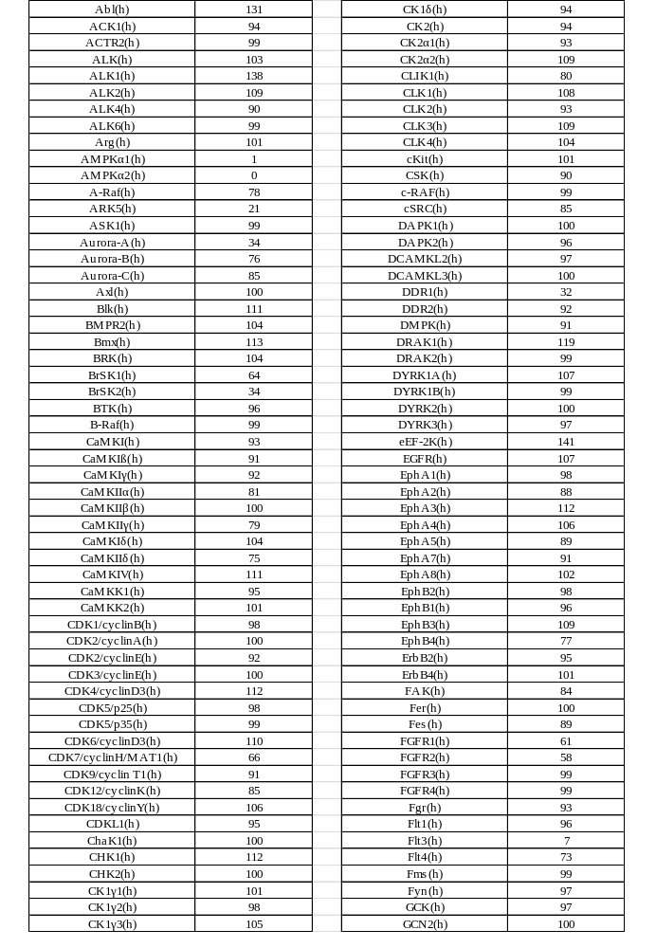

Slide 2
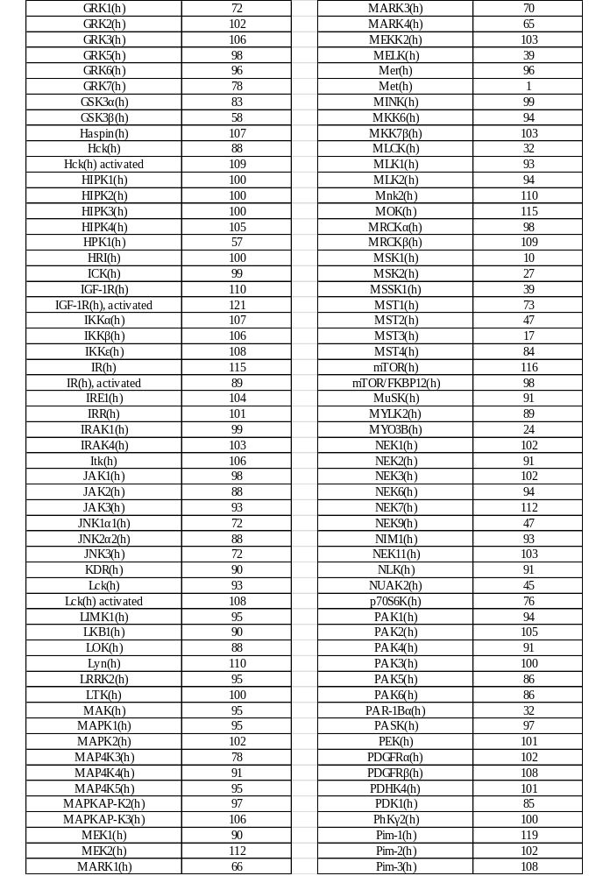

Slide 3
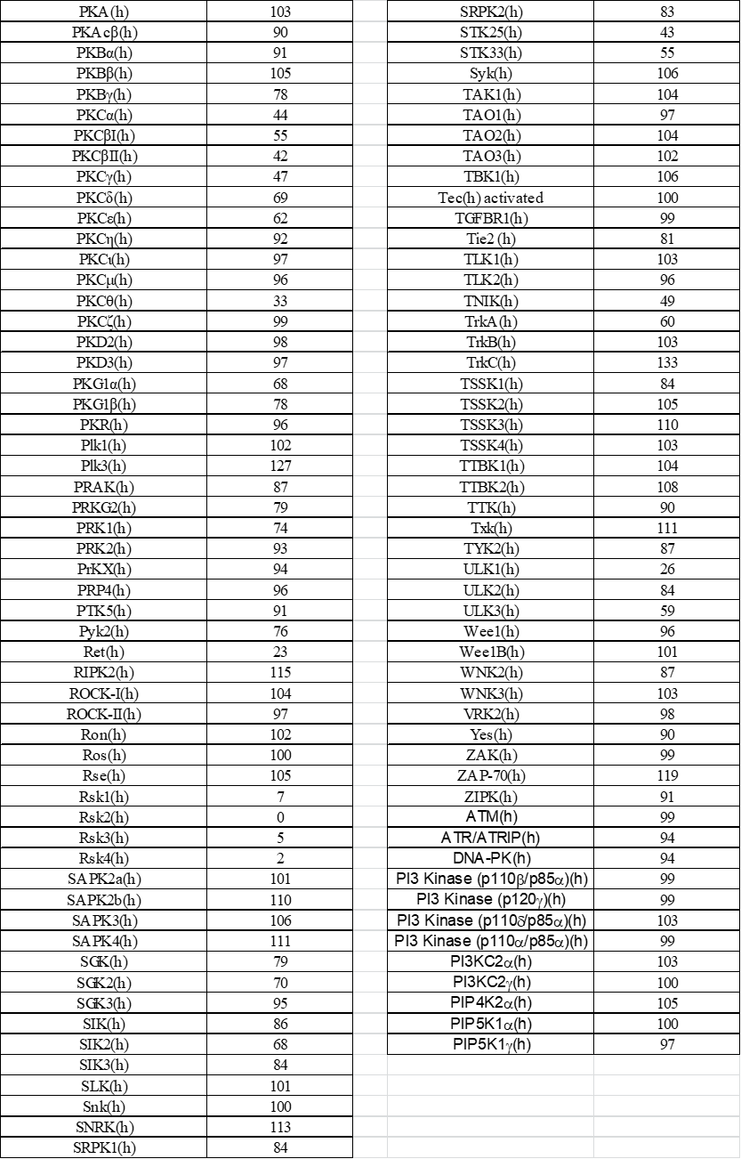
Table S1 Results of the kinase panel tested at 10 µM ATP concentration. Percentage activity compared to buffer control is given. (h): human.

Slide 4
Cell line Origin | Oci-Ly-7 B cell | Ramos B cell | REC-1 B cell | RAJI lympho-blast | SU-DHL-10 lymph node | Daudi lymphoma | L-363 plasma cell
Treatment duration (days) | 3 | 3 | 3 | 3 | 3 | 3 | 3
IC₅₀ (µM) | 12.2 | 12.1 | 3.3 | > 33.0 | 12.5 | 22.9 | 10.8
Cell line Origin | JJN-3 plasma cell | AMO-1 plasma-cytoma | SK-N-F-1 bone marrow | LP-1 multiple myeloma | OPM-2 multiple myeloma | SW780 bladder | U2-OS bone
Treatment duration (days) | 3 | 3 | 6 | 3 | 3 | 3 | 3
IC₅₀ (µM) | > 20.0 | > 33.0 | 21.2 | 1.9 | 1.5 | 10.3 | 18.7
Cell line Origin | IMR32 brain | U251 brain | IMR-5/75 neuroblastoma | MDA-MB-231 breast | MDA-MB-453 breast | HeLa cervix | Colo201 colon
Treatment duration (days) | 6 | 3 | 6 | 3 | 3 | 3 | 3
IC₅₀ (µM) | > 11.5 | 20.9 | 21.3 | > 30.0 | 14.6 | 25.7 | 16.0
Cell line Origin | Colo320 colon | LS174T colon | SW480 colon | Snu398 liver | A549 lung | NCI-H292 lung | NCI-H460 lung
Treatment duration (days) | 3 | 3 | 3 | 3 | 3 | 3 | 3
IC₅₀ (µM) | > 22.2 | > 30.0 | 27.8 | 7.3 | 25.8 | 17.1 | > 33.0
Cell line Origin | NCI-H520 lung | A2780 ovary | BxPC3 pancreas | PANC-1 pancreas | A375 skin | Snu16 stomach
Treatment duration (days) | 3 | 3 | 3 | 3 | 3 | 3
IC₅₀ (µM) | 24.1 | > 33.0 | 11.4 | 17.1 | 22.8 | 11.6
Table S2 Anti-proliferative activity of BAY-3827. Cancer cell viability was determined by CellTiter-Glo® after treatment with BAY-3827 for the indicated time. Mean IC₅₀ values are given.

Slide 5
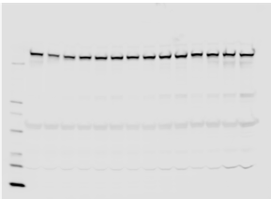
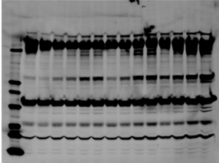
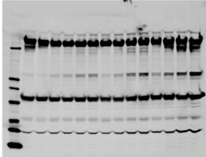
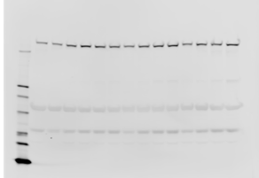
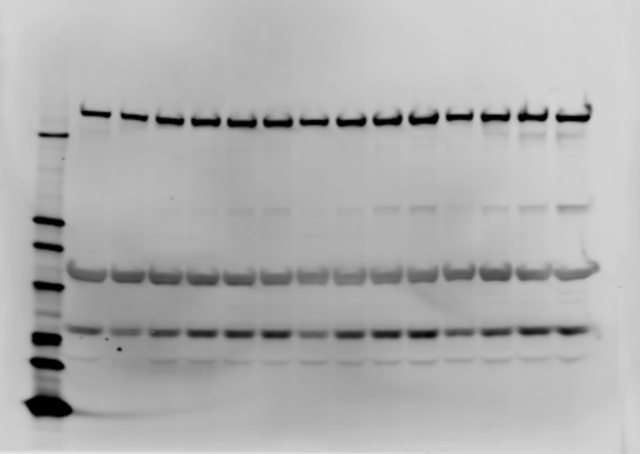
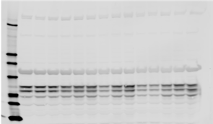
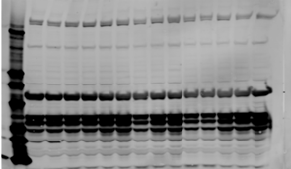
24 hours 72 hours 144 hours
24 hours 72 hours 144 hours
24 hours 72 hours 144 hours
0.1 nM R1881
0.1 nM R1881
0.1 nM R1881
0.1 nM R1881
0.1 nM R1881
0.1 nM R1881
0.1 nM R1881
0.1 nM R1881
0.1 nM R1881
10 nM R1881
10 nM R1881
10 nM R1881
10 nM R1881
10 nM R1881
10 nM R1881
10 nM R1881
10 nM R1881
10 nM R1881
1 nM R1881
0 nM R1881
1 nM R1881
0 nM R1881
1 nM R1881
1 nM R1881
0 nM R1881
1 nM R1881
0 nM R1881
1 nM R1881
1 nM R1881
0 nM R1881
1 nM R1881
0 nM R1881
0 nM R1881
1 nM R1881
0 nM R1881
0 nM R1881
+ cFCS
+ cFCS
+ cFCS
normal
normal
normal
ACC1 (280 kDa)
HSP90 (90 kDa)
AMPKα (62 kDa)
24 hours 72 hours 144 hours
24 hours 72 hours 144 hours
0.1 nM R1881
0.1 nM R1881
0.1 nM R1881
0.1 nM R1881
0.1 nM R1881
0.1 nM R1881
10 nM R1881
10 nM R1881
10 nM R1881
10 nM R1881
10 nM R1881
10 nM R1881
1 nM R1881
0 nM R1881
1 nM R1881
0 nM R1881
1 nM R1881
1 nM R1881
0 nM R1881
1 nM R1881
0 nM R1881
0 nM R1881
0 nM R1881
1 nM R1881
+ cFCS
+ cFCS
normal
normal
pACC1 (280 kDa)
HSP90 (90 kDa)
pAMPKα (62 kDa)
24 hours 72 hours 144 hours
24 hours 72 hours 144 hours
0.1 nM R1881
0.1 nM R1881
0.1 nM R1881
0.1 nM R1881
0.1 nM R1881
0.1 nM R1881
10 nM R1881
10 nM R1881
10 nM R1881
10 nM R1881
10 nM R1881
10 nM R1881
1 nM R1881
0 nM R1881
1 nM R1881
0 nM R1881
1 nM R1881
1 nM R1881
0 nM R1881
1 nM R1881
0 nM R1881
0 nM R1881
1 nM R1881
0 nM R1881
+ cFCS
+ cFCS
normal
normal
CaMKK2 (68 kDa)
HSP90 (90 kDa)
Figure S1 Western blot analysis of ACC1, AMPKa, CaMKK2 protein levels, and of ACC1 and AMPKa phosphorylation in LNCaP cells. HSP90 protein levels were determined as loading control.

Slide 6
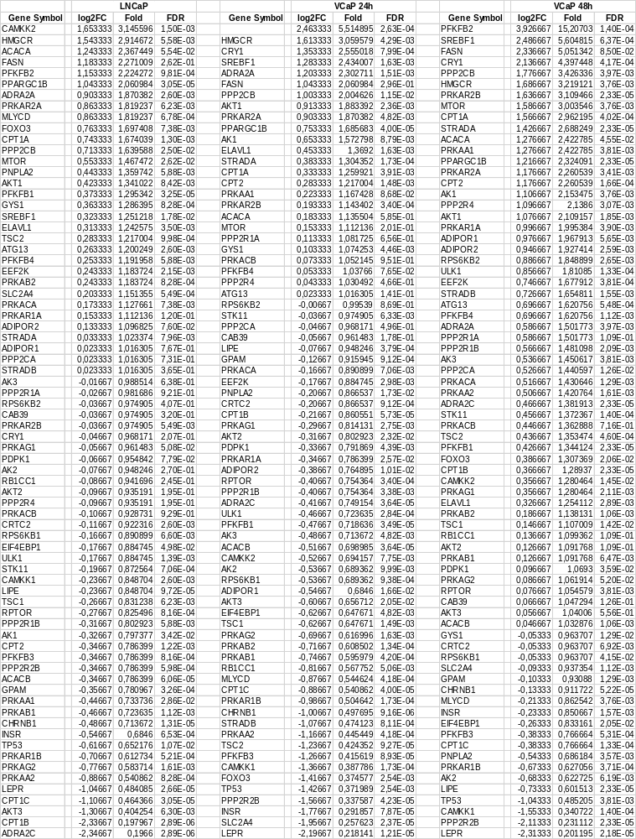
Table S3 Impact of androgen treatment on the expression of genes linked to AMPK signaling. RNA was extracted from LNCaP or VCaP cells treated with DMSO only or with 1 nM R1881, and analyzed using the AMPK signaling RT2 array.

Slide 7
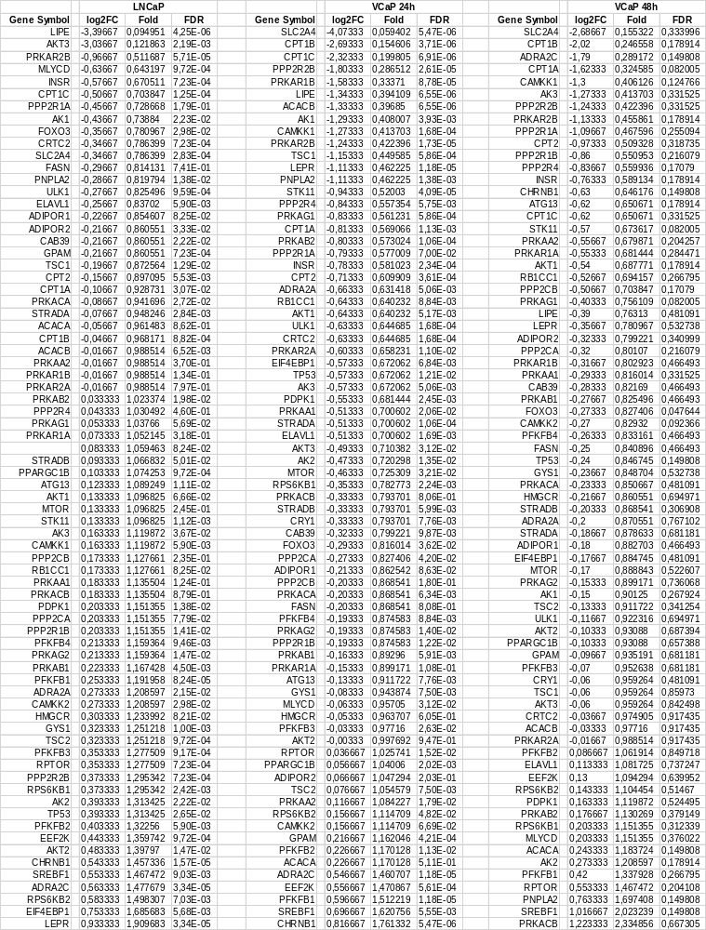
Table S4 Impact of BAY-3827 treatment on the expression of genes linked to AMPK signaling. RNA was extracted from LNCaP or VCaP cells grown in the presence of R1881 and treated with BAY-3827, and analyzed using the AMPK signaling RT² array.

Slide 8
A B C
LNCaP cells (24 hours) VCaP cells (24 hours) VCaP cells (48 hours)
log2FC R1881 + BAY-3827 effect
log2FC R1881 + BAY-3827 effect
log2FC R1881 + BAY-3827 effect
CPT1A
PRKAR2B
Correlation
R = 0.10
p = 0.4
Correlation
R = 0.29
p = 0.01
Correlation
R = 0.11
p = 0.3
log2FC R1881 effect
log2FC R1881 effect
log2FC R1881 effect
Figure S2 Scatter plot of log2 fold changes (log2FC) in gene expression comparing genes regulated by R1881 (x-axis) and by R1881 plus BAY-3827 (y-axis). A LNCaP cells treated for 24 hours. B VCaP cells treated for 24 hours. C VCaP cells treated for 48 hours.

