Slide 1
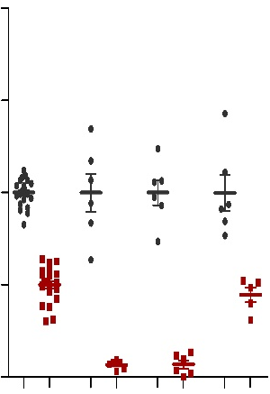
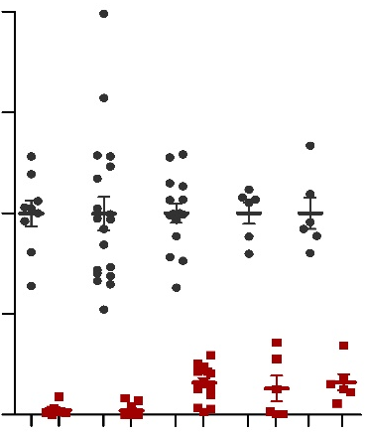
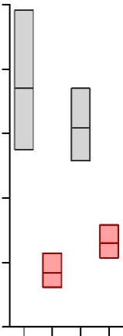
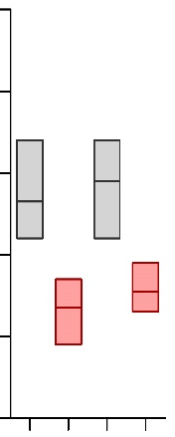
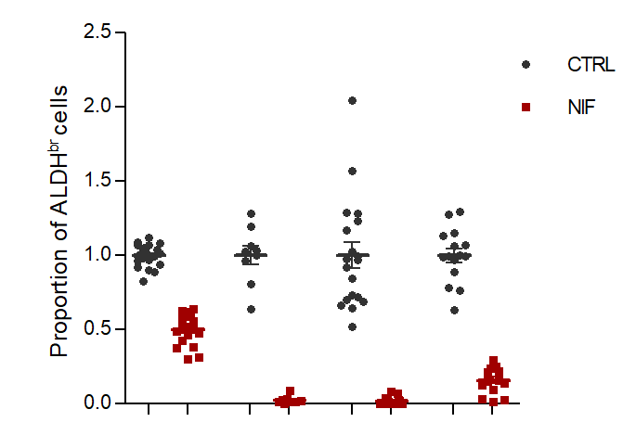
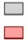
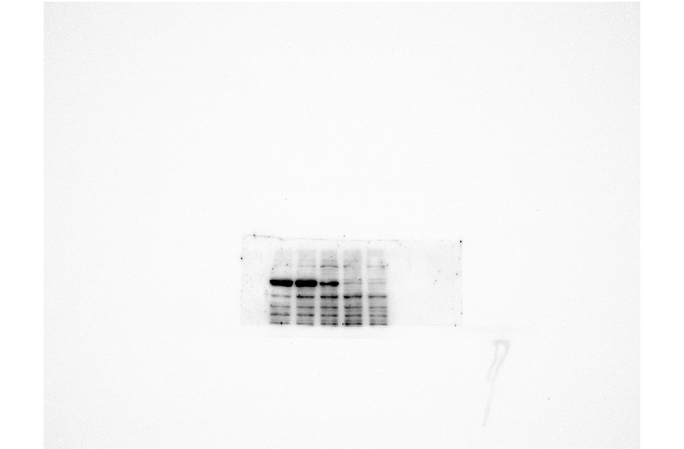
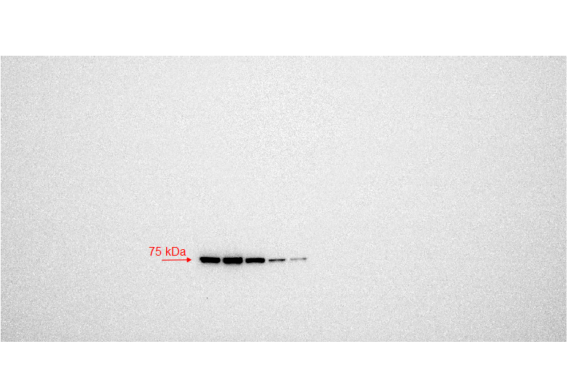
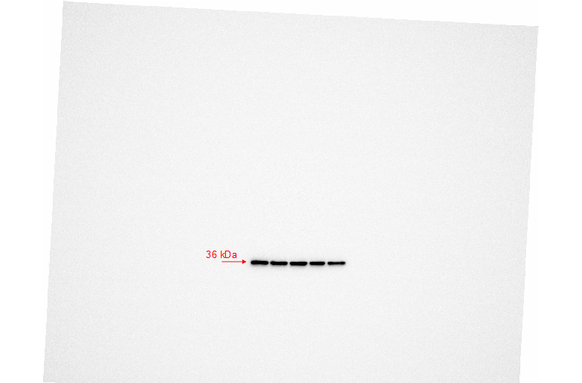
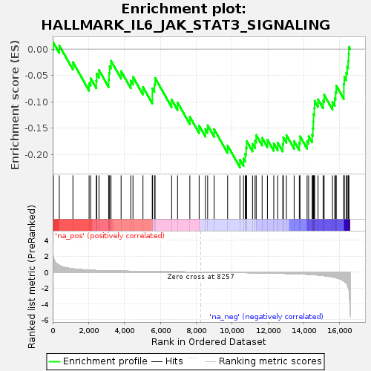
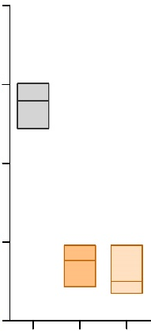
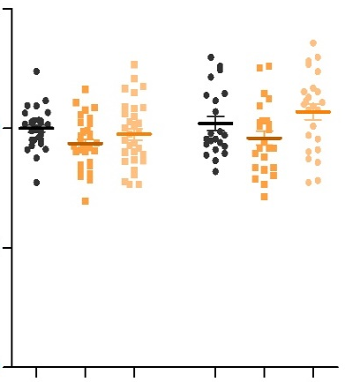
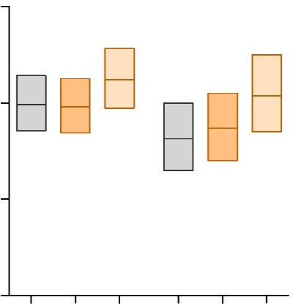
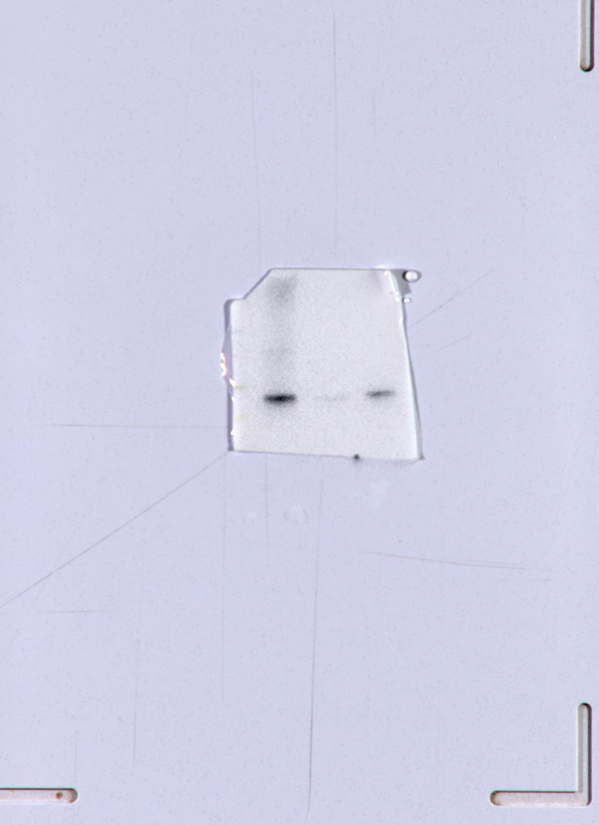
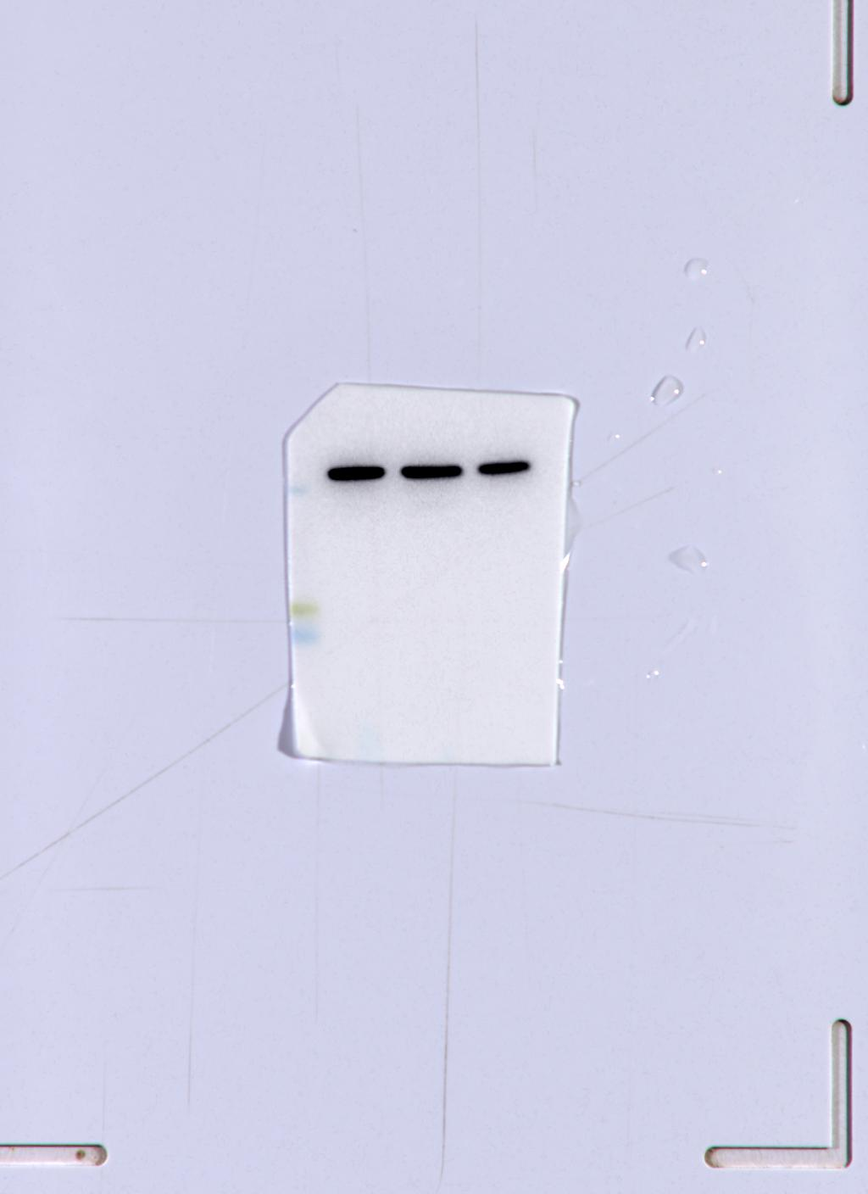
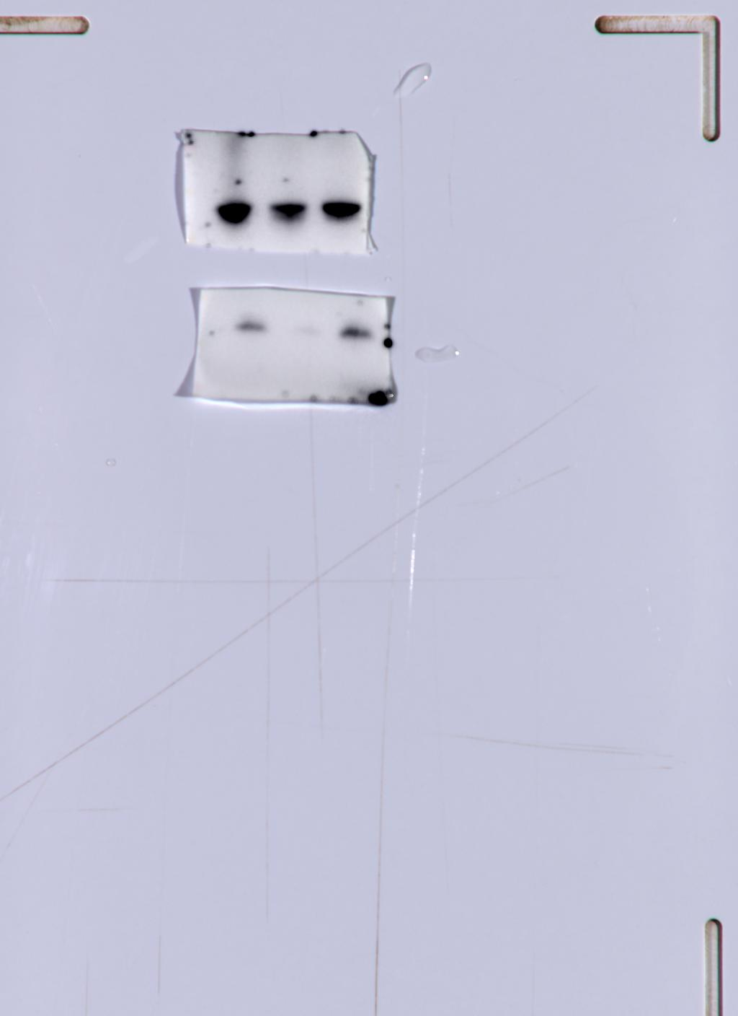
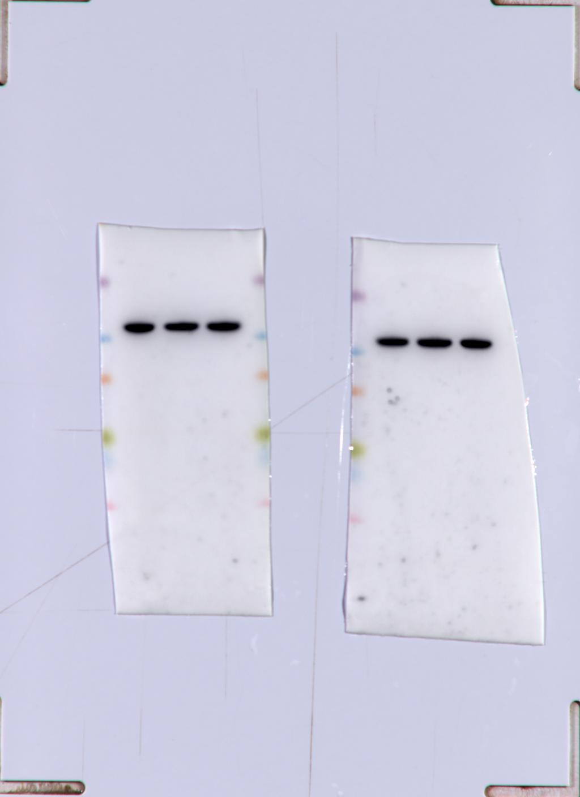

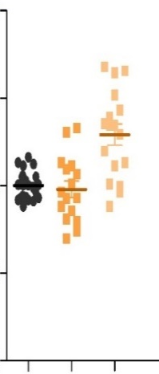
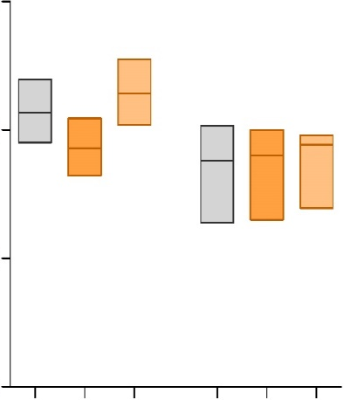
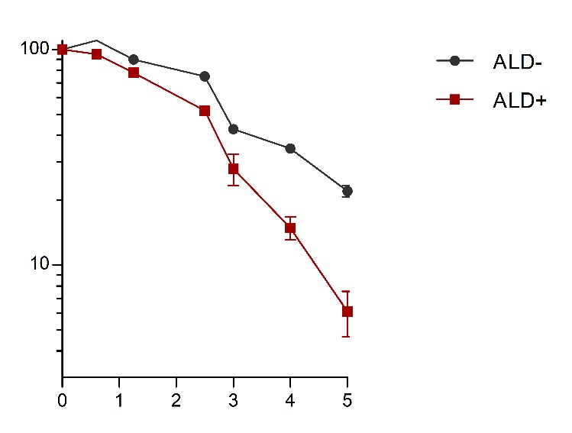
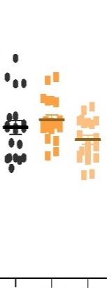
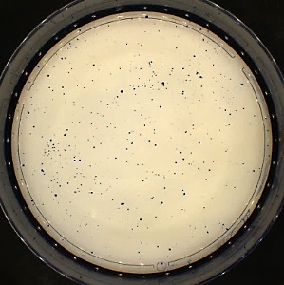
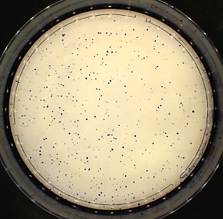
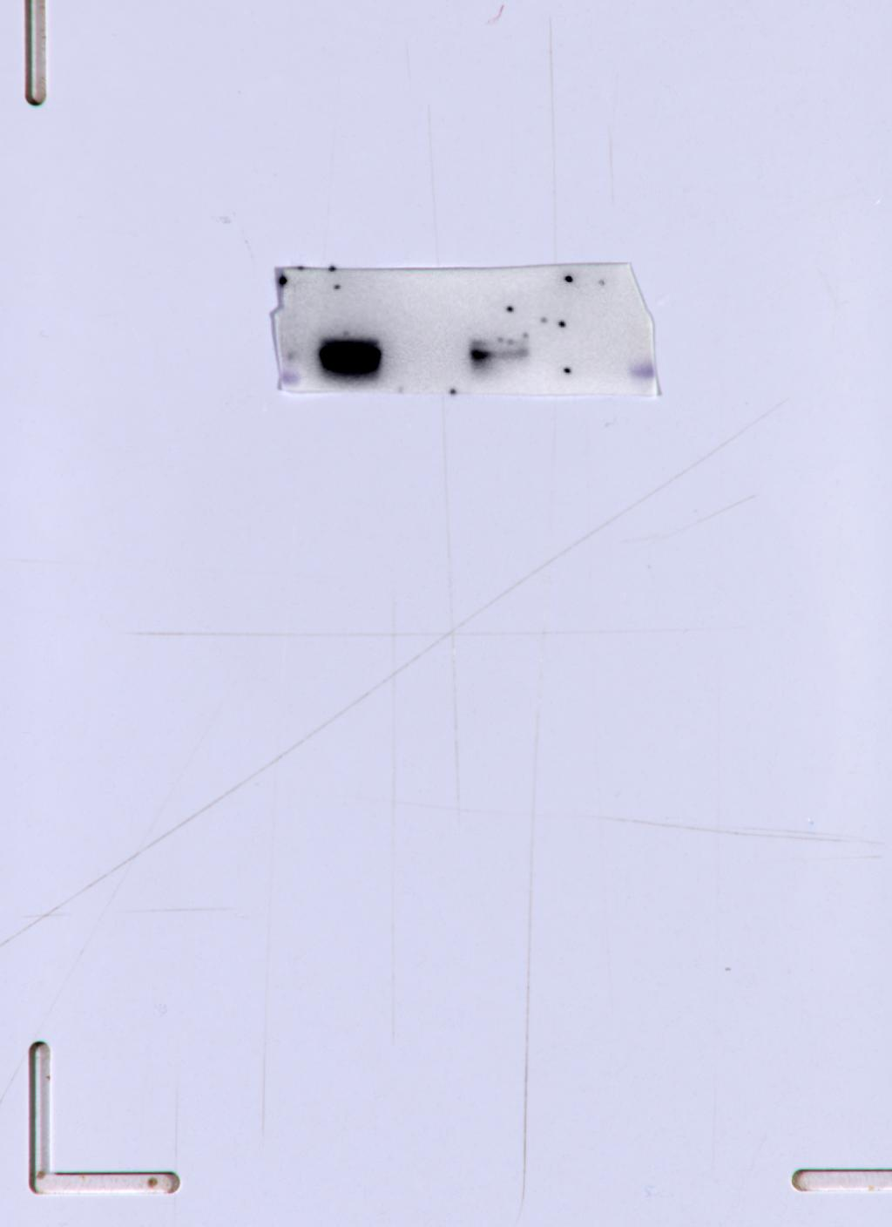
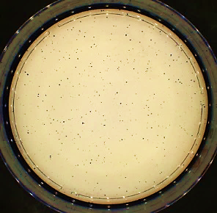
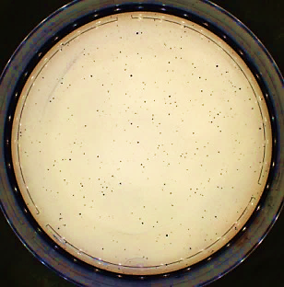
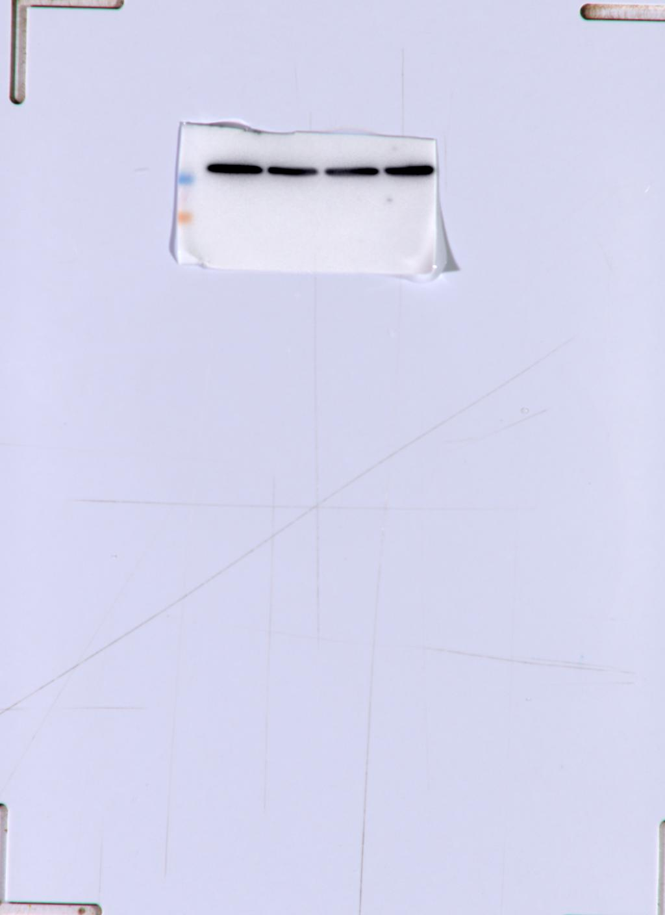
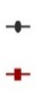
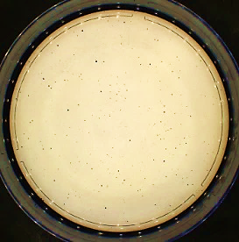
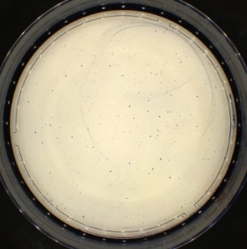
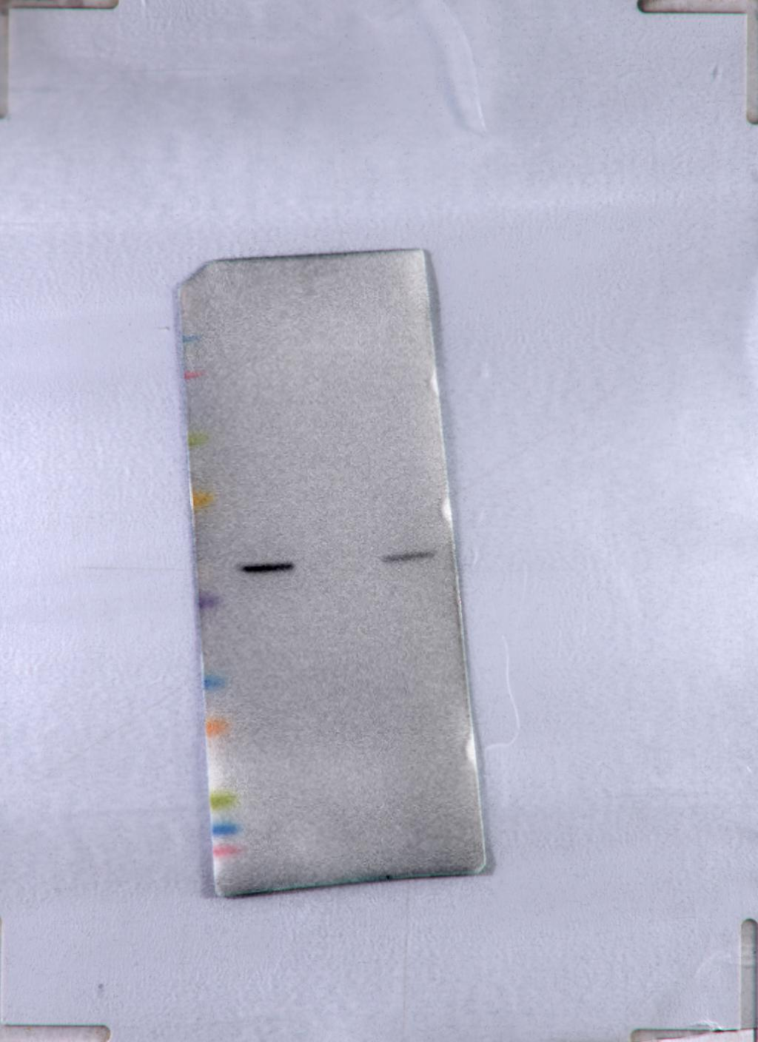
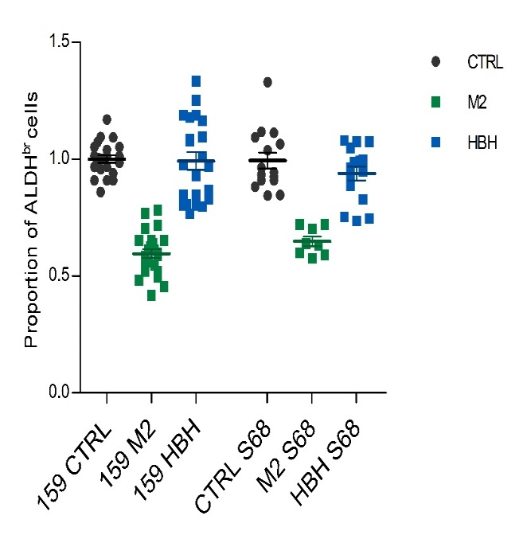
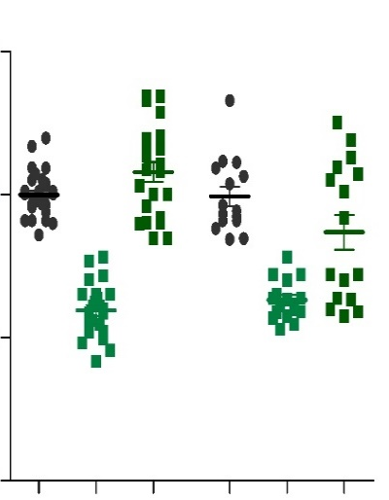
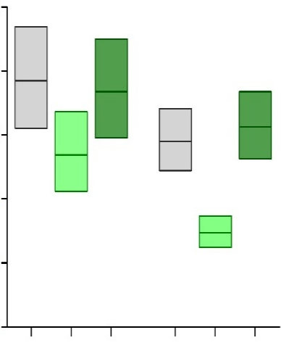
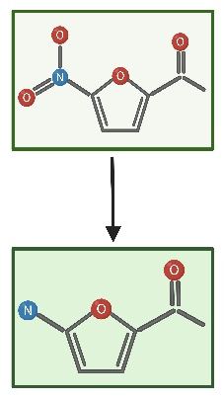
HT29
A
Breast
Colon
B
Breast
Colon
C
CTRL
NIF
2.0
***
25
***
CTRL
1.0
0.5
0.25
0.125
Proportion of ALDHbr cells
SFE
CTRL
NIF
NIF
p-STAT3
20
1.27
1.07
0.72
0.13
0.29
pSTAT3/STAT3
***
1
1.07
0.56
0.03
0.04
Total
1.5
***
***
***
***
***
***
***
***
1
1.28
0.99
0.28
0.12
STAT3
1.0
***
***
15
D
GAPDH
Enrichment score (ES)
STAT3 pathway
10
0.0
-0.05
0.5
5
-0.10
-0.15
NES=-2.208
q-value=0.00695
0.0
0
-0.20
SUM159
SW620
MKN45
PANC1
S68
SUM149
HT29
CRC1
S68
SUM149
HT29
CRC1
MDA-MB436
CTRL
NIF
E
F
SW620-KRAB
G
SUM159-KRAB
S68-KRAB
H
SUM159-KRAB
S68-KRAB
sgCTRL
sgSTAT3#2
40
1.5
ns
60
sgSTAT3#1
SFE
Proportion of ALDHbr cells
ns
ns
SFE
ns
SUM159-KRAB
STAT3
***
ns
ns
ns
1
0.02
0.45
GAPDH
30
***
1.0
40
ns
S68-KRAB
1
0.04
0.5
STAT3
20
SW620-KRAB
GAPDH
10
0.5
20
1
0.008
0.01
STAT3
0
0.0
0.0
Actin
sgCTRL
sgSTAT3#2
sgSTAT3#1
sgSTAT3#1
sgCTRL
sgSTAT3#2
sgSTAT3#2
sgSTAT3#1
sgSTAT3#1
sgCTRL
sgSTAT3#2
sgSTAT3#2
sgCTRL
sgSTAT3#1
sgCTRL
I
SUM159
S68
J
SUM159
S68
K
100
S68
L
2.0
60
Survival (%)
Proportion of ALDHbr cells
SFE
ALDHneg
ALDHbr
sgEmpty
ns
ns
0µM NIF
SUM159-KRAB
sgALDH1A1
ns
ns
ns
ALDH1A1
1.5
ns
ns
40
ns
1
0.03
***
GAPDH
1.0
2.5µM NIF
sgALDH1A1
20
10
S68-KRAB
sgEmpty
ALDH1A1
0.5
ALDHneg
5µM NIF
1
0.006
ALDHbr
GAPDH
0
0
0
1
2
3
4
5
CTRL
STAT3i
JAK2i
CTRL
JAK2i
CTRL
STAT3i
JAK2i
CTRL
STAT3i
JAK2i
STAT3i
[NIF]µM
M
SUM159
S68
N
O
SUM159
S68
P
SUM159
S68
1.5
1.5
50
ns
Proportion of ALDHbr cells
***
Proportion of ALDHbr cells
***
SFE
*
***
***
40
ns
1.0
M2
1.0
30
***
0.5
0.5
20
M7
10
0.0
0.0
0
CTRL
M2
M7
CTRL
CTRL
M2
HBH
CTRL
M2
HBH
CTRL
M2
M7
CTRL
M2
M7
M2
M7
Supplementary figure 1

Slide 2
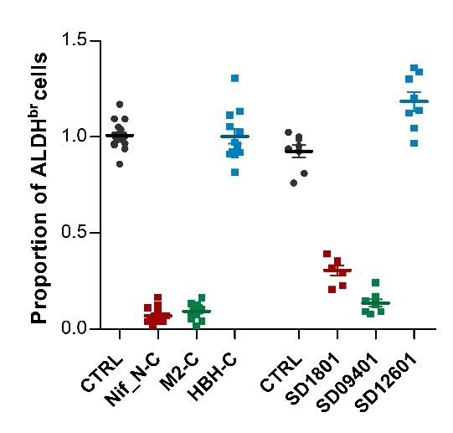
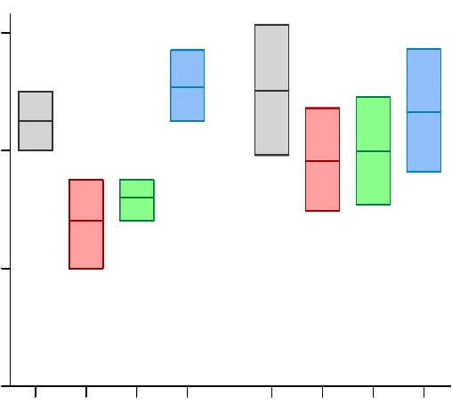
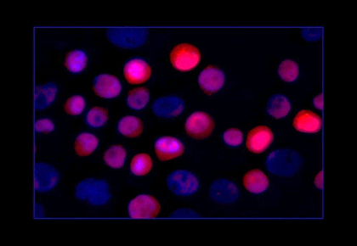
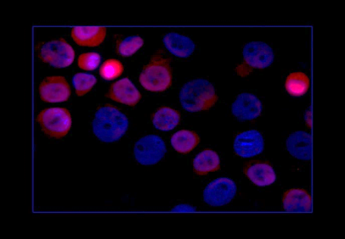
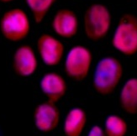
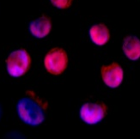
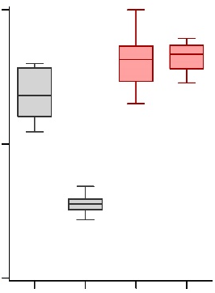
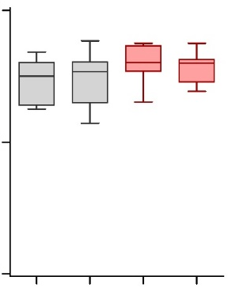
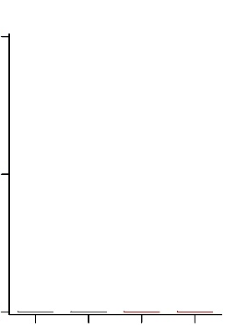
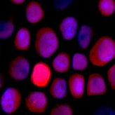
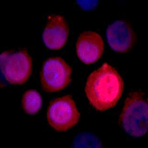
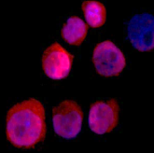
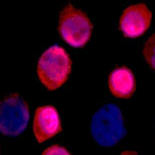
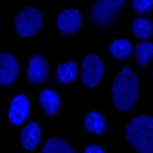
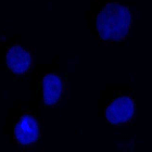











A
SUM159
S68
B
SUM159
S68
Proportion of ALDHbr cells
***
1.5
SFE
***
***
60
***
***
***
***
1.0
***
40
0.5
20
0.0
CTRL
M2-C
0
CTRL
NIF-C
M2-C
HBH-C
CTRL
NIF-C
M2-C
HBH-C
CTRL
M2-C
HBH-C
C
NIF-C
HBH-C
NIF-C
ALDHneg
ALDHbr
NIF-C
6h
72h
6h
72h
NIF-C
M2-C
HBH-C
100
ns
ns
ns
% of positive cells
***
M2-C
50
HBH-C
0
6h
72h
6h
72h
6h
72h
6h
72h
6h
72h
6h
72h
DAPI Clickable derivatives
ALDHneg
ALDHbr
ALDHneg
ALDHbr
ALDHneg
ALDHbr
D
SUM159
S68
CTRL
100
SUM159
S68
% of positive cells
***
***
30min
80
***
***
60
40
20
6h
0
DAPI HBH-C
CTRL
30min
6h
CTRL
30min
6h
Supplementary figure 2
Notes:
SUP2
Scal barre 3,5µM

Slide 3


















A
ALDHneg
ALDHbr
B
SUM159
40
S68
CTRL
80
ꙋH2AX positive cells (%)
ns
ꙋH2AX positive cells (%)
ns
ns
ns
ns
60
ns
30
ns
ns
40
20
NIF
20
10
0
0
CTRL
STAT3i
JAK2i
CTRL
CTRL
STAT3i
JAK2i
CTRL
STAT3i
JAK2i
ALDHneg
STAT3i
JAK2i
ALDHneg
ALDHbr
ALDHbr
C
S68
D
S68
M2
Cell cycle distribution
**
40
100
G2/M
% of polyploid cells
**
80
S
30
G0/G1
60
20
HBH
40
10
20
0
0
CTRL
NIF
CTRL
NIF
CTRL
NIF
CTRL
NIF
DAPI ɣH2AX
ALDHneg
ALDHbr
ALDHneg
ALDHbr
60
S68
E
G2/M cell cycle
ꙋH2AX positive cells (%)
**
**
Enrichement score (ES)
**
0.00
40
ns
0.10
0.20
20
0.30
NES=-6.23
q-value=0
0.40
0
CTRL
NIF
M2
HBH
CTRL
NIF
M2
HBH
CTRL
NIF
ALDHneg
ALDHbr
F
CTRL
Melphalan
NIF
G
S68
ALDHneg
2.0
Tail moment
***
1.5
***
***
ALDHbr
1.0
0.5
0
CTRL
Melphalan
NIF
CTRL
Melphalan
NIF
ALDHneg
ALDHbr
Supplementary figure 3
Notes:
Sup3
Scal bar comet 103µm
Scal bar gH2AX 15µm

Slide 4






















A
SUM159
B
C
-3000
-2000
-1000
TSS
+1000
Bits
STAT3 motif
FANCM
shFANCD2#1
FANCD2
shCTRL
1
FANCA
FANCB
GAPDH
1
0.09
FANCF
0
1
2
3
4
5
6
7
8
10
FANCD2
9
11
12
13
FANCI
E-Value 4.5e-20
STAT3 motif
shSTAT3+
shFANCD2#1
D
E
shCTRL
shSTAT3
shSTAT3+
shFANCD2#2
FANCD2
SUM159
1
1.30
0.07
0.03
STAT3
1
0.43
0.2
0.26
GAPDH
S68
FANCD2
1
1.97
0.74
0.24
STAT3
1
0.36
0.18
0.42
GAPDH
F
SUM159
S68
G
H
100
SUM159
S68
100
Survival (%)
100
Survival (%)
***
***
SUM159
shCTRL
shSTAT1
Survival (%)
***
***
STAT1
1
0.03
ns
GAPDH
***
shCTRL
shCTRL
10
shCTRL
shCTRL
S68
STAT1
10
shFANCD2#1
shFANCD2#1
shSTAT3
shSTAT3
shFANCD2#2
shFANCD2#2
shFANCD2#2
shFANCD2#2
1
0.15
shSTAT3
shSTAT3
shSTAT3+shFANCD2#2
shSTAT3+shFANCD2#2
GAPDH
0
shSTAT1
10
shSTAT1
0
0.5
1.0
1.5
2.0
0.5
1.0
1.5
2.0
[Melphalan]µM
0
0.5
1.0
1.5
2.0
[Melphalan]µM
0.0
0.5
1.0
1.5
2.0
2.5
[Melphalan]µM
[Melphalan]µM
Supplementary figure 4
Notes:
SUP4

Slide 5





















A
B
S68 (HRP)
C
S68 (HRP)
D
S68 (HRP)
100
50
100
0µM
2,5µM
5µM
100
SFE
***
Survival (%)
SUM159
Survival (%)
Survival (%)
***
*
40
10
S68
10
**
30
ALDHneg
20
***
SUM159 (HRP)
ALDHbr
1
S68 (HRP)
SUM149
ALDHneg
1
ALDHneg PARPi
10
0
1
SUM149(HRD)
10
ALDHbr
ALDHbr PARPi
0
2
3
4
5
0
1
2
3
4
5
0
1
2
3
4
5
CTRL
PARPi
NIF
[PARPi]µM
[PARPi]µM
[NIF]µM
PARPi+NIF
E
SUM159-KRAB (HRP)
S68-KRAB (HRP)
F
SUM159-KRAB (HRP)
S68-KRAB (HRP)
Survival (%)
Survival (%)
80
100
100
SFE
***
60
***
***
63.0
***
**
40
**
sgCTRL
39.8
sgCTRL
sgSTAT3#1
25.1
sgSTAT3#1
20
10
sgSTAT3#2
sgSTAT3#2
0
0
1
2
3
4
5
0
1
2
3
4
5
CTRL
PARPi
CTRL
PARPi
CTRL
PARPi
CTRL
PARPi
CTRL
PARPi
CTRL
PARPi
[PARPi]µM
[PARPi]µM
sgCTRL
sgSTAT3#1
sgSTAT3#2
sgCTRL
sgSTAT3#1
sgSTAT3#2
Supplementary figure 5
Notes:
SUP 5
Scal bar SUM159 149 2,5cm S68 1,25cm

Slide 6






A
B
CRCM434
C
CRCM494
100
100
Tumor-free survival
Tumor-free survival
80
80
60
60
40
40
CTRL
CTRL
ns
*
20
PARPi
*
20
PARPi
ns
NIF
*
NIF
***
0
PARPi+NIF
0
PARPi+NIF
40
60
80
100
120
20
40
60
80
100
Days after re-implantation
Days after re-implantation
D
Pandora21
E
Pandora7
100
100
Tumor-free survival
Tumor-free survival
80
80
60
60
40
CTRL
40
CTRL
ns
*
*
20
PARPi
***
20
PARPi
ns
NIF
NIF
***
0
PARPi+NIF
0
60
70
80
90
PARPi+NIF
40
60
80
100
120
Days after re-implantation
Days after re-implantation
Supplementary figure 6

