Slide 1
Supplemental Information
Title: Silver nanoparticles reduce ACE2 expression via changing mitochondrial function in human fibroblast-like lung cell and periodontal ligament fibroblast cells.
Journal: Mol Biol Rep
Authors: Shosei Takahashi, Kazuo Tomita, Kento Igarashi, Yoshikazu Kuwahara, Junichi Kitanaka, Nobue Kitanaka, Koh-ichi Tanaka, Akihiro Kurimasa, Yoshiaki Kamikawa, Tomoaki Sato
Corresponding author:
Kazuo Tomita
Tomoaki Sato
Department of Applied Pharmacology
Kagoshima University Graduate School of Medical and Dental Science
8-35-1 Sakuragaoka
Kagoshima City, 890-8544, Japan
Phone No: +81 99 275 6162
Fax No: +81 99 275 6162
Email Address: ktomita@dent.kagoshima-u.ac.jp
tomsato@dent.kagoshima-u.ac.jp

Slide 2
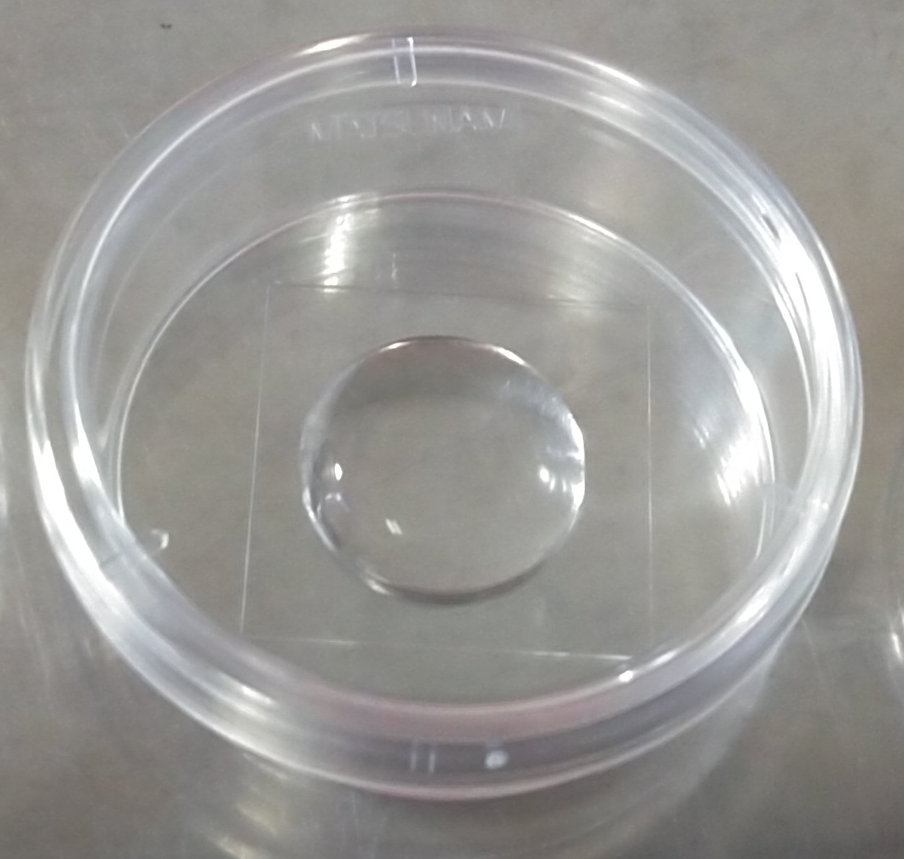
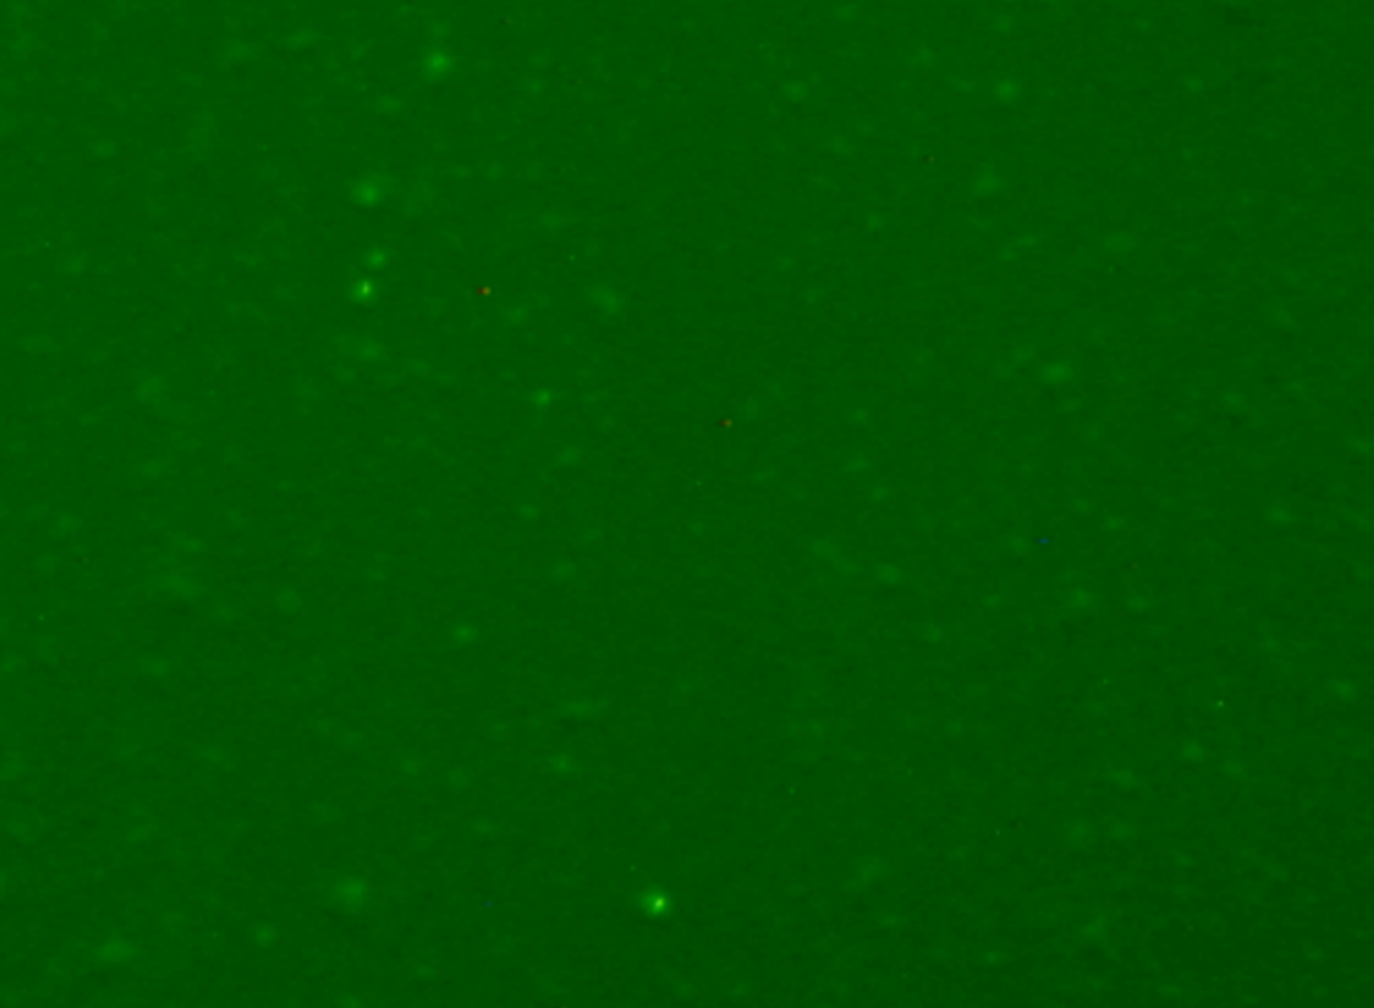

a
b
c
50 µm
50 µm
Supplemental Fig. 1 Detection of AgNP by Scattered Light Imaging method.
a: AgNP and acrylamide were mixed and polymerized and solidified on glass-bottomed dish. b: When this gel was observed with BZ-8000, green dots were observed (white arrowhead). c: When we do not mixed AgNP in acrylamide, the dots could not observe as the same condition.

