Slide 1
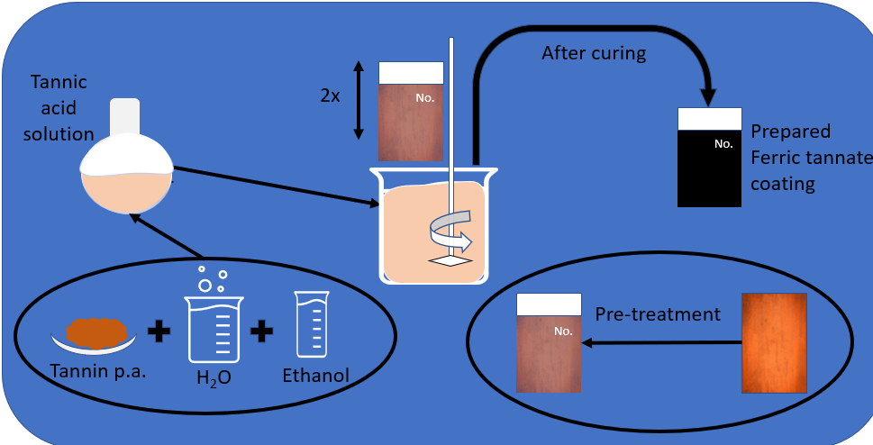
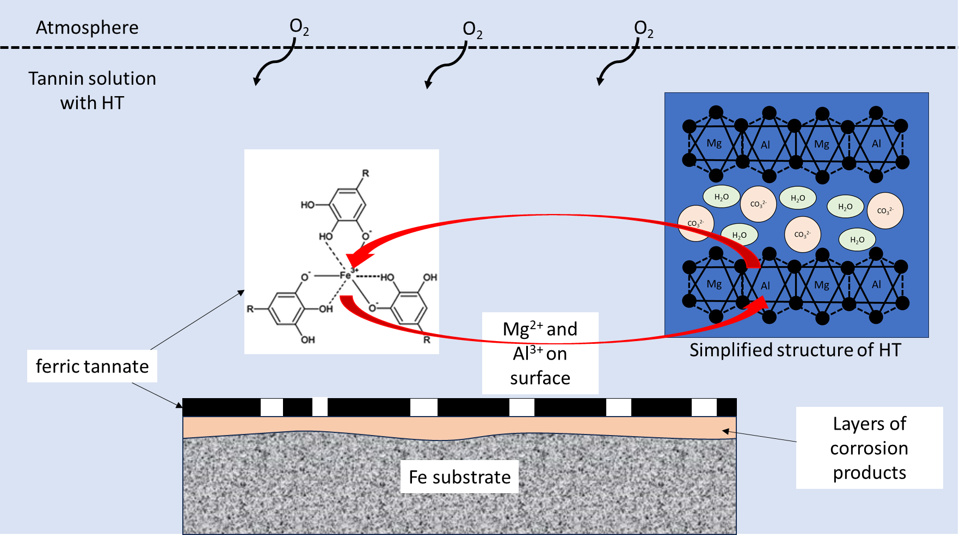
Coating preparation
Protection mechanism of coating
MgAlCO₃- HT

