Slide 1
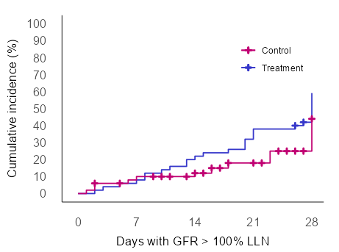
Phase 2 Trial of INM004 in STEC-HUS
AIM: To assess the safety, pharmacokinetics, and efficacy of INM004 in pediatric patients with STEC-HUS.
Safety
DESIGN & OUTCOMES:
Treatment
Arm N=57
Safety population N=57
Well tolerated;
no serious related
adverse events
INM004
+
standard of care
Efficacy
Historical Controls N=125
Trends favoring the treatment arm:
Less dialysis requirement;
shorter Time to eGFR normalization
Matched population N=52 per arm
Standard of care
Open-label, controlled, phase 2 clinical trial assessing the safety, efficacy, and pharmacokinetics of INM004 in pediatric patients with Shiga toxin-producing Escherichia coli-associated hemolytic uremic syndrome
Alicia Fayad et al. 2024
CONCLUSION: INM004 showed an adequate safety profile. Efficacy trends suggest a beneficial effect in the amelioration of kidney injury These results encourage the conduction of a Phase 3 study of INM004.

