Slide 1
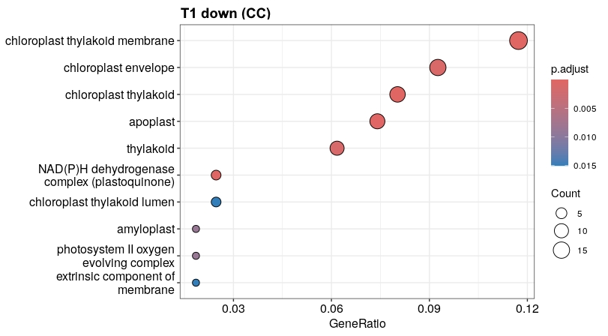
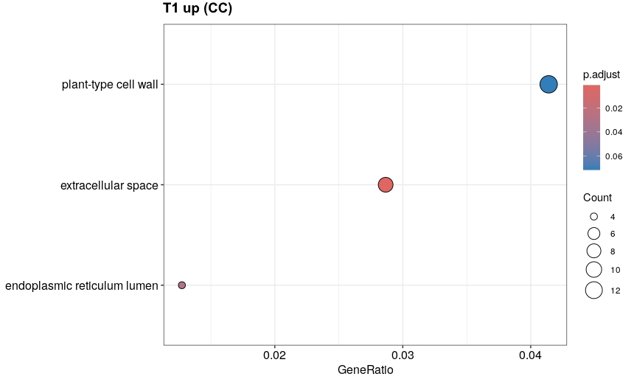
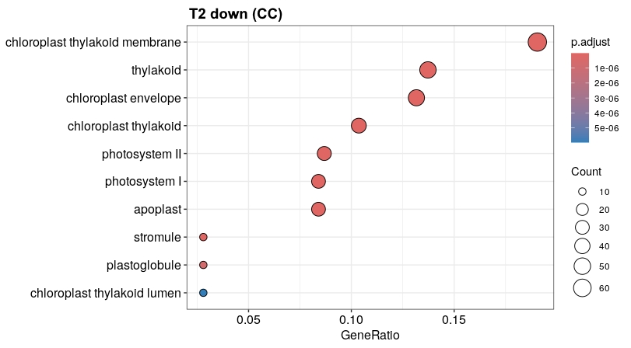
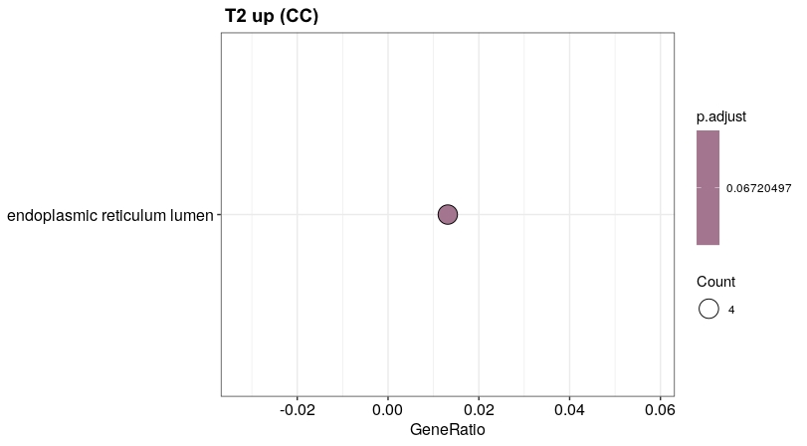
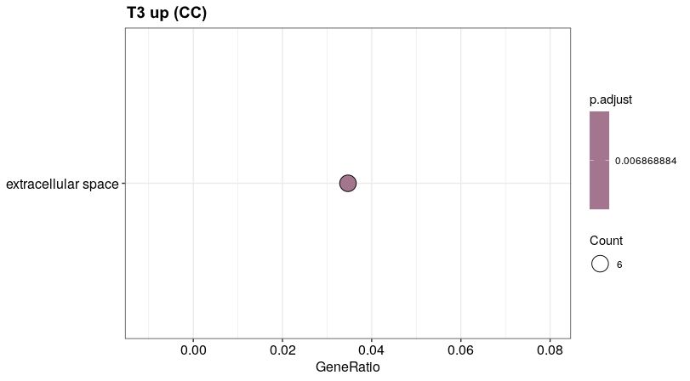
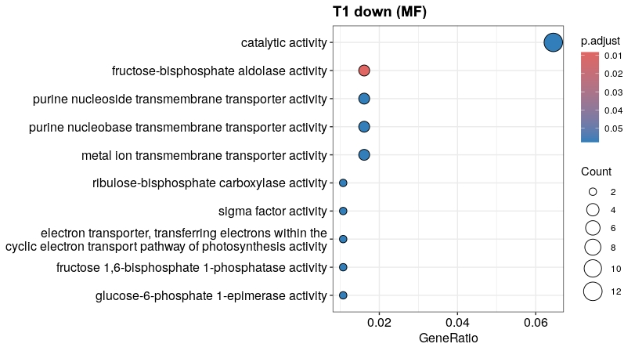
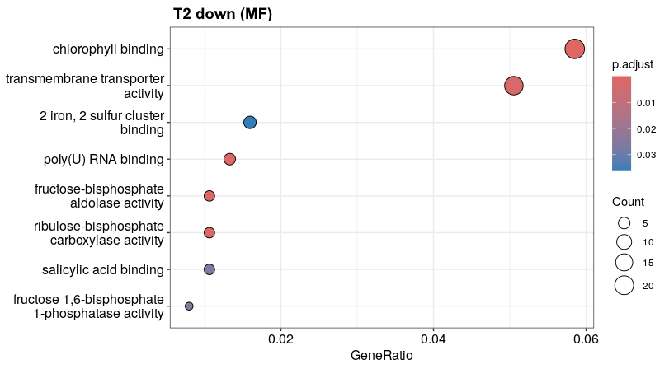
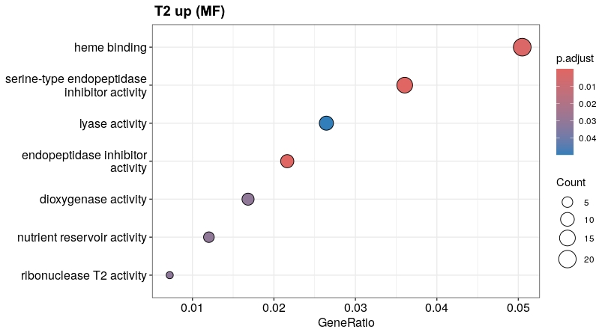
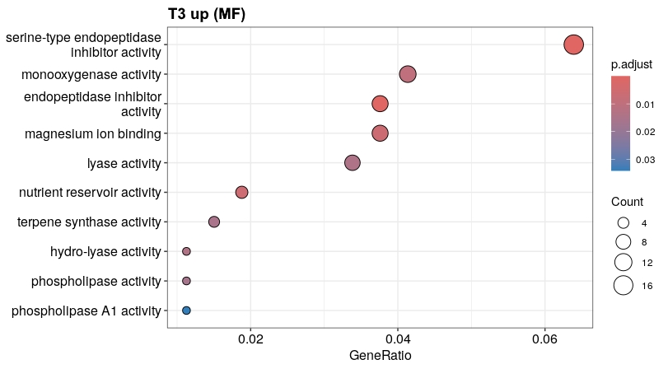
Supplementary Figure 3. Dot plots of Gene Ontology (GO) enrichment analysis of up- and down- differentially annotated DEGs in Streptomyces sp. DLS2013-treatments at T1 (6 HPT), T2 (12 HPT) and T3 (24 HPT) in tomato cv. H3402 transcriptome. The genes corresponded to three main categories, cellular component (CC) and molecular function (MF). The points in each dot plot are sized by the proportion of all genes annotated with the corresponding term and coloured by enrichment confidence (p. adjust value is the p-value corrected by ‘BH’ method).

