Slide 1
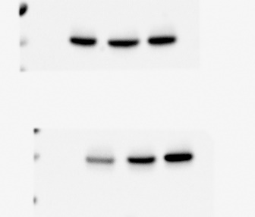
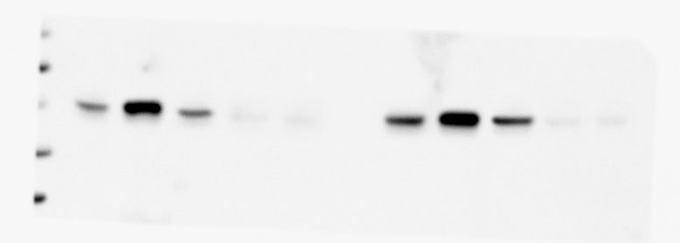
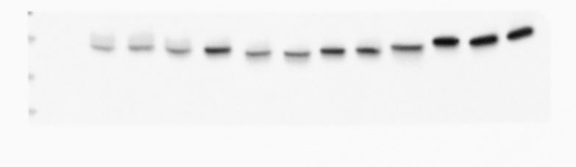
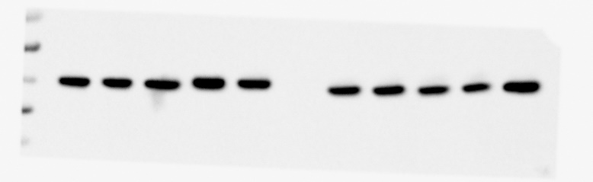
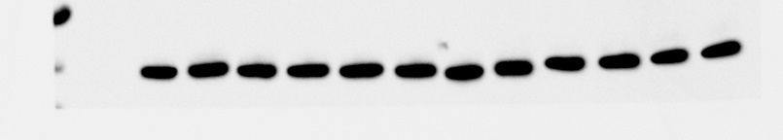
Figure 1 and 2
CHON-001
Hs 819.T
SW1353
34kDa
26kDa
KDELR1
SW1353
Hs 819.T
15kDa
₊
₋
₋
₋
₋
oe-ctrl
₊
₋
₋
₋
₋
KDELR1-oe
₋
₊
₋
₋
₋
₋
₊
₋
₋
₋
55kDa
Actin
siRNA-ctrl
₋
₋
₊
₋
₋
₋
₋
₊
₋
₋
43kDa
KDELR1-siRNA1
₋
₋
₋
₊
₋
₋
₋
₋
₊
₋
34kDa
KDELR1-siRNA2
₋
₋
₋
₋
₊
₋
₋
₋
₋
₊
34kDa
26kDa
KDELR1
chondrosarcoma
15kDa
Ctrl
Grade Ⅰ
Grade Ⅱ
Grade Ⅲ
34kDa
55kDa
26kDa
KDELR1
15kDa
43kDa
Actin
34kDa
55kDa
Actin
43kDa
34kDa

Slide 2
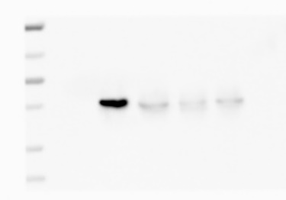
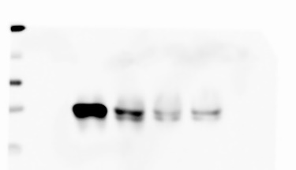
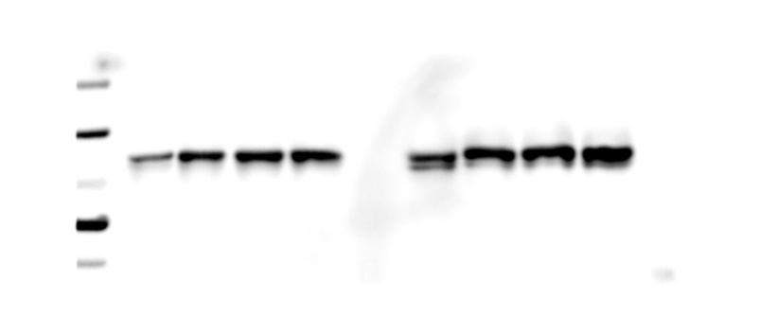
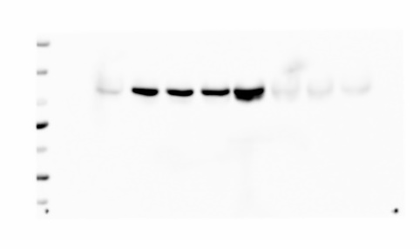
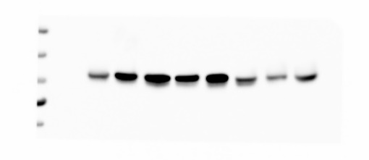
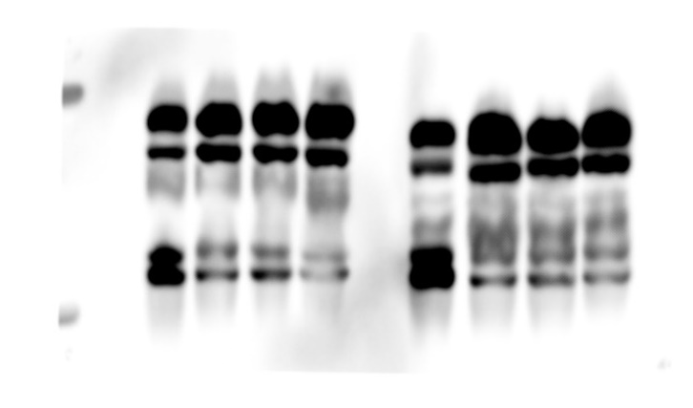
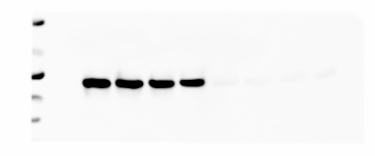
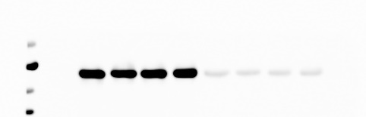
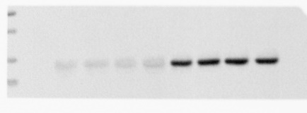
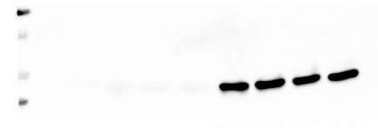
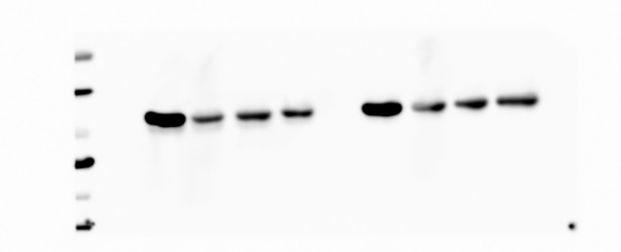
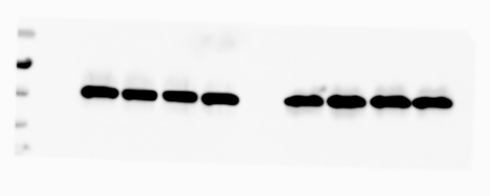
Figure 3
SW1353
Hs 819.T
siRNA-ctrl
₊
₋
₋
₋
₊
₋
₋
₋
₋
₊
₋
₋
KDELR1-siRNA1
₋
₊
₋
₋
KDELR1-siRNA2
₋
₋
₊
₋
₋
₋
₊
₋
₋
₋
₋
₊
₋
₋
₋
₊
KDELR1-siRNA3
34kDa
KDELR1
Hs 819.T
26kDa
SW1353
15kDa
Cytosol
Nucleus
Cytosol
Nucleus
siRNA-ctrl
₊
₋
₋
₋
₊
₋
₋
₋
₊
₋
₋
₋
₊
₋
₋
₋
₋
₊
₋
₋
₋
₊
₋
₋
₋
₊
₋
₋
₋
₊
₋
₋
95kDa
KDELR1-siRNA1
₋
₋
₊
₋
₋
₋
₊
₋
KDELR1-siRNA2
70kDa
₋
₋
₊
₋
₋
₋
₊
₋
₋
₋
₋
₊
₋
₋
₋
₊
₋
₋
₋
₊
₋
₋
₋
₊
YAP1
KDELR1-siRNA3
55kDa
70kDa
43kDa
55kDa
YAP1
43kDa
95kDa
70kDa
YAP1
Phos-tag
55kDa
Tubulin
34kDa
70kDa
26kDa
15kDa
H2A
11kDa
95kDa
70kDa
Active-YAP1
55kDa
43kDa
55kDa
43kDa
Actin
34kDa

Slide 3
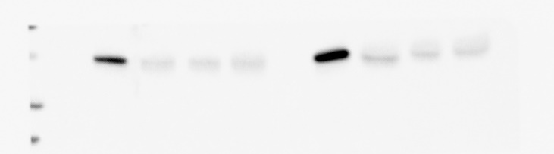
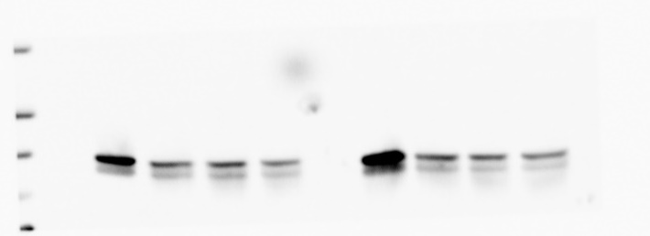
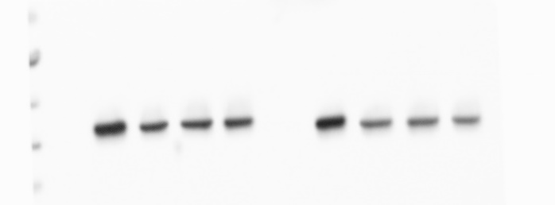
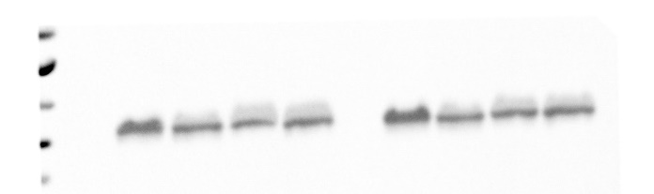
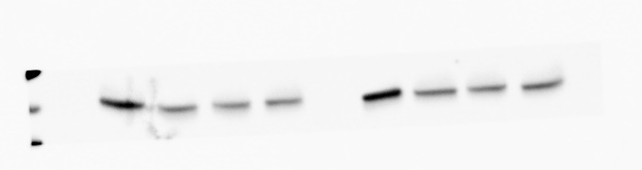
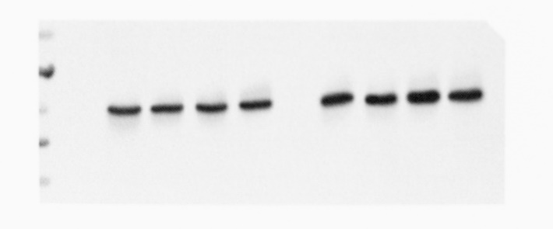
Figure 4
SW1353
Hs 819.T
siRNA-ctrl
₊
₋
₋
₋
₊
₋
₋
₋
₋
₊
₋
₋
₋
₊
₋
₋
KDELR1-siRNA1
KDELR1-siRNA2
₋
₋
₊
₋
₋
₋
₊
₋
₋
₋
₋
₊
₋
₋
₋
₊
KDELR1-siRNA3
34kDa
KDELR1
26kDa
15kDa
130kDa
AMOT
98kDa
70kDa
55kDa
CCN1
43kDa
55kDa
43kDa
CCN2
34kDa
55kDa
ANKRD1
43kDa
34kDa
55kDa
Actin
43kDa
34kDa

Slide 4
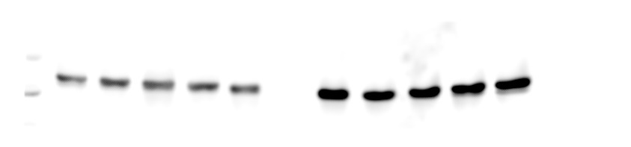
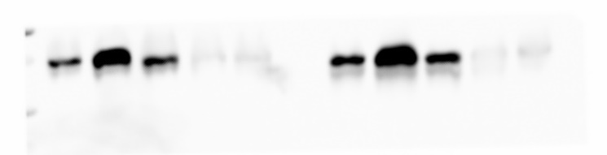
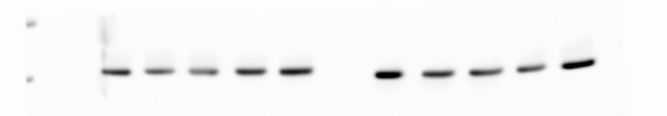
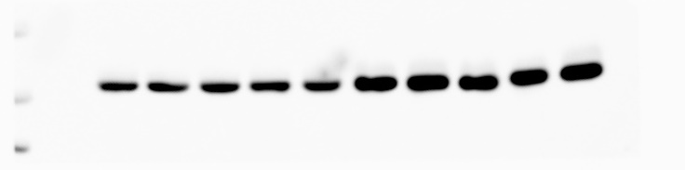
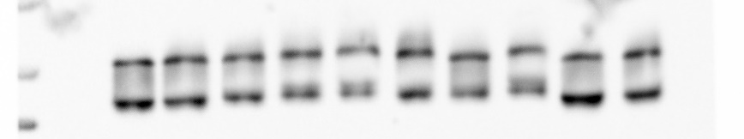
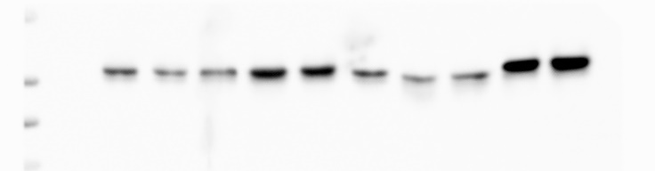
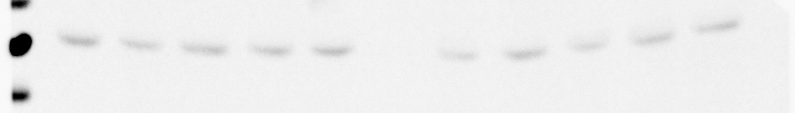
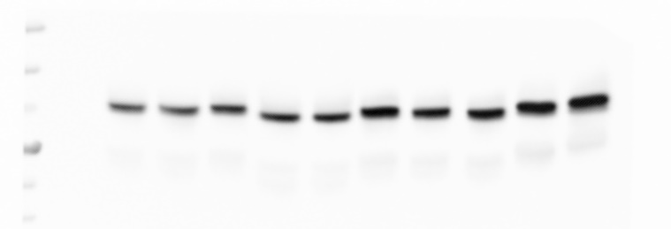
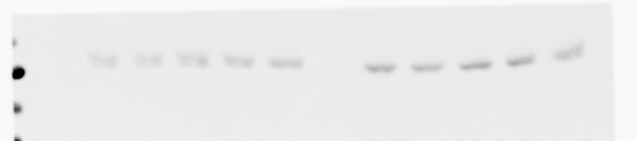
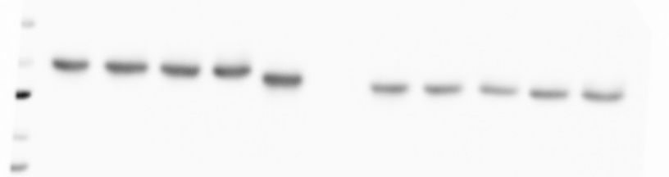
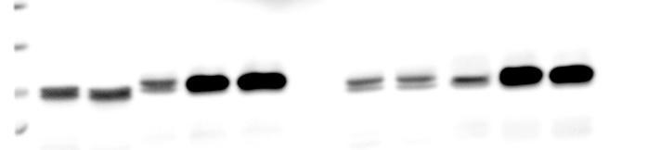
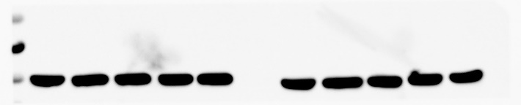
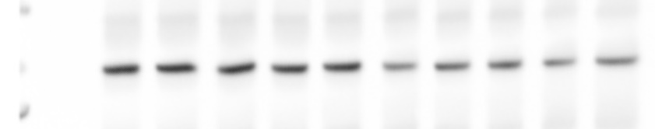
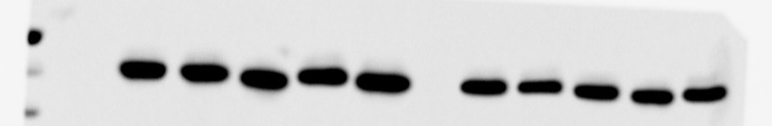
Figure 5
SW1353
Hs 819.T
SW1353
Hs 819.T
₊
₋
₋
₋
₋
₊
₋
₋
₋
₋
oe-ctrl
₊
₋
₋
₋
₋
oe-ctrl
₊
₋
₋
₋
₋
KDELR1-oe
₋
₊
₋
₋
₋
₋
₊
₋
₋
₋
KDELR1-oe
₋
₊
₋
₋
₋
₋
₊
₋
₋
₋
siRNA-ctrl
₋
₋
₊
₋
₋
₋
₋
₊
₋
₋
siRNA-ctrl
₋
₋
₊
₋
₋
₋
₋
₊
₋
₋
KDELR1-siRNA1
₋
₋
₋
₊
₋
₋
₋
₋
₊
₋
KDELR1-siRNA1
₋
₋
₋
₊
₋
₋
₋
₋
₊
₋
KDELR1-siRNA2
₋
₋
₋
₋
₊
₋
₋
₋
₋
₊
KDELR1-siRNA2
₋
₋
₋
₋
₊
₋
₋
₋
₋
₊
34kDa
130kDa
TAOK1
26kDa
KDELR1
95kDa
15kDa
250kDa
130kDa
TAOK2
250kDa
130kDa
LAST1
95kDa
130kDa
p-TAOK
250kDa
95kDa
130kDa
p-LAST1
95kDa
55kDa
MST1
43kDa
70kDa
55kDa
MST2
55kDa
YAP1
43kDa
43kDa
70kDa
NF2
95kDa
55kDa
70kDa
pYAP1
43kDa
55kDa
43kDa
70kDa
p-NF2
34kDa
Actin
55kDa
55kDa
43kDa
Actin
34kDa

Slide 5
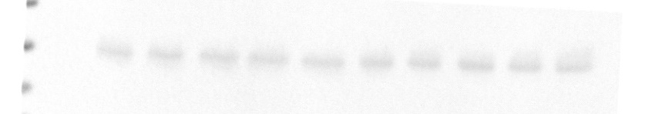
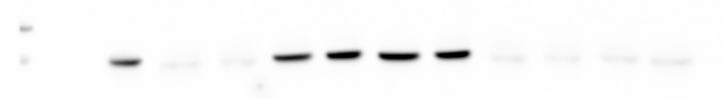
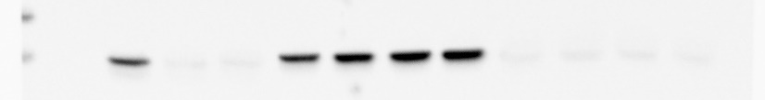
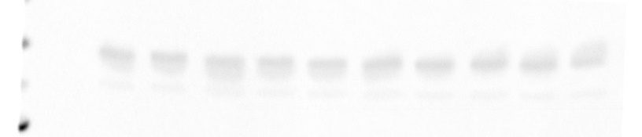
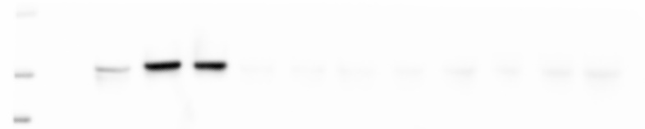
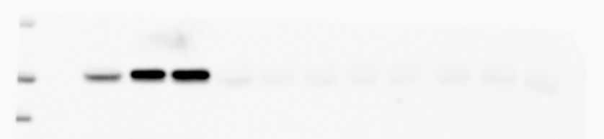
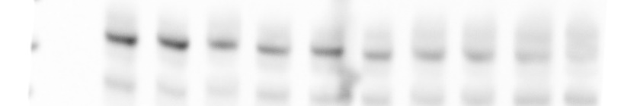
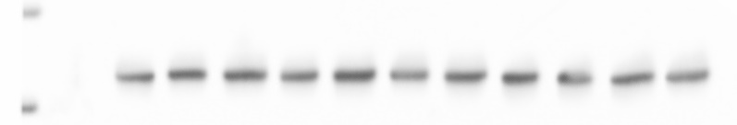
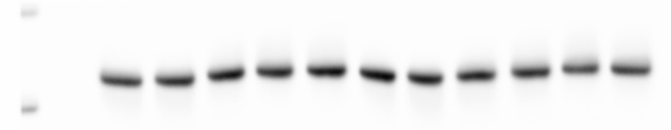
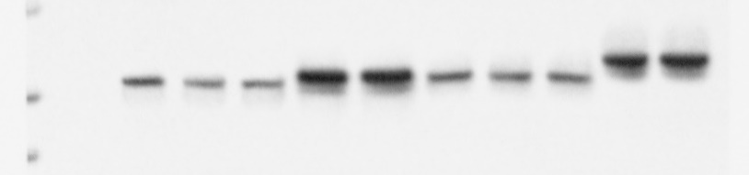
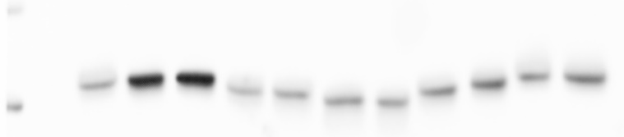
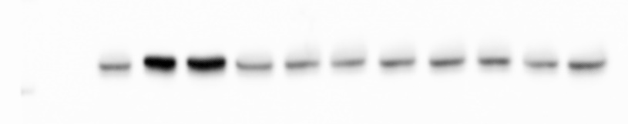
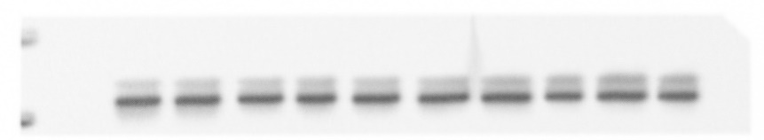








Figure 5
SW1353
Hs 819.T
SW1353
Hs 819.T
₊
₋
₋
₋
₋
oe-ctrl
₊
₋
₋
₋
₋
siRNA-ctrl
₊
₋
₋
₋
₋
₊
₊
₋
₋
₋
₋
₊
₋
₋
₋
₋
₊
₊
₋
₋
₋
₋
KDELR1-oe
₋
₊
₋
₋
₋
₋
₊
₋
₋
₋
MAP4K4-siRNA1
₋
₊
₋
₋
₋
₋
₋
₊
₊
₋
₋
₋
₊
₋
₋
₋
₋
₋
₊
₊
₋
₋
siRNA-ctrl
₋
₋
₊
₋
₋
₋
₋
₊
₋
₋
MAP4K4-siRNA2
₋
₋
₊
₋
₋
₋
₋
₋
₋
₊
₊
₋
₋
₊
₋
₋
₋
₋
₋
₋
₊
₊
KDELR1-siRNA1
₋
₋
₋
₊
₋
₋
₋
₋
₊
₋
KDELR1-siRNA1
₋
₋
₋
₊
₋
₊
₋
₊
₋
₊
₋
₋
₋
₋
₊
₋
₊
₋
₊
₋
₊
₋
KDELR1-siRNA2
₋
₋
₋
₋
₊
₋
₋
₋
₋
₊
KDELR1-siRNA2
₋
₋
₋
₋
₊
₋
₊
₋
₊
₋
₊
₋
₋
₋
₋
₊
₋
₊
₋
₊
₋
₊
95kDa
MAP4K1
34kDa
70kDa
26kDa
KDELR1
95kDa
15kDa
70kDa
MAP4K2
130kDa
MAP4K4
95kDa
95kDa
MAP4K3
250kDa
70kDa
LAST1
130kDa
MAP4K4
250kDa
130kDa
p-LAST1
95kDa
130kDa
130kDa
70kDa
MAP4K5
YAP1
95kDa
55kDa
43kDa
95kDa
130kDa
MAP4K6
95kDa
70kDa
pYAP1
55kDa
55kDa
43kDa
Actin
43kDa
Actin
34kDa
34kDa

Slide 6















Figure 6
SW1353
Hs 819.T
SW1353
Hs 819.T
siRNA-ctrl
₊
₋
₋
₋
₊
₋
₋
₋
siRNA-ctrl
₊
₋
₋
₋
₊
₋
₋
₋
₋
₊
₋
₋
₋
₊
₋
₋
₋
₊
₋
₋
₋
₊
₋
₋
KDELR1-siRNA1
KDELR1-siRNA1
KDELR1-siRNA2
₋
₋
₊
₋
KDELR1-siRNA2
₋
₋
₊
₋
₋
₋
₊
₋
₋
₋
₊
₋
₋
₋
₋
₊
₋
₋
₋
₊
₋
₋
₋
₊
₋
₋
₋
₊
KDELR1-siRNA3
KDELR1-siRNA3
55kDa
43kDa
PP2A
130kDa
Integrin-α1
34kDa
95kDa
43kDa
pPP2A
34kDa
130kDa
Integrin-α2
95kDa
26kDa
15kDa
RAP2
130kDa
Integrin-α3
250kDa
95kDa
130kDa
PLCγ
250kDa
250kDa
Integrin-α4
130kDa
pPLCγ
130kDa
250kDa
Integrin-α5
130kDa
130kDa
95kDa
PYK2
70kDa
130kDa
Integrin-α6
95kDa
130kDa
pPYK2
95kDa
55kDa
130kDa
Integrin-αV
43kDa
Actin
95kDa
34kDa

Slide 7












Figure 6
SW1353
Hs 819.T
SW1353
Hs 819.T
siRNA-ctrl
₊
₋
₋
₋
₊
₋
₋
₋
siRNA-ctrl
₊
₋
₋
₋
₋
₊
₋
₋
₋
₊
₋
₋
₊
₋
₋
₋
KDELR1-siRNA1
₋
₊
₋
₋
₋
₊
₋
₋
KDELR1-siRNA2
₋
₋
₊
₋
KDELR1-siRNA1
₋
₋
₊
₋
₋
₋
₋
₊
KDELR1-siRNA2
₋
₋
₊
₋
₋
₋
₋
₊
₋
₋
₊
₋
KDELR1-siRNA3
₋
₋
₋
₊
₋
₋
₋
₊
250kDa
KDELR1-siRNA3
130kDa
Integrin-β1
130kDa
Integrin-α3
95kDa
130kDa
250kDa
95kDa
Integrin-β2
130kDa
Integrin-α5
130kDa
95kDa
Integrin-β3
130kDa
95kDa
Integrin-β5
250kDa
Integrin-β4
70kDa
130kDa
130kDa
55kDa
PDI
95kDa
Integrin-β5
130kDa
250kDa
95kDa
Integrin-β6
130kDa
GM130
55kDa
Actin
43kDa

Slide 8





Figure 7
CTRL
KDELR1-kd
34kDa
26kDa
KDELR1
15kDa
70kDa
YAP1
55kDa
70kDa
55kDa
Active-YAP1
43kDa
250kDa
130kDa
MAP4K4
55kDa
43kDa
Actin

