Slide 1
Figure 1
A
B
C
Glucose
MVA pathway
2,3-oxidosqualene
ERG7
Stop!!!
ERG11
ERG24/25/26/27
ERG6
ERG2/ERG3
Lanosterol
4,4-dimethyl-5α-cholesta-8,14,24-trien-3β-ol
Zymosterol
Fecosterol
Ergosta-5,7,24-trienol
ERG2/ERG3
Stop!!!
ERG4/ERG5
Dhcr7
Dhcr24
Cholesterol
7-dehydrocholesterol
Cholesta-5,7,24-trieneol
Ergosterol

Slide 2
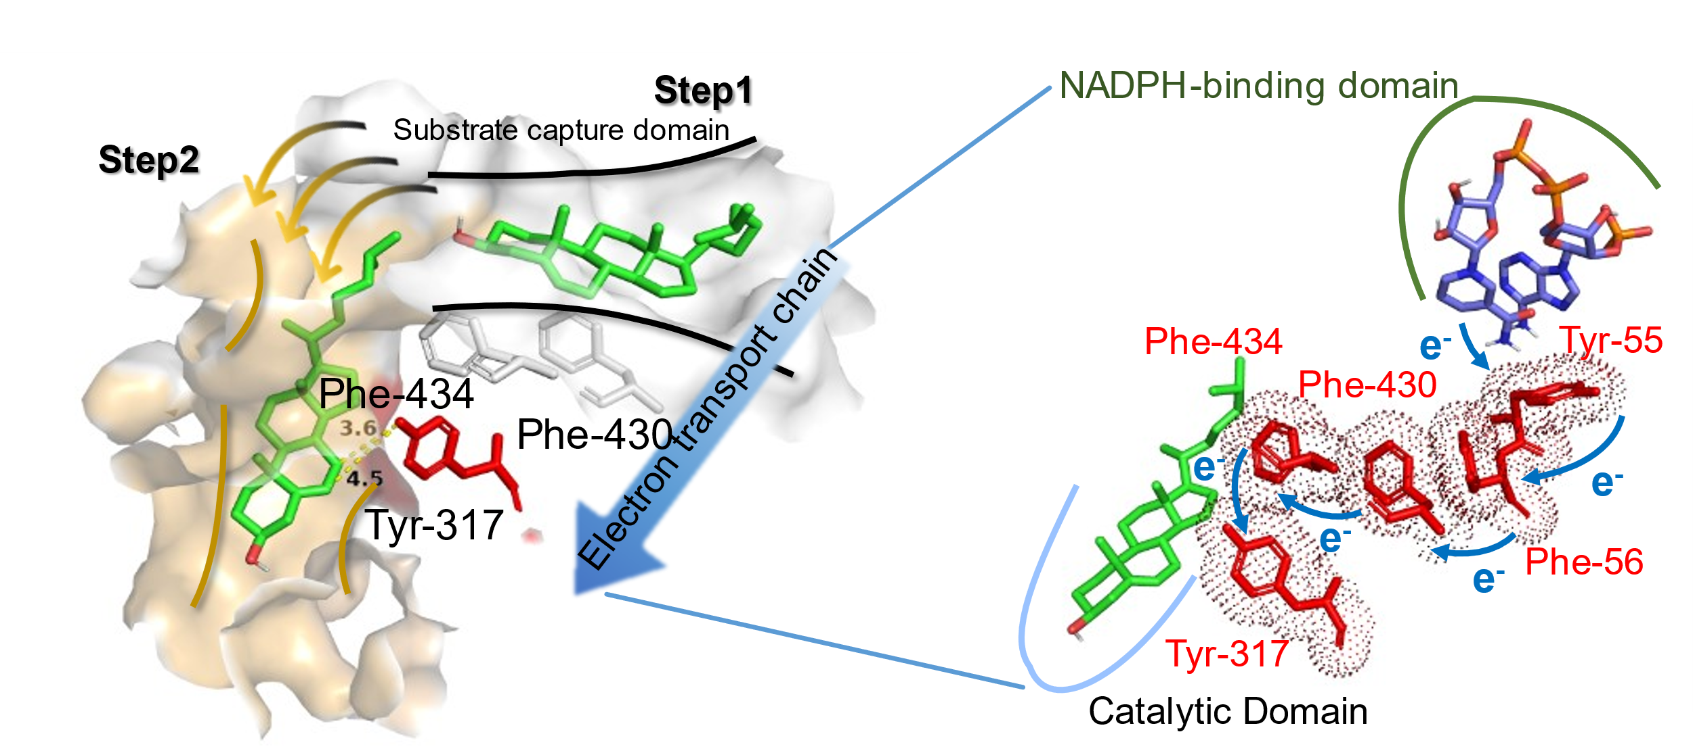
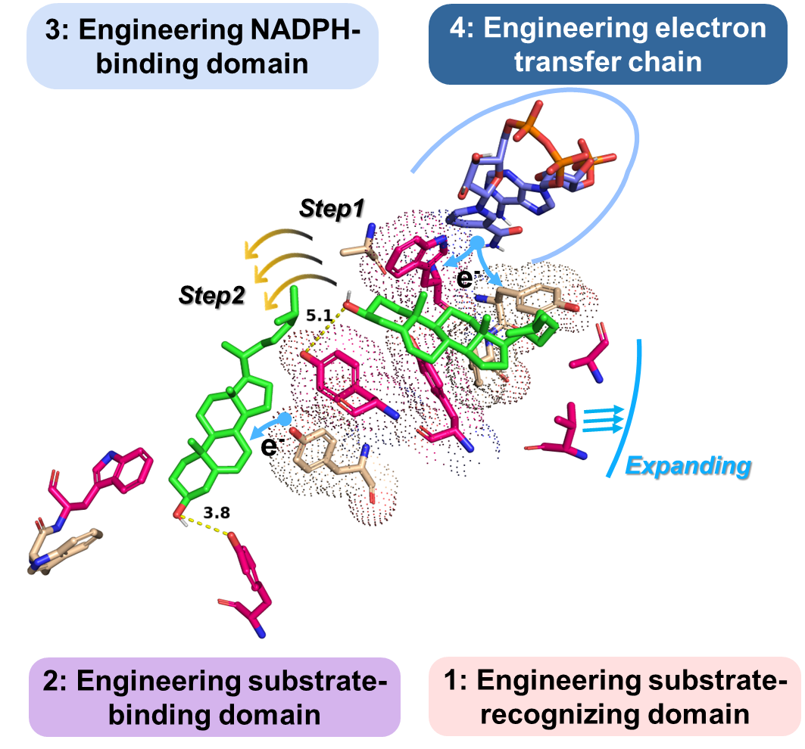
Figure 2
A
B
0
0
0
C
D
1
2
E
4
ETE
3
1
2

Slide 3
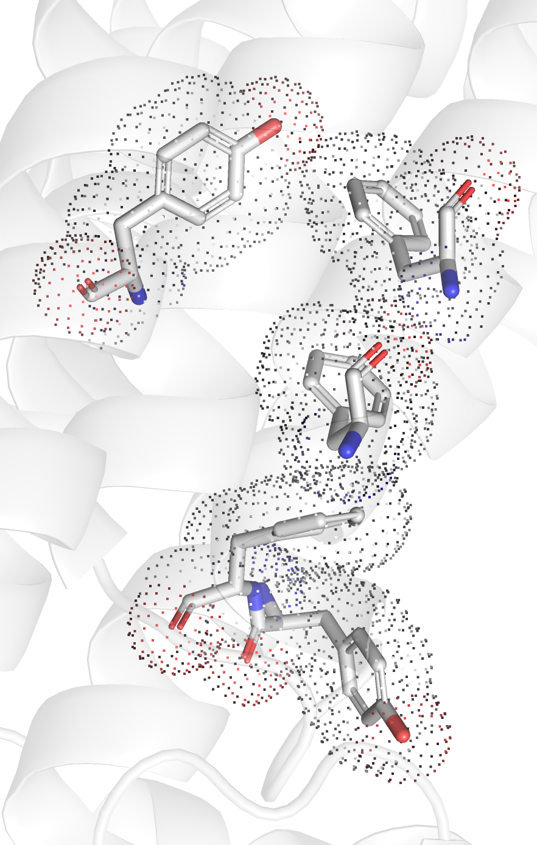
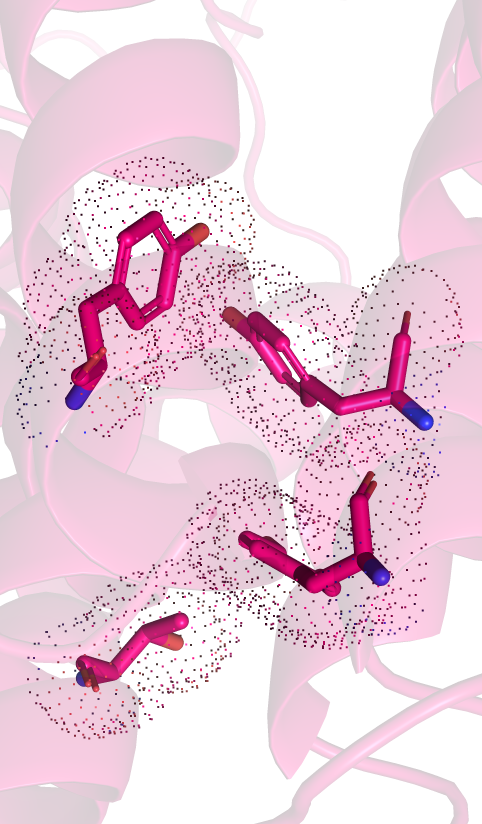
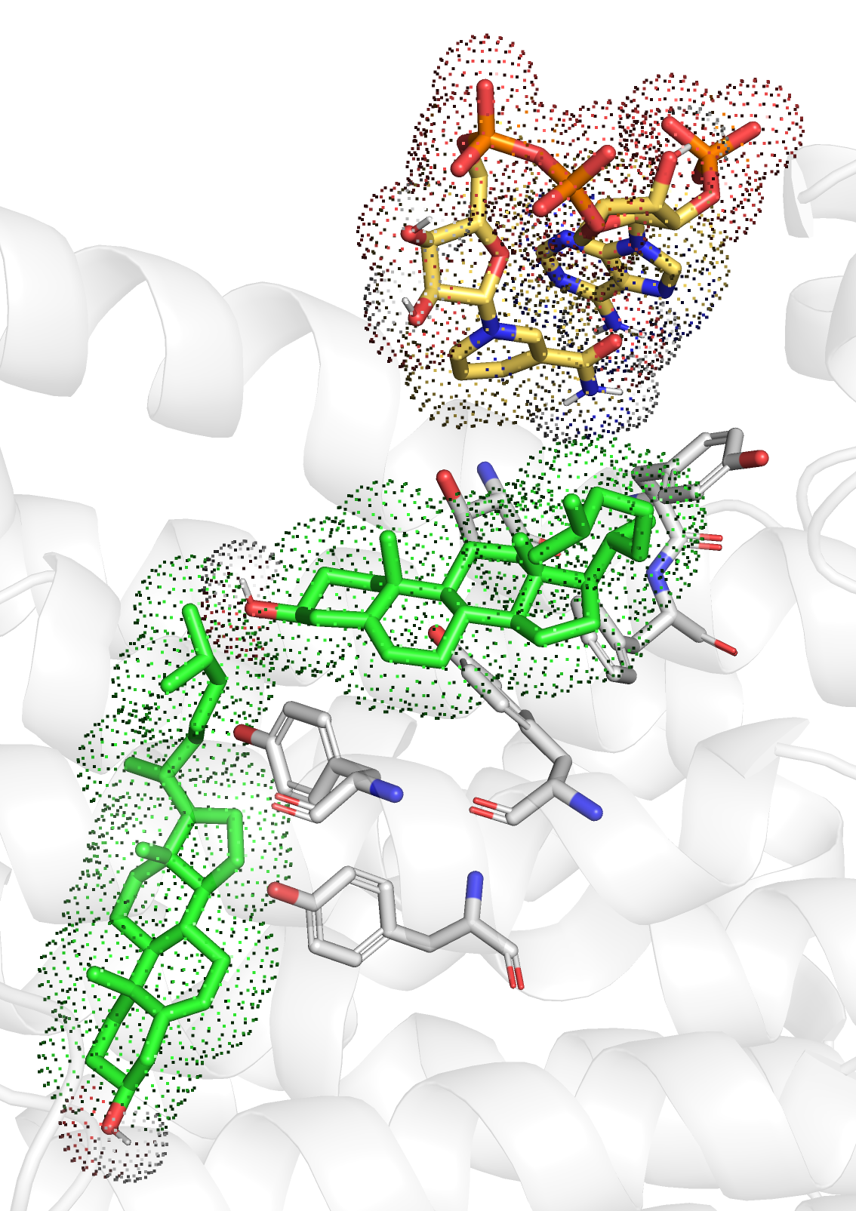
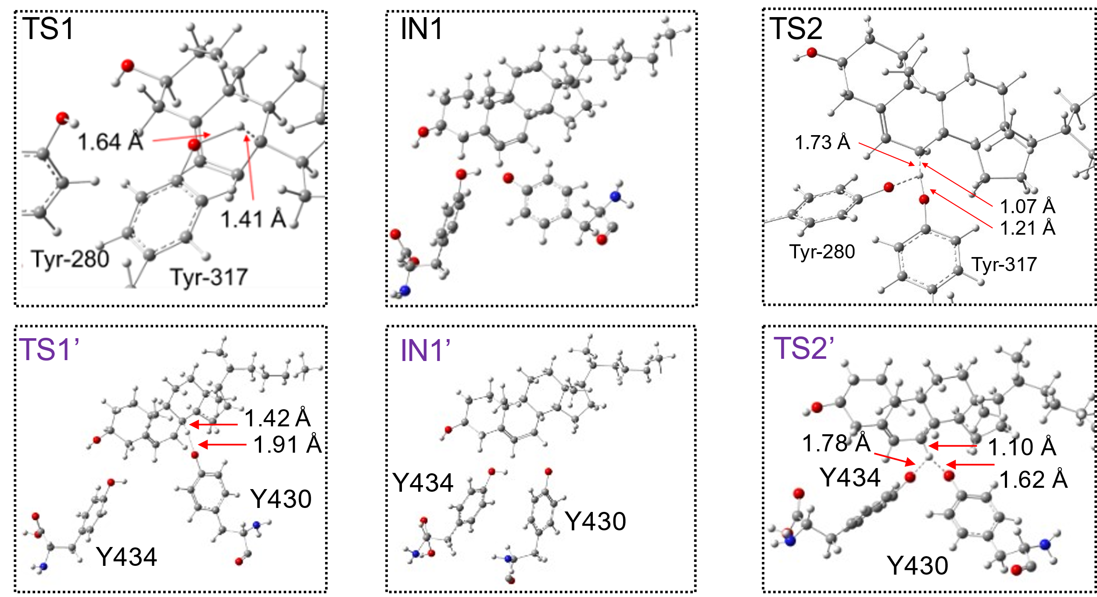
Figure 3
A
Measurement of electron transfer chain length
WTDhcr7
F430
MuDhcr7
Y317
F434Y
Y317
F434
F55
F430Y
Y56
I53T
B
C
TS1’
26.5
TS2’
21.3
21.2
TS1
0.0
ES
14.8
TS2
Reductase domain
Int1’
-1.7
EP
-2.7
T53
Y56
-5.7
Int1
-7.8
EP’
Y434
F55
Y430
Catalytic site2
Y317
Catalytic site1

Slide 4
Figure 4
A
B
RgCYP11A1_ATR
Glu
MVA pathway
2,3-oxidosqualene
ERG7
ERG11
ERG24/25/26/27
ERG2/ERG3
Lanosterol
4,4-dimethyl-5α-cholesta-8,14,24-trien-3β-ol
Zymosterol
Cholesta-5,7,24-trieneol
Dhcr24
CYP11A1-ATR
MuCoDhcr7
Pregnenolone
Cholesterol
7-dehydrocholesterol

Slide 5
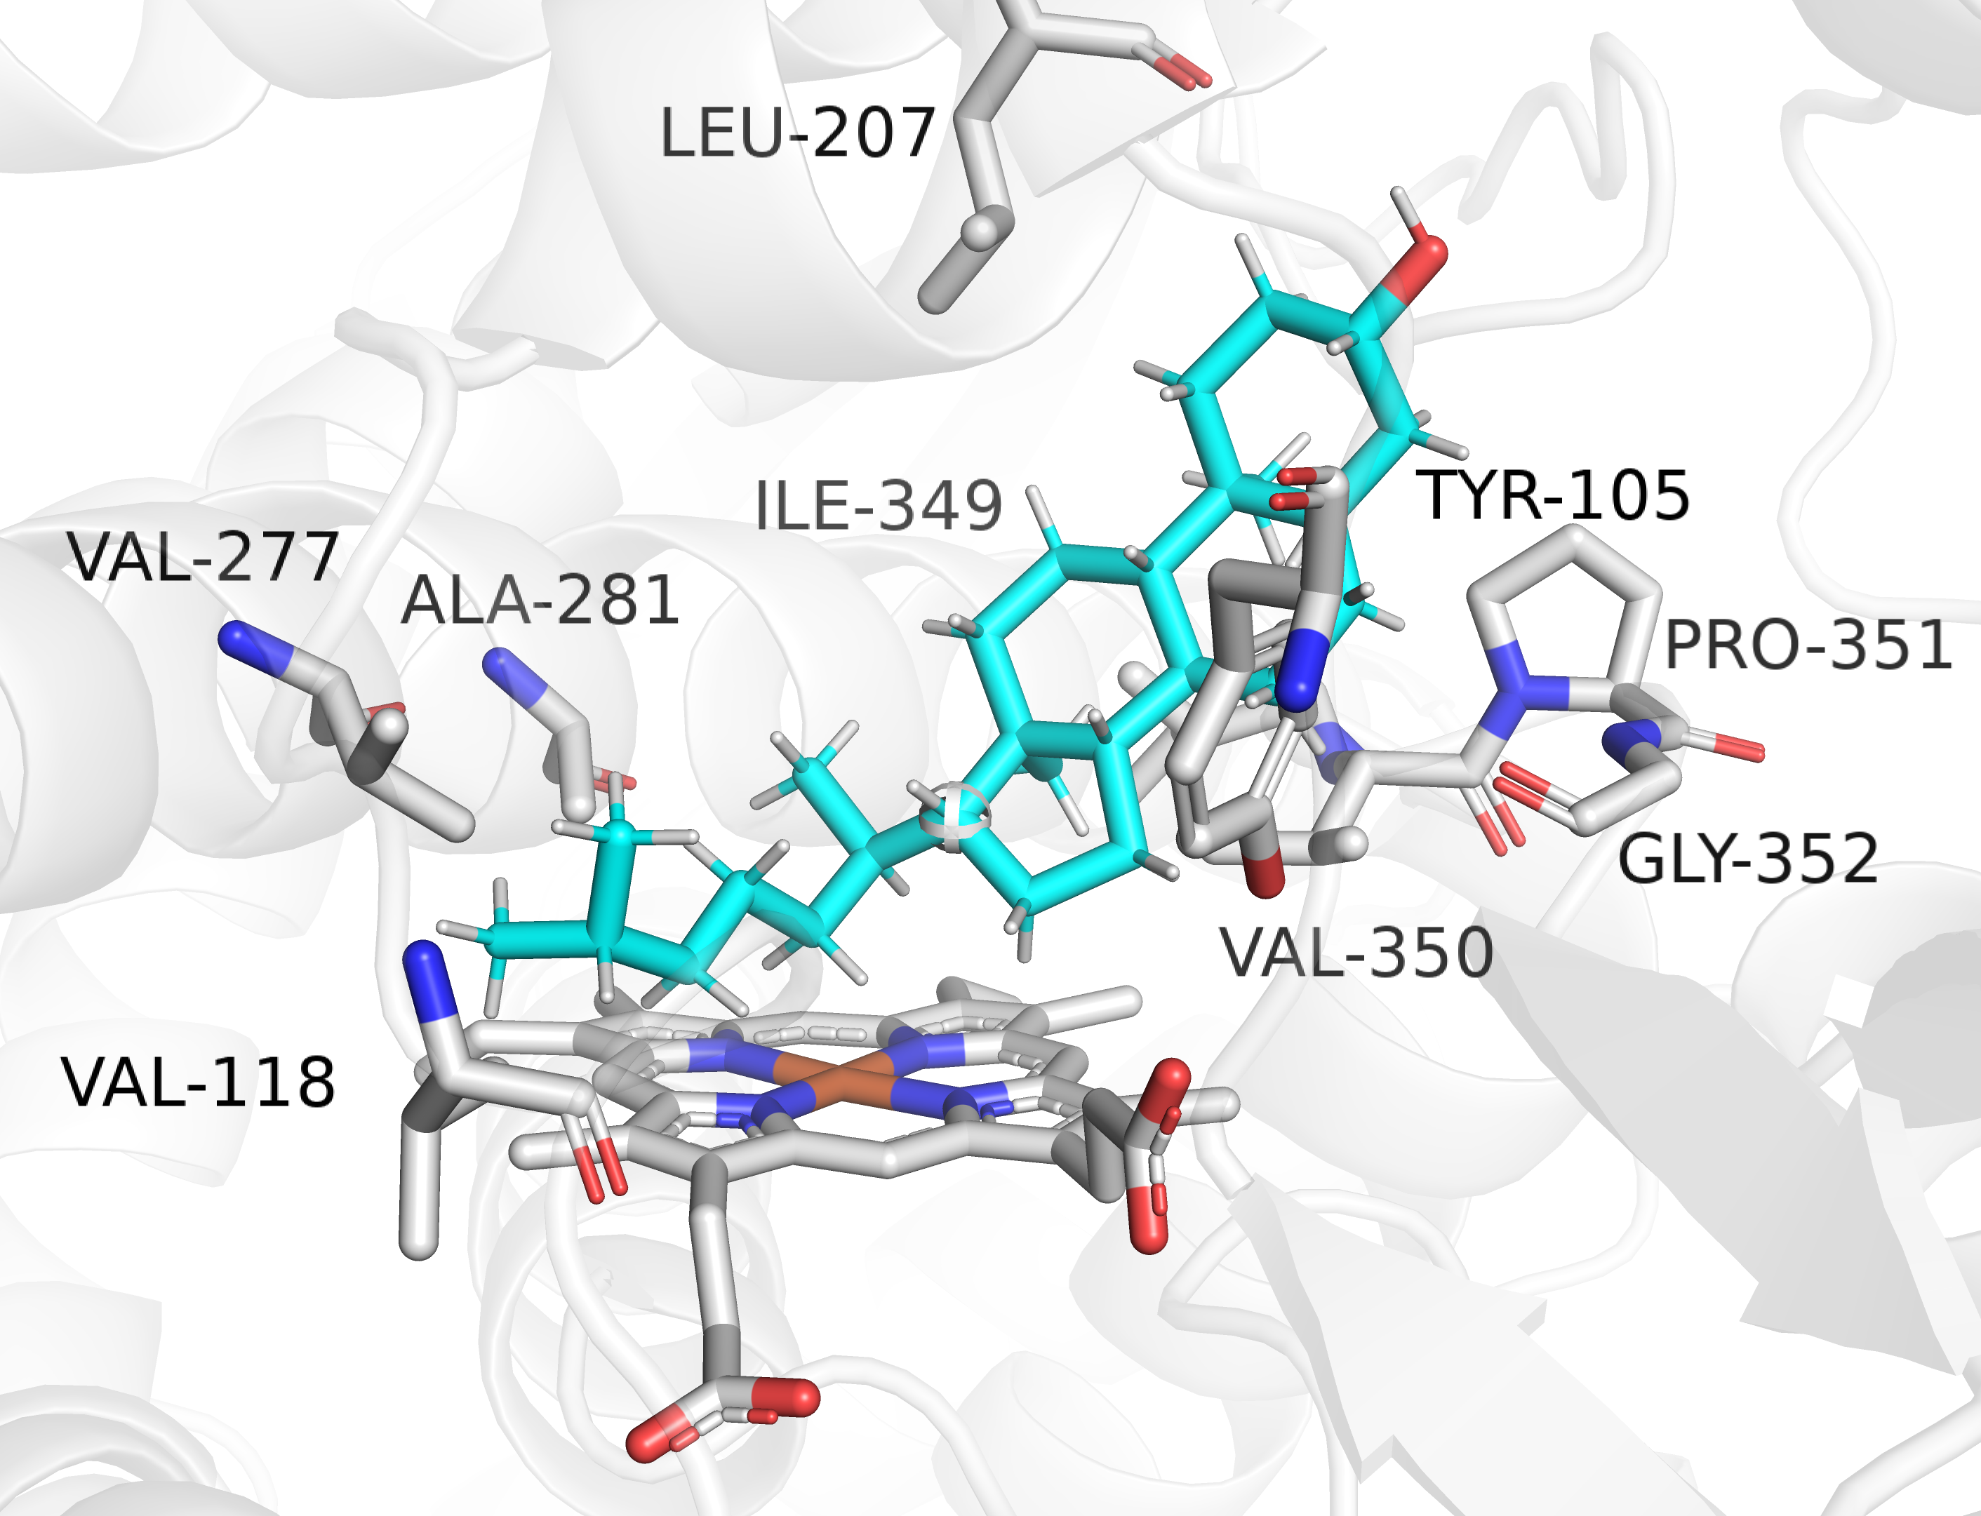
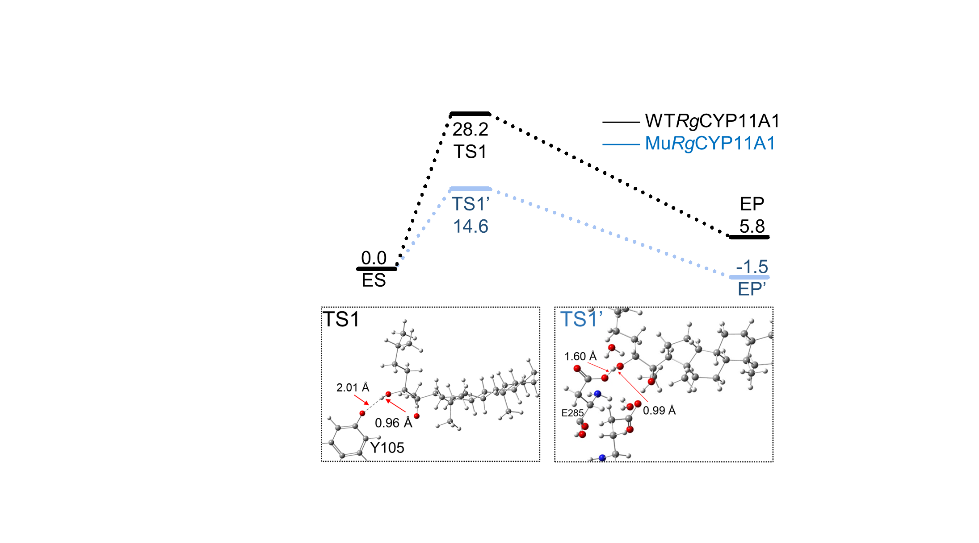
Figure 5
A
B
C
D
(1)
(2)
(3)
PCET
E
Heme
F
G
WT-RgCYP11A1
Mu-RgCYP11A1

Slide 6
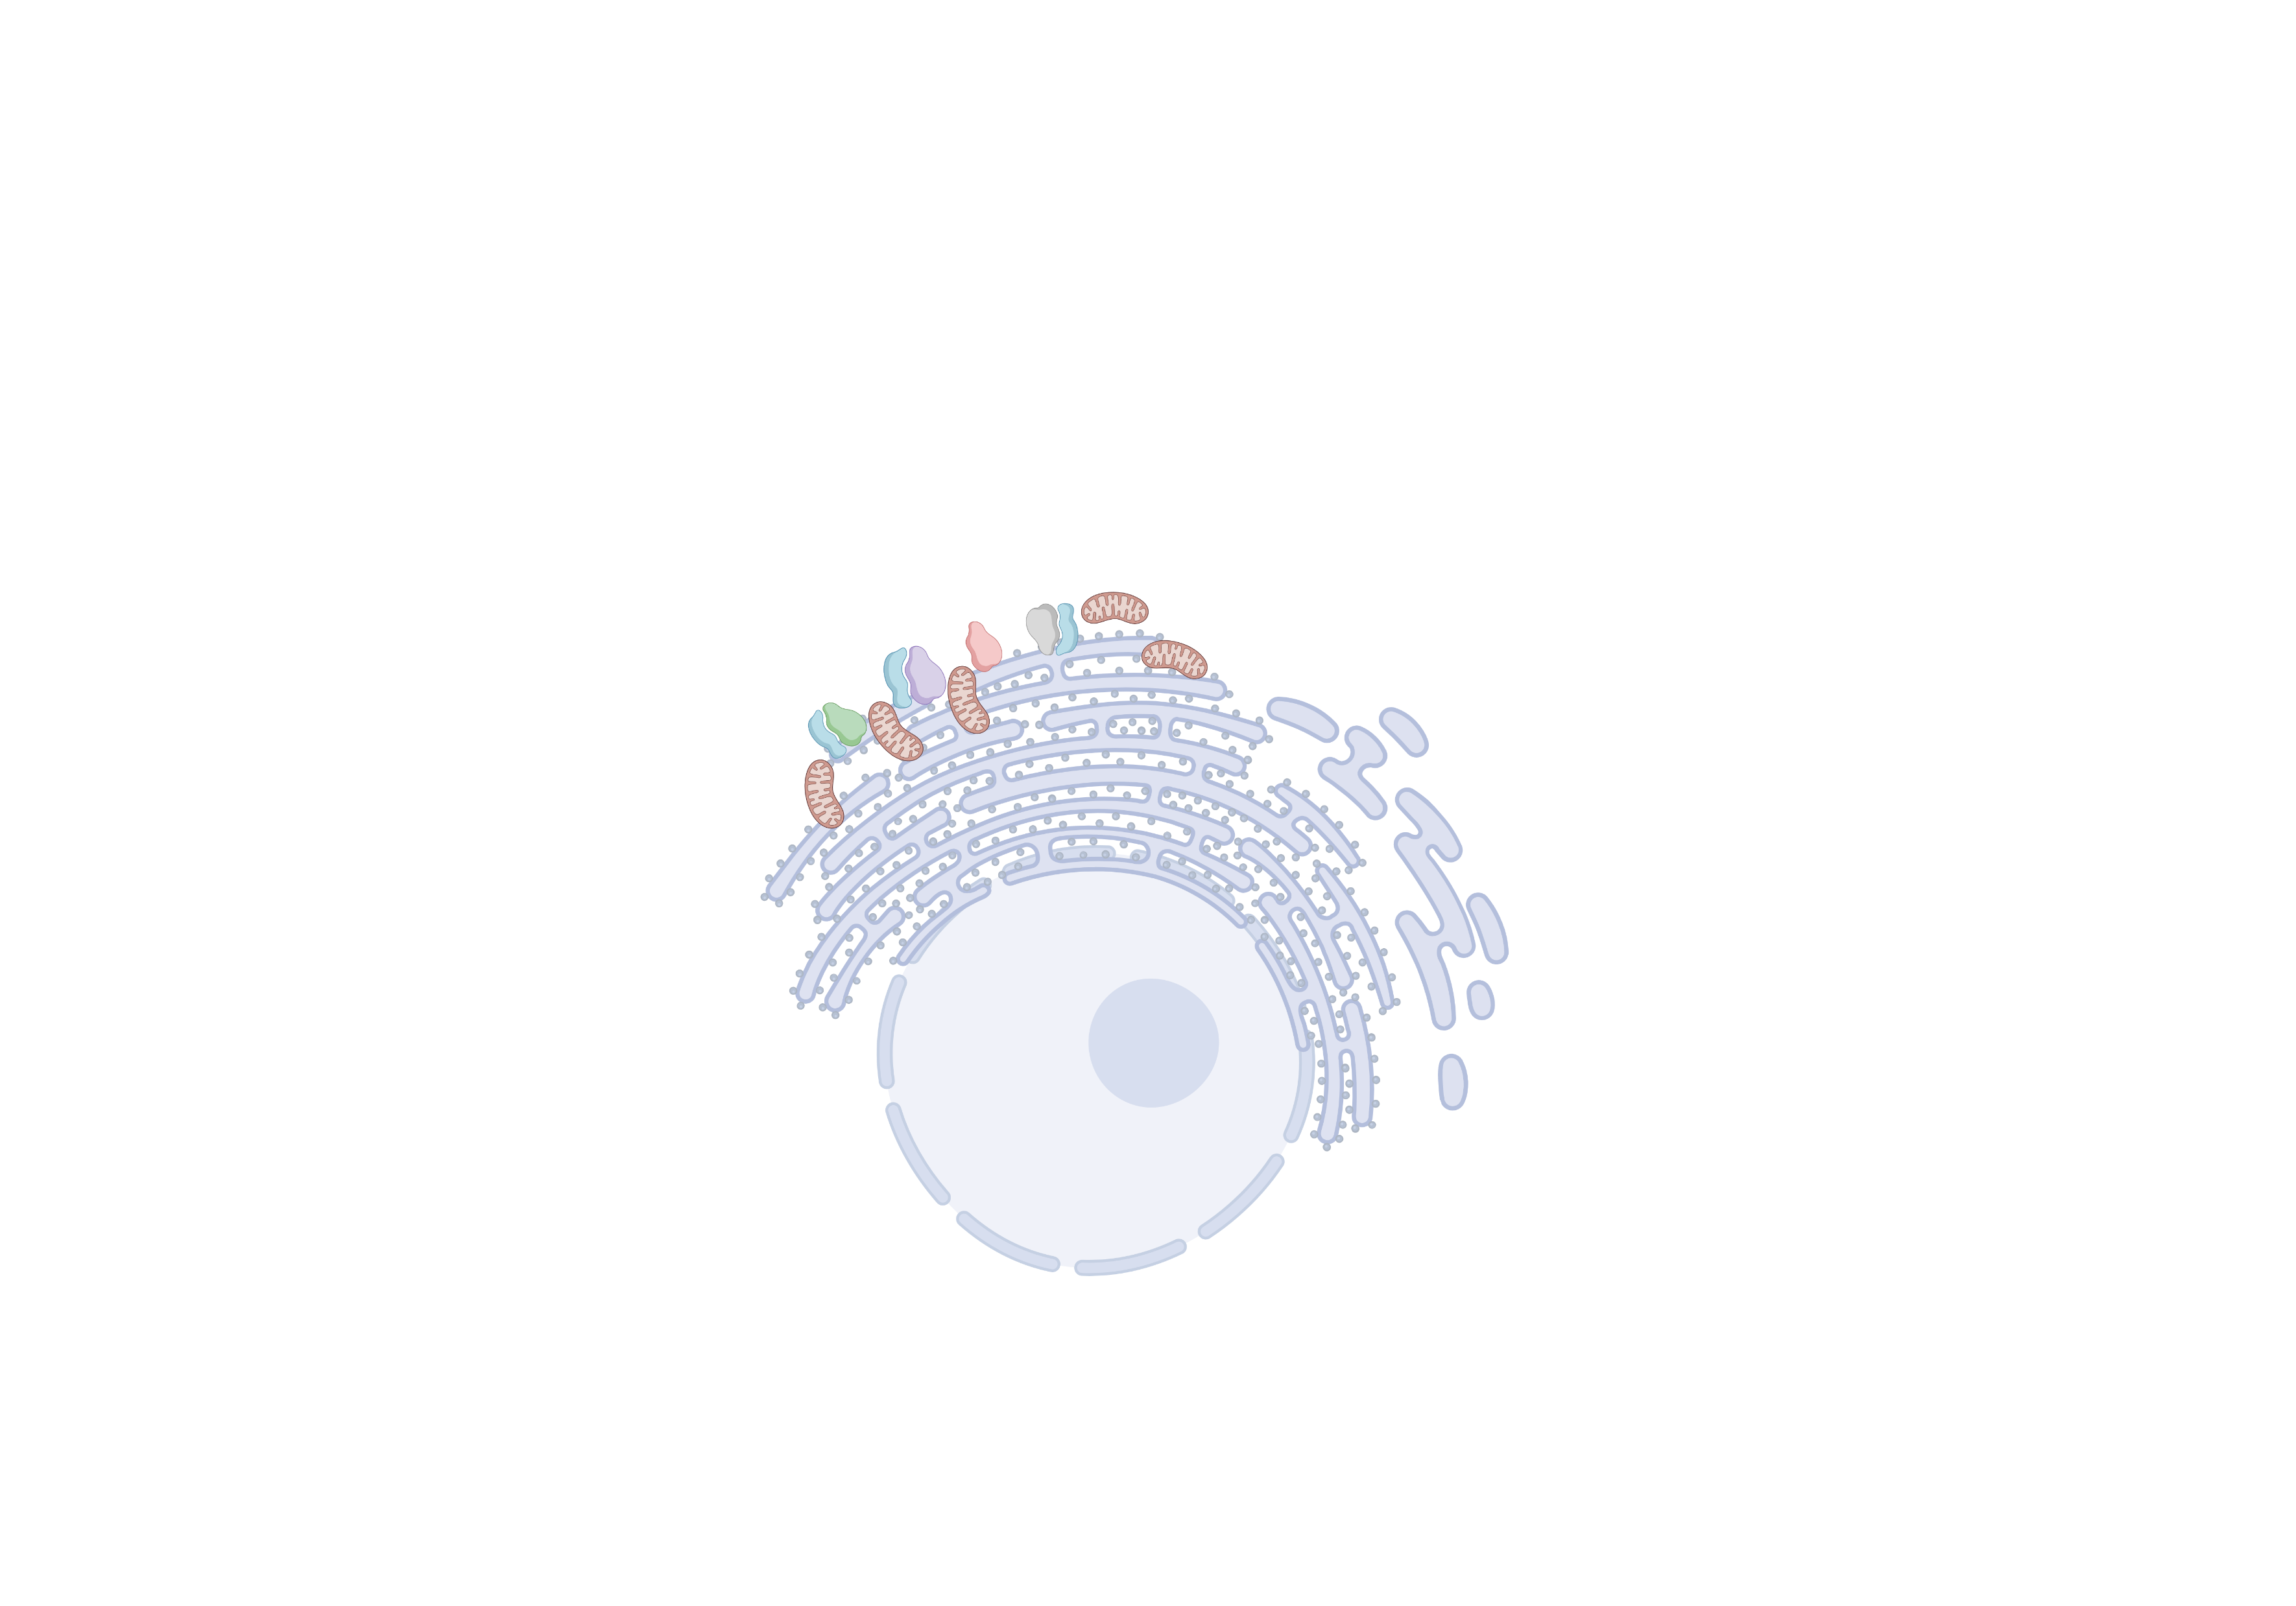
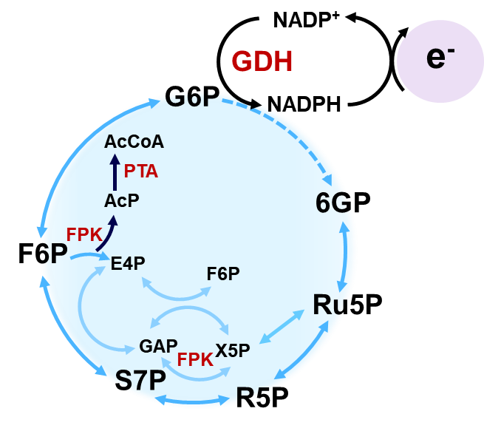
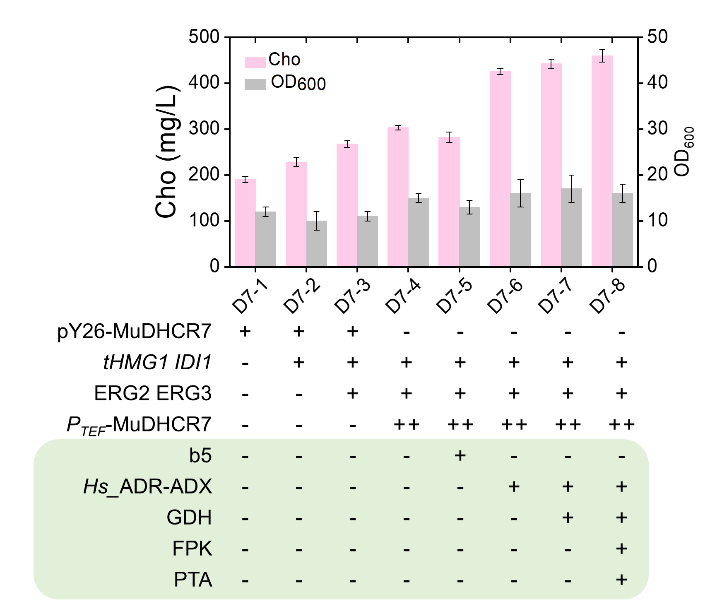
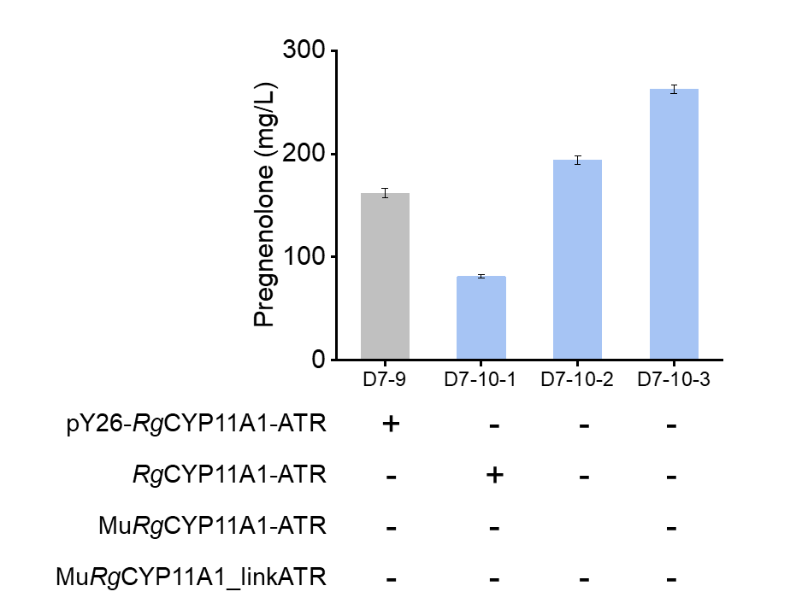
Figure 6
A
MVA pathway
Glu
tHMG1
IDI1
2,3-oxidosqualene
ERG7
Lanosterol
Ergosterol
Push!!!
ETE Directing
C-flux!
ERG25-CPR
ERG11/25/24/26/27
DHCR7
ERG2/ERG3
ETE Push!!!
ERG4/ERG5
ERG11-CPR
CYP11A1-CPR
ADX
ADR
Dhcr24
C
Cholesta-5,7,24-trieneol
7-dehydrocholesterol
ETE Push!!!
MuCoDhcr7
Endoplasmic Reticulum
CYP11A1-ATR
Engineering by ETE
Pregnenolone
ETE Push!!!
Cholesterol
B
D
E
F

