Slide 1
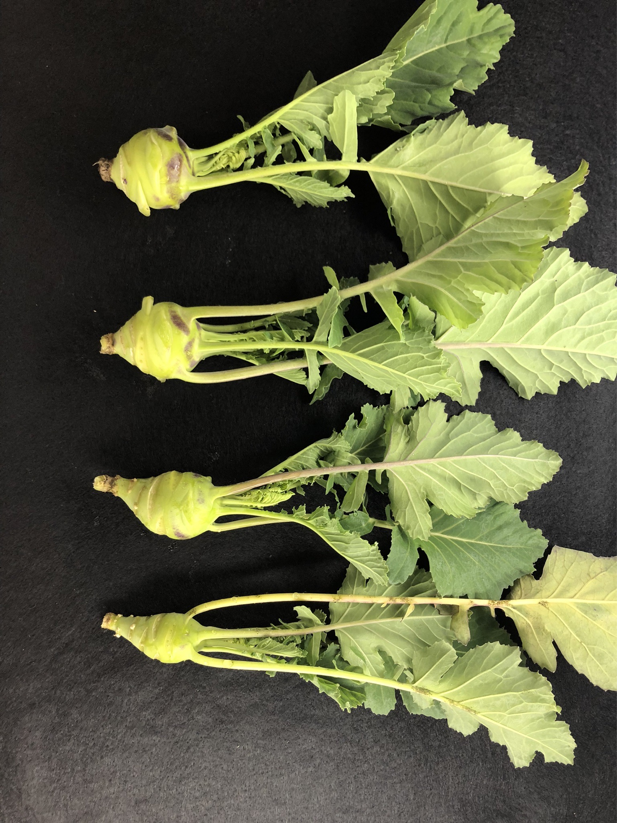
A
B
C
Stem Height
Stem Diameter
Grade
No. of recombinant plants
No. of recombinant plants
No. of recombinant plants
Scale of Grade
Stem height (mm)
Stem diameter (mm)
D
Grade 1
(SEI: >1.80)
Grade 2
(SEI: 1.80–1.51)
Grade 3
(SEI: 1.50–1.21)
Grade 4
(SEI: <1.21)

