Slide 1
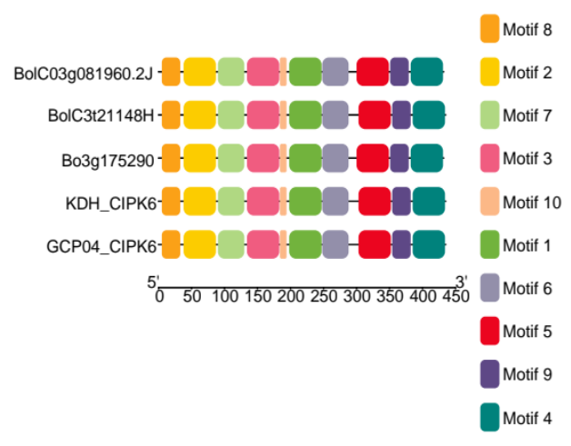
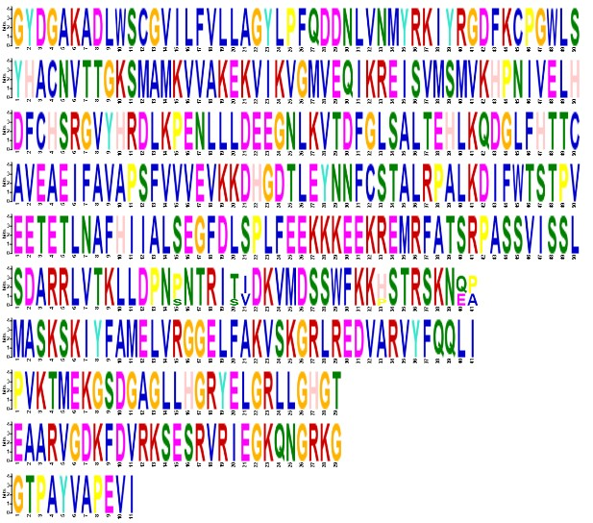
A
BolC03g081960.2J
Auxin responsiveness
BolC3t21148H
Gibberellin responsiveness
Bo3g175290
ABA responsiveness
CIPK6_KDH
MeJA responsiveness
CIPK6_GCP04
SA responsiveness
5’
3’
-1
300
600
900
1200
1800
2400
1500
2100
2700
-3000
B
C
AT4G30960
AT4G30960
BolC03g081960.2J
BolC03g081960.2J
BolC3t21148H
BolC3t21148H
Bo3g175290
Bo3g175290
KDH_CIPK6
GCP04_CIPK6
250
CIPK6_KDH
50
CIPK6_GCP04
100
350
150
200
300
400
0
450
0
50
100
150
200
250
300
STKc_SnRK3
CIPK_C
350
400
450
SPS1
NAF
D
1
2
3
4
5
6
7
8
9
10

