Slide 1
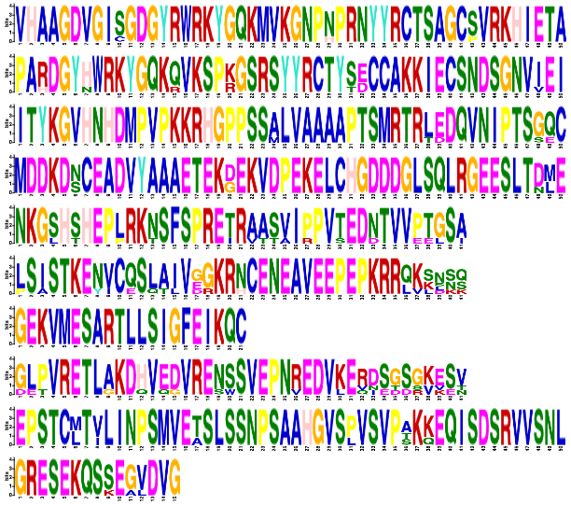
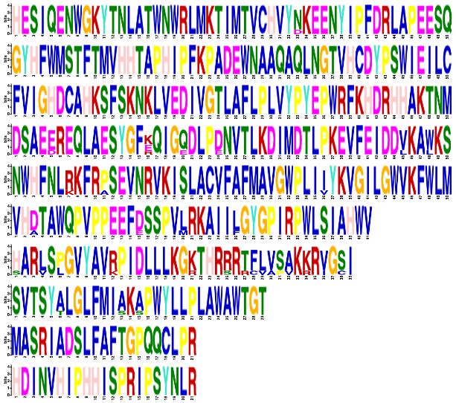
A
AT4G30935
B
AT4G30935
BolC03g081980.2J
BolC03g081980.2J
BolC3t21152H
BolC3t21152H
Bo3g175320
WRKY32_KDH
Bo3g175320
WRKY32_GCP04
WRKY32_KDH
0
100
200
300
400
500
WRKY32_GCP04
WRKY
0
50
100
150
200
250
300
350
400
450
500
C
D
1
AT4G30950
2
BolC03g081970.2J
3
BolC3t21150H
4
Bo3g175310
FAD6_KDH
5
FAD6_GCP04
6
DesA
0
100
200
300
400
500
7
Delta12_FADS like
8
FA desaturase
9
10
E
F
AT4G30950
1
BolC03g081970.2J
2
BolC3t21150H
3
Bo3g175310
4
FAD6_KDH
5
FAD6_GCP04
6
0
50
7
100
150
200
250
300
350
400
450
500
8
9
10

