Slide 1
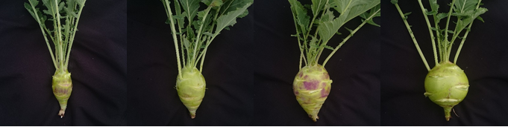
A
Stem Height
B
Stem Diameter
C
Grade
No. of recombinant plants
No. of recombinant plants
No. of recombinant plants
Scale of Grade
Stem height (mm)
Diameter of stem (mm)
D
Grade 1
SEI: >1.80
Grade 2
SEI: 1.80 – 1.51
Grade 3
SEI: 1.50 – 1.21
Grade 4
SEI: <1.21

