Slide 1
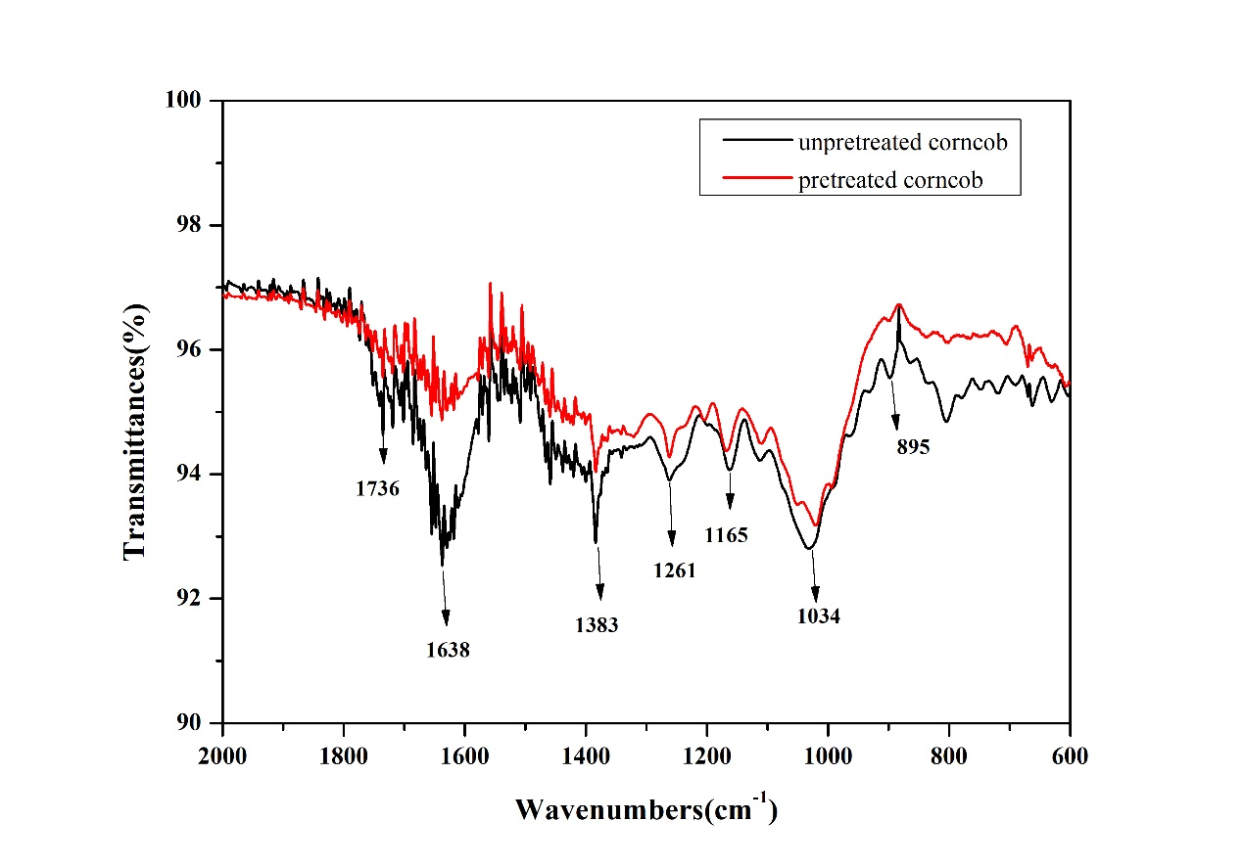
FTIR spectra of raw and pretreated corncob (600–2000 cm⁻¹).

