Slide 1
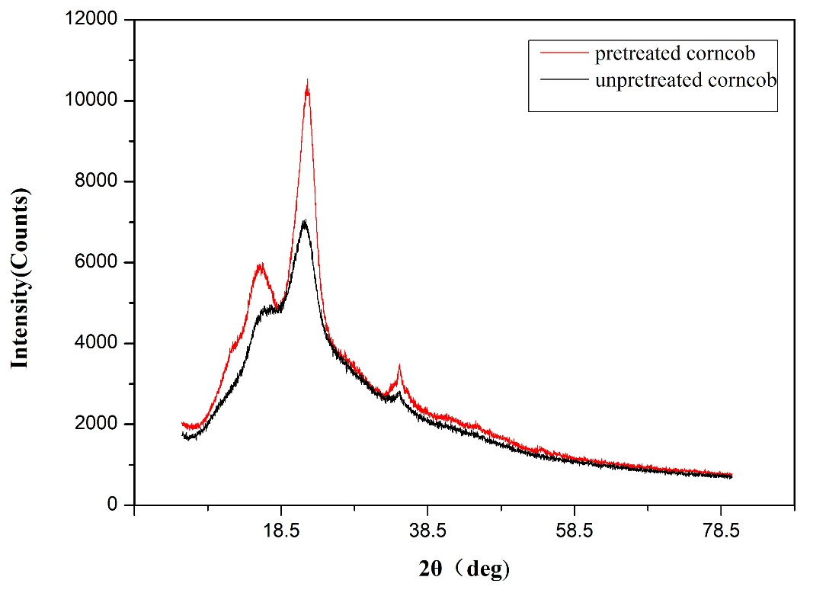
XRD data of raw and pretreated corncob.

