Slide 1
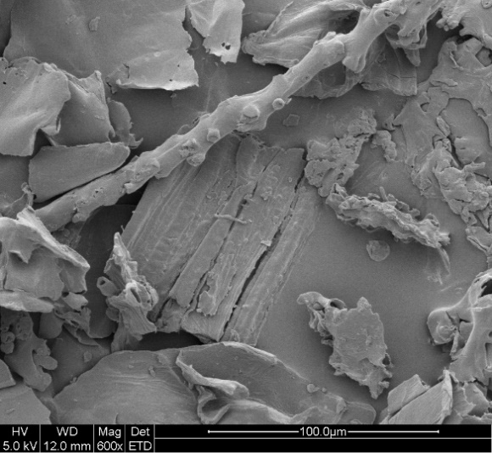
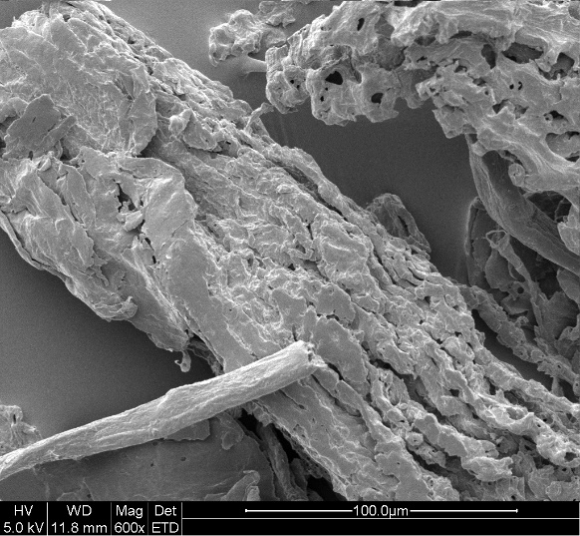
A
B
SEM analysis of raw or pretreated corncob at magnification of 600.
(A) untreated corncob (B) pretreated corncob by EaCl:LAC.

