Slide 1
Additional Figure 1
Safety and efficacy of pemetrexed for patients with non-small cell lung cancer in the setting of renal impairment
BMC Cancer
Yusuke Shima, Hironori Yoshida*, Keiichiro Suminaga, Hiroshi Yoshida, Kentaro Hashimoto, Tatsuya Ogimoto,
Kazutaka Hosoya, Hitomi Ajimizu, Tomoko Funazo, Takashi Nomizo, Hiroaki Ozasa, and Toyohiro Hirai
Department of Respiratory Medicine, Graduate School of Medicine, Kyoto University, Kyoto, Japan
*Corresponding author: Hironori Yoshida, MD
Department of Respiratory Medicine, Graduate School of Medicine, Kyoto University,
54 Kawaharacho, Shogoin, Sakyo-ku, Kyoto 606-8507, Japan
E-mail: highd42@kuhp.kyoto-u.ac.jp

Slide 2
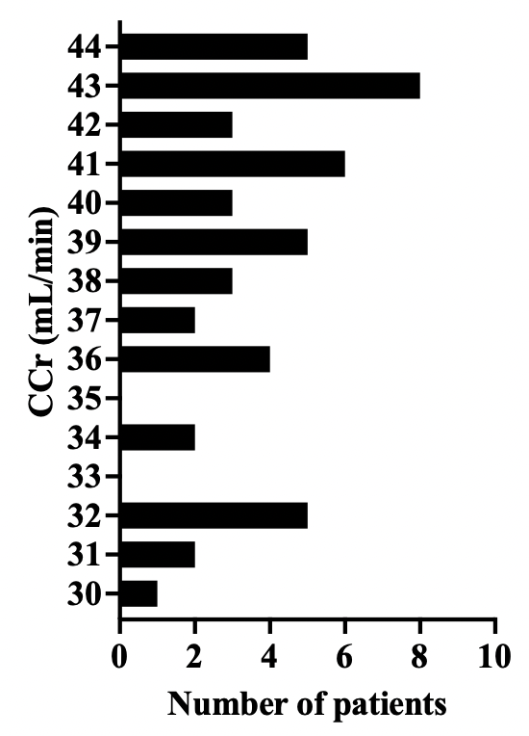
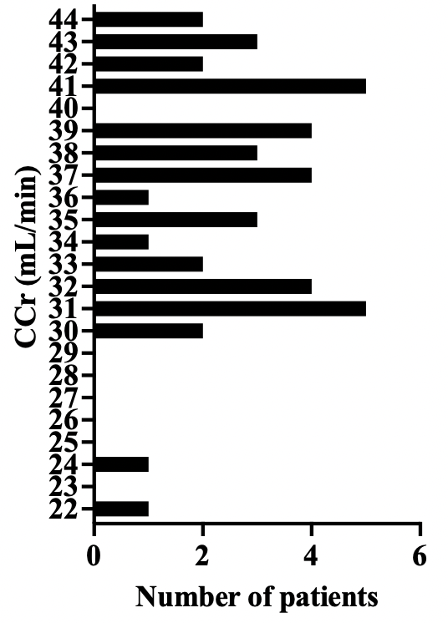
Additional Figure 1. The distribution of patients with CCr ≤45
Platinum-concomitant group
Pemetrexed-alone group

Slide 3
Additional Figure 1. The distribution of patients with CCr ≤45
Histogram shows the number of patients with CCr ≤45 in each treatment groups.
CCr, creatinine clearance

