Slide 1
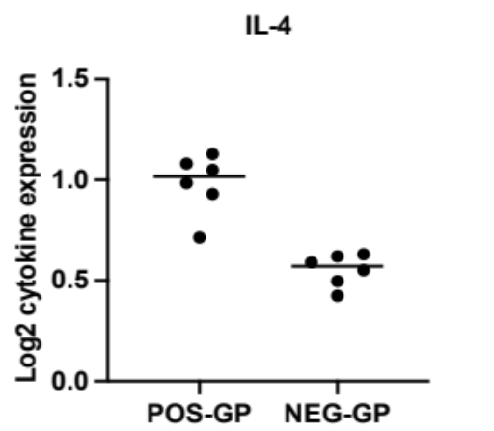
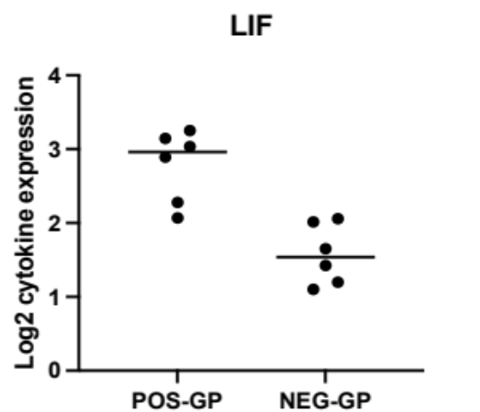
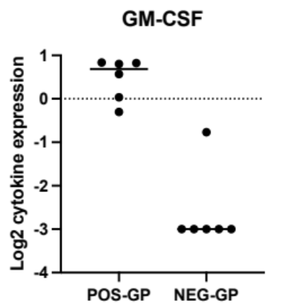
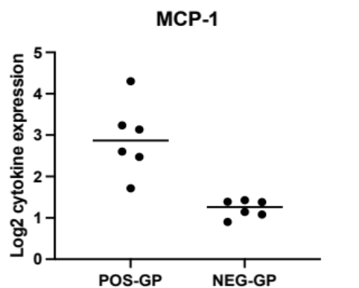
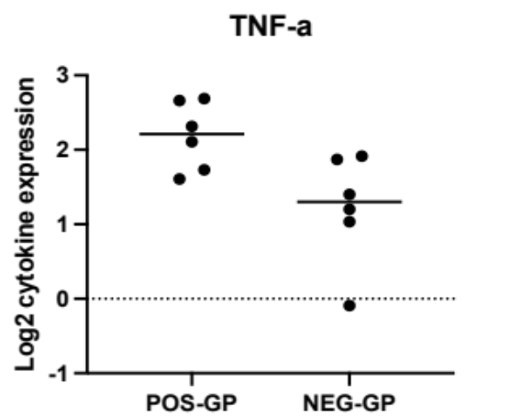
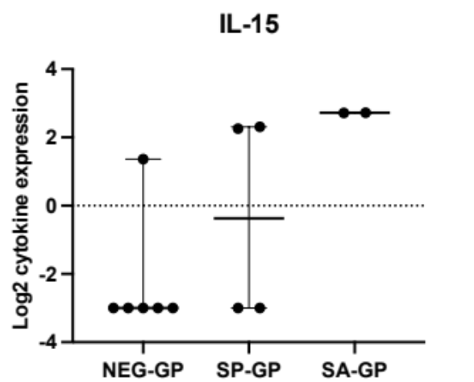
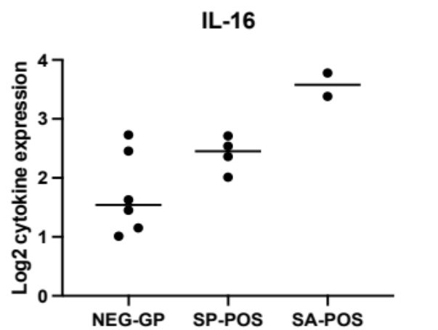
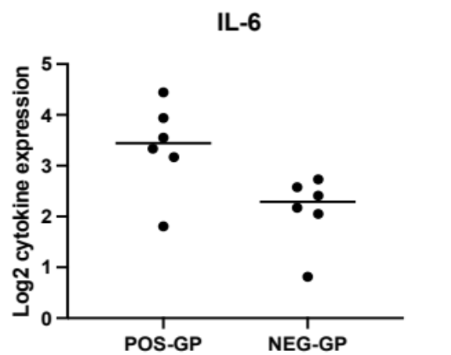
Suppl. Fig. 1 Top cytokine elevated in infection positive group
A
B
C
D
p =0.0009
p =0.001
p <0.0001
p <0.0001
E
F
H
G
p =NS
p =0.01
p =0.02
p =0.009
p =0.01
p =0.02
G-H: Staphylococcus infection associated cytokine IL-15 & IL-16
ABBREVIATIONS:
POS, positive
NEG, negative
SP, Streptococcus pyogenes
SA, Staphylococcus aureus

Slide 2
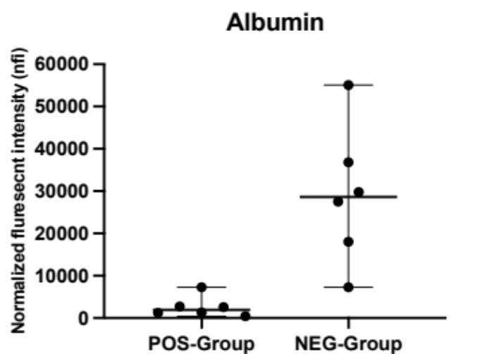
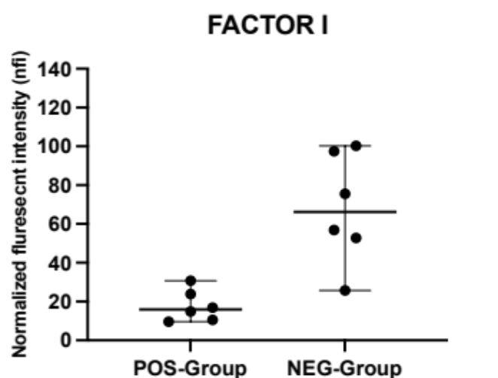
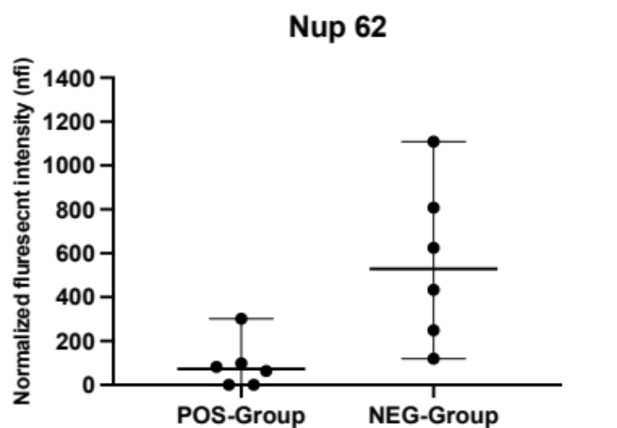
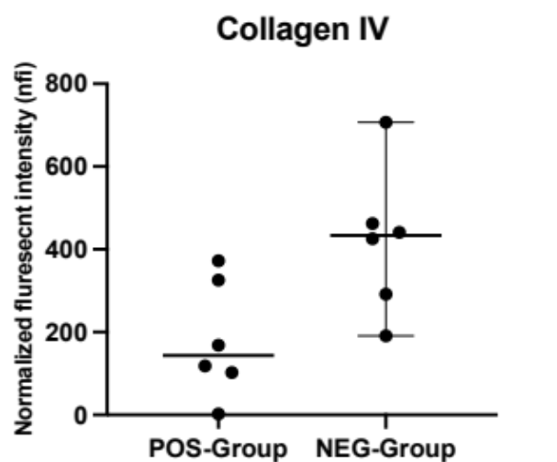
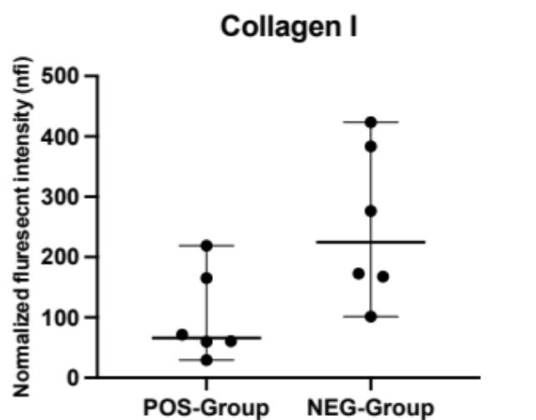
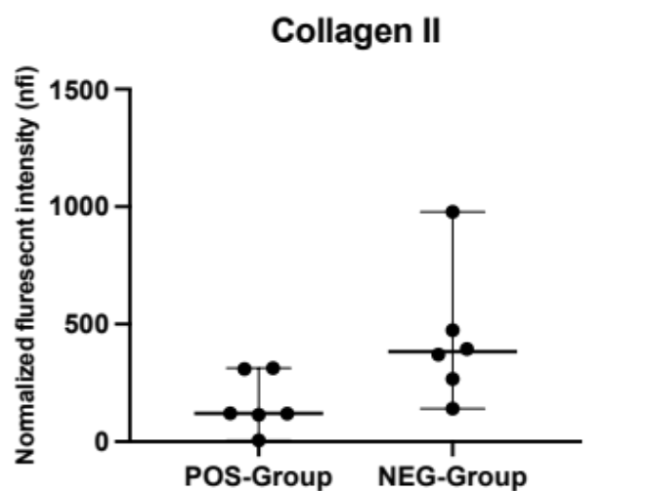
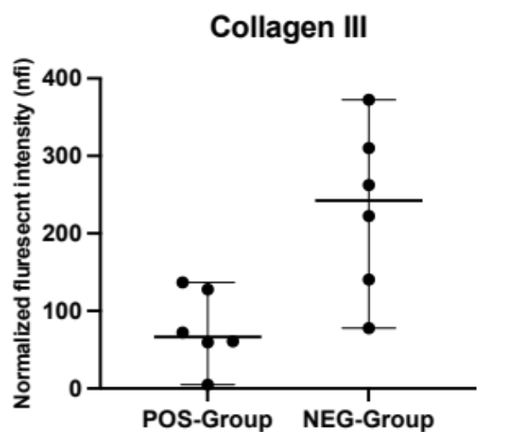
Suppl. Fig.2. Top autoantibodies associated with infection negative group
p =0.002
p =0.002
p =0.01
p =0.01
p =0.02
p =0.03
p =0.05

Slide 3
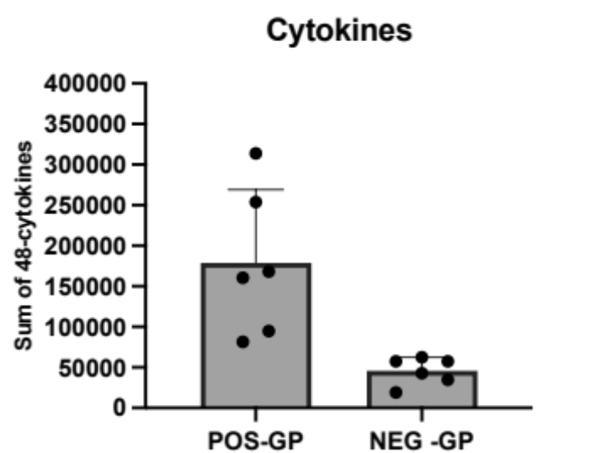
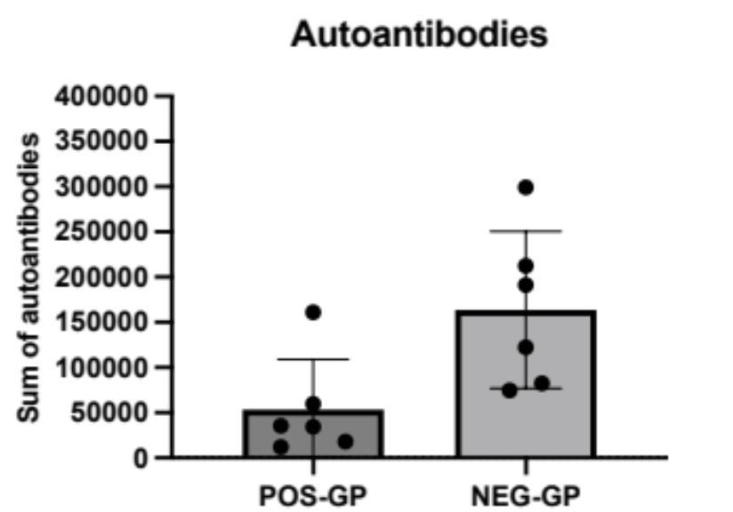
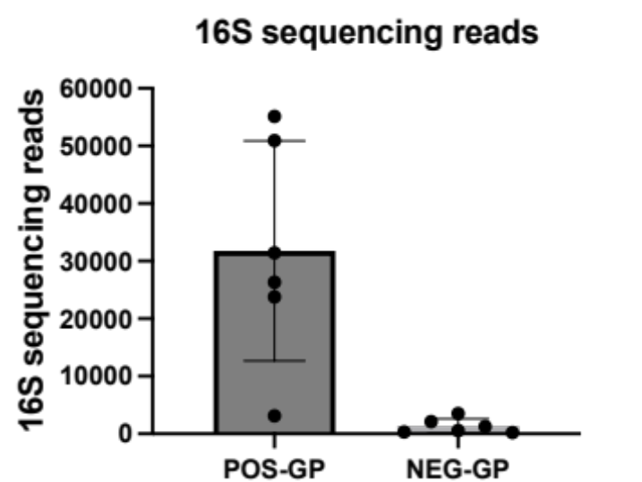
Suppl. Fig.3. Significantly different multiomics results between infection negative vs infection positive subset
P=0.02
P=0.005
P=0.003

Slide 4
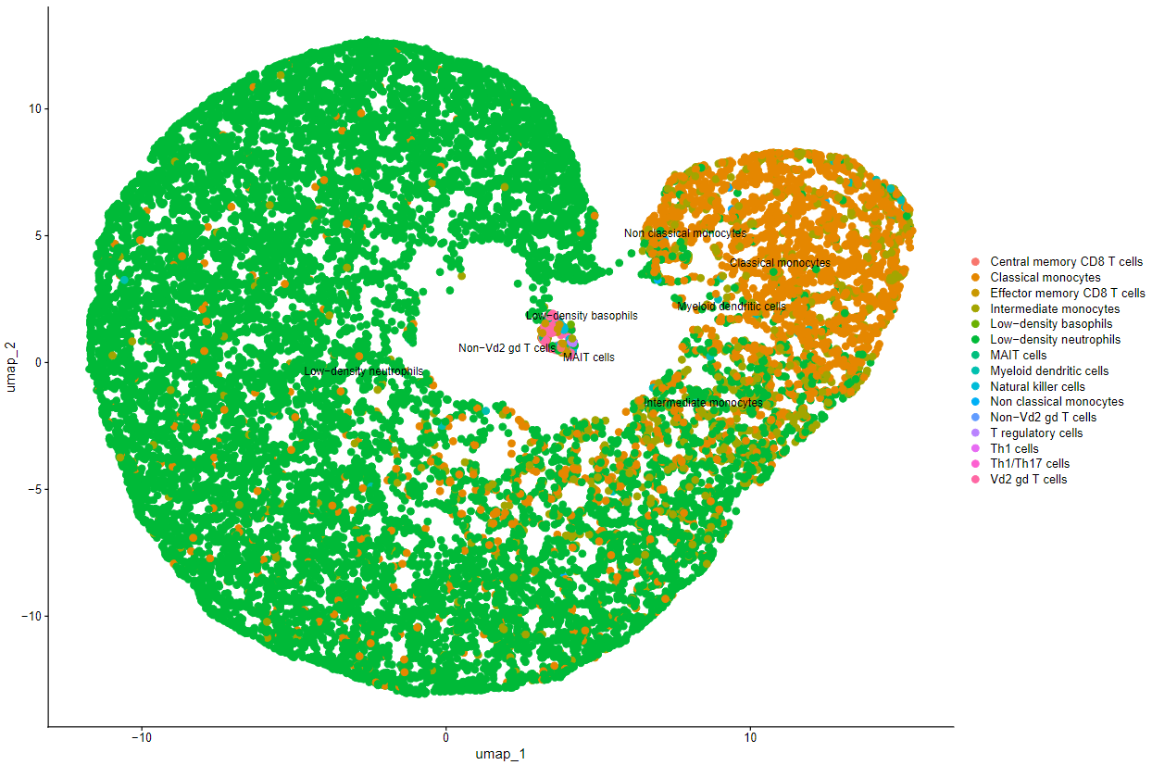
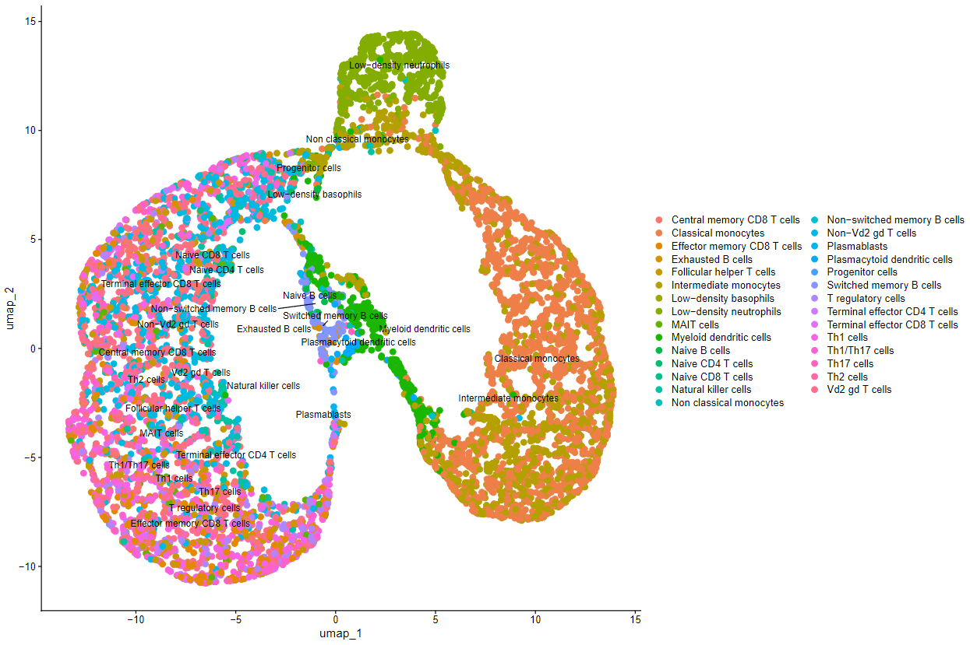
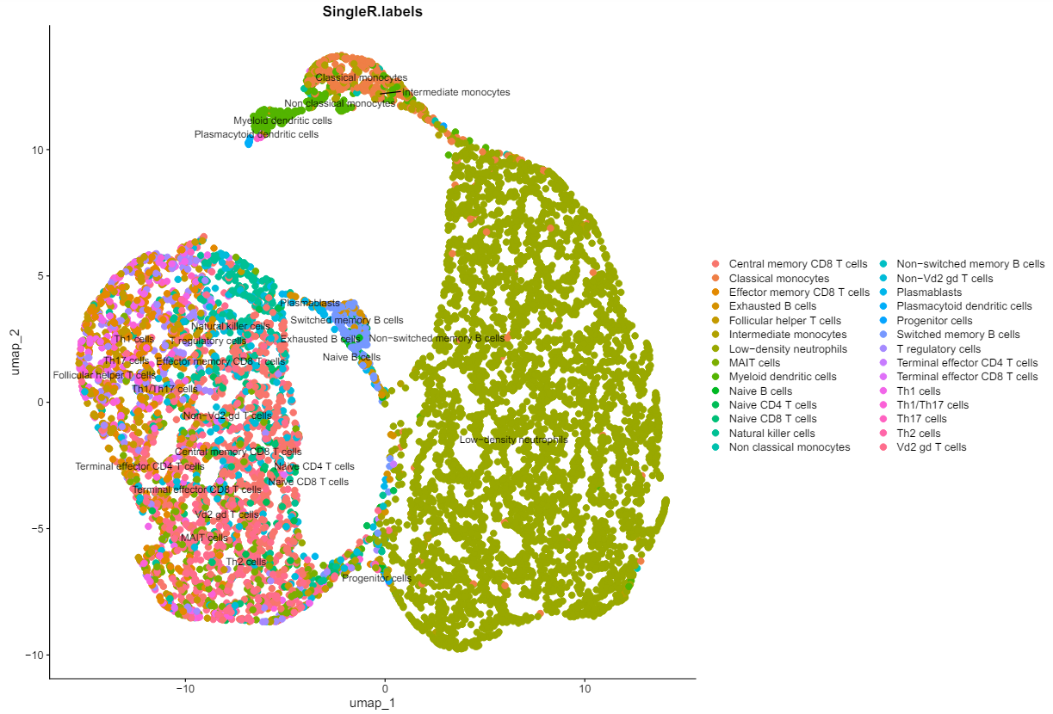
A. JF7
Suppl. Fig.4. Single cell RNA sequencing analysis unravel immune cell composition of infection positive (JF7) vs Infection negative (JF8 & JF12) joint-fluids
B. JF8
C. JF9

Slide 5
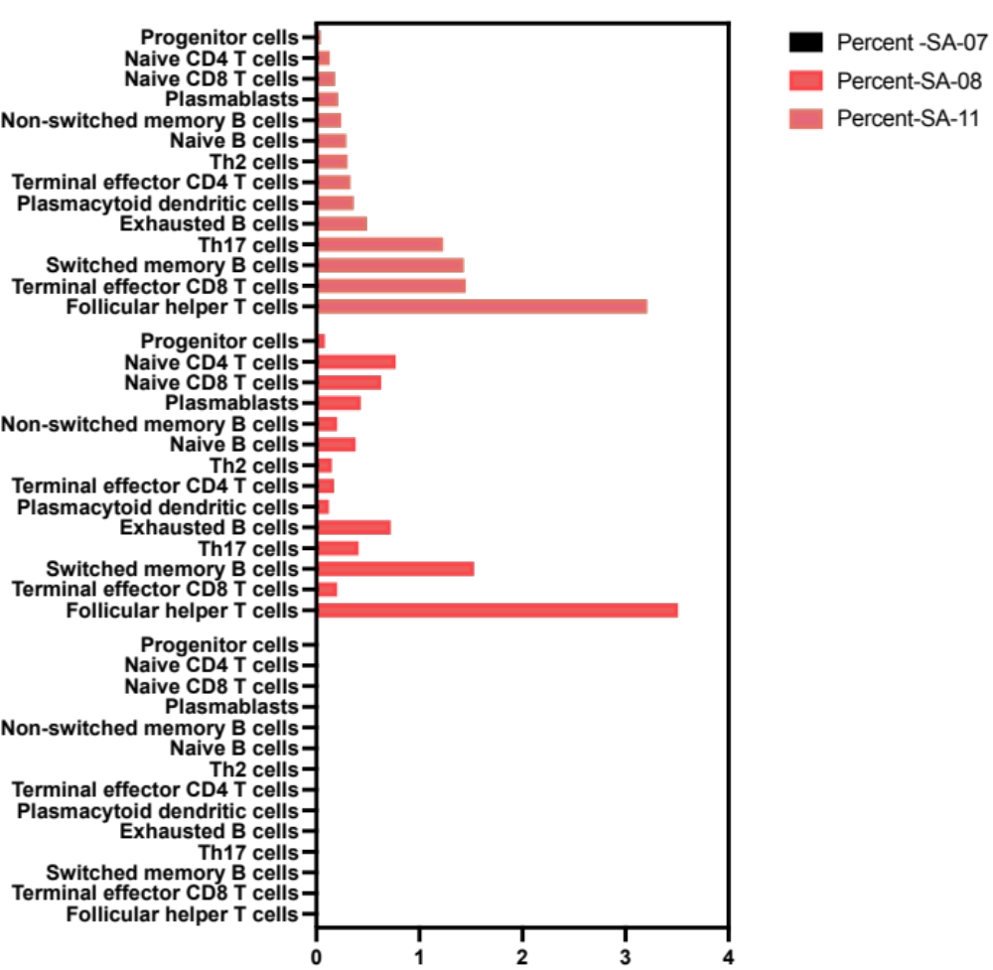
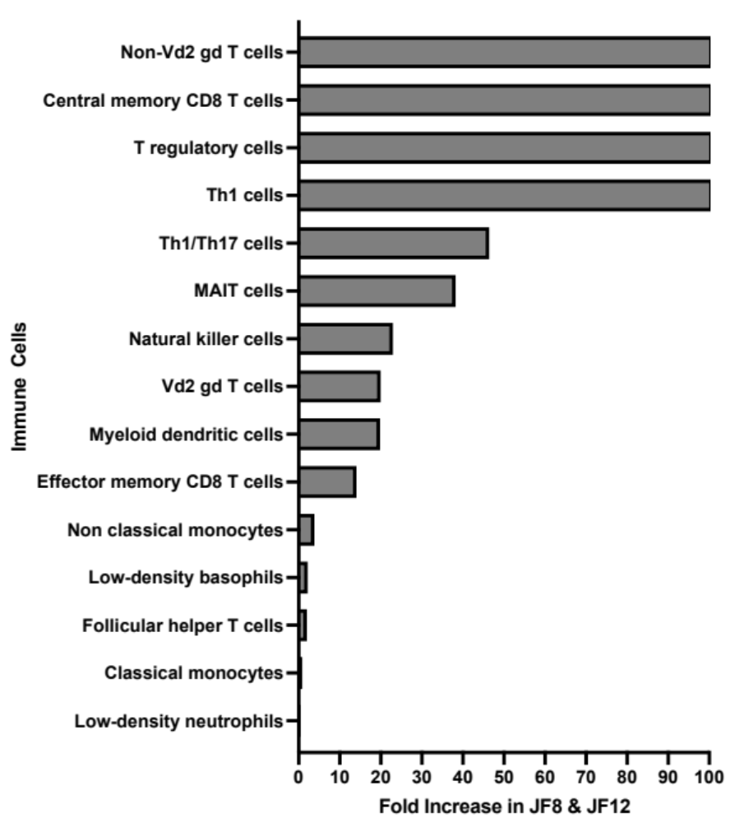
Suppl. Fig.5. Single cell RNA sequencing analysis unravel immune cell composition of infection positive (JF7) vs Infection negative (JF8 & JF12) joint-fluids. Panel A shows cell types exclusively detected in JF8 and JF12 specimen. Panel B shows fold increase in percentage of immune cell types in JF8 & JF12 sample as compared to JF7.
A
B
JF12
JF8
JF7

