Slide 1
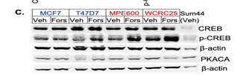
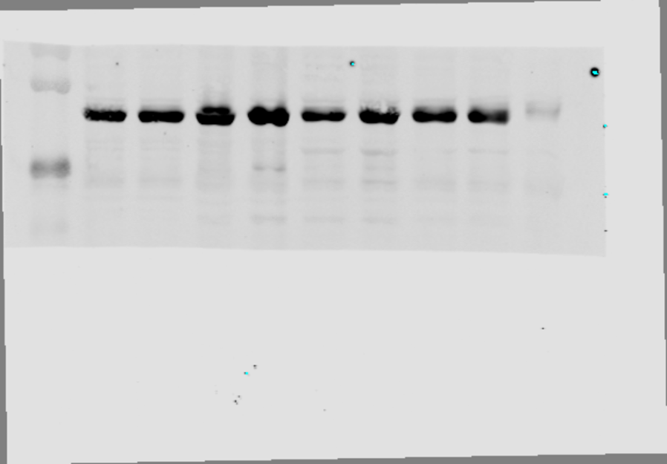
Figure 4. part C
CREB
55K
35K

Slide 2
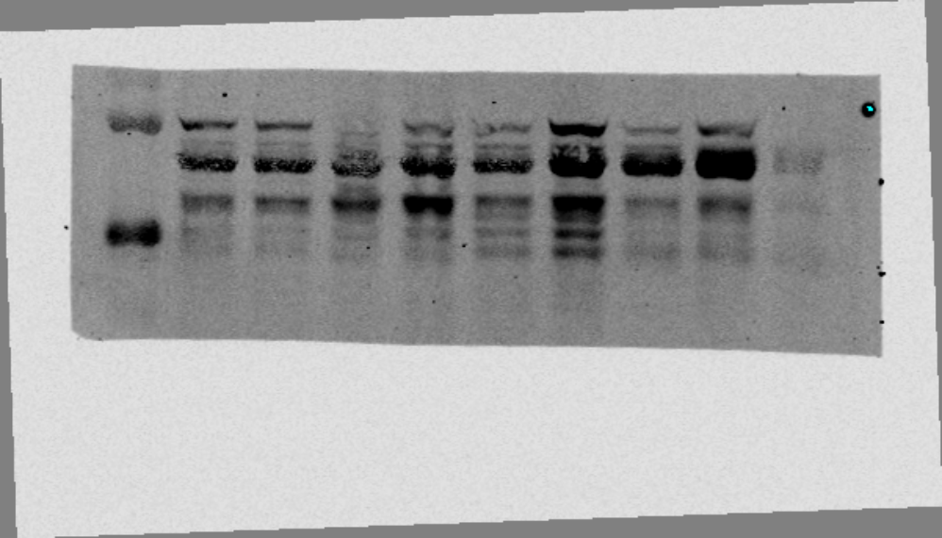
Figure 4. part C
P-CREB
55K
35K

Slide 3
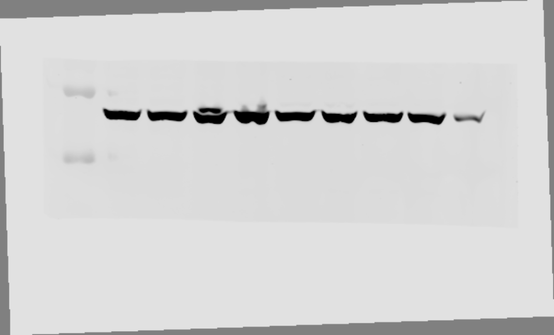
Figure 4. part C
β-actin
55K
35K

Slide 4
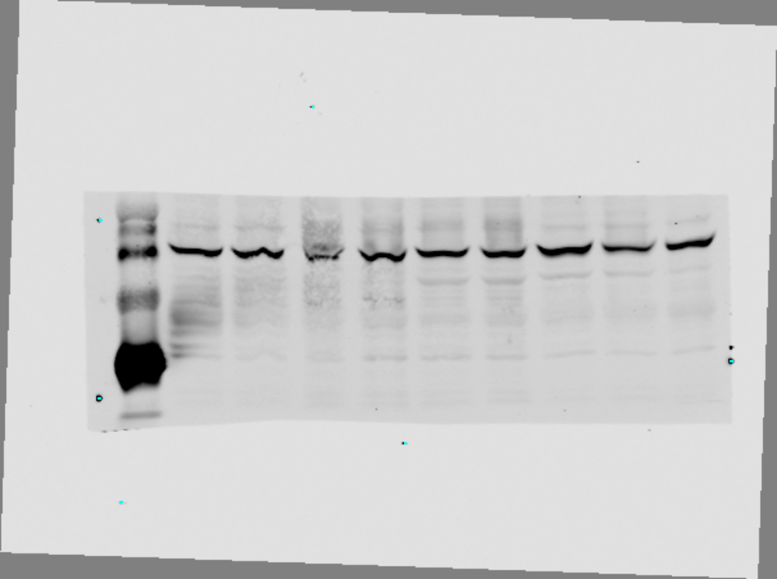
Figure 4. part C
PKAC
55K
35K

Slide 5
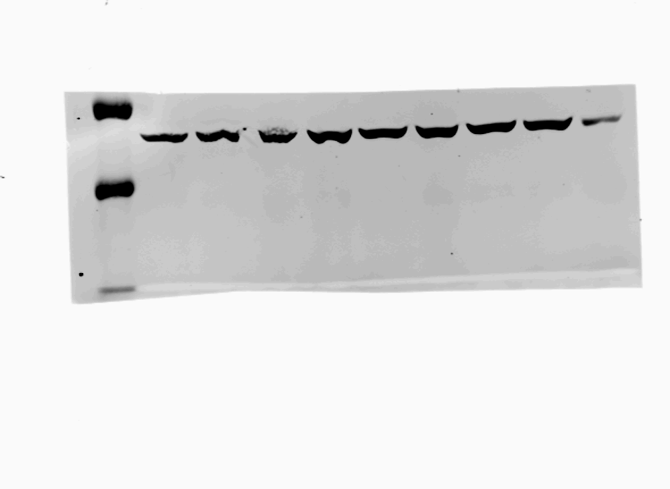
Figure 4. part C
Β-actin
55K
35K

Slide 6

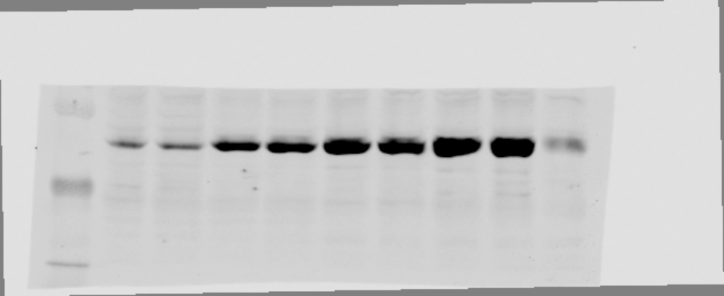
Figure 4. part C
CREB
55K
35K

Slide 7
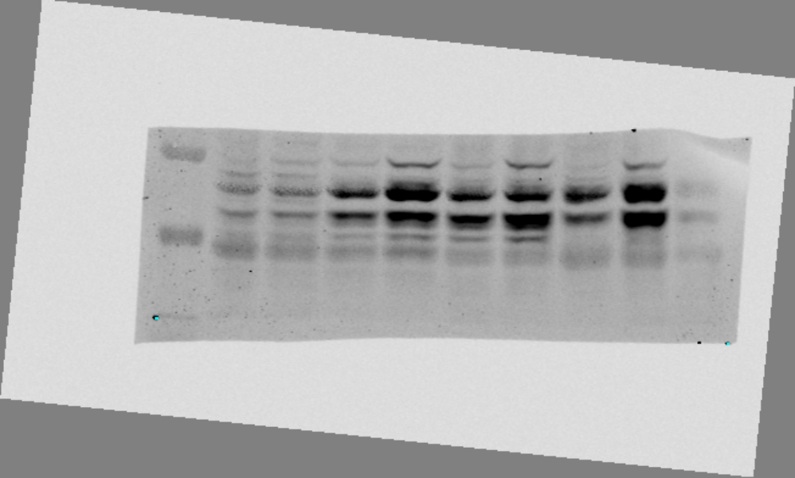
Figure 4. part C
P-CREB
55K
35K

Slide 8
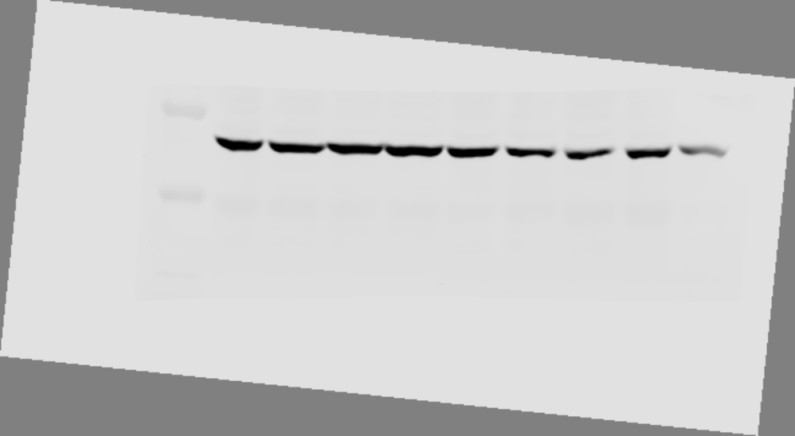
Figure 4. part C
β-actin
55K
35K

Slide 9
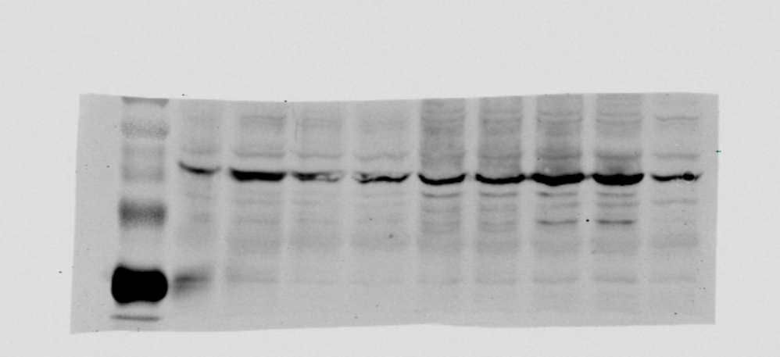
Figure 4. part C
PKACA
55K
35K

Slide 10
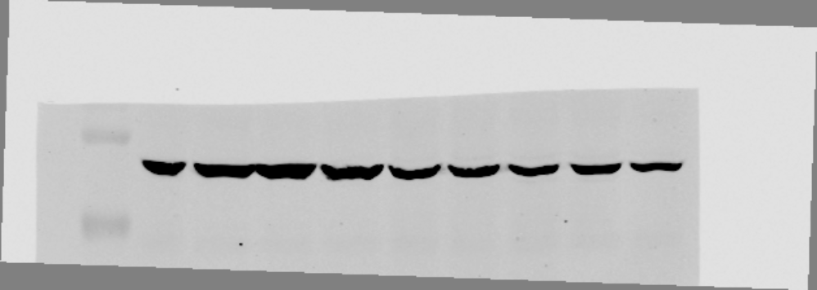
Figure 4. part C
Β-actin
55K
35K

Slide 11

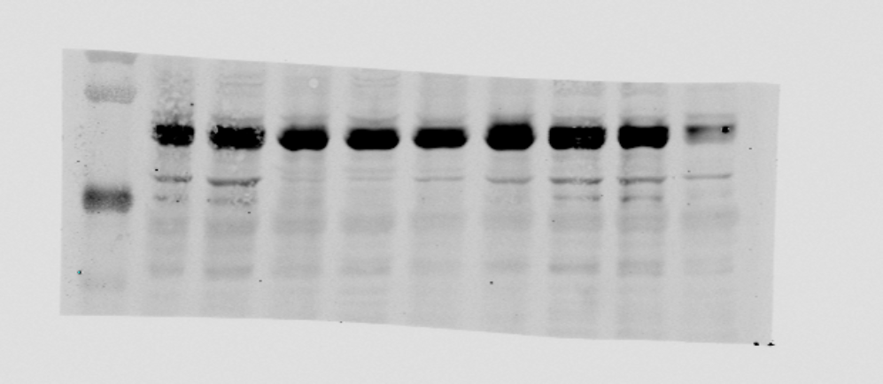
Figure 4. part C
CREB
55K
35K

Slide 12
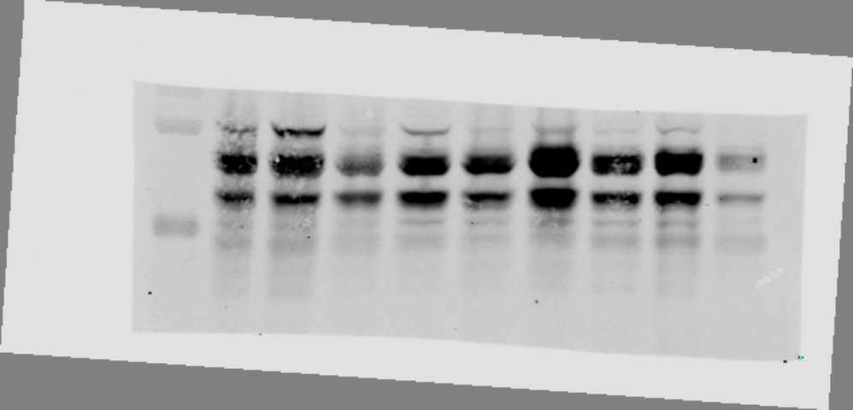
Figure 4. part C
p-CREB
55K
35K

Slide 13
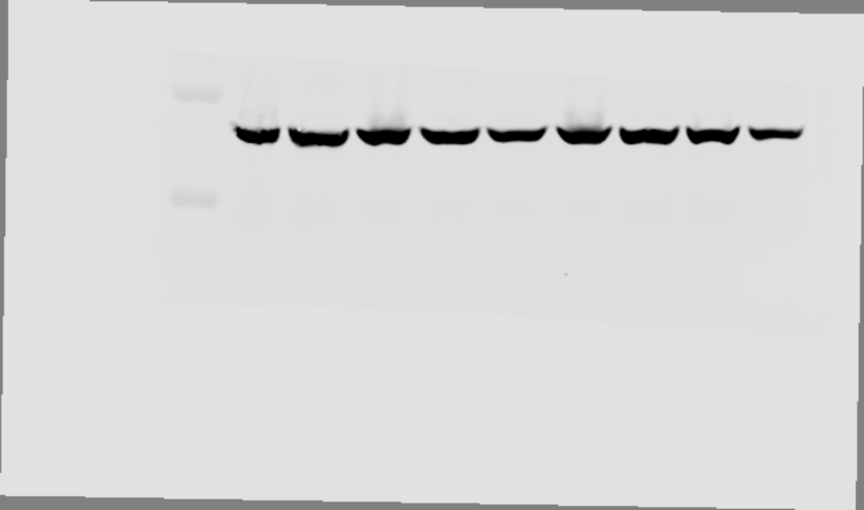
Figure 4. part C
β-actin
55K
35K

Slide 14
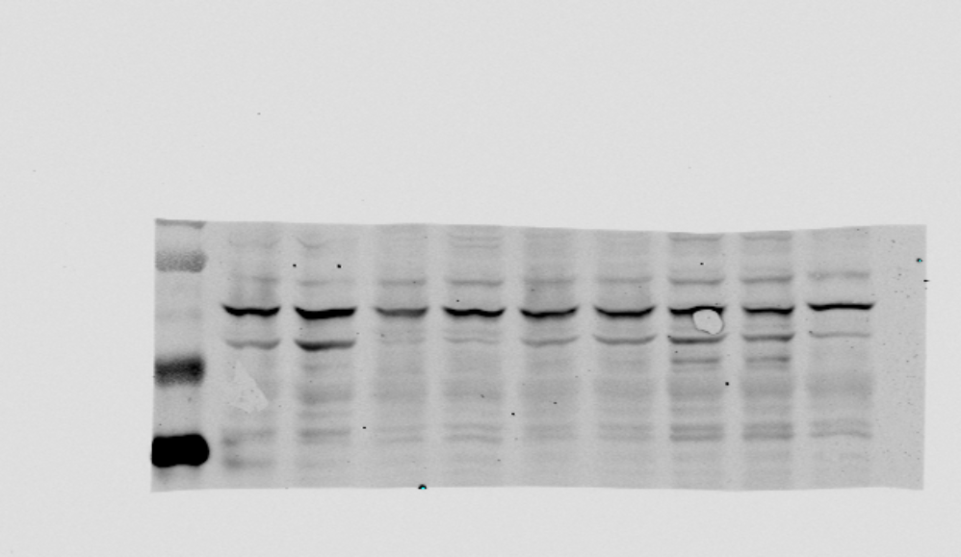
Figure 4. part C
PKACA
55K
35K

Slide 15
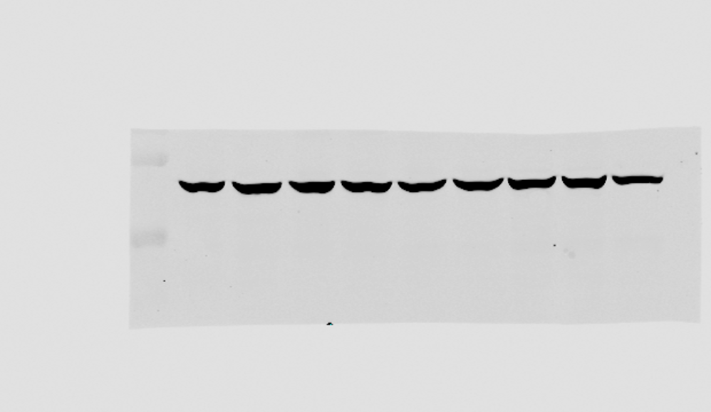
Figure 4. part C
β-actin
55K
35K

Slide 16

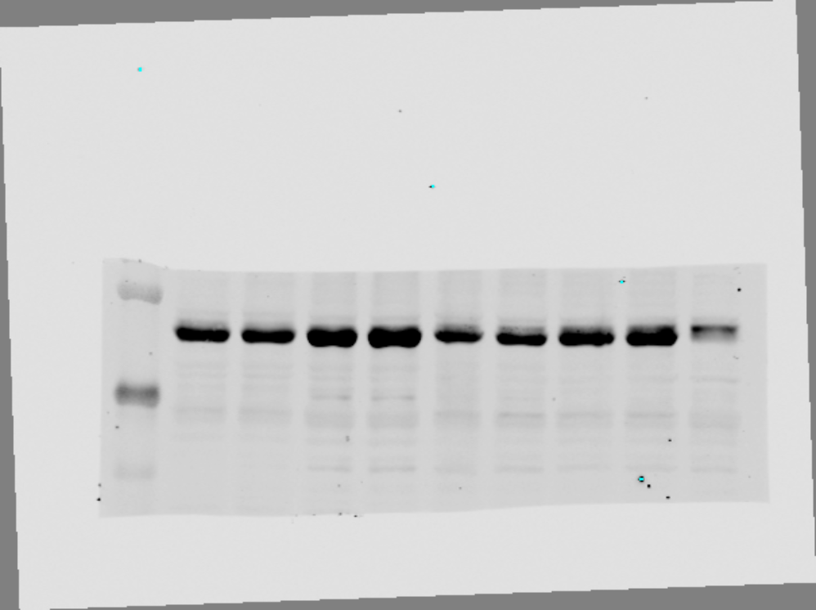
Supplementary Fig 3 part A
A.
MCF7 |  | T47D7 |  | MPE600 |  | WCRC25
Veh | Forsk | Veh | Forsk | Veh | Forsk | Veh | Forsk
Sum44 (Veh)
CREB
P-CREB
β-actin
PKACA
β-actin
CREB
55K
35K

Slide 17
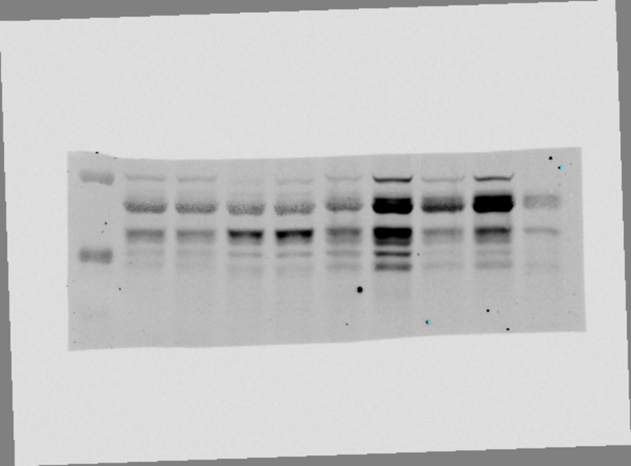
Supplementary Fig 3 part A
A.
MCF7 |  | T47D7 |  | MPE600 |  | WCRC25
Veh | Forsk | Veh | Forsk | Veh | Forsk | Veh | Forsk
Sum44 (Veh)
CREB
P-CREB
β-actin
PKACA
β-actin
p-CREB
55K
35K

Slide 18
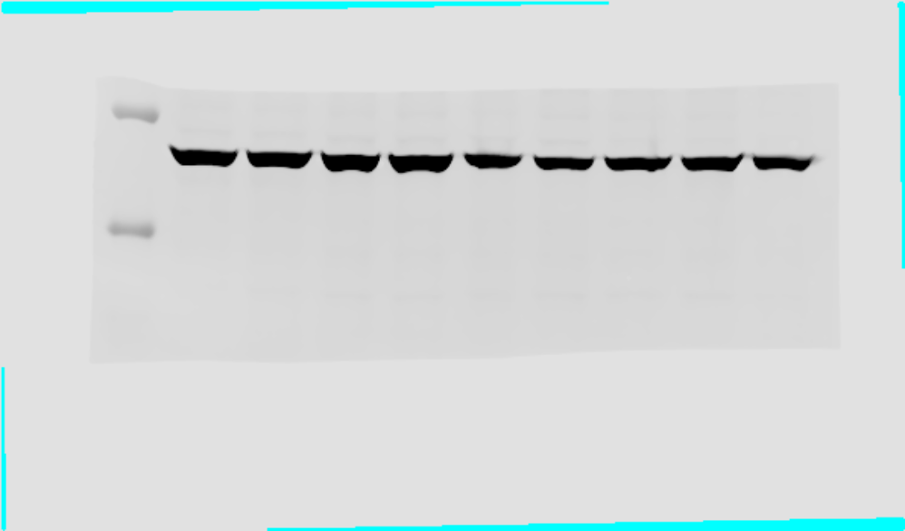
Supplementary Fig 3 part A
A.
MCF7 |  | T47D7 |  | MPE600 |  | WCRC25
Veh | Forsk | Veh | Forsk | Veh | Forsk | Veh | Forsk
Sum44 (Veh)
CREB
P-CREB
β-actin
PKACA
β-actin
β-actin
55K
35K

Slide 19
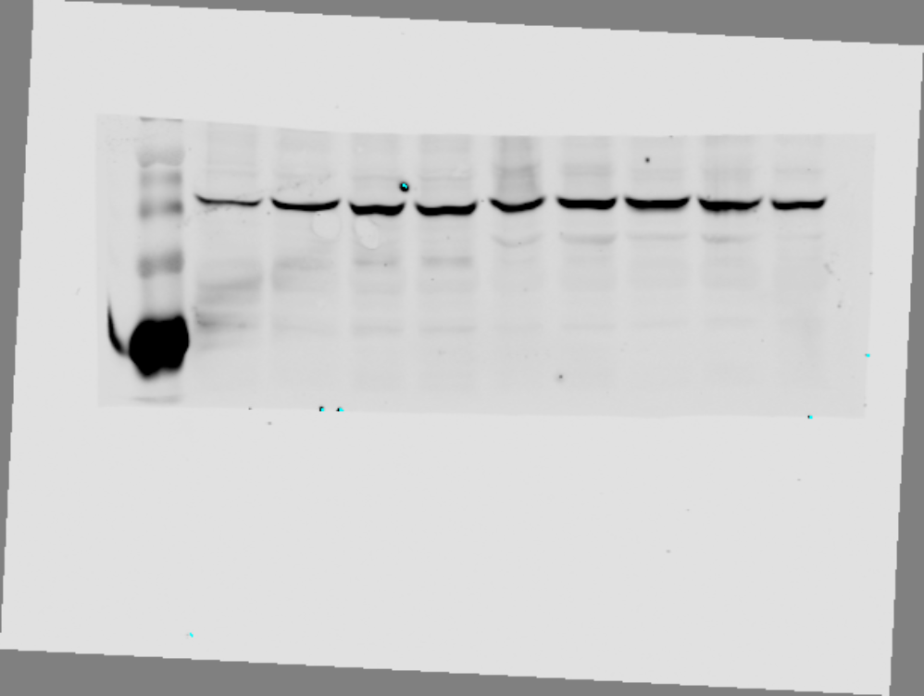
Supplementary Fig 3 part A
A.
MCF7 |  | T47D7 |  | MPE600 |  | WCRC25
Veh | Forsk | Veh | Forsk | Veh | Forsk | Veh | Forsk
Sum44 (Veh)
CREB
P-CREB
β-actin
PKACA
β-actin
PKCA
55K
35K

Slide 20
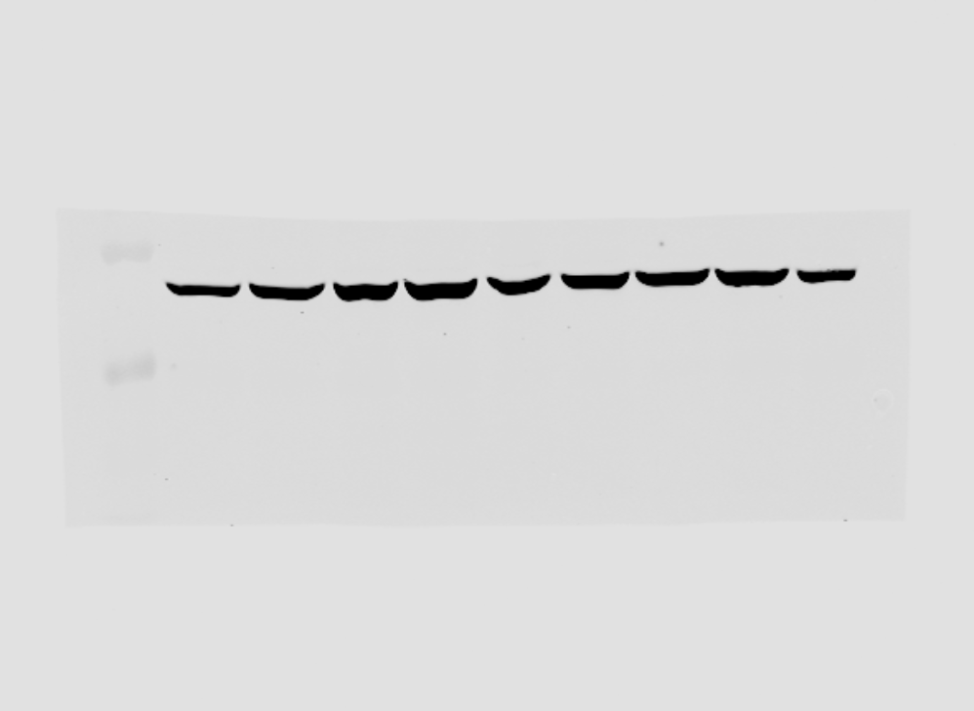
Supplementary Fig 3 part A
A.
MCF7 |  | T47D7 |  | MPE600 |  | WCRC25
Veh | Forsk | Veh | Forsk | Veh | Forsk | Veh | Forsk
Sum44 (Veh)
CREB
P-CREB
β-actin
PKACA
β-actin
β-actin
55K
35K

Slide 21

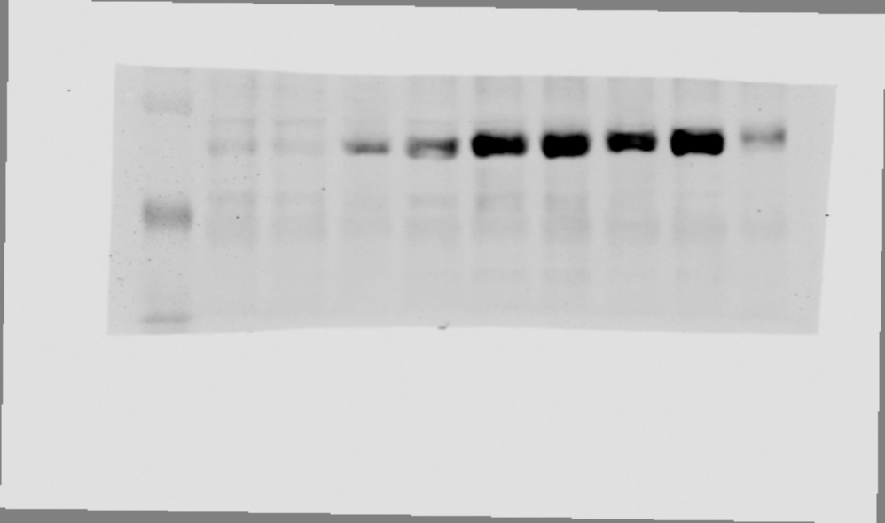
Supplementary Fig 3 part A
BT474 |  | ZR75-30 |  | EFM19 |  | MM134
Veh | Fors | Veh | Fors | Veh | Fors | Veh | Fors
Sum44 (Veh)
CREB
P-CREB
β-actin
PKACA
β-actin
CREB
55K
35K

Slide 22
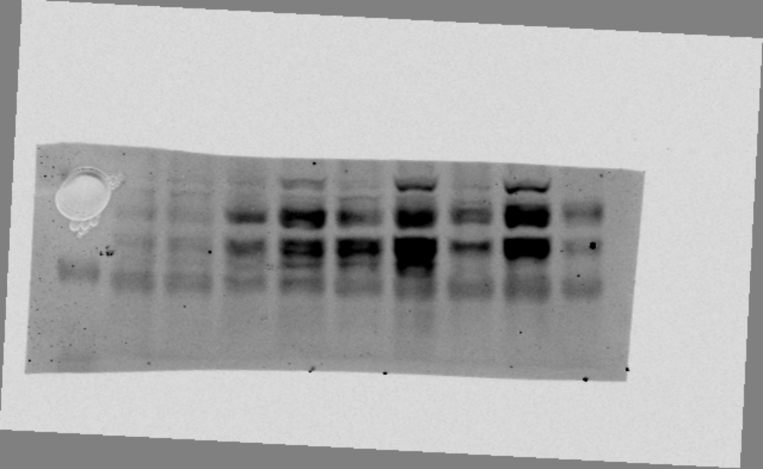
Supplementary Fig 3 part A
BT474 |  | ZR75-30 |  | EFM19 |  | MM134
Veh | Fors | Veh | Fors | Veh | Fors | Veh | Fors
Sum44 (Veh)
CREB
P-CREB
β-actin
PKACA
β-actin
P-CREB
55K
35K

Slide 23
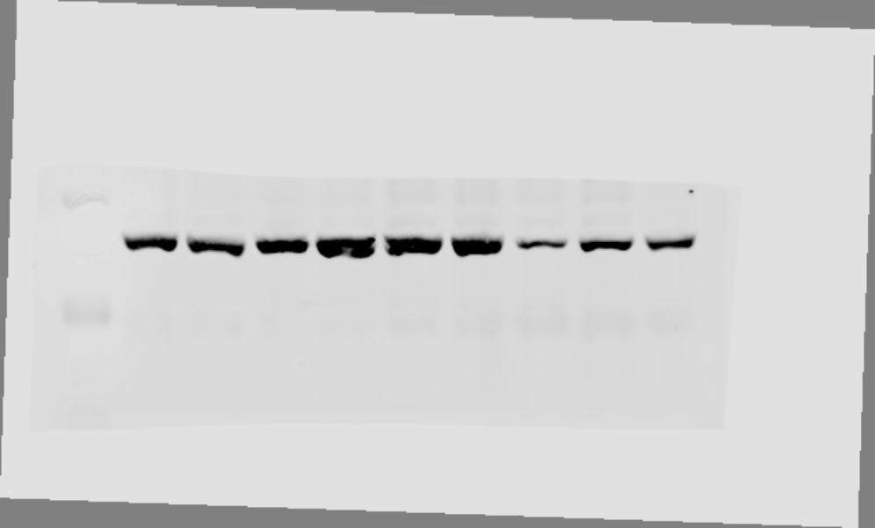
Supplementary Fig 3 part A
BT474 |  | ZR75-30 |  | EFM19 |  | MM134
Veh | Fors | Veh | Fors | Veh | Fors | Veh | Fors
Sum44 (Veh)
CREB
P-CREB
β-actin
PKACA
β-actin
Β-actin
55K
35K

Slide 24
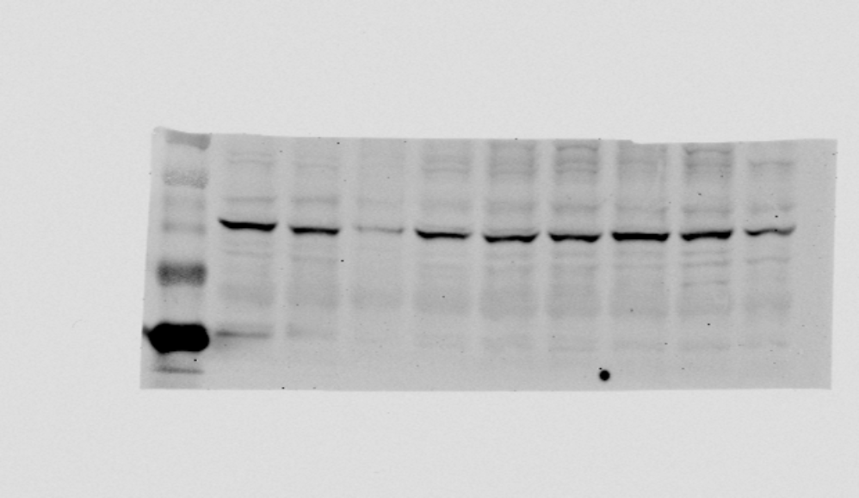
Supplementary Fig 3 part A
BT474 |  | ZR75-30 |  | EFM19 |  | MM134
Veh | Fors | Veh | Fors | Veh | Fors | Veh | Fors
Sum44 (Veh)
CREB
P-CREB
β-actin
PKACA
β-actin
PKAC
55K
35K

Slide 25
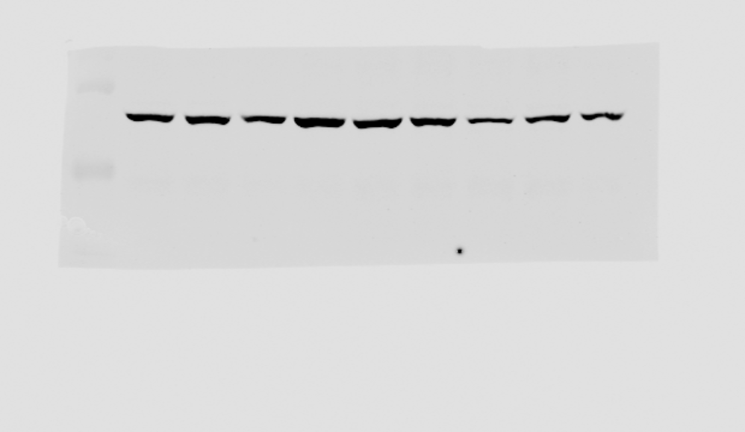
Supplementary Fig 3 part A
BT474 |  | ZR75-30 |  | EFM19 |  | MM134
Veh | Fors | Veh | Fors | Veh | Fors | Veh | Fors
Sum44 (Veh)
CREB
P-CREB
β-actin
PKACA
β-actin
55K
35K

Slide 26



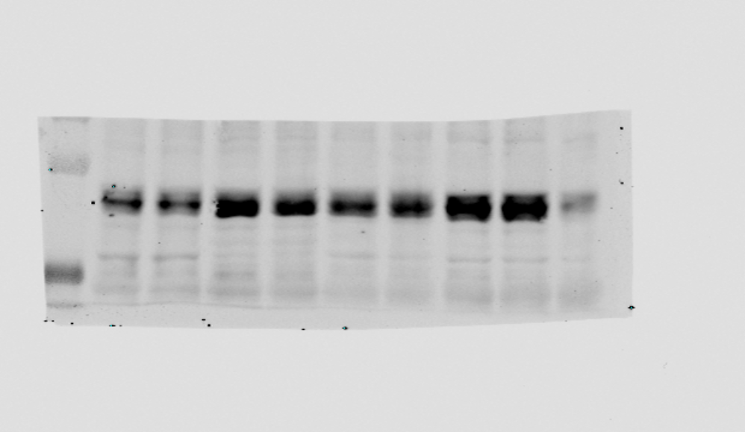
Supplementary Fig 3 part A
ZR75-1 |  | CAMA-1 |  | BCK4 |  | SUM44
Veh | Fors | Veh | Fors | Veh | Fors | Veh | Fors
Sum44 (Veh)
CREB
P-CREB
β-actin
PKACA
β-actin
CREB
55K
35K

Slide 27
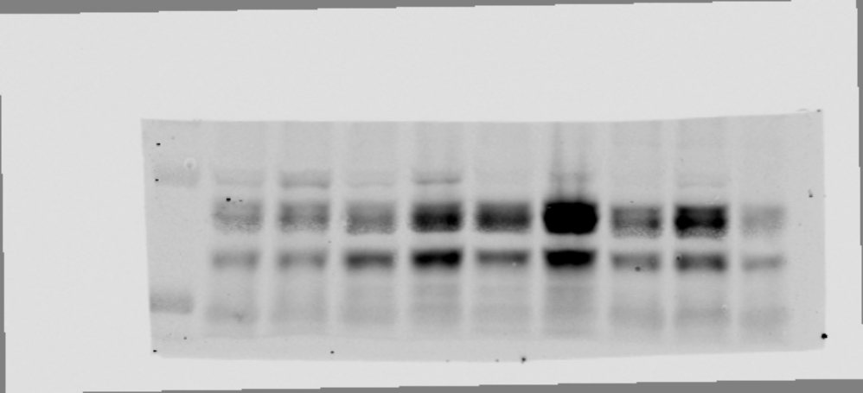
Supplementary Fig 3 part A
ZR75-1 |  | CAMA-1 |  | BCK4 |  | SUM44
Veh | Fors | Veh | Fors | Veh | Fors | Veh | Fors
Sum44 (Veh)
CREB
P-CREB
β-actin
PKACA
β-actin
P-CREB
55K
35K

Slide 28
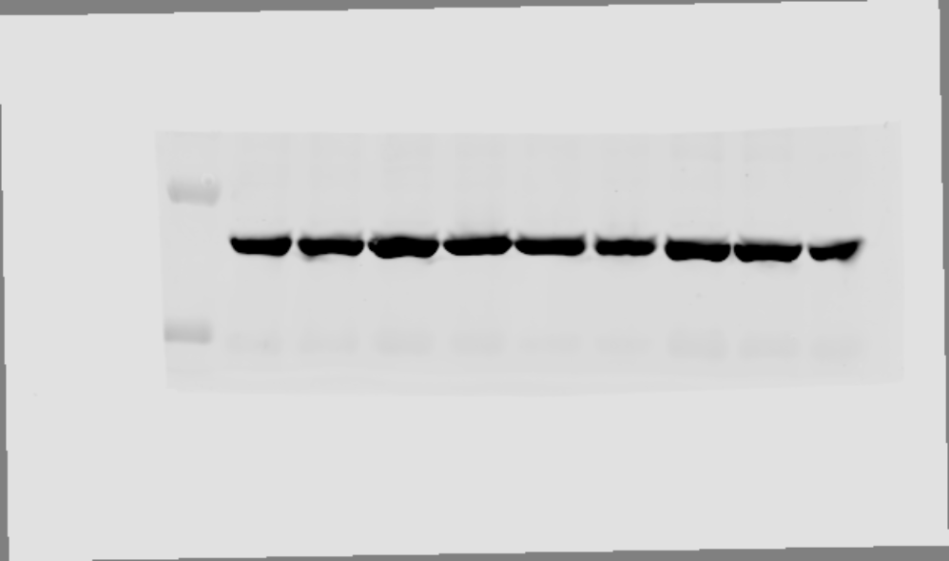
Supplementary Fig 3 part A
ZR75-1 |  | CAMA-1 |  | BCK4 |  | SUM44
Veh | Fors | Veh | Fors | Veh | Fors | Veh | Fors
Sum44 (Veh)
CREB
P-CREB
β-actin
PKACA
β-actin
β-actin
55K
35K

Slide 29
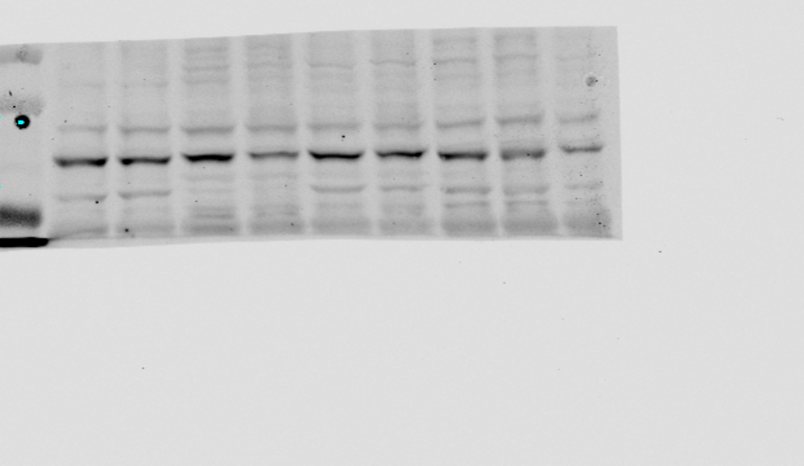
Supplementary Fig 3 part A
ZR75-1 |  | CAMA-1 |  | BCK4 |  | SUM44
Veh | Fors | Veh | Fors | Veh | Fors | Veh | Fors
Sum44 (Veh)
CREB
P-CREB
β-actin
PKACA
β-actin
PKAC
55K
35K

Slide 30
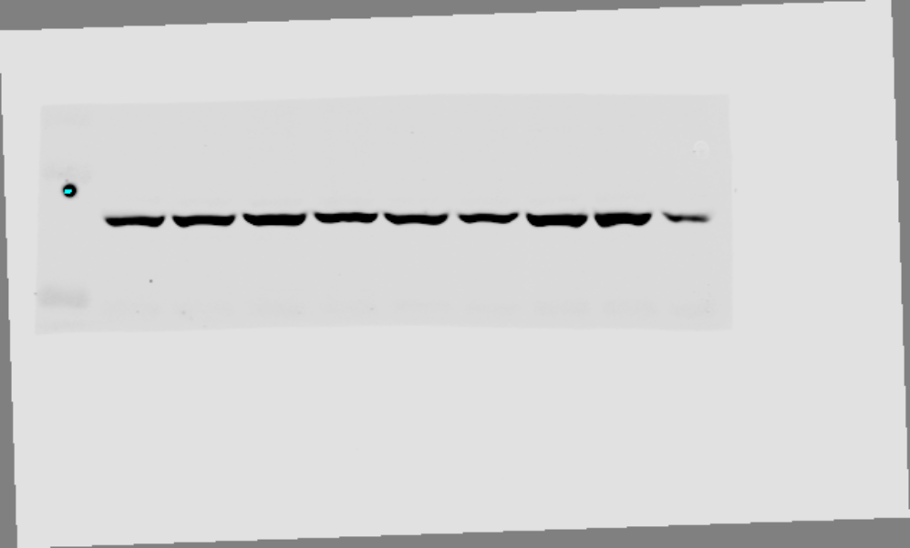
Supplementary Fig 3 part A
ZR75-1 |  | CAMA-1 |  | BCK4 |  | SUM44
Veh | Fors | Veh | Fors | Veh | Fors | Veh | Fors
Sum44 (Veh)
CREB
P-CREB
β-actin
PKACA
β-actin
Β-actin
55K
35K

Slide 31
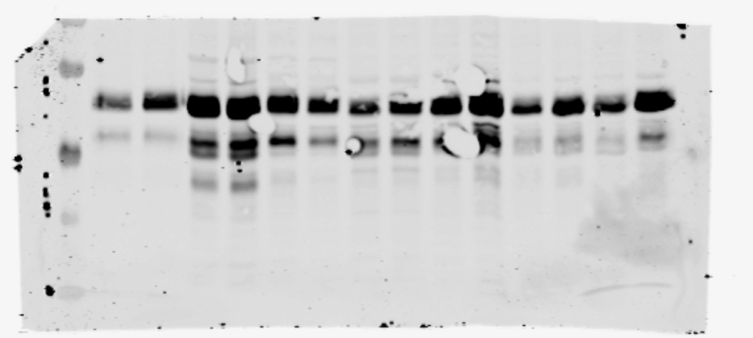
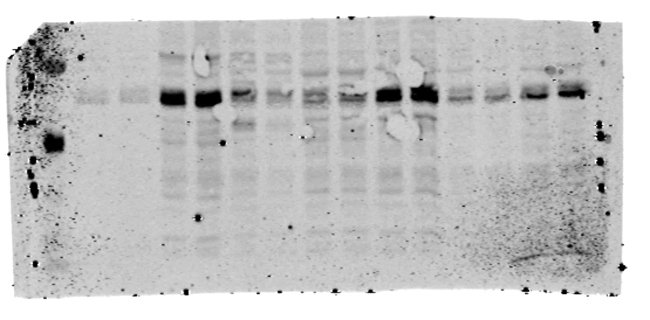
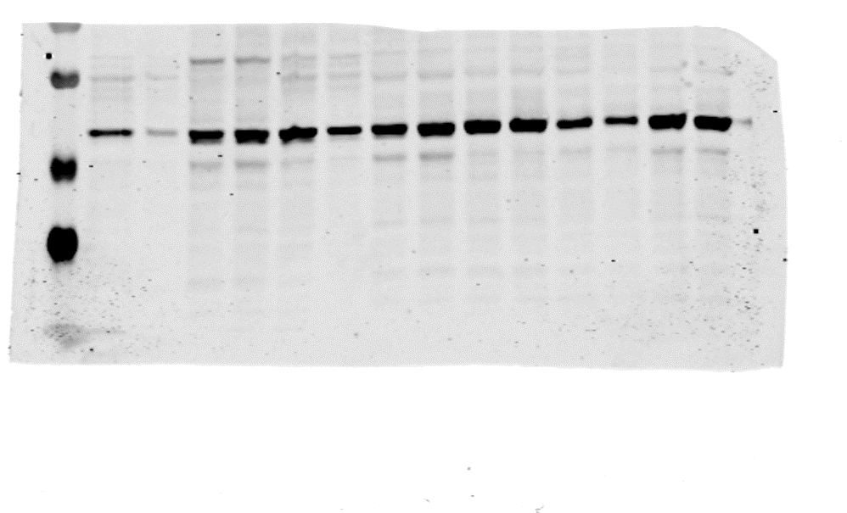
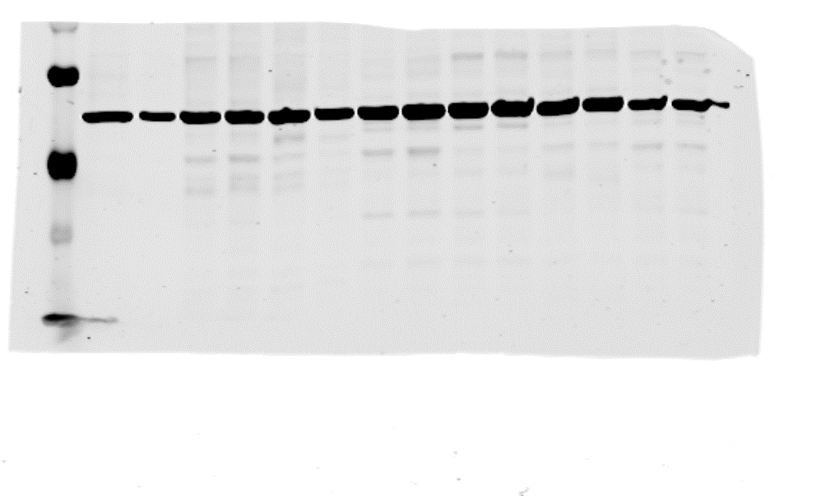
Supplementary Fig 5 Part A
PDO Number
PDO 126 |  | PDO 56 |  | PDO 134 |  | PDO 53 |  | PDO 86 |  | PDO 123 |  | PDO 146
Veh | Frsk | Veh | Frsk | Veh | Frsk | Veh | Frsk | Veh | Frsk | Veh | Frsk | Veh | Frsk
Treatment
p-CREB
CREB
E-cad
β-actin
PKA Cα
β-actin
p-CREB
55 KD
35 KD

Slide 32
Supplementary Fig 5 Part A
PDO Number
PDO 126 |  | PDO 56 |  | PDO 134 |  | PDO 53 |  | PDO 86 |  | PDO 123 |  | PDO 146
Veh | Frsk | Veh | Frsk | Veh | Frsk | Veh | Frsk | Veh | Frsk | Veh | Frsk | Veh | Frsk
Treatment
p-CREB
CREB
E-cad
β-actin
PKA Cα
β-actin
CREB
55 KD
35 KD

Slide 33
Supplementary Fig 5 Part A
PDO Number
PDO 126 |  | PDO 56 |  | PDO 134 |  | PDO 53 |  | PDO 86 |  | PDO 123 |  | PDO 146
Veh | Frsk | Veh | Frsk | Veh | Frsk | Veh | Frsk | Veh | Frsk | Veh | Frsk | Veh | Frsk
Treatment
p-CREB
CREB
E-cad
β-actin
PKA Cα
β-actin
E-cad
130 KD
100 KD

Slide 34
Supplementary Fig 5 Part A
PDO Number
PDO 126 |  | PDO 56 |  | PDO 134 |  | PDO 53 |  | PDO 86 |  | PDO 123 |  | PDO 146
Veh | Frsk | Veh | Frsk | Veh | Frsk | Veh | Frsk | Veh | Frsk | Veh | Frsk | Veh | Frsk
Treatment
p-CREB
CREB
E-cad
β-actin
PKA Cα
β-actin
β-actin
55 KD
35 KD

Slide 35
Supplementary Fig 5 Part A
PDO Number
PDO 126 |  | PDO 56 |  | PDO 134 |  | PDO 53 |  | PDO 86 |  | PDO 123 |  | PDO 146
Veh | Frsk | Veh | Frsk | Veh | Frsk | Veh | Frsk | Veh | Frsk | Veh | Frsk | Veh | Frsk
Treatment
p-CREB
CREB
E-cad
β-actin
PKA Cα
β-actin
PKA Cα
55 KD
35 KD

Slide 36
Supplementary Fig 5 Part A
PDO Number
PDO 126 |  | PDO 56 |  | PDO 134 |  | PDO 53 |  | PDO 86 |  | PDO 123 |  | PDO 146
Veh | Frsk | Veh | Frsk | Veh | Frsk | Veh | Frsk | Veh | Frsk | Veh | Frsk | Veh | Frsk
Treatment
p-CREB
CREB
E-cad
β-actin
PKA Cα
β-actin
β-actin
55 KD
35 KD

Slide 37
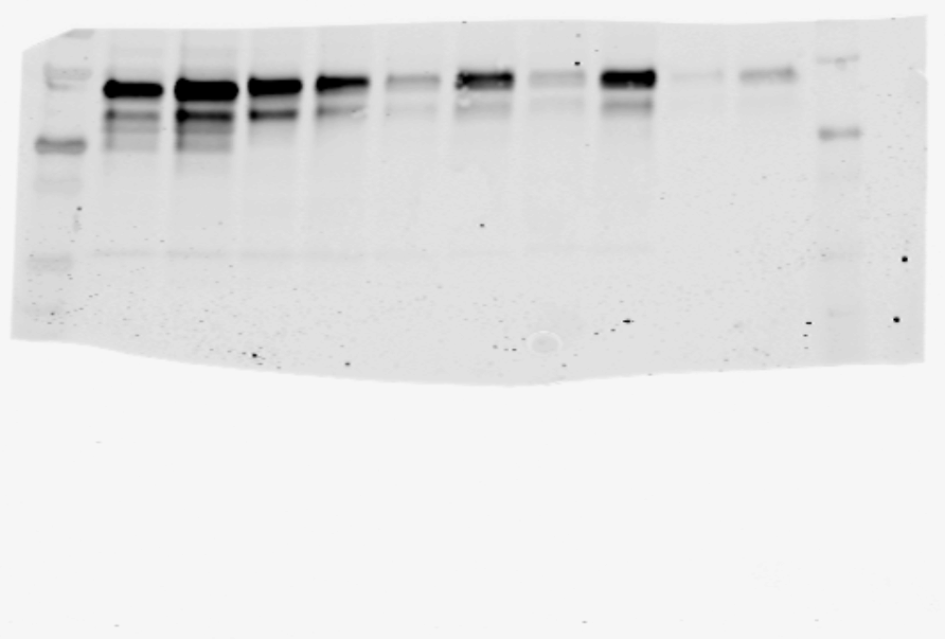
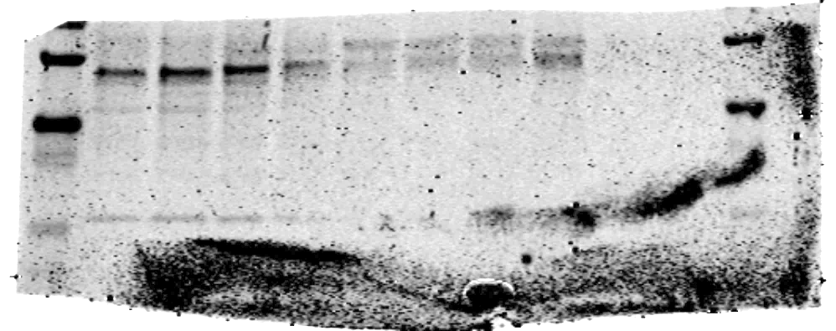
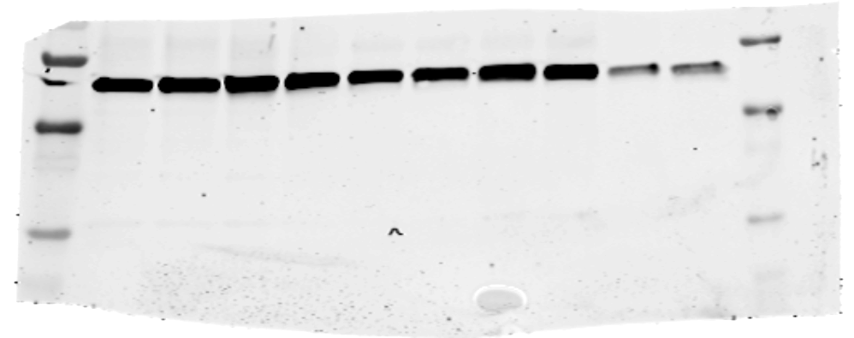
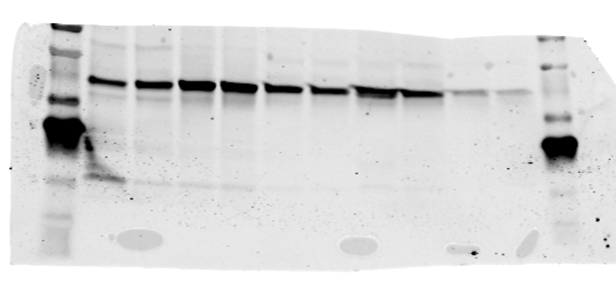
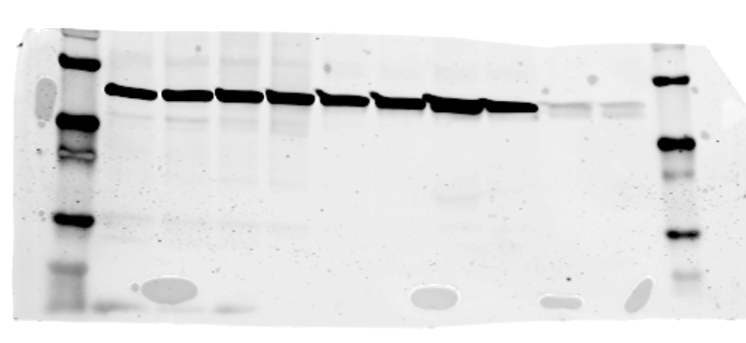
PDO Number
PDO 30 |  | PDO 46
Veh | Frsk | Veh | Frsk
Supplementary Fig 5 Part B
Treatment
p-CREB
CREB
E-cad
β-actin
PKA Cα
β-actin
p-CREB
55 KD
35 KD

Slide 38
PDO Number
PDO 30 |  | PDO 46
Veh | Frsk | Veh | Frsk
Supplementary Fig 5 Part B
Treatment
p-CREB
CREB
E-cad
β-actin
PKA Cα
β-actin
CREB
55 KD
35 KD

Slide 39
PDO Number
PDO 30 |  | PDO 46
Veh | Frsk | Veh | Frsk
Supplementary Fig 5 Part B
Treatment
p-CREB
CREB
E-cad
β-actin
PKA Cα
β-actin
E-cad
250 KD
130 KD
100 KD

Slide 40
PDO Number
PDO 30 |  | PDO 46
Veh | Frsk | Veh | Frsk
Supplementary Fig 5 Part B
Treatment
p-CREB
CREB
E-cad
β-actin
PKA Cα
β-actin
β-actin
55 KD
35 KD

Slide 41
PDO Number
PDO 30 |  | PDO 46
Veh | Frsk | Veh | Frsk
Supplementary Fig 5 Part B
Treatment
p-CREB
CREB
E-cad
β-actin
PKA Cα
β-actin
PKA Cα
55 KD
35 KD

Slide 42
PDO Number
PDO 30 |  | PDO 46
Veh | Frsk | Veh | Frsk
Supplementary Fig 5 Part B
Treatment
p-CREB
CREB
E-cad
β-actin
PKA Cα
β-actin
β-actin
55 KD
35 KD

Slide 43
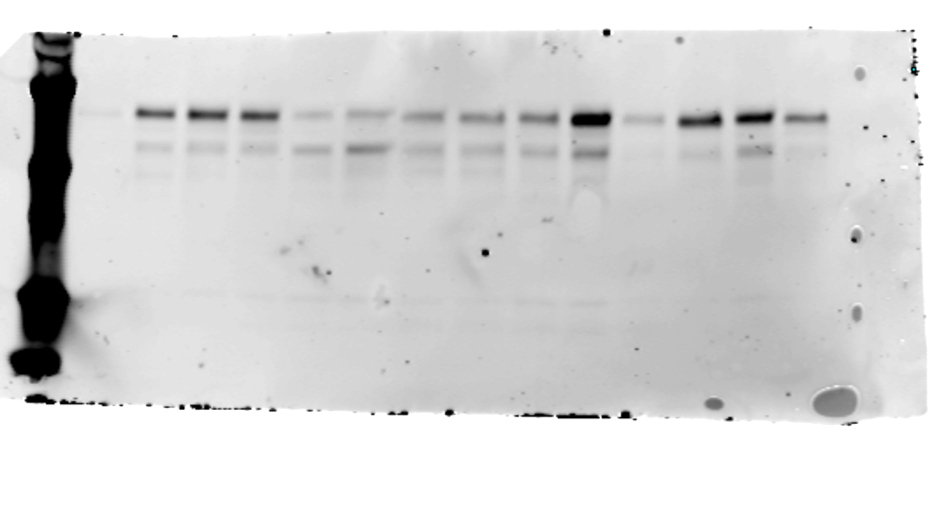
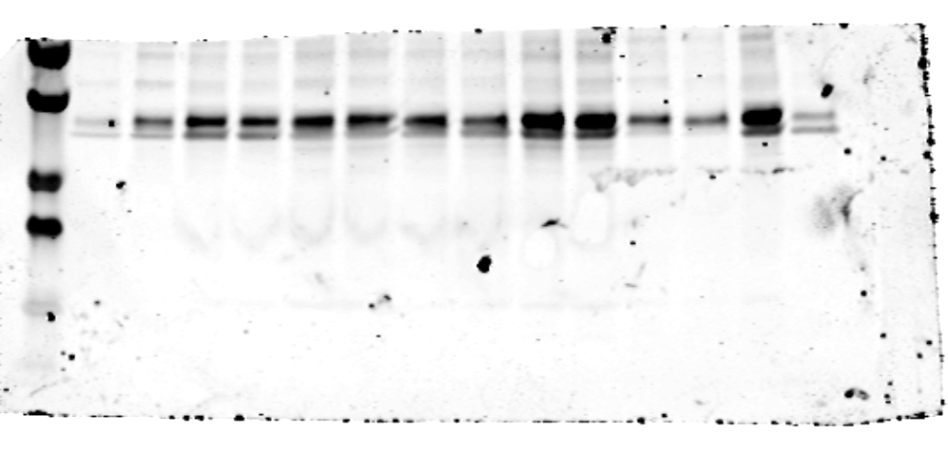
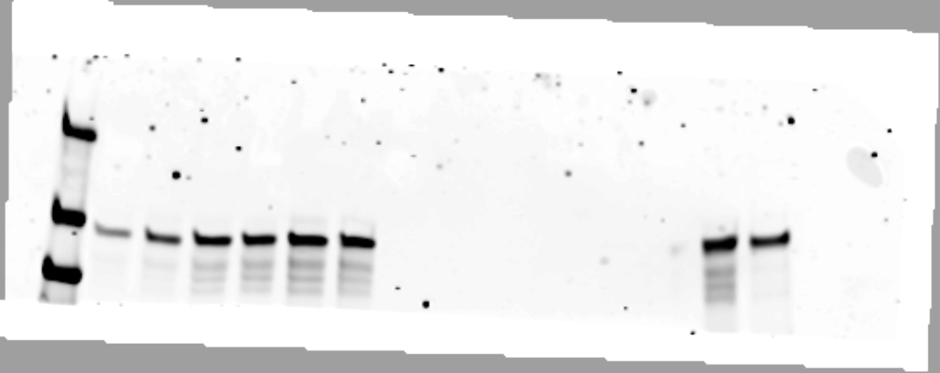
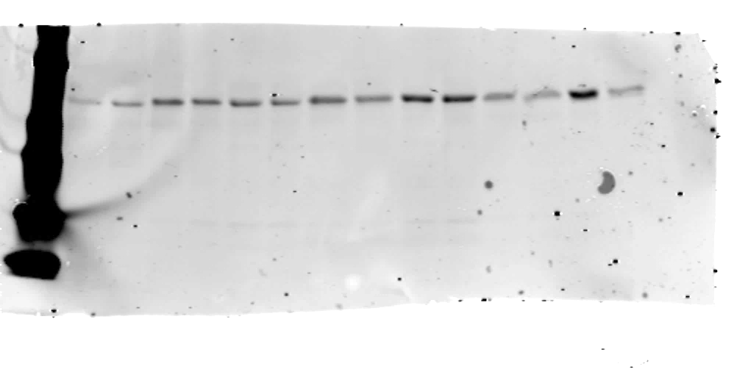
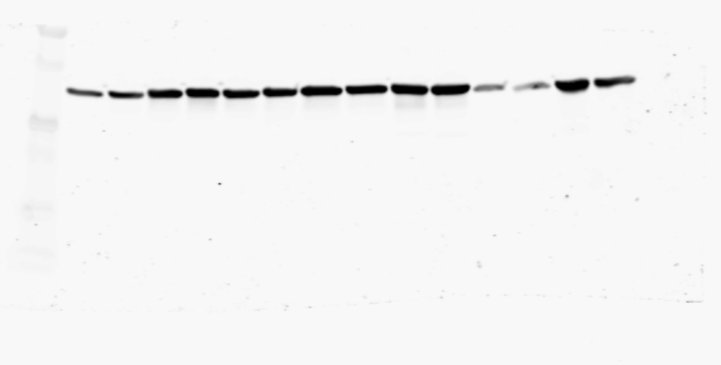
Supplementary Fig 5 Part C
PDO Number
PDO 111 |  | PDO 102 |  | PDO 129
Veh | Frsk | Veh | Frsk | Veh | Frsk
Treatment
p-CREB
CREB
E-cad
β-actin
PKA Cα
β-actin
p-CREB
55 KD
35 KD

Slide 44
Supplementary Fig 5 Part C
PDO Number
PDO 111 |  | PDO 102 |  | PDO 129
Veh | Frsk | Veh | Frsk | Veh | Frsk
Treatment
p-CREB
CREB
E-cad
β-actin
PKA Cα
β-actin
p-CREB
55 KD
35 KD

Slide 45
Supplementary Fig 5 Part C
PDO Number
PDO 111 |  | PDO 102 |  | PDO 129
Veh | Frsk | Veh | Frsk | Veh | Frsk
Treatment
p-CREB
CREB
E-cad
β-actin
PKA Cα
β-actin
CREB
55 KD
35 KD

Slide 46
Supplementary Fig 5 Part C
PDO Number
PDO 111 |  | PDO 102 |  | PDO 129
Veh | Frsk | Veh | Frsk | Veh | Frsk
Treatment
p-CREB
CREB
E-cad
β-actin
PKA Cα
β-actin
E-cad
250 KD
130 KD
100 KD

Slide 47
Supplementary Fig 5 Part C
PDO Number
PDO 111 |  | PDO 102 |  | PDO 129
Veh | Frsk | Veh | Frsk | Veh | Frsk
Treatment
p-CREB
CREB
E-cad
β-actin
PKA Cα
β-actin
β-actin
55 KD
35 KD

Slide 48
Supplementary Fig 5 Part C
PDO Number
PDO 111 |  | PDO 102 |  | PDO 129
Veh | Frsk | Veh | Frsk | Veh | Frsk
Treatment
p-CREB
CREB
E-cad
β-actin
PKA Cα
β-actin
PKA Cα
55 KD
35 KD

Slide 49
Supplementary Fig 5 Part C
PDO Number
PDO 111 |  | PDO 102 |  | PDO 129
Veh | Frsk | Veh | Frsk | Veh | Frsk
Treatment
p-CREB
CREB
E-cad
β-actin
PKA Cα
β-actin
β-actin
55 KD
35 KD

Slide 50
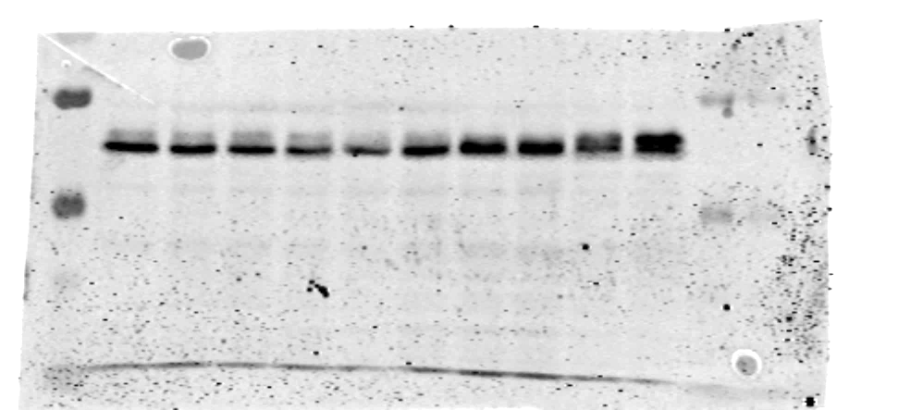
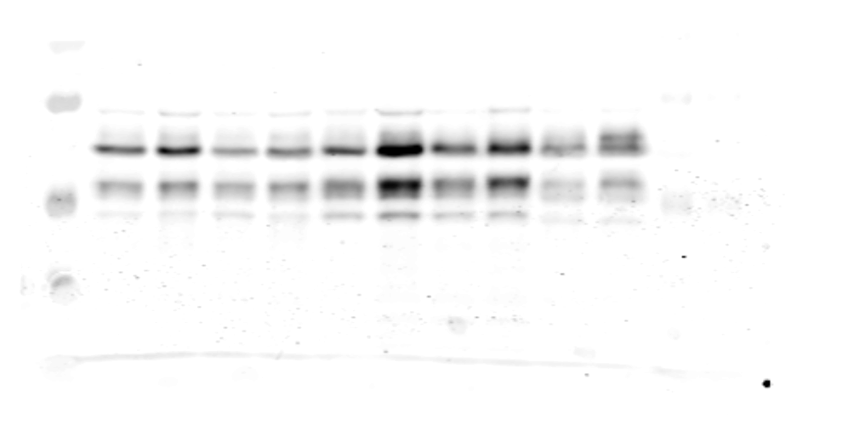
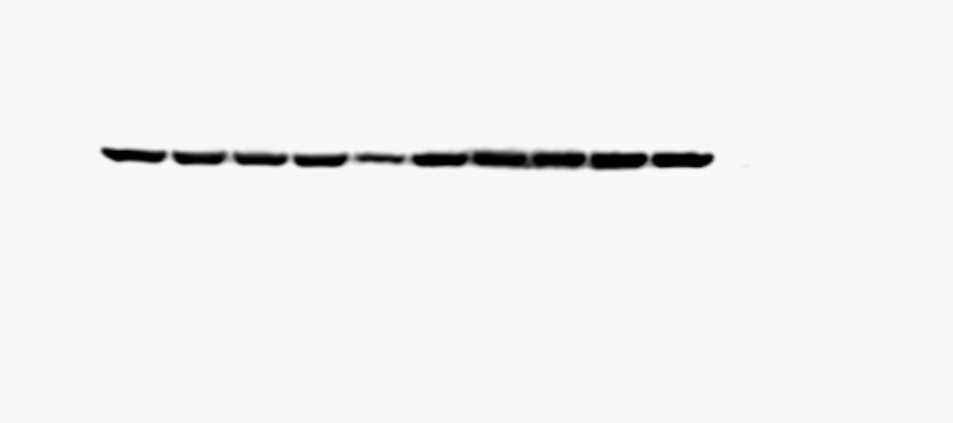
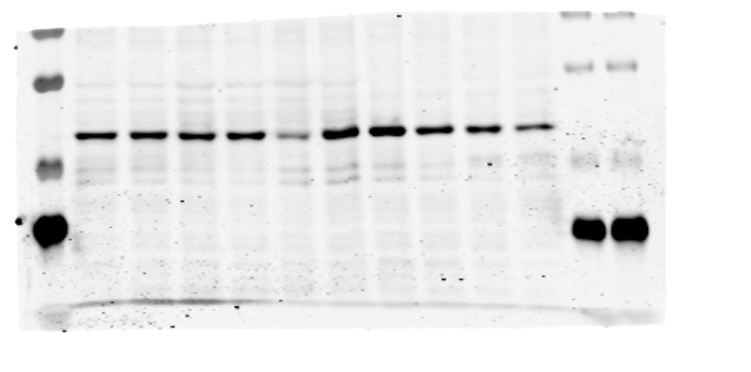
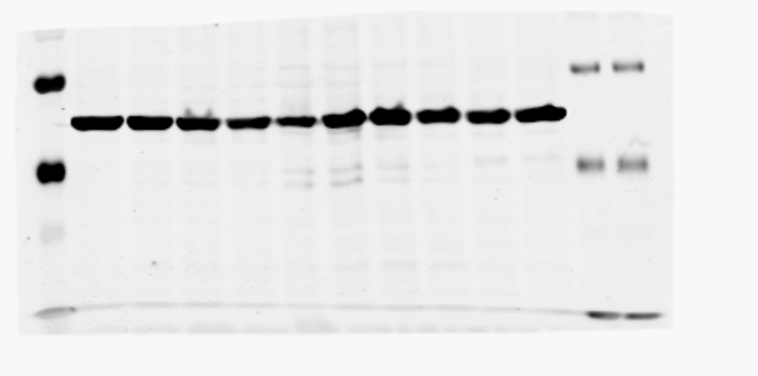

A.
Supplementary Fig 7
MCF7 |  | MCF7 Ecad KO |  | T47D |  | T47D Ecad KO |  | SUM44PE
Veh | Fors | Veh | Fors | Veh | Fors | Veh | Fors | Veh | Fors
CREB
p-CREB
β-actin
PKACA
β-actin
E-Cad
β-actin
CREB
55 KD
35 KD
Notes:
Supplementary Fig 7. A. Western blot images of CREB, p-CREB, PKACA, E-cadherin (E-cad) and β-actin in NST (blue: MCF7, T47D), NST E-cad KO (orange: MCF7 Ecad KO, T47D Ecad KO) and ILC (red: SUM44PE) cell lines after treatment with vehicle or Forskolin in low serum media
B. Dot plots depicting quantified western blot levels of CREB, p-CREB, and PKACA with forskolin treatment as a ratio to their baseline levels (vehicle treatment) in NST (blue: MCF7, T47D), NST E-cad KO (orange: MCF7 Ecad KO, T47D Ecad KO) and ILC (red: SUM44PE)

Slide 51
A.
Supplementary Fig 7
MCF7 |  | MCF7 Ecad KO |  | T47D |  | T47D Ecad KO |  | SUM44PE
Veh | Fors | Veh | Fors | Veh | Fors | Veh | Fors | Veh | Fors
CREB
p-CREB
β-actin
PKACA
β-actin
E-Cad
β-actin
p-CREB
55 KD
35 KD
Notes:
Supplementary Fig 7. A. Western blot images of CREB, p-CREB, PKACA, E-cadherin (E-cad) and β-actin in NST (blue: MCF7, T47D), NST E-cad KO (orange: MCF7 Ecad KO, T47D Ecad KO) and ILC (red: SUM44PE) cell lines after treatment with vehicle or Forskolin in low serum media
B. Dot plots depicting quantified western blot levels of CREB, p-CREB, and PKACA with forskolin treatment as a ratio to their baseline levels (vehicle treatment) in NST (blue: MCF7, T47D), NST E-cad KO (orange: MCF7 Ecad KO, T47D Ecad KO) and ILC (red: SUM44PE)

Slide 52
A.
Supplementary Fig 7
MCF7 |  | MCF7 Ecad KO |  | T47D |  | T47D Ecad KO |  | SUM44PE
Veh | Fors | Veh | Fors | Veh | Fors | Veh | Fors | Veh | Fors
CREB
p-CREB
β-actin
PKACA
β-actin
E-Cad
β-actin
β-actin
55 KD
35 KD
Notes:
Supplementary Fig 7. A. Western blot images of CREB, p-CREB, PKACA, E-cadherin (E-cad) and β-actin in NST (blue: MCF7, T47D), NST E-cad KO (orange: MCF7 Ecad KO, T47D Ecad KO) and ILC (red: SUM44PE) cell lines after treatment with vehicle or Forskolin in low serum media
B. Dot plots depicting quantified western blot levels of CREB, p-CREB, and PKACA with forskolin treatment as a ratio to their baseline levels (vehicle treatment) in NST (blue: MCF7, T47D), NST E-cad KO (orange: MCF7 Ecad KO, T47D Ecad KO) and ILC (red: SUM44PE)

Slide 53
A.
Supplementary Fig 7
MCF7 |  | MCF7 Ecad KO |  | T47D |  | T47D Ecad KO |  | SUM44PE
Veh | Fors | Veh | Fors | Veh | Fors | Veh | Fors | Veh | Fors
CREB
p-CREB
β-actin
PKACA
β-actin
E-Cad
β-actin
PKACA
55 KD
35 KD
Notes:
Supplementary Fig 7. A. Western blot images of CREB, p-CREB, PKACA, E-cadherin (E-cad) and β-actin in NST (blue: MCF7, T47D), NST E-cad KO (orange: MCF7 Ecad KO, T47D Ecad KO) and ILC (red: SUM44PE) cell lines after treatment with vehicle or Forskolin in low serum media
B. Dot plots depicting quantified western blot levels of CREB, p-CREB, and PKACA with forskolin treatment as a ratio to their baseline levels (vehicle treatment) in NST (blue: MCF7, T47D), NST E-cad KO (orange: MCF7 Ecad KO, T47D Ecad KO) and ILC (red: SUM44PE)

Slide 54
A.
Supplementary Fig 7
MCF7 |  | MCF7 Ecad KO |  | T47D |  | T47D Ecad KO |  | SUM44PE
Veh | Fors | Veh | Fors | Veh | Fors | Veh | Fors | Veh | Fors
CREB
p-CREB
β-actin
PKACA
β-actin
E-Cad
β-actin
β-actin
55 KD
35 KD
Notes:
Supplementary Fig 7. A. Western blot images of CREB, p-CREB, PKACA, E-cadherin (E-cad) and β-actin in NST (blue: MCF7, T47D), NST E-cad KO (orange: MCF7 Ecad KO, T47D Ecad KO) and ILC (red: SUM44PE) cell lines after treatment with vehicle or Forskolin in low serum media
B. Dot plots depicting quantified western blot levels of CREB, p-CREB, and PKACA with forskolin treatment as a ratio to their baseline levels (vehicle treatment) in NST (blue: MCF7, T47D), NST E-cad KO (orange: MCF7 Ecad KO, T47D Ecad KO) and ILC (red: SUM44PE)

Slide 55
A.
Supplementary Fig 7
MCF7 |  | MCF7 Ecad KO |  | T47D |  | T47D Ecad KO |  | SUM44PE
Veh | Fors | Veh | Fors | Veh | Fors | Veh | Fors | Veh | Fors
CREB
p-CREB
β-actin
PKACA
β-actin
E-Cad
β-actin
E-cad
130 KD
100 KD
Notes:
Supplementary Fig 7. A. Western blot images of CREB, p-CREB, PKACA, E-cadherin (E-cad) and β-actin in NST (blue: MCF7, T47D), NST E-cad KO (orange: MCF7 Ecad KO, T47D Ecad KO) and ILC (red: SUM44PE) cell lines after treatment with vehicle or Forskolin in low serum media
B. Dot plots depicting quantified western blot levels of CREB, p-CREB, and PKACA with forskolin treatment as a ratio to their baseline levels (vehicle treatment) in NST (blue: MCF7, T47D), NST E-cad KO (orange: MCF7 Ecad KO, T47D Ecad KO) and ILC (red: SUM44PE)

Slide 56
A.
Supplementary Fig 7
MCF7 |  | MCF7 Ecad KO |  | T47D |  | T47D Ecad KO |  | SUM44PE
Veh | Fors | Veh | Fors | Veh | Fors | Veh | Fors | Veh | Fors
CREB
p-CREB
β-actin
PKACA
β-actin
E-Cad
β-actin
β-actin
55 KD
35 KD
Notes:
Supplementary Fig 7. A. Western blot images of CREB, p-CREB, PKACA, E-cadherin (E-cad) and β-actin in NST (blue: MCF7, T47D), NST E-cad KO (orange: MCF7 Ecad KO, T47D Ecad KO) and ILC (red: SUM44PE) cell lines after treatment with vehicle or Forskolin in low serum media
B. Dot plots depicting quantified western blot levels of CREB, p-CREB, and PKACA with forskolin treatment as a ratio to their baseline levels (vehicle treatment) in NST (blue: MCF7, T47D), NST E-cad KO (orange: MCF7 Ecad KO, T47D Ecad KO) and ILC (red: SUM44PE)

