Slide 1
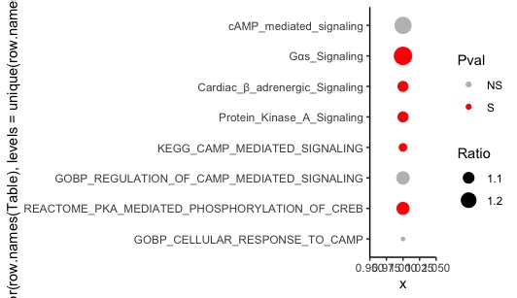
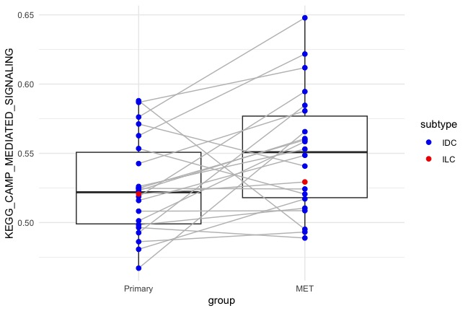
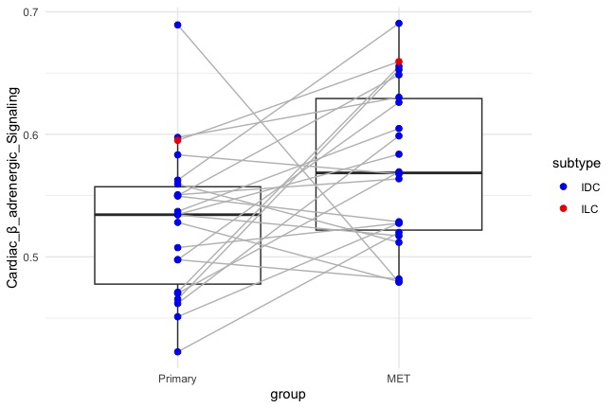
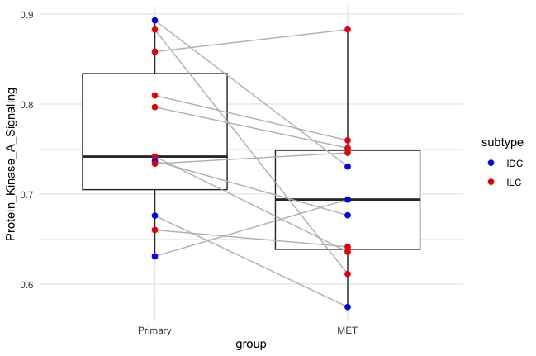
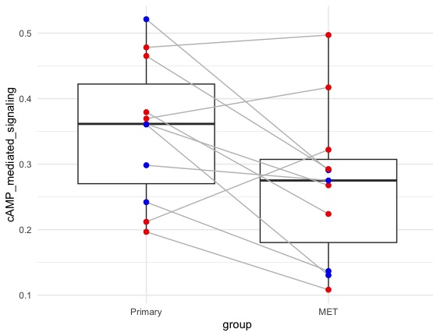
Supplementary Fig 1 cAMP/PKA/CREB related signaling in paired primary and metastatic ILC and NST using GSVA scores for 8 cAMP/PKA/CREB related pathways (4 pathways from Cluster 5 of the Jaccard index heatmap with positive z-score and 4 pathways downloaded from MSigDB)
Bubble plot depicting comparison of GSVA scores between ILC (N = 11) and NST (N = 36) primary breast tumors, the size of bubble represents the ratio of mean GSVA scores for the pathways in ILC over NST (all ratios are > 1 except for GOBP cellular response to cAMP), color represents significance of Wilcoxon test
Overlapping box and jitter plot comparing GSVA scores of selected cAMP/PKA/CREB pathways between primary breast tumors and their paired brain and ovarian metastases. Paired samples were compared using the paired t test
A
B
P = .01
.7
P = .03
cAMP-mediated signaling
Gαs Signaling
Cardiac β-adrenergic Signaling
Protein Kinase A Signaling
KEGG cAMP mediated signaling
GOBP regulation of cAMP mediated signaling
Reactome PKA mediated phosphorylation of CREB
GOBP cellular response to cAMP
.65
.6
.6
KEGG cAMP mediated signaling
Cardiac β-adrenergic Signaling
.55
.5
.5
NST
ILC
Primary - Breast
Metastatic – Brain
Primary - Breast
Metastatic – Brain
.9
P = .04
P = .03
.5
.8
.4
Protein Kinase A Signaling
cAMP mediated signaling
Ratio of mean GSVA scores between ILC and NST
.7
.3
.6
.2
Red = P < 0.05 on Wilcoxon test
Grey = No significant difference on Wilcoxon test
Primary - Breast
Metastatic – Ovary
.1
Primary - Breast
Metastatic – Ovary
Notes:
Supplementary Fig 1 cAMP/PKA/CREB related signaling in paired primary and metastatic ILC and NST using GSVA scores for 8 cAMP/PKA/CREB related pathways (4 pathways from Cluster 5 of the Jaccard index heatmap with positive z-score and 4 pathways downloaded from MSigDB)
Bubble plot depicting comparison of GSVA scores between ILC (N = 11) and NST (N = 36) primary breast tumors, the size of bubble represents the ratio of mean GSVA scores for the pathways in ILC over NST (all ratios are > 1 except for GOBP cellular response to cAMP), color represents significance of Wilcoxon test
Overlapping box and jitter plot comparing GSVA scores of selected cAMP/PKA/CREB pathways between primary breast tumors and their paired brain and ovarian metastases. Paired samples were compared using the paired t test

Slide 2
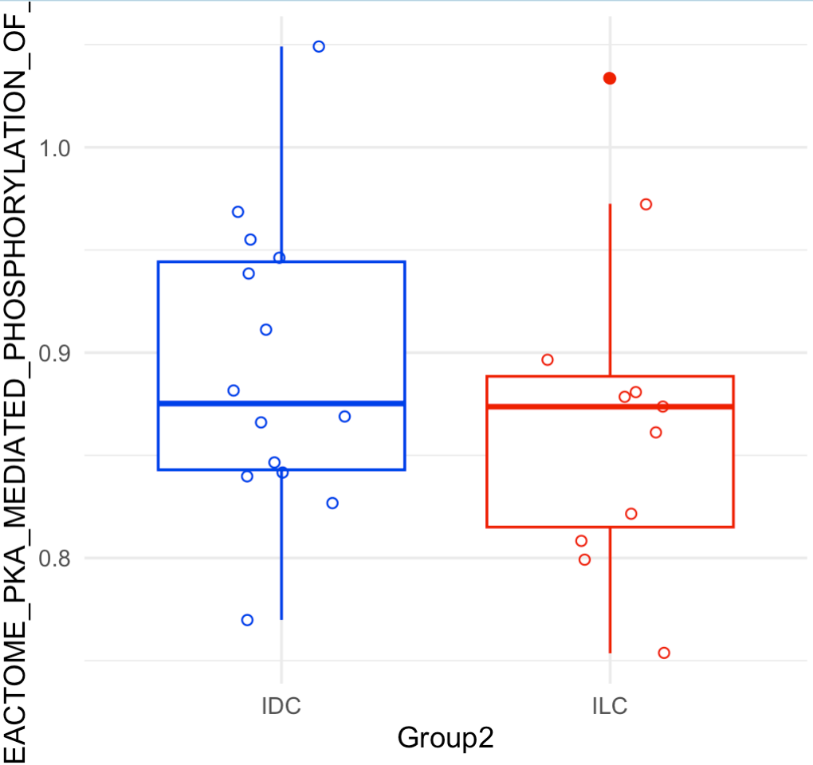
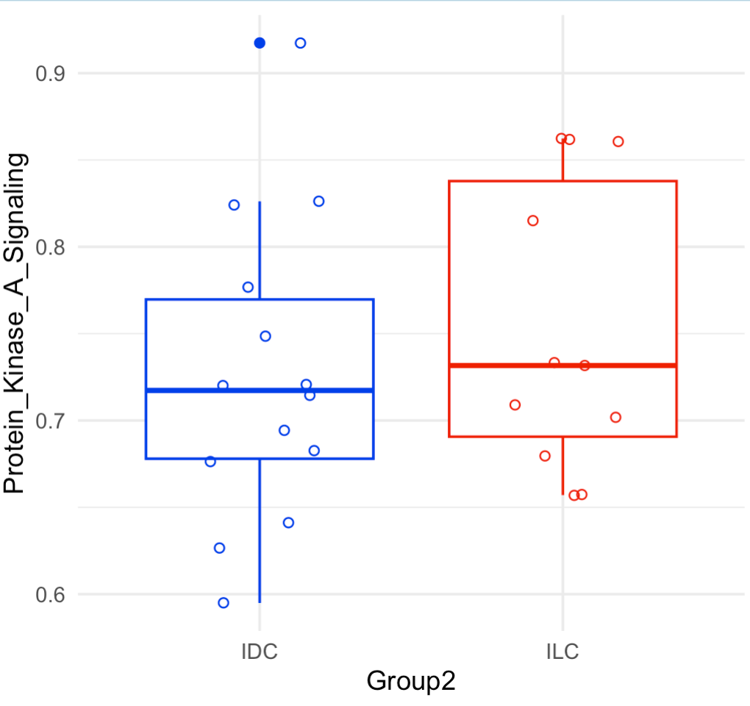
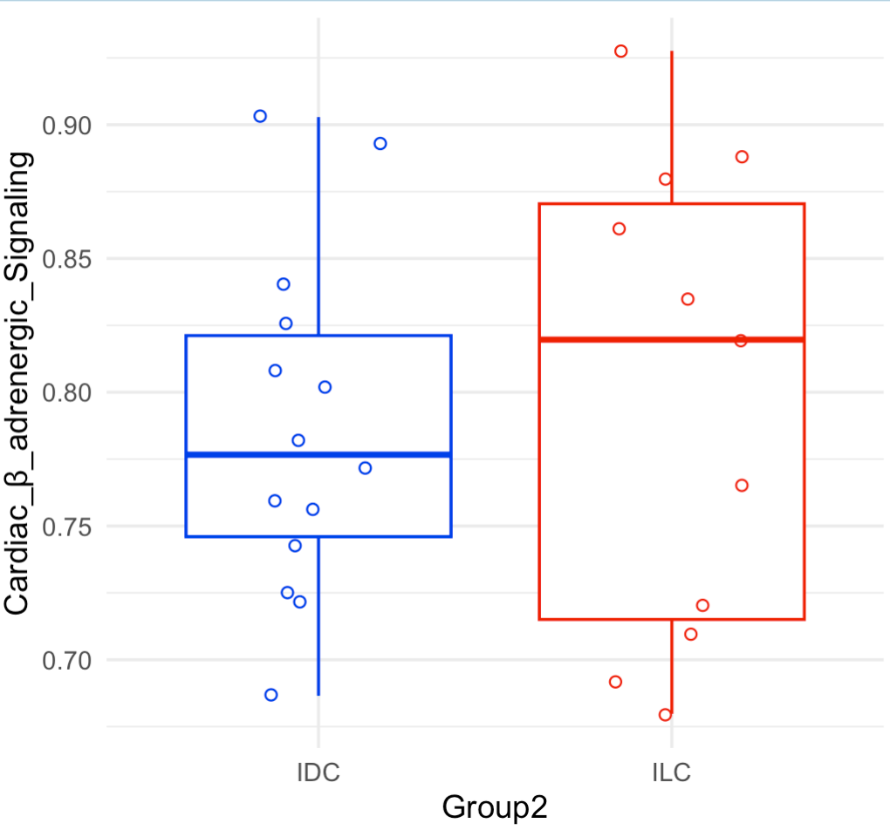
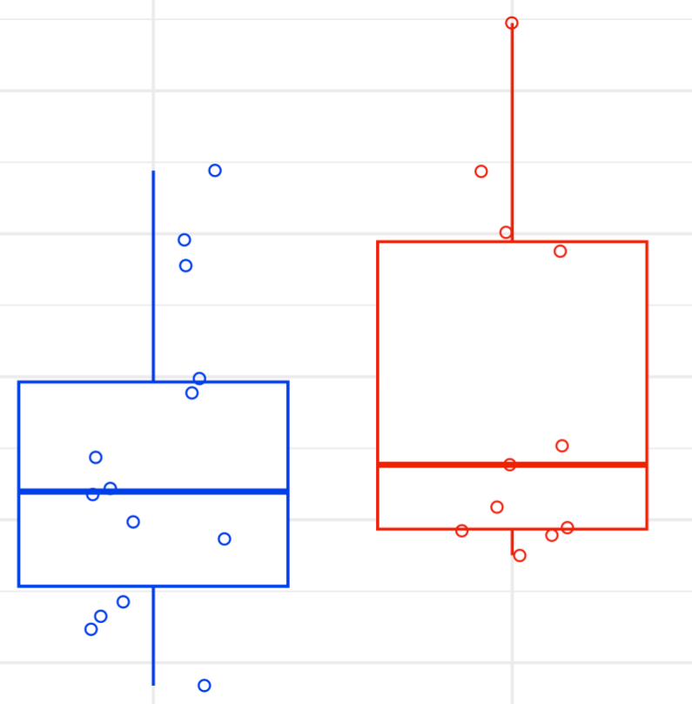
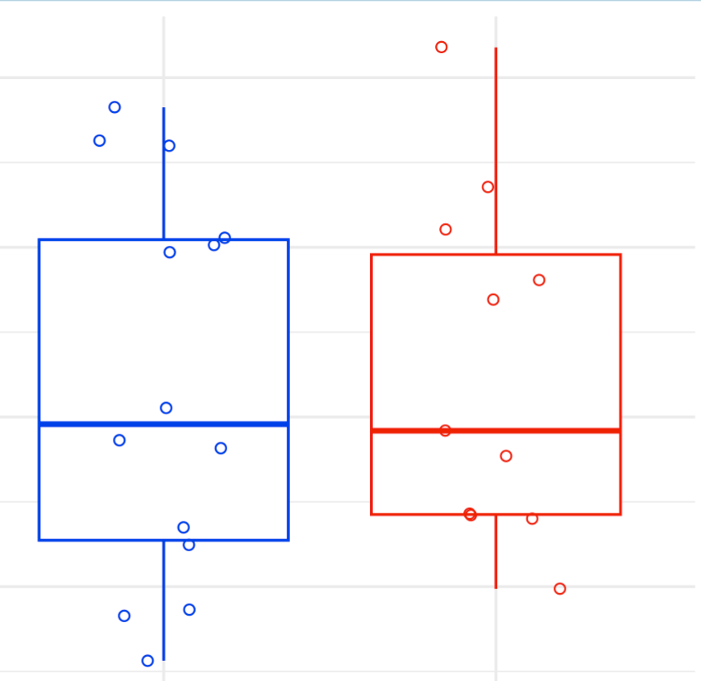
Supplementary Figure 2: Overlapping box and jitter plots depicting GSVA estimation scores for cAMP/PKA/CREB signaling related pathways (not reported in Fig 4A) in ILC and ILC like (red; ILC - HCC2185, MDAMB134, MDAMB330, SUM44PE; ILC like - MPE600, CAMA1, HCC2218, MDAMB453, OCUBM, SKBR5, ZR7530) and NST (blue; NST - BT474, BT483, EFM19, HCC1008, HCC1419, HCC1500, LY2, MCF7, MDAMB157, MDAMB175, T47D, UACC812, ZR75-1, ZR75B) cell lines based on gene expression data from Marcotte et al 2016
1.0
0.9
Reactome PKA mediated phosphorylation of CREB
0.8
0.9
Protein kinase A signaling
0.7
0.8
0.6
NST
ILC + ILC-like
NST
ILC + ILC-like
0.9
0.7
0.8
0.7
Cardiac beta adrenergic signaling
0.5
G alpha signaling
0.8
cAMP mediated signaling
0.6
0.7
0.3
0.5
NST
ILC + ILC-like
NST
ILC + ILC-like
NST
ILC + ILC-like
.
Notes:
Supplementary Figure 2: Overlapping box and jitter plots depicting GSVA estimation scores for cAMP/PKA/CREB signaling related pathways (not reported in Fig 4A) in ILC and ILC like (red; ILC - HCC2185, MDAMB134, MDAMB330, SUM44PE; ILC like - MPE600, CAMA1, HCC2218, MDAMB453, OCUBM, SKBR5, ZR7530) and NST (blue; NST - BT474, BT483, EFM19, HCC1008, HCC1419, HCC1500, LY2, MCF7, MDAMB157, MDAMB175, T47D, UACC812, ZR75-1, ZR75B) cell lines based on gene expression data from Marcotte et al 2016

Slide 3
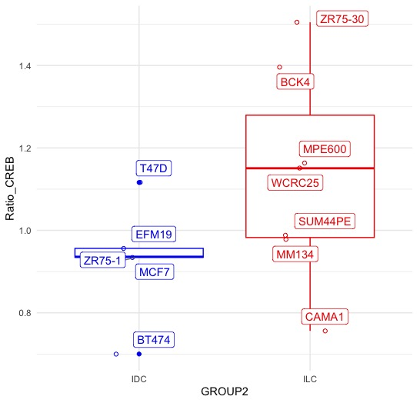


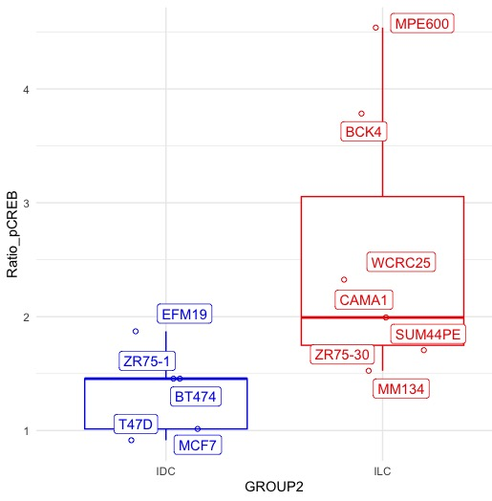
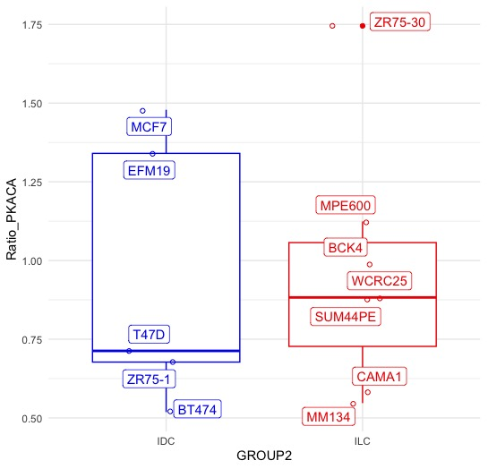



Supplementary Fig 3
A) Western blot images for levels of CREB, p-CREB and PKACA in ILC and ILC-like (red; MPE600, WCRC25, ZR75-30, MM134, CAMA-1, BCK4, SUM44PE) and NST (blue; MCF7, T47D, BT474, EFM19, ZR75-1) cell lines exposed to a low serum medium after treatment with Vehicle (Veh) and Forskolin (Fors) treatment
B) Overlapping box and jitter plots comparing the ratio of quantified western blot levels of CREB, p-CREB and PKACA (each normalized for corresponding levels of β-actin); after treatment with forskolin vs at baseline (treated with vehicle) in ILC, ILC-like and NST cell lines exposed to a low serum medium
A.
MCF7 |  | T47D7 |  | MPE600 |  | WCRC25
Veh | Forsk | Veh | Forsk | Veh | Forsk | Veh | Forsk
Sum44 (Veh)
B.
CREB
P-CREB
P = .07
β-actin
1.4
1.2
Ratio of CREB between forskolin treatment and baseline (low serum)
PKACA
β-actin
1.0
BT474 |  | ZR75-30 |  | EFM19 |  | MM134
Veh | Fors | Veh | Fors | Veh | Fors | Veh | Fors
0.8
Sum44 (Veh)
NST
ILC + ILC-like
CREB
P = .02
P-CREB
4
β-actin
3
Ratio of p-CREB between forskolin treatment and baseline (low serum)
PKACA
2
β-actin
1
ZR75-1 |  | CAMA-1 |  | BCK4 |  | SUM44
Veh | Fors | Veh | Fors | Veh | Fors | Veh | Fors
NST
ILC + ILC-like
Sum44 (Veh)
1.75
P = .9
CREB
1.5
1.25
Ratio of PKACA between forskolin treatment and baseline (low serum)
P-CREB
β-actin
1.0
0.75
PKACA
0.5
β-actin
NST
ILC + ILC-like
Notes:
Supplementary Fig 3
Western blot images for levels of CREB, p-CREB and PKACA in ILC and ILC-like (red; MPE600, WCRC25, ZR75-30, MM134, CAMA-1, BCK4, SUM44PE) and NST (blue; MCF7, T47D, BT474, EFM19, ZR75-1) cell lines exposed to a low serum medium after treatment with Vehicle (Veh) and Forskolin (Fors) treatment
Overlapping box and jitter plots comparing the ratio of quantified western blot levels of CREB, p-CREB and PKACA (each normalized for corresponding levels of β-actin); after treatment with forskolin vs at baseline (treated with vehicle) in ILC, ILC-like and NST cell lines exposed to a low serum medium

Slide 4
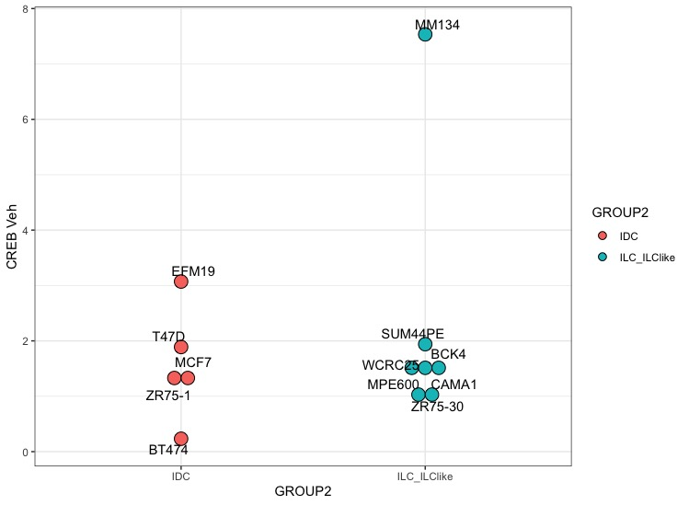
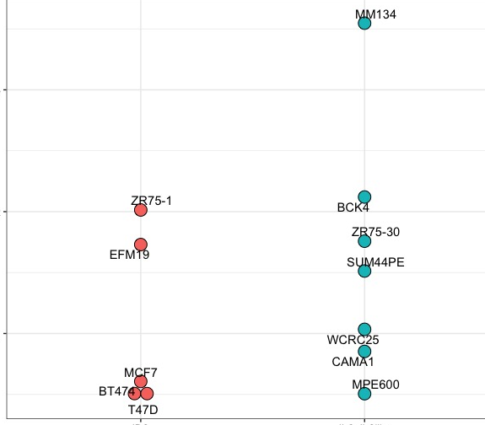
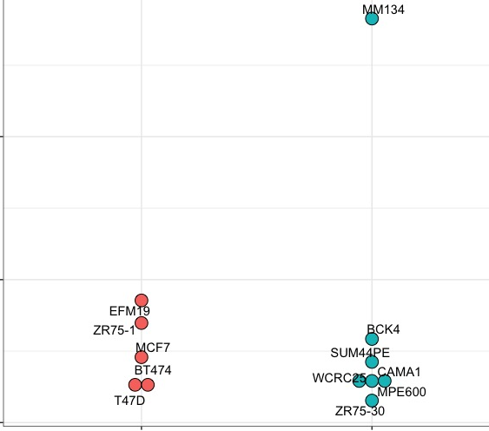
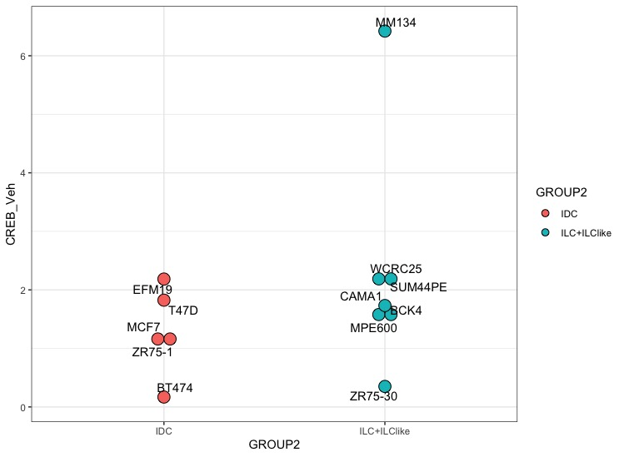
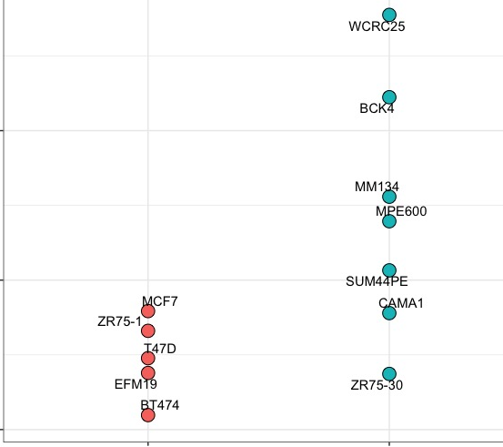
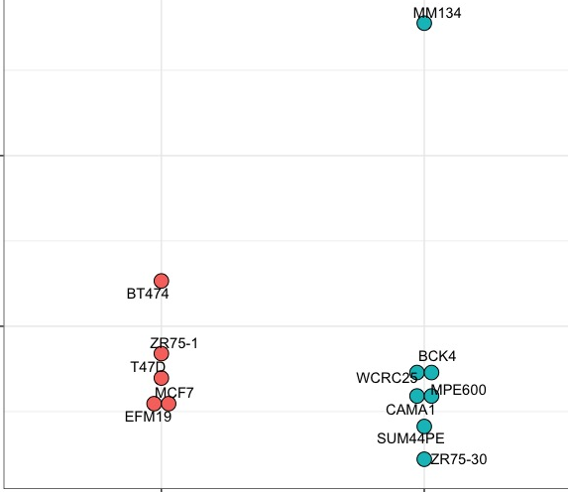
Supplementary Fig 4 Jitter plots representing quantification of immunoblotting of p-CREB, CREB and PKA-CA in ILC (light blue) and NST (light red) cell lines at baseline conditions (Vehicle treatment). Each parameter was normalized to β-actin. All cell lines were grown in their respective media then were collected in either (A) the same medium or (B) low serum medium (DMEM with 1% FBS). Wilcoxon test was used to compare means of two groups. ILC and ILC-like cell lines (light blue; MPE600, WCRC25, ZR75-30, MM134, CAMA-1, BCK4, SUM44PE) and NST (light red; MCF7, T47D, BT474, EFM19, ZR75-1)
CREB, cAMP response element-binding protein; p-CREB, phospho-CREB on Ser133; PKA-CA, protein kinase A- alpha catalytic subunit.
A
8
3
3
6
2
CREB baseline
pCREB baseline
PKACA baseline
4
2
2
1
1
0
NST
ILC + ILC-like
NST
ILC + ILC-like
0
NST
ILC + ILC-like
Wilcoxon test p = 1
Wilcoxon test p = 0.3
Wilcoxon test p = 0.7
B
6
2
2
4
pCREB baseline
CREB baseline
PKACA baseline
2
1
1
0
NST
ILC + ILC-like
0
NST
ILC + ILC-like
NST
ILC + ILC-like
Wilcoxon test p = 0.3
Wilcoxon test p = 0.048
Wilcoxon test p = 0.6
Notes:
Supplementary Fig 4 Jitter plots representing quantification of immunoblotting of p-CREB, CREB and PKA-CA in ILC (light blue) and NST (light red) cell lines at baseline conditions (Vehicle treatment). Each parameter was normalized to β-actin. All cell lines were grown in their respective media then were collected in either (A) the same medium or (B) low serum medium (DMEM with 1% FBS). Wilcoxon test was used to compare means of two groups. ILC and ILC-like cell lines (light blue; MPE600, WCRC25, ZR75-30, MM134, CAMA-1, BCK4, SUM44PE) and NST (light red; MCF7, T47D, BT474, EFM19, ZR75-1)
CREB, cAMP response element-binding protein; p-CREB, phospho-CREB on Ser133; PKA-CA, protein kinase A- alpha catalytic subunit.

Slide 5
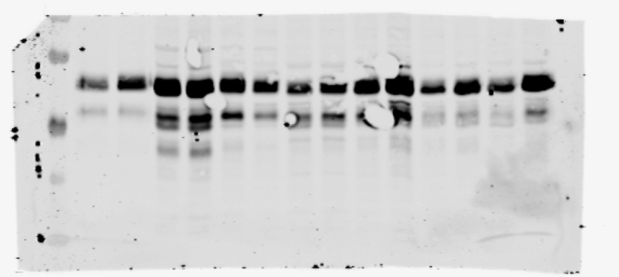
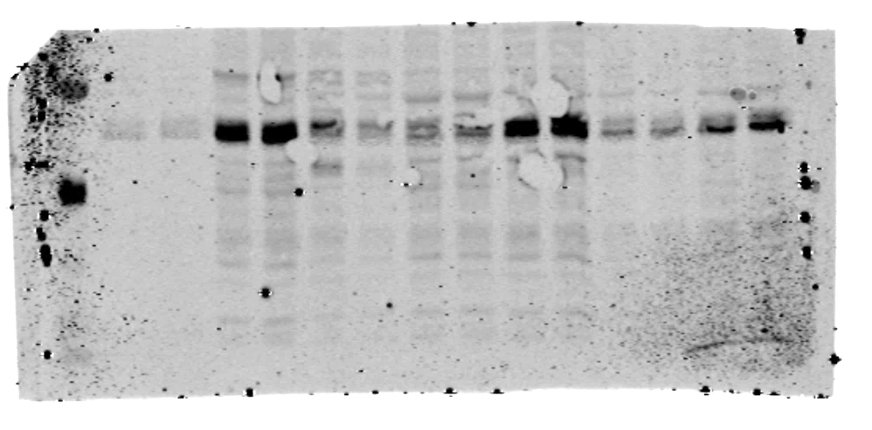
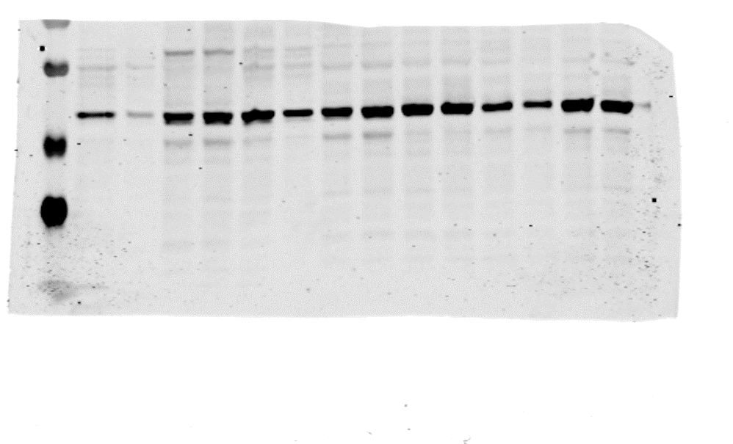
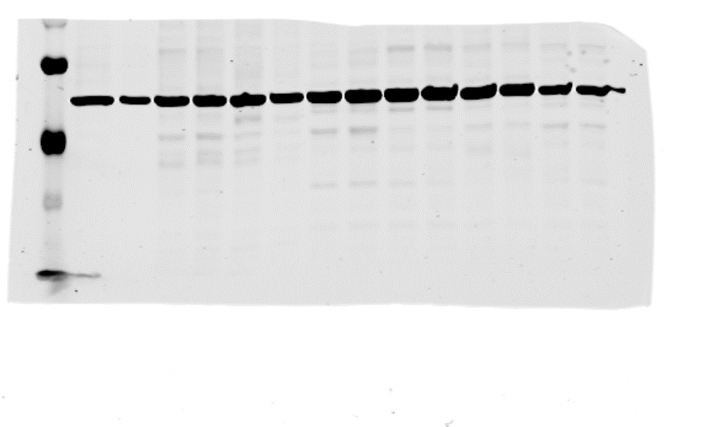
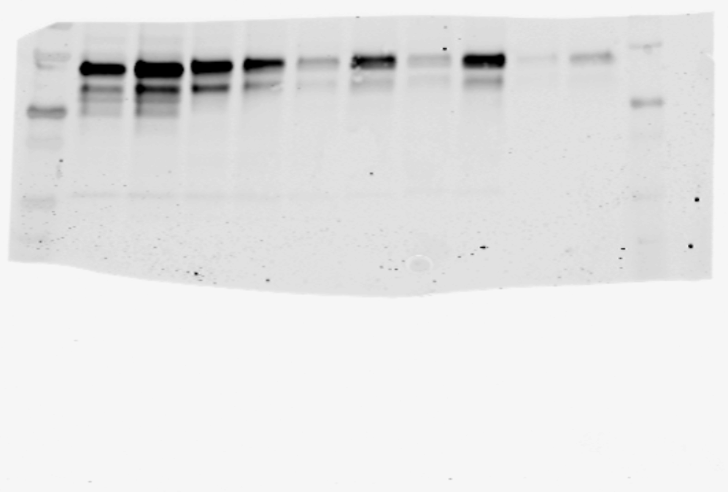
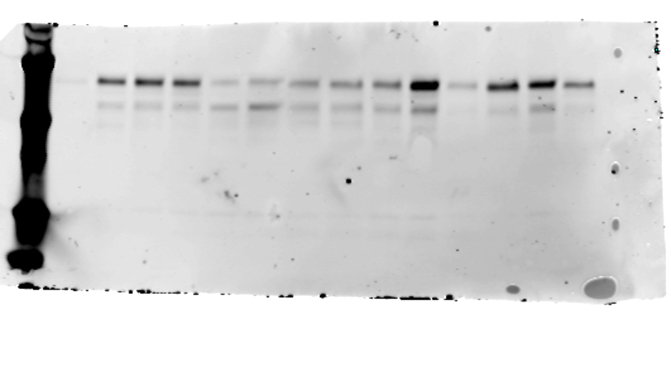
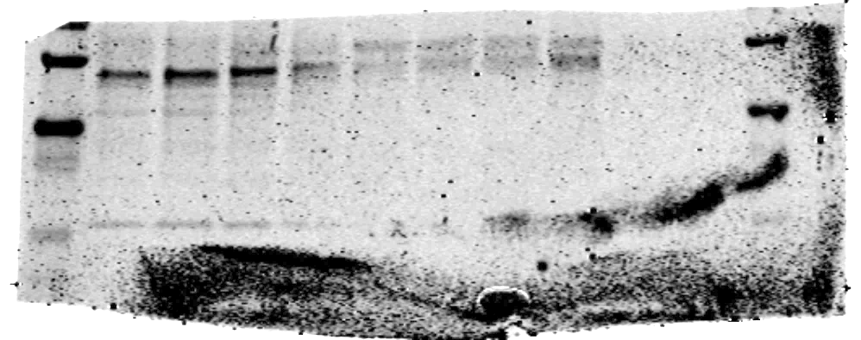
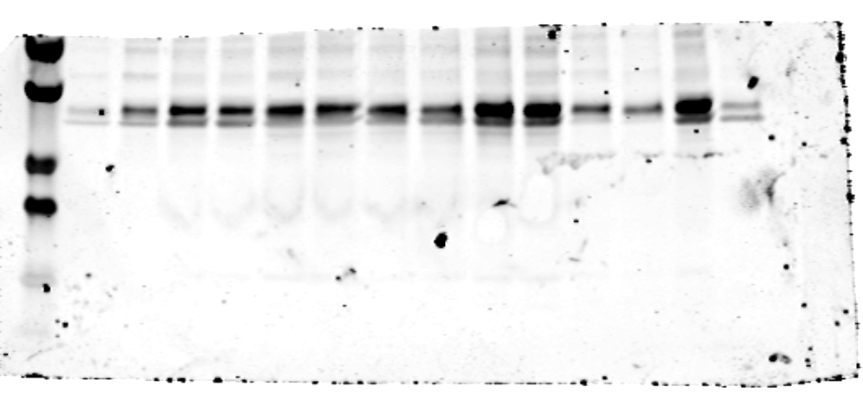
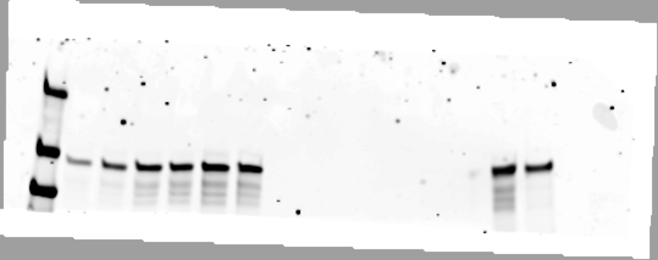
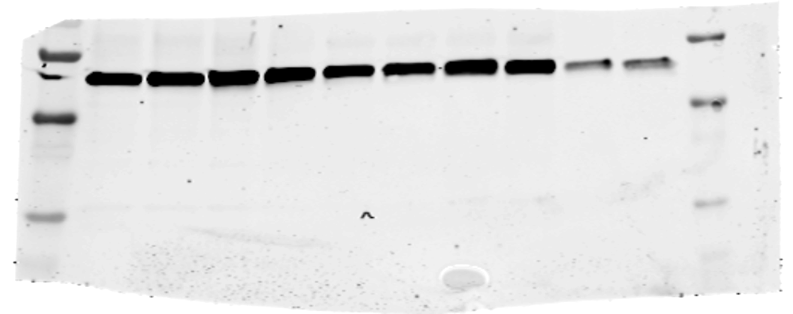
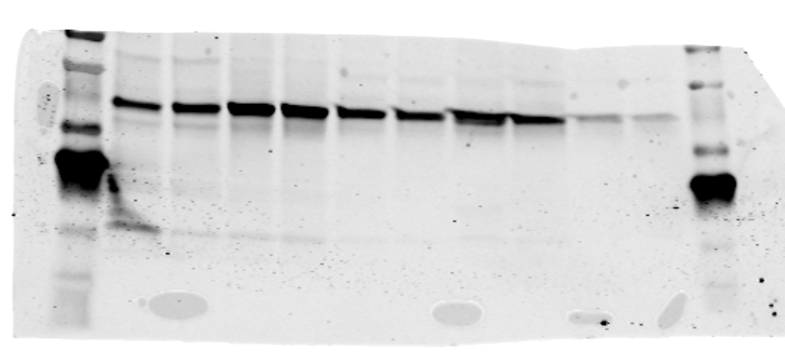
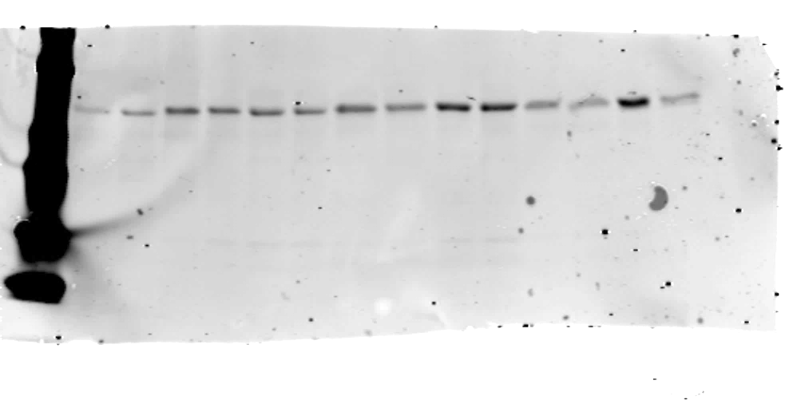
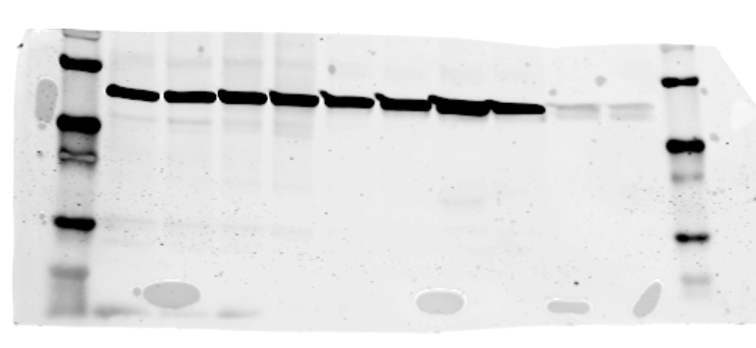
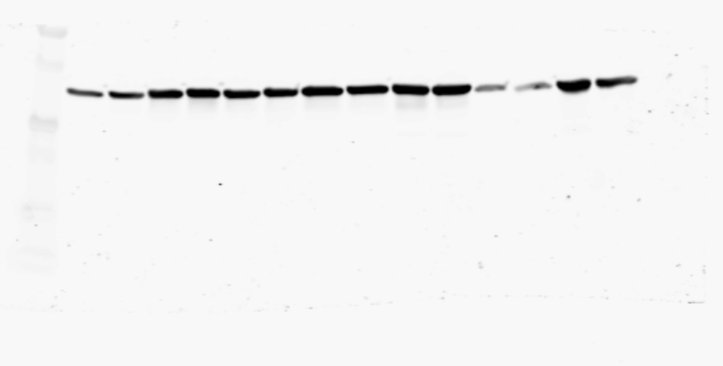
Supplementary Fig 5 Western blot images showing levels of phospho-CREB, total CREB, PKA-CA, E-cadherin and β-actin in NST (blue) and ILC (red) patient derived organoids after treatment with vehicle (DMSO) or Forskolin (25 uM) for 20 minutes; ILC PDOs (PDO146 PDO86 PDO53 PDO46 PDO30) and NST PDOs (PDO126 PDO56 PDO134 PDO123 PDO111 PDO102 PDO129)
CREB, cAMP response element-binding protein; PKA-CA, protein kinase A- alpha catalytic subunit.
PDO Number
PDO 126 |  | PDO 56 |  | PDO 134 |  | PDO 53 |  | PDO 86 |  | PDO 123 |  | PDO 146
Veh | Frsk | Veh | Frsk | Veh | Frsk | Veh | Frsk | Veh | Frsk | Veh | Frsk | Veh | Frsk
Treatment
p-CREB
CREB
E-cad
β-actin
PKA Cα
β-actin
PDO Number
PDO 30 |  | PDO 46
Veh | Frsk | Veh | Frsk
PDO Number
PDO 111 |  | PDO 102 |  | PDO 129
Veh | Frsk | Veh | Frsk | Veh | Frsk
Treatment
Treatment
p-CREB
p-CREB
CREB
CREB
E-cad
E-cad
β-actin
β-actin
PKA Cα
PKA Cα
β-actin
β-actin
Notes:
Supplementary Fig 5 Western blot images showing levels of phospho-CREB, total CREB, PKA-CA, E-cadherin and β-actin in NST (blue) and ILC (red) patient derived organoids after treatment with vehicle (DMSO) or Forskolin (25 uM) for 20 minutes; ILC PDOs (PDO146 PDO86 PDO53 PDO46 PDO30) and NST PDOs (PDO126 PDO56 PDO134 PDO123 PDO111 PDO102 PDO129)
CREB, cAMP response element-binding protein; PKA-CA, protein kinase A- alpha catalytic subunit.

Slide 6
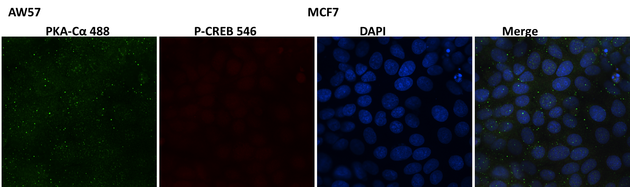
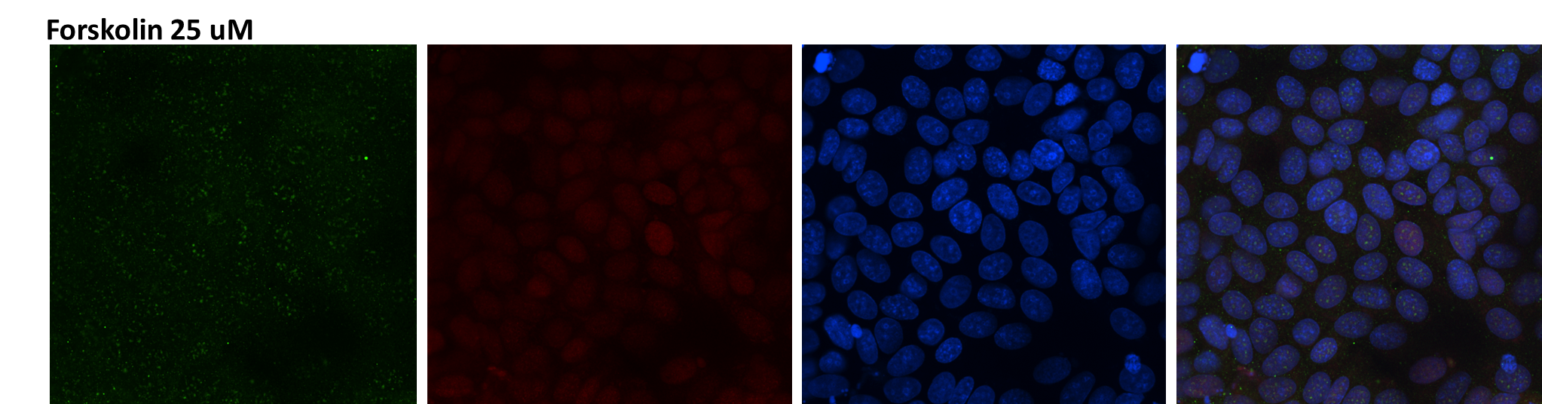
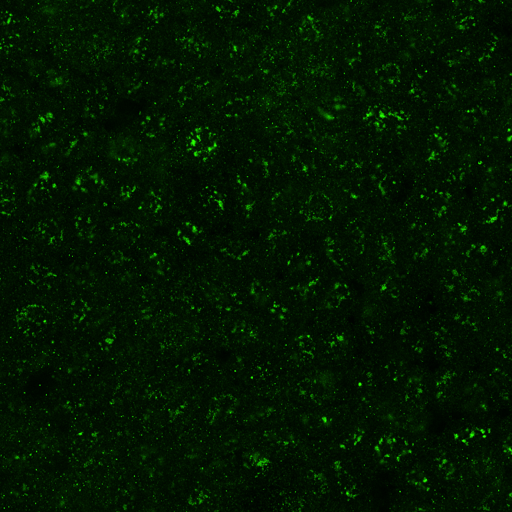
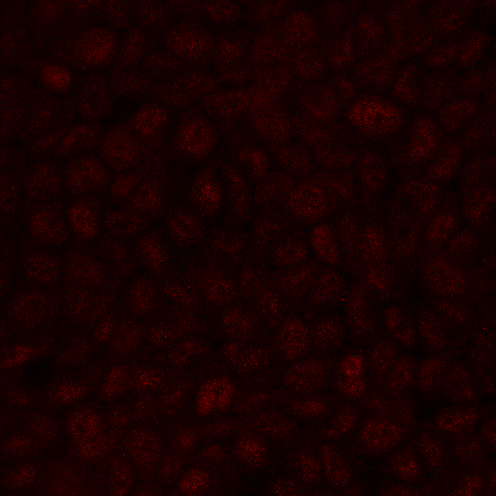
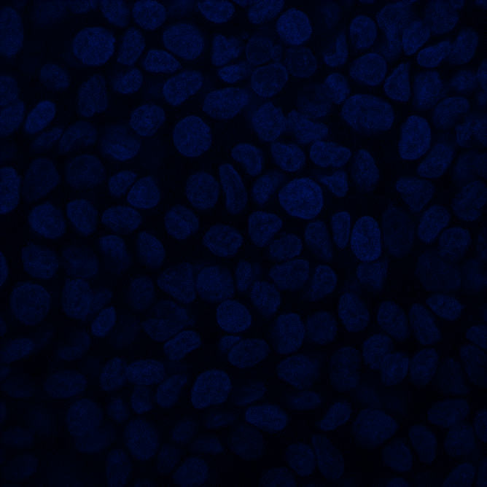
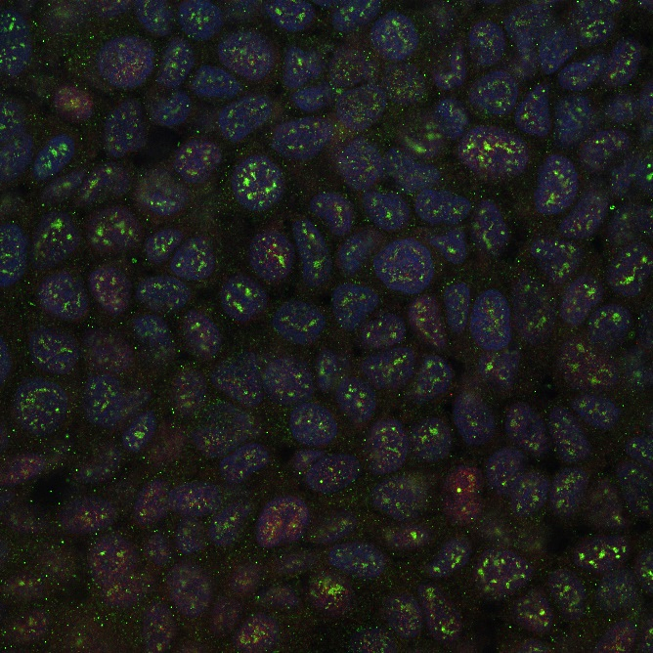
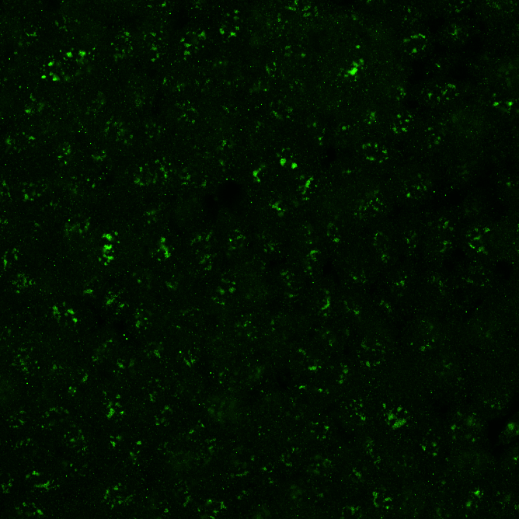
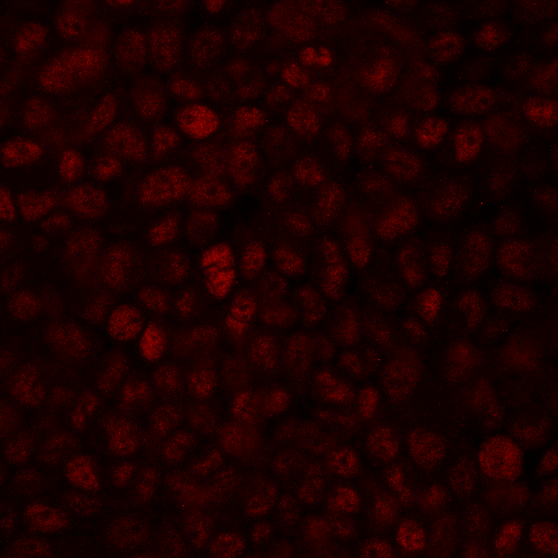
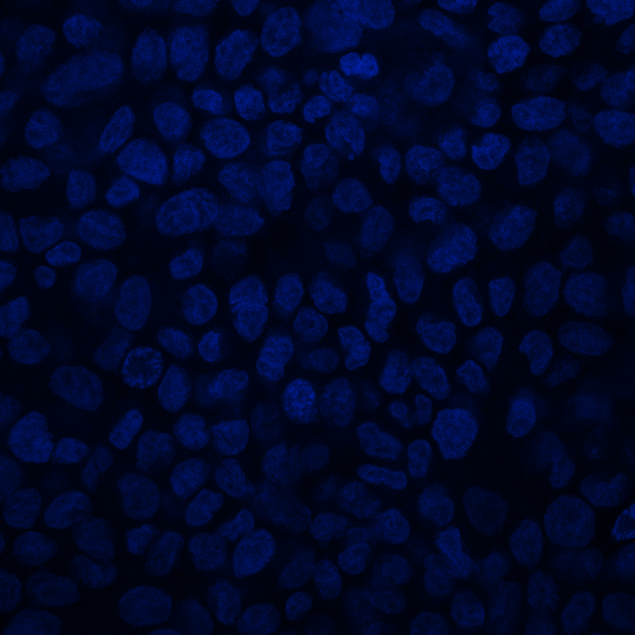
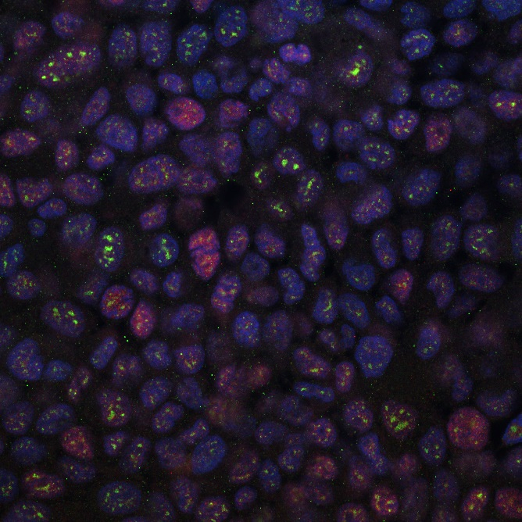
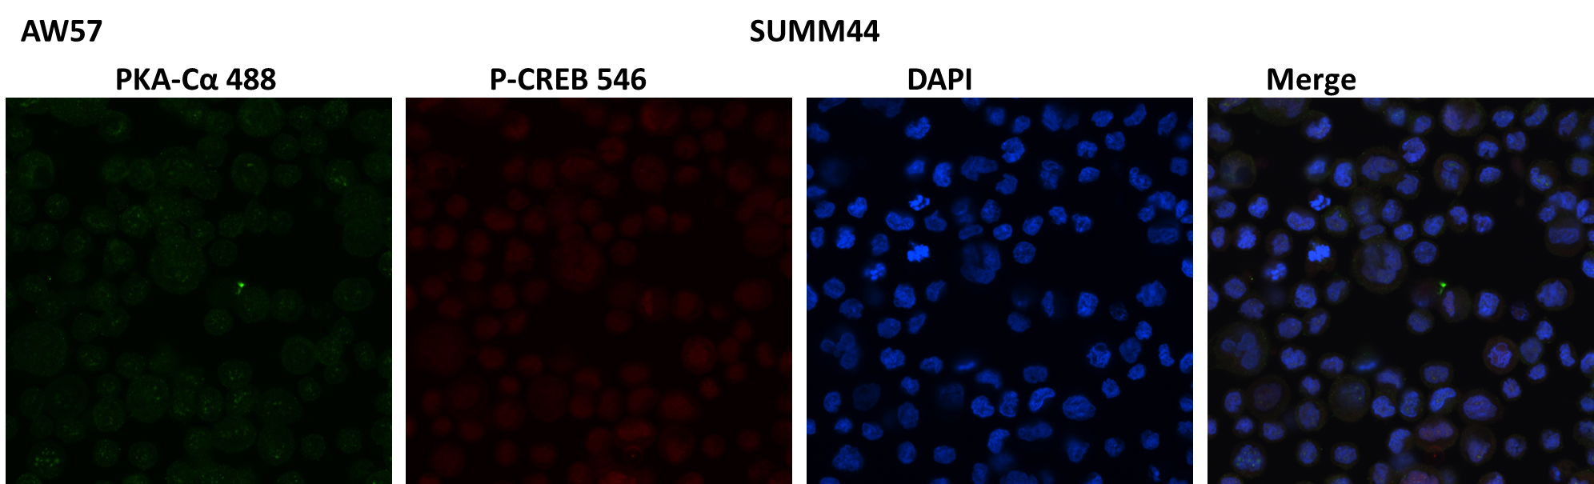
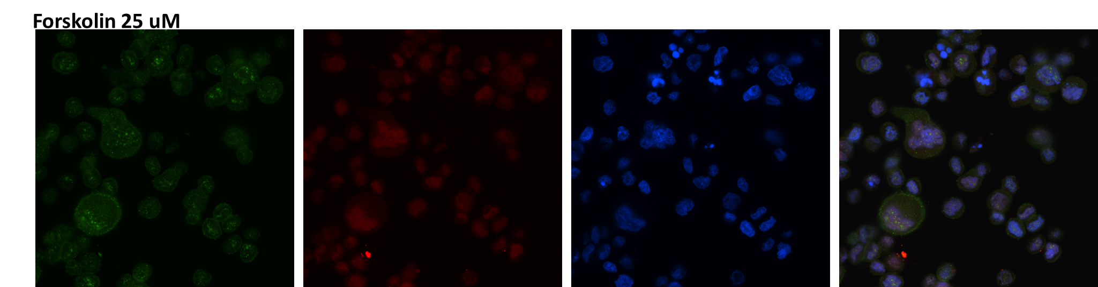
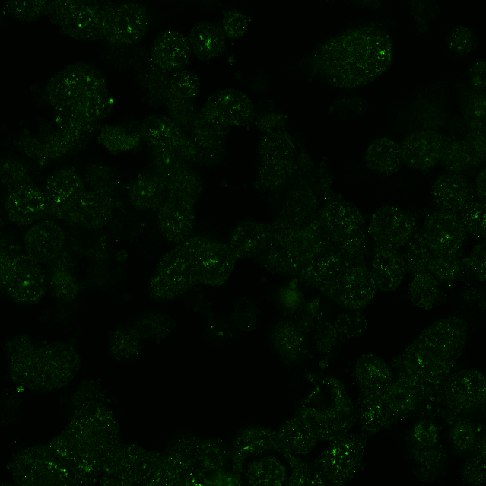
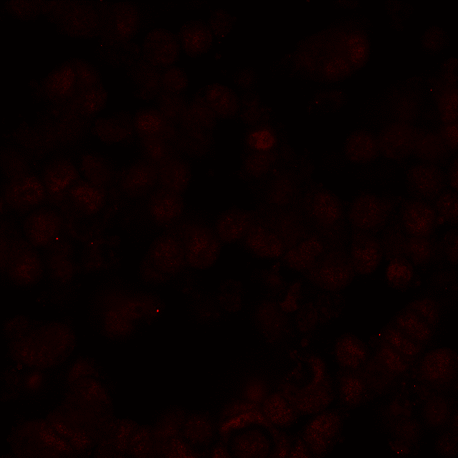
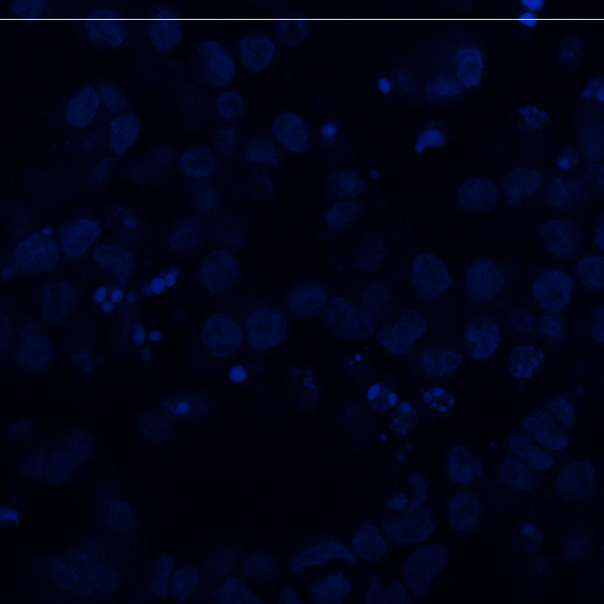
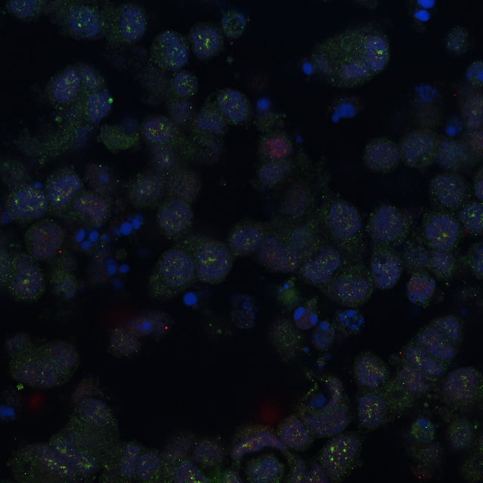
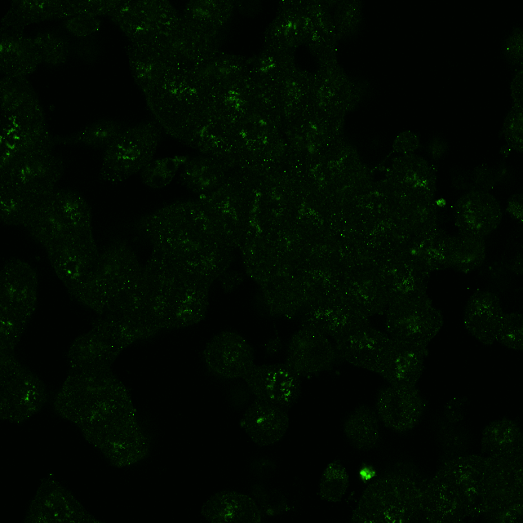



Supplementary Fig 6 Immunofluorescence of PKA-CA and p-CREB to compare nuclear co-localization before and after treatment with forskolin in NST (T47D, MCF7) and ILC (SUM44PE and MPE600) cell lines
PKA-Cα
p-CREB
DAPI
Merge
Vehicle
MCF7
Forsk
25 uM
Vehicle
T47D
Forsk
25 uM
Vehicle
SUM44PE
Forsk
25 uM
Vehicle
MPE600
Forsk
25 uM
Notes:
Supplementary Fig 6 Immunofluorescence of PKA-CA and p-CREB to compare nuclear co-localization before and after treatment with forskolin in NST (T47D, MCF7) and ILC (SUM44PE and MPE600) cell lines

Slide 7









Supplementary Fig 7. A) Western blot images of CREB, p-CREB, PKACA, E-cadherin (E-cad) and β-actin in NST (blue: MCF7, T47D), NST E-cad KO (orange: MCF7 Ecad KO, T47D Ecad KO) and ILC (red: SUM44PE) cell lines after treatment with vehicle or Forskolin in low serum media
B) Dot plots depicting quantified western blot levels of CREB, p-CREB, and PKACA with forskolin treatment as a ratio to their baseline levels (vehicle treatment) in NST (blue: MCF7, T47D), NST E-cad KO (orange: MCF7 Ecad KO, T47D Ecad KO) and ILC (red: SUM44PE)
A.
MCF7 |  | MCF7 Ecad KO |  | T47D |  | T47D Ecad KO |  | SUM44PE
Veh | Fors | Veh | Fors | Veh | Fors | Veh | Fors | Veh | Fors
B.
2.4
CREB forskolin/vehicle
1.6
CREB
0.8
NST
ILC
p-CREB
2.1
NST
Ecad KO
β-actin
p-CREB forskolin/vehicle
PKACA
1.7
β-actin
1.3
NST
ILC
E-Cad
NST
Ecad KO
β-actin
1.5
PKACA forskolin/vehicle
1.0
0.5
NST
ILC
NST
Ecad KO
Notes:
Supplementary Fig 7. A. Western blot images of CREB, p-CREB, PKACA, E-cadherin (E-cad) and β-actin in NST (blue: MCF7, T47D), NST E-cad KO (orange: MCF7 Ecad KO, T47D Ecad KO) and ILC (red: SUM44PE) cell lines after treatment with vehicle or Forskolin in low serum media
B. Dot plots depicting quantified western blot levels of CREB, p-CREB, and PKACA with forskolin treatment as a ratio to their baseline levels (vehicle treatment) in NST (blue: MCF7, T47D), NST E-cad KO (orange: MCF7 Ecad KO, T47D Ecad KO) and ILC (red: SUM44PE)

