Slide 1
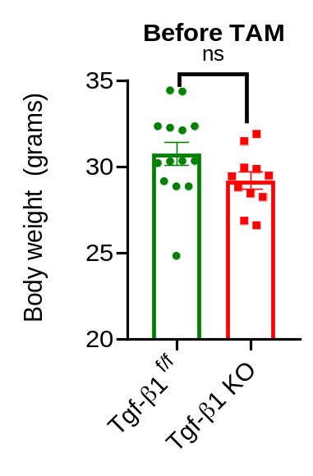
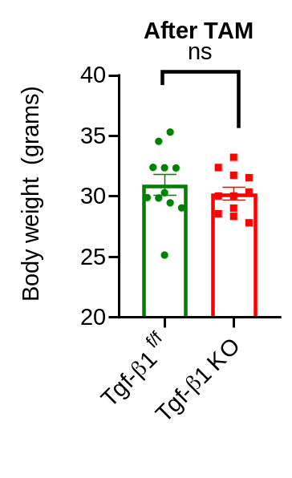
(A)
(B)
(C)
(D)
Supplementary Figure 1: Body weight and food intake during 12 week of normal chow diet. (A) Body weight before TAM (n=11,11), (A) Body weight after 5 times of TAM treatment (n=11,11), (C) Body weight during 12 weeks of normal chow diet (n=11,11), (D) Food intake during 12 weeks of normal chow diet (n=11,11)
Data represent mean ± SEM. Statistical analysis was performed using a two-tail Student's t-test (ns p> 0.05)

Slide 2
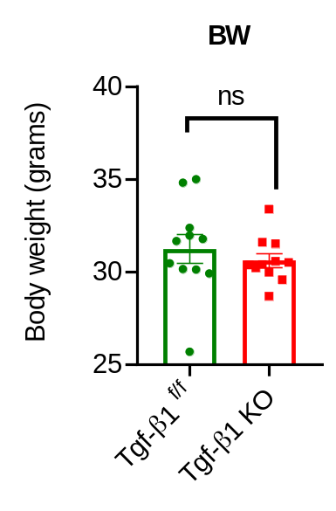
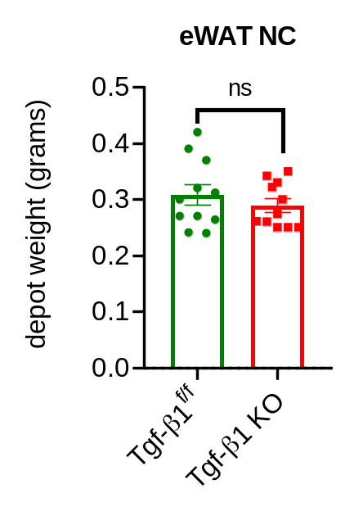
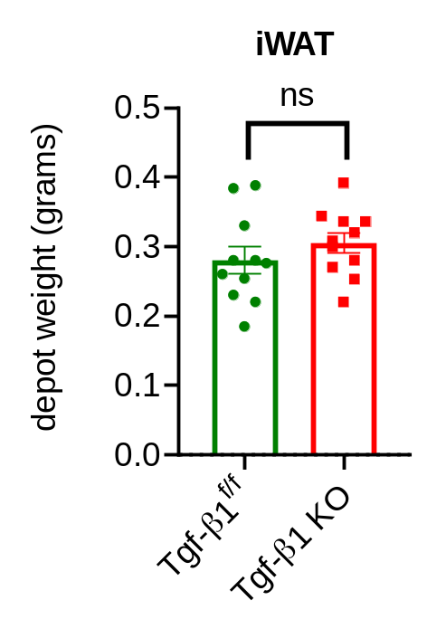
(A)
(B)
(C)
Supplementary Figure 2: Body weight and weight depot of eWAT and iWAT at sacrificing time. (A) Body weight of NC-fed mice (n=11,11), (B) eWAT weight of NC-fed mice (n=11,11), (C) iWAT weight of NC-fed mice (n=11,11)
Data represent mean ± SEM. Statistical analysis was performed using a two-tail Student's t-test (ns p> 0.05)

Slide 3
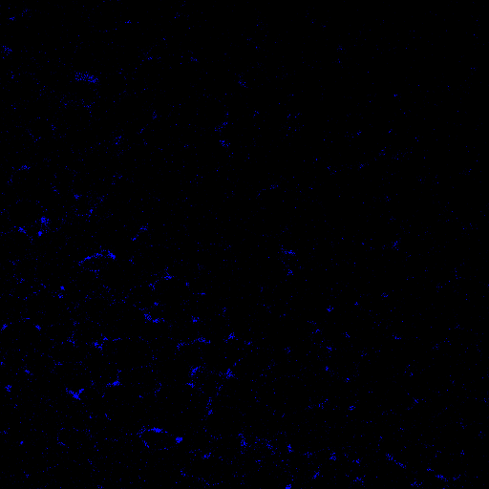
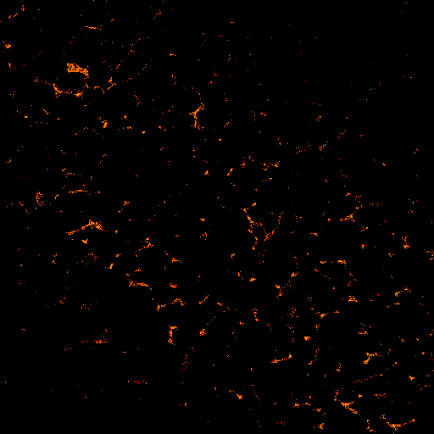
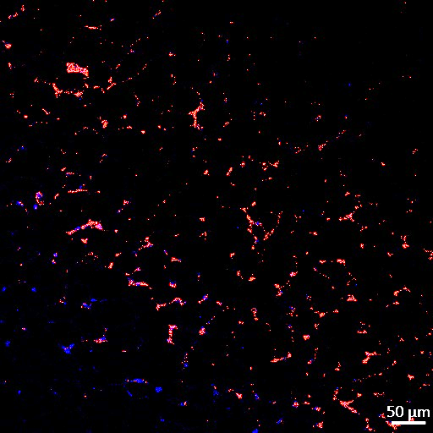
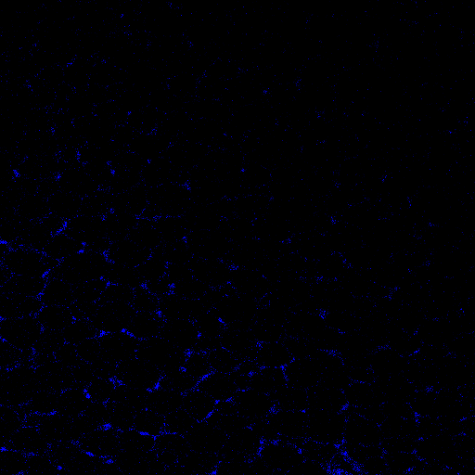
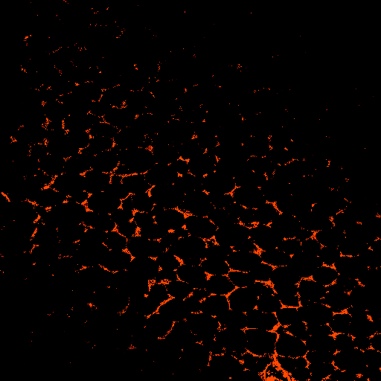
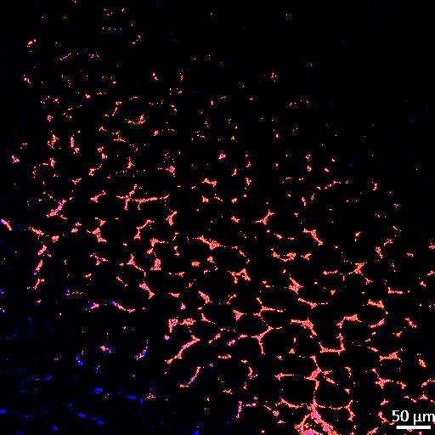
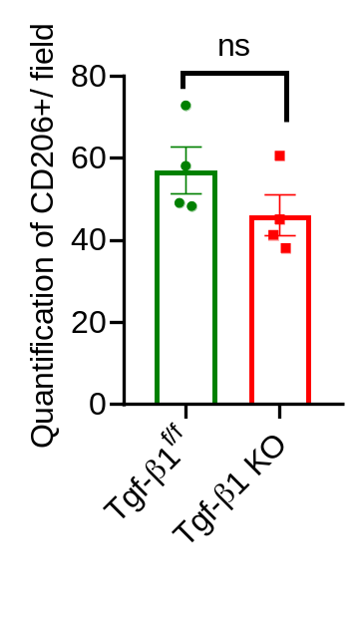
(A)
DAPI
CD206
Merged
Tgf-β1^{f/f}
Tgf-β1 KO
(B)
Supplementary 3: Representative confocal images stain with CD206. (A) Representative image of immunohistochemistry staining for CD206 (red) and DAPI (blue) sections of (scale bar = 50 μm, n=4,4), (B) Quantification of CD206⁺ /field of eWAT (n=4,4)

Slide 4
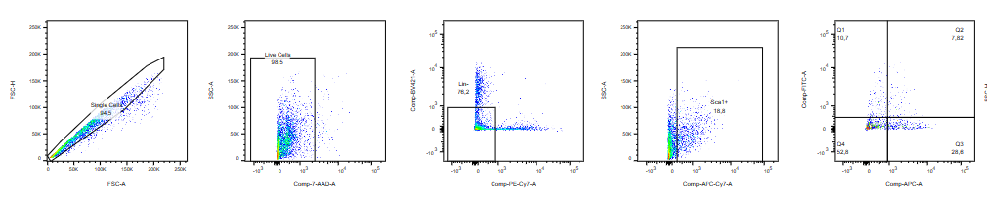
Single Cells
Live Cells
FSC-H
SSC-A
FSC-A
7AAD
Lin- population
Sca1
CD31/45
Dpp4
Icam1
Supplementary 4: Gating strategy for flow cytometry

