Slide 1
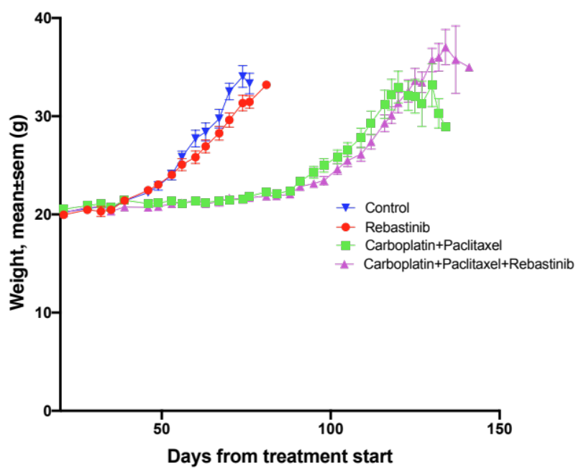
Fig. S1. Rebastinib causes no significant difference in body weights compared to control or chemotherapy
Syngeneic ID8 mice body weight

