Slide 1
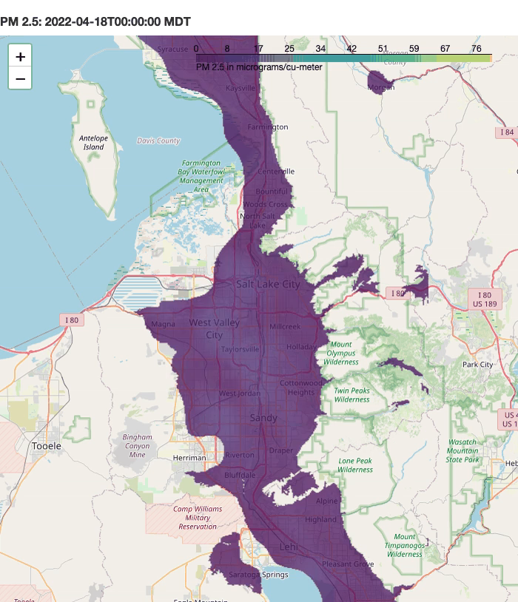
Supplemental Movie:
PM10:
PM10 in micrograms/cu-meter

