Slide 1
Uncropped WB
Figure 1

Slide 2
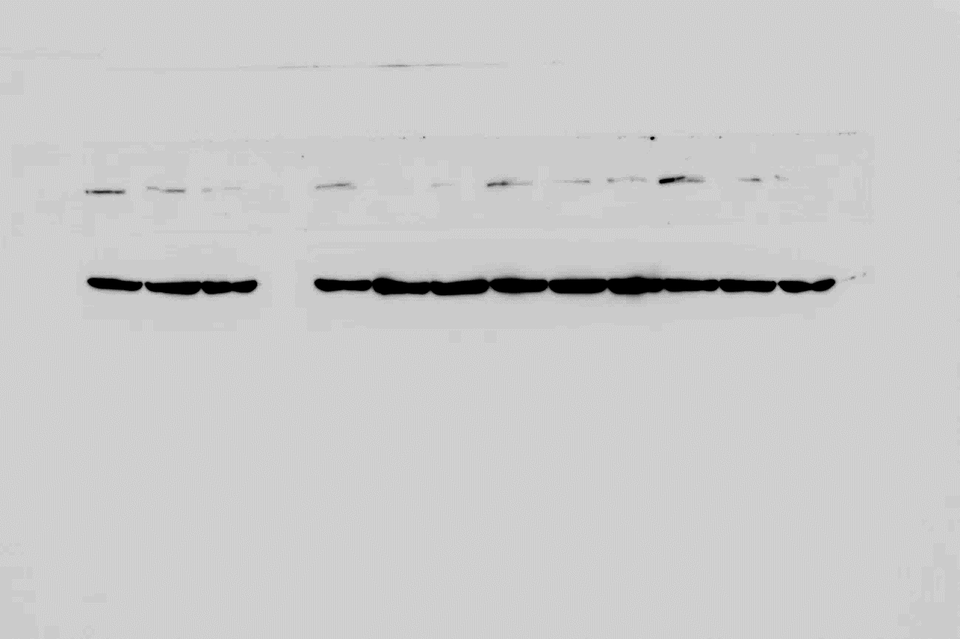
Fig. 1 shRNA-mediated knockdown of endogenous FASN in Kasumi1 cells - FASN

Slide 3
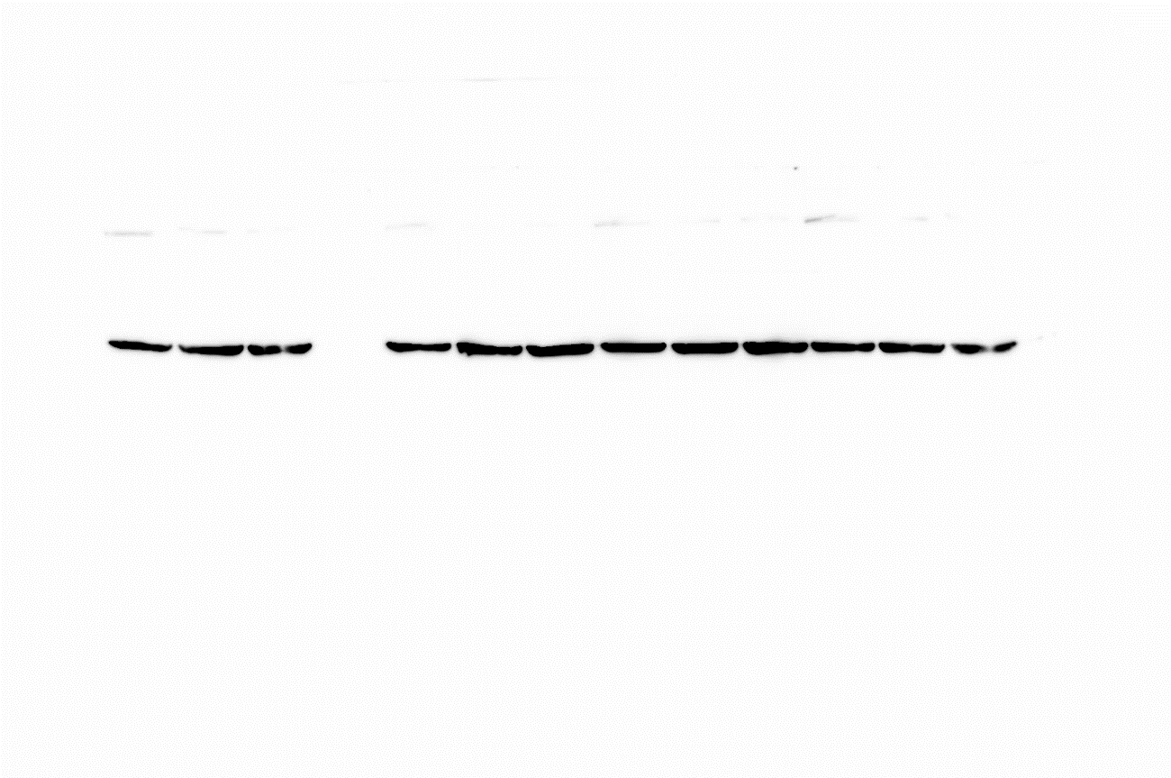
Fig. 1 shRNA-mediated knockdown of endogenous FASN in Kasumi1 cells – HSC70

Slide 4
Uncropped WB
Figure 4

Slide 5
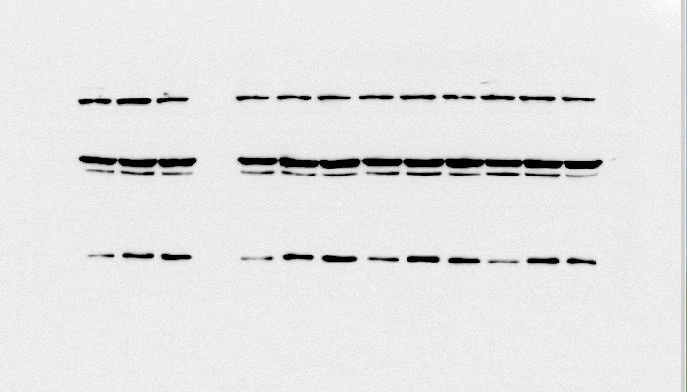
Fig. 4A pAkt

Slide 6
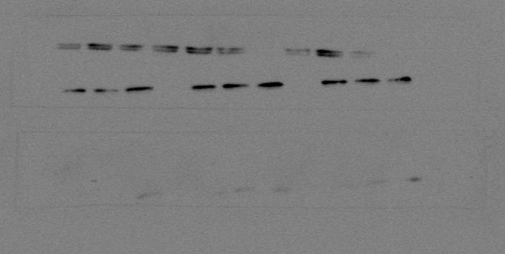
Fig. 4A Akt

Slide 7
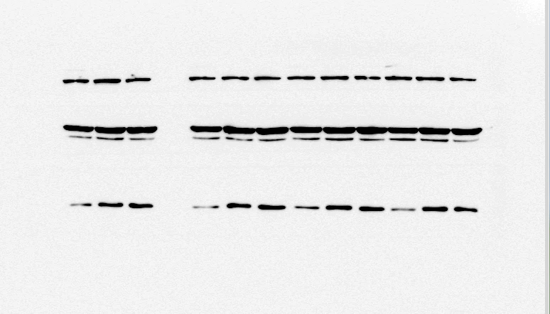
Fig. 4A pS6

Slide 8
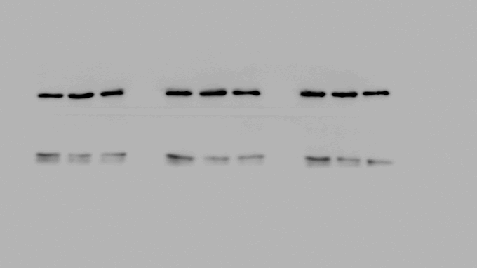
Fig. 4A S6

Slide 9
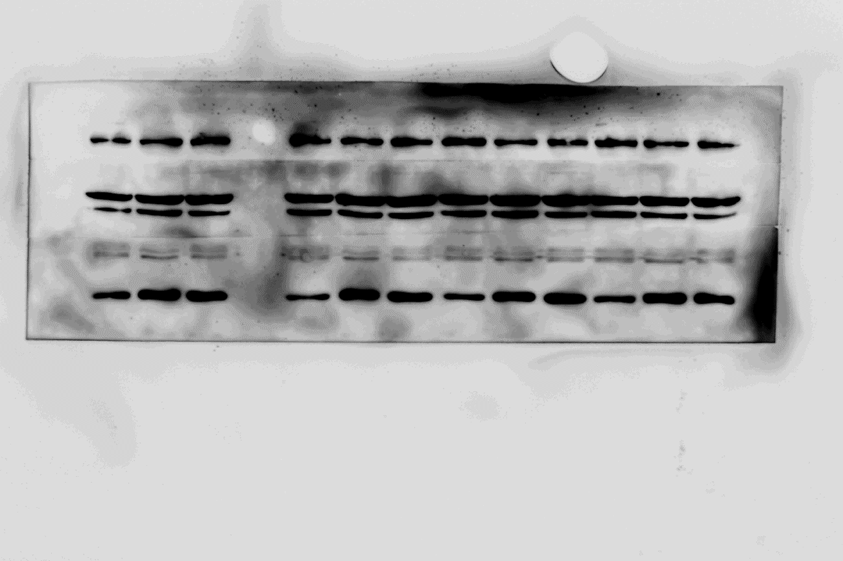
Fig. 4A pMAPK

Slide 10
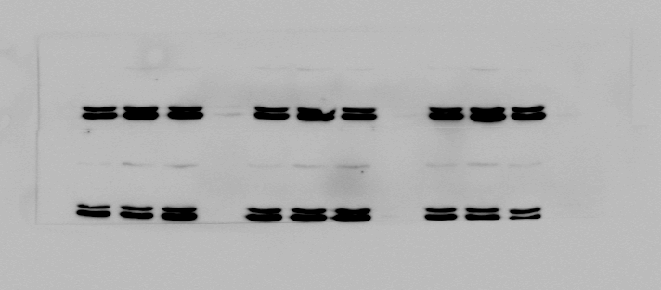
Fig. 4A MAPK

Slide 11
Fig. 4B pS6

Slide 12
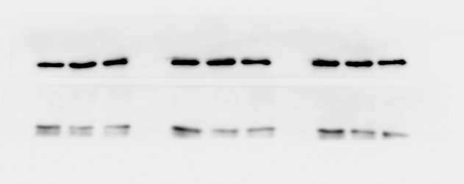
Fig. 4B S6

Slide 13

Fig. 4C Gli1

Slide 14
Uncropped WB
Figure 5

Slide 15
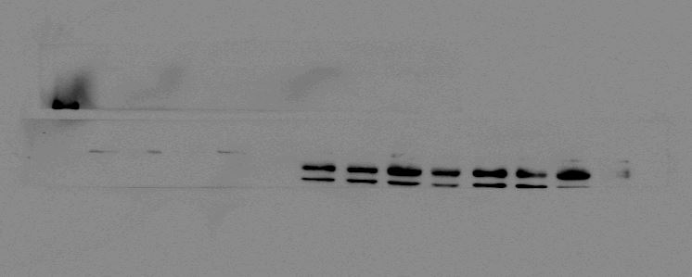
Fig. 5 mut.c-Kit

Slide 16
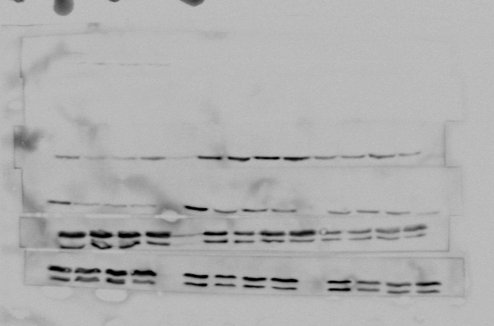
Fig. 5 pAkt(Ser473)

Slide 17
Fig. 5 Akt

Slide 18
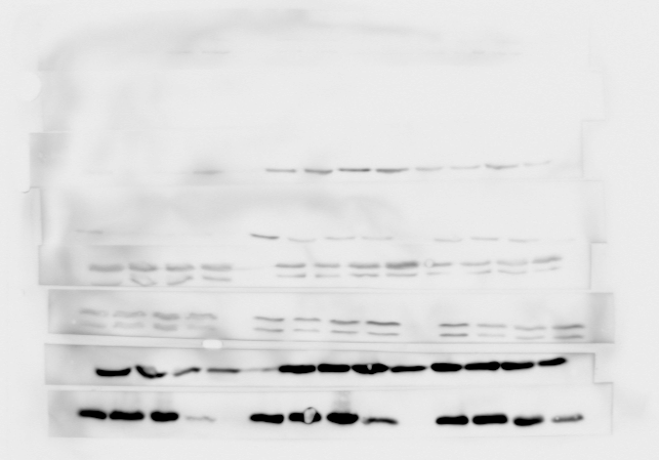
Fig. 5 pS6

Slide 19
Fig. 5 S6

