Slide 1
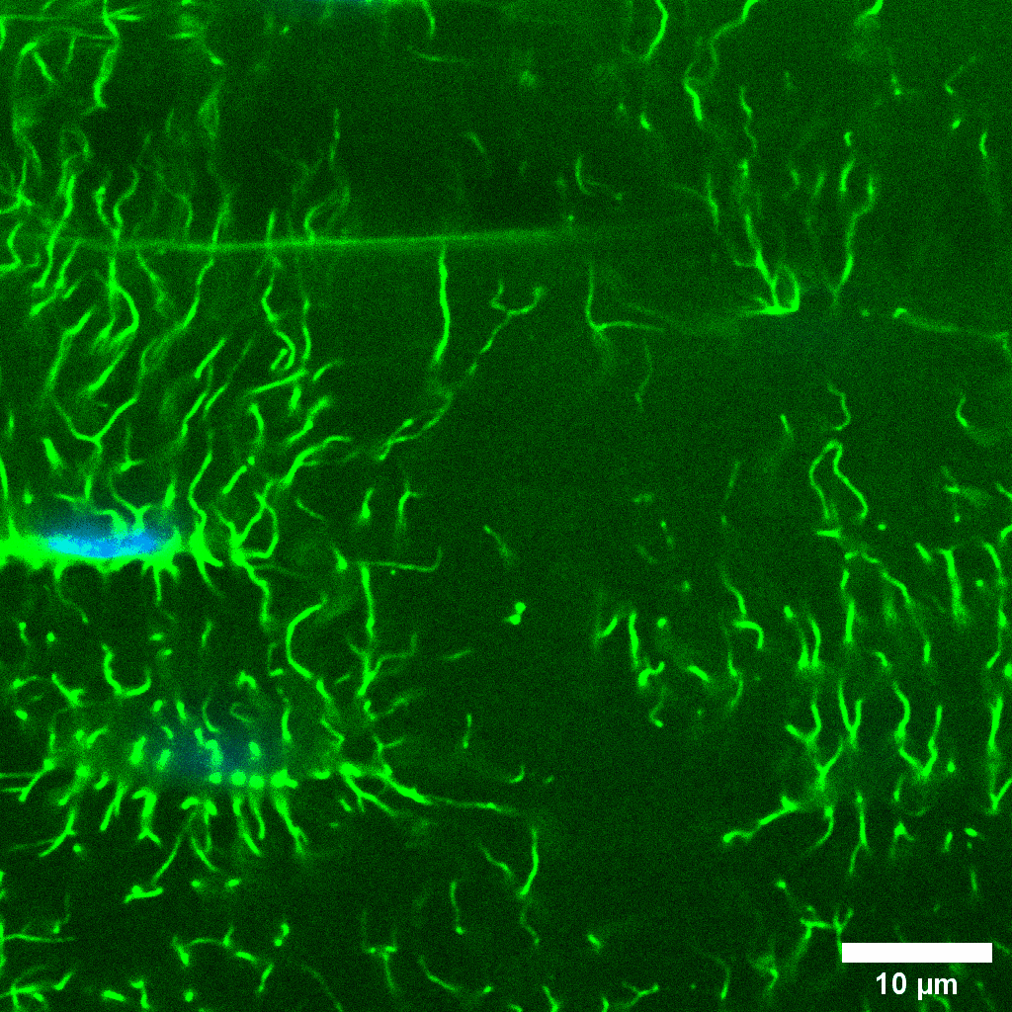
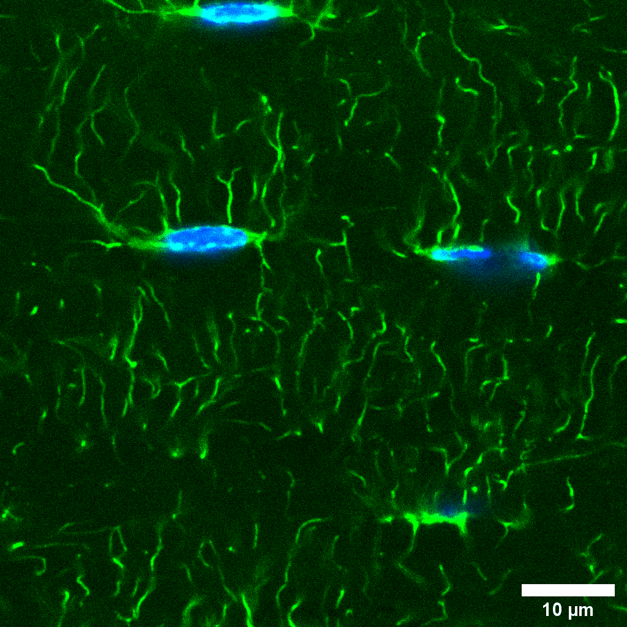
WT
PolgA
Male 40-week-old
Phalloidin Hoechst

Slide 2
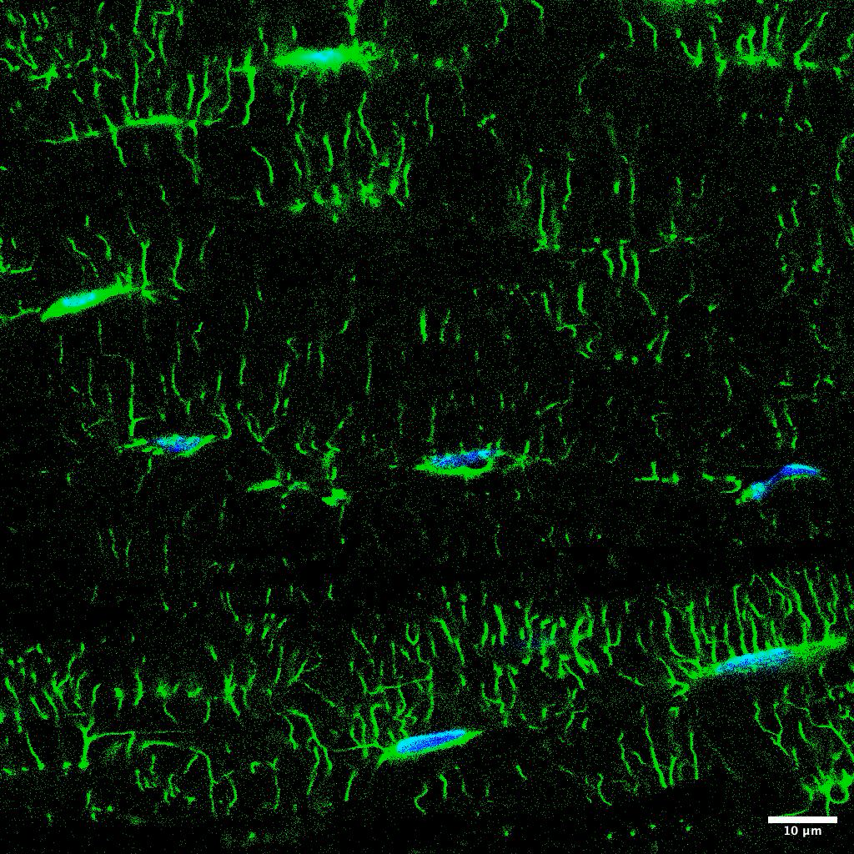
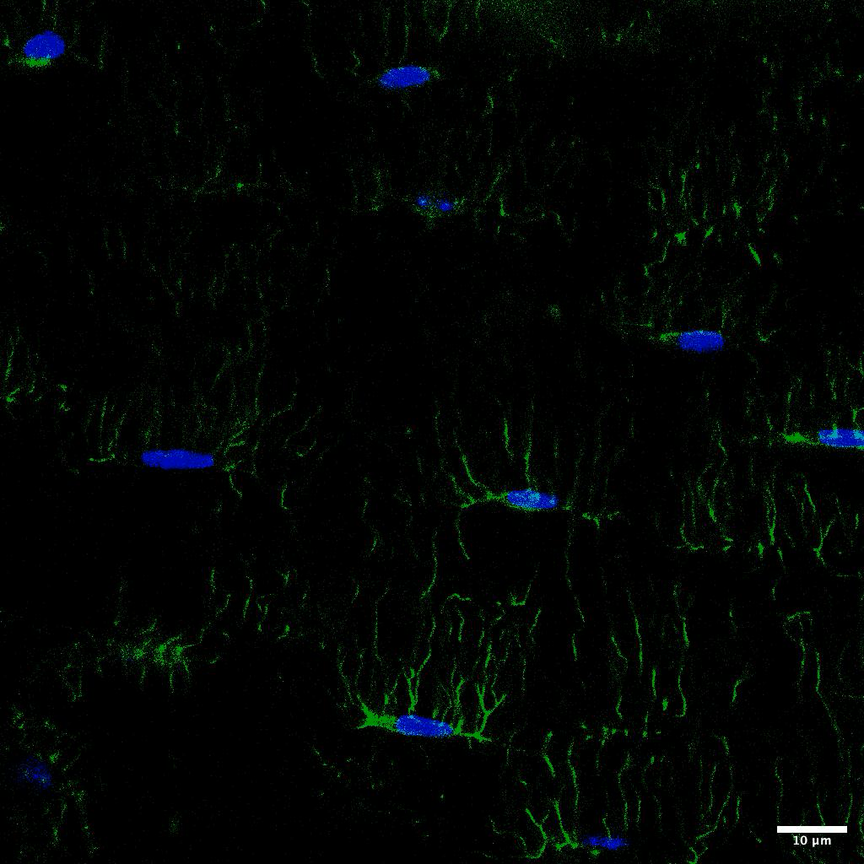
WT
PolgA
Female 40-week-old
Phalloidin Hoechst

Slide 3
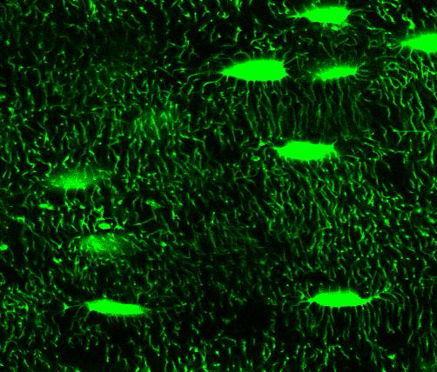
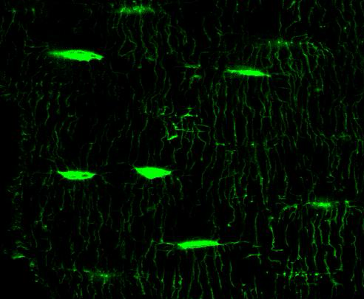
WT
PolgA
Male 40-week-old
10 µm
10 µm
FITC

Slide 4
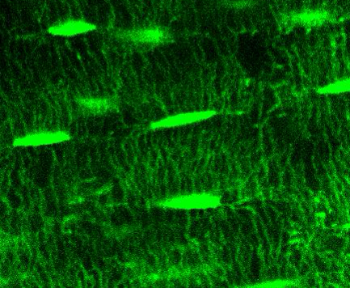
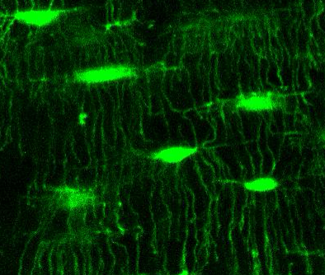
WT
PolgA
Female 40-week-old
10 µm
10 µm
FITC

