Slide 1
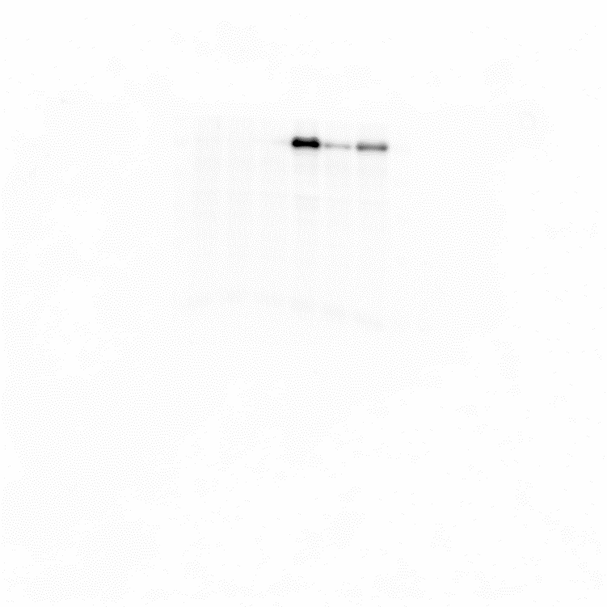
Figure 1 (B)
AD
ASC
72kDa
55kDa
MAGEA1
43kDa
MAGEC2
72kDa
55kDa
β-actin
55kDa
43kDa
Figure 2 (A)
AD
ASC
siMAGEC2
siMAGEC2
Ctrl
#1
#2
Ctrl
#1
#2
72kDa
MAGEC2
55kDa
β-actin
55kDa
43kDa

