Slide 1


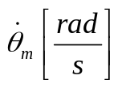
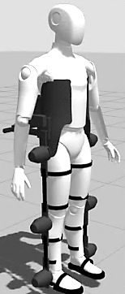








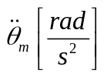


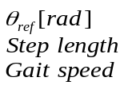























Assistance controller with
interaction torque rejection
Direct control of motor-gearbox frictions
+
+
+
-
+
+
Measured and estimated signals
-
+
Motor torque controller
Assistance controller with angular trajectory tracking
+
+
+
+
-
+
-
+
-
-
+
Assistance
hybrid controller
+
+
+
-
-
Direct control of
exoskeleton dynamic (Gravity and Inertia)
+
+
+
+
+
+
+
+
+
-
-
+

