Slide 1
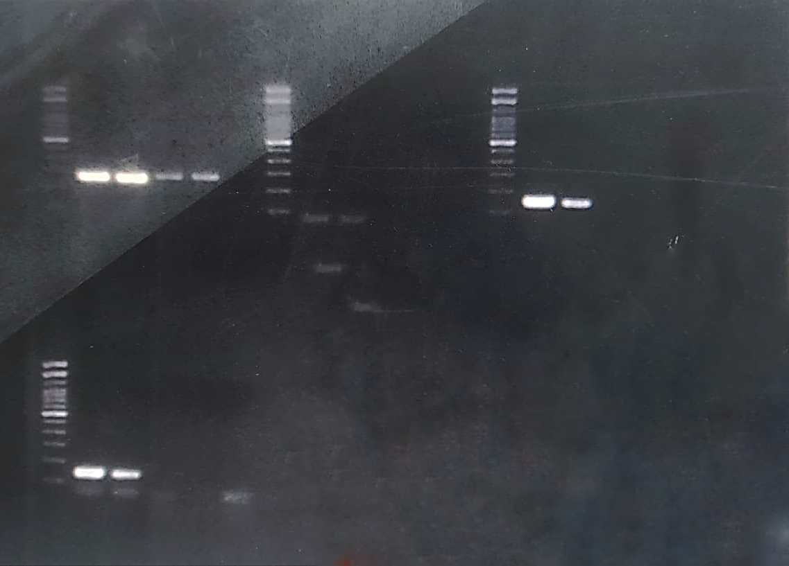
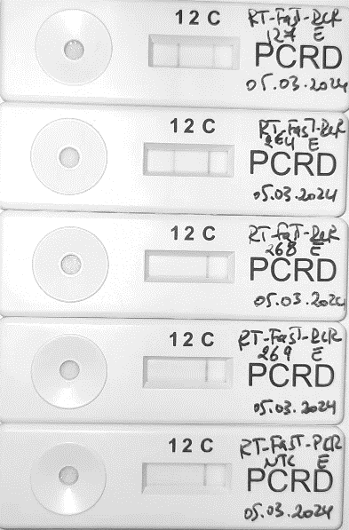
E target
CoV+
CoV-
MW
NTC
(a)
264
269
127
268
Where the gel in the manuscript is cropped
300bp
100bp
(b)
127 264 268 269 NTC
Figure 2 (1/2)
CoV+
CoV-
Notes:
Figure 2. Simplex RT-Fast PCR assays targeting the N and E genes visualized on (a) 2% agarose gels and (b) PCRD. Test line 1 detects Dig/biotin labeled E target amplicon. Test line 2 detects Fam/biotin labeled N target amplicon. C: Control line for flow migration. MW: 100bp Molecular weight. CoV+: Positive samples. CoV-: Negative samples. NTC: No Template Control. The arrows show positive results.

Slide 2
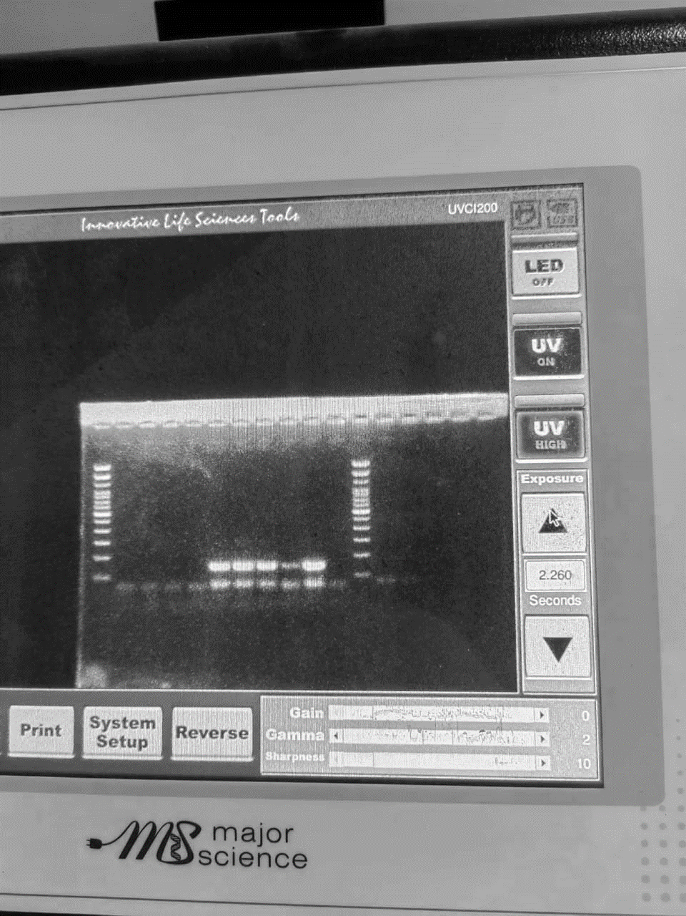
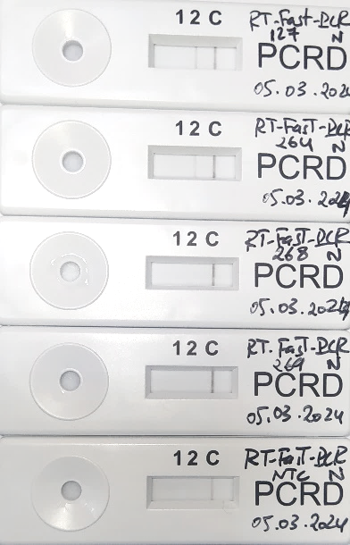
N target
CoV+
CoV-
MW
NTC
269
268
264
127
(a)
Where the gel in the manuscript is cropped
300bp
100bp
Simplex N
(b)
127 264 268 269 NTC
CoV+
CoV-
Figure 2 (2/2)
Notes:
Figure 2. Simplex RT-Fast PCR assays targeting the N and E genes visualized on (a) 2% agarose gels and (b) PCRD. Test line 1 detects Dig/biotin labeled E target amplicon. Test line 2 detects Fam/biotin labeled N target amplicon. C: Control line for flow migration. MW: 100bp Molecular weight. CoV+: Positive samples. CoV-: Negative samples. NTC: No Template Control. The arrows show positive results.

Slide 3
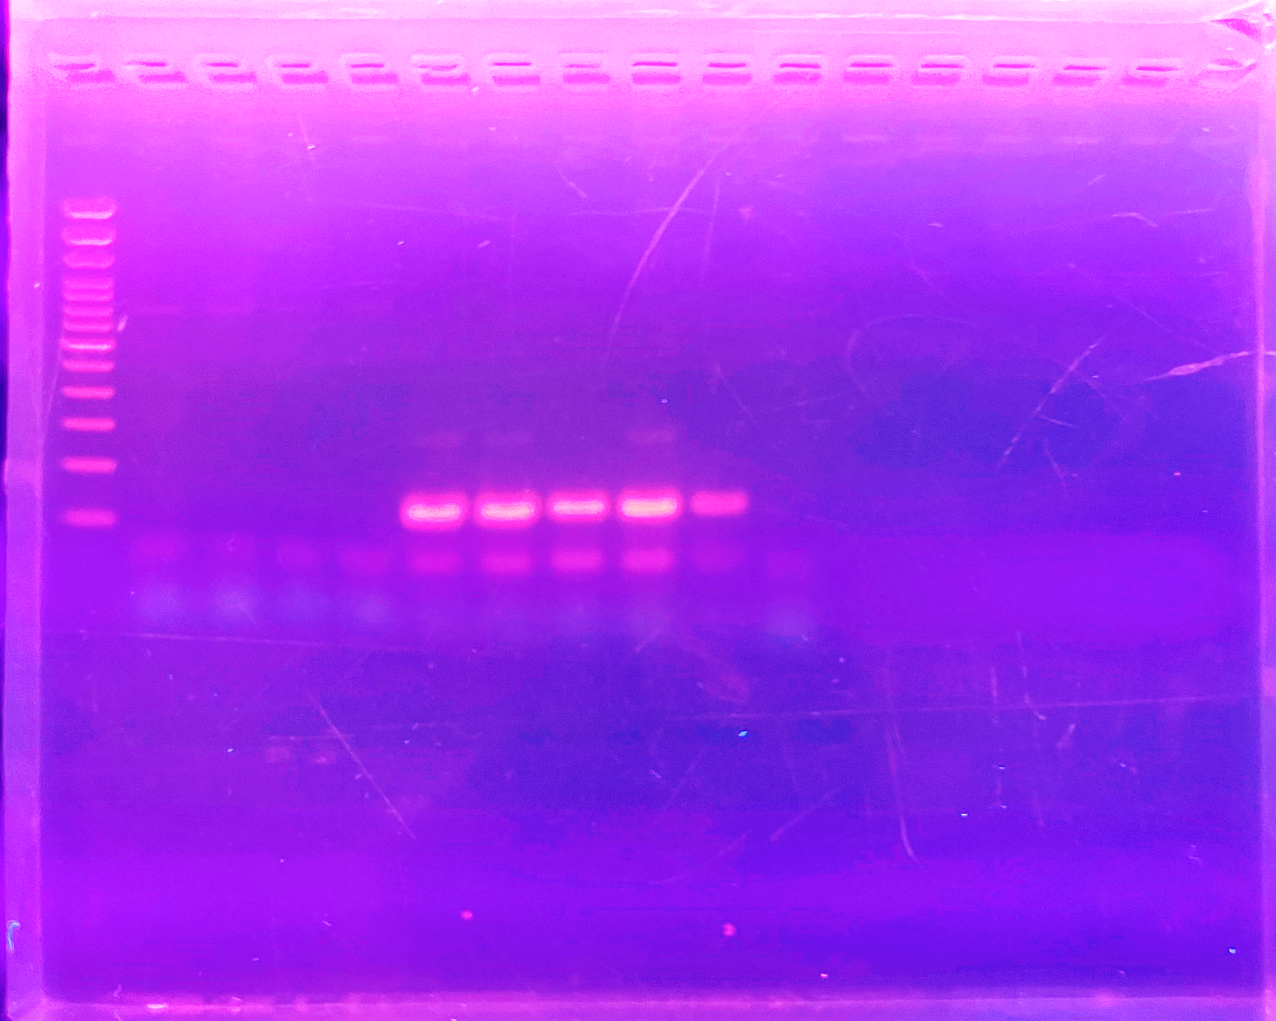
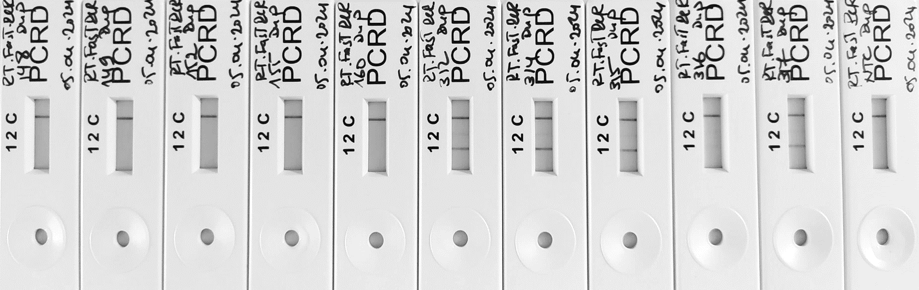
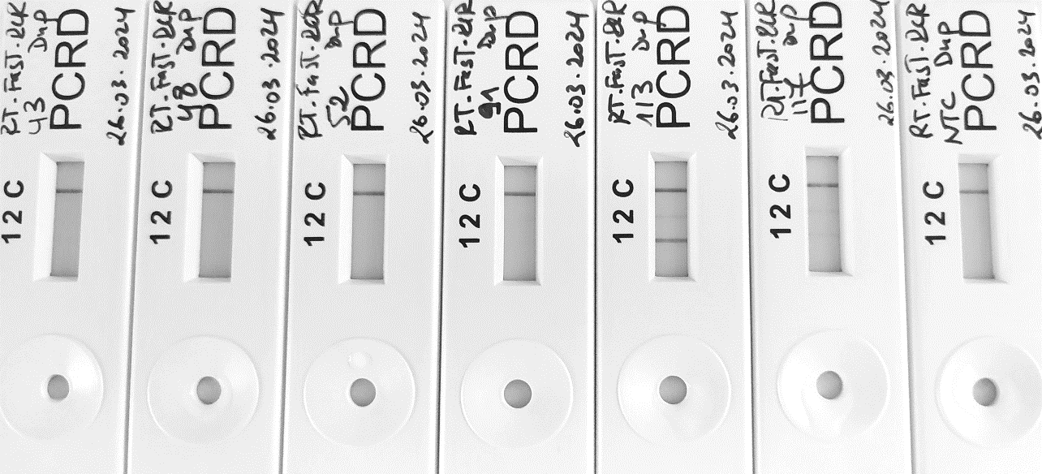
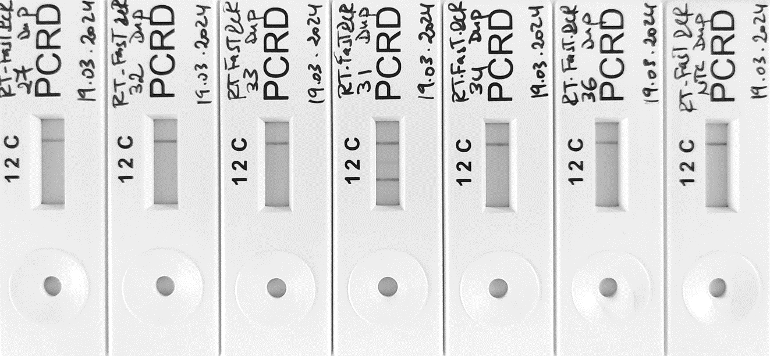
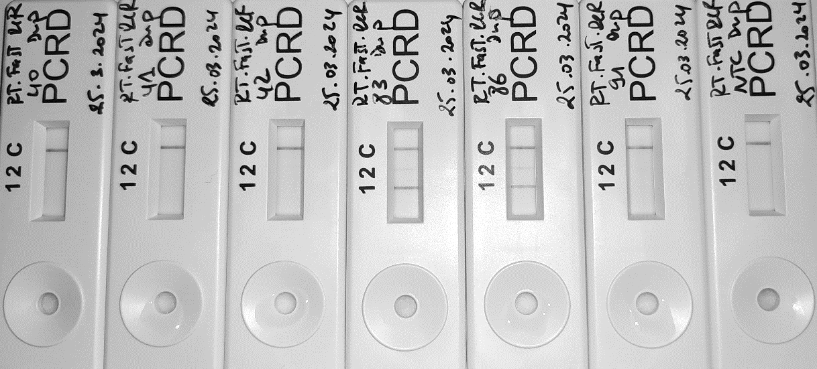
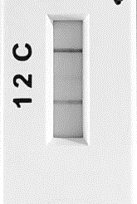
Figure 4
CoV- CoV+
NTC
MW
152
317
152
160
149
155
31
83
86
113
Where the gel in the manuscript is cropped
500 pb
200 pb
100 pb
Ambiguous results
CoV- CoV+
149 152 155 160
31 83 86 113 317 NTC
Notes:
Figure 4. Evaluation of the one-step multiplex fast RT-PCR on clinical samples.
N target showed in Agarose gel ambiguous result that was resolved by the PCRD detection.
CoV-: Negative samples, CoV+: Positive samples, MW: 100bp Molecular weight, NTC: No template control

