Slide 1
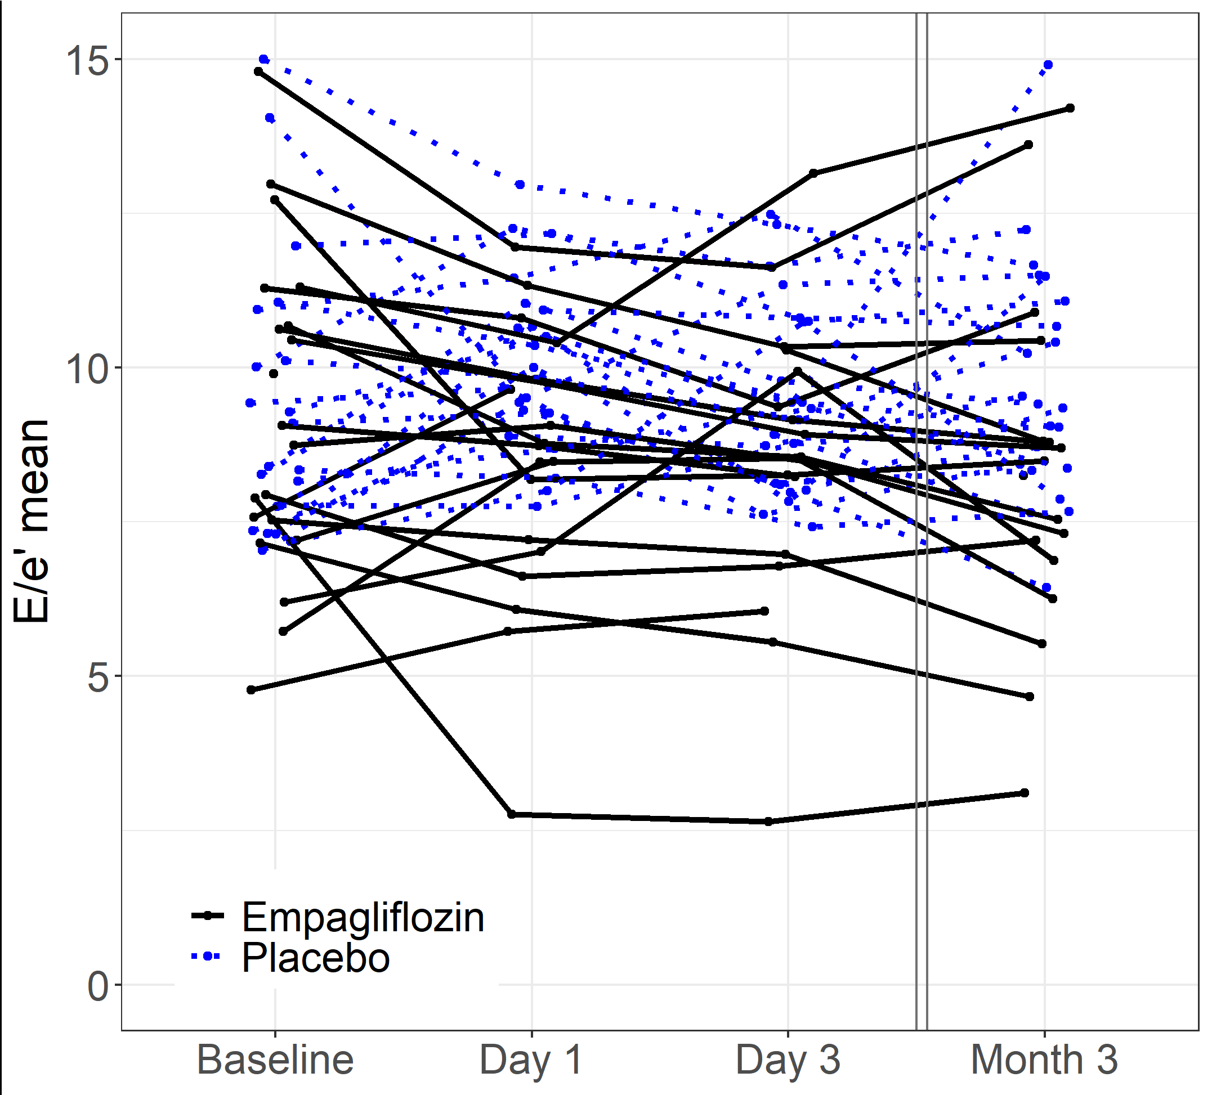
Supplementary Figure

