Slide 1
Supplementary Table
sRNA ID | Control group (count) | VCAM1 group (count) | TNFα group (count) | IL-6 (count)
miR-17-5p | 252 ± 16 | 381 ± 18 | 168 ± 26 | 138 ± 36
miR-21-5p | 1544110 ± 3513 | 1640334 ± 3862 | 1454726 ± 3715 | 1323387 ± 4815
miR-27b-3p | 15977 ± 213 | 17417 ± 162 | 32081 ± 122 | 24810 ± 68
miR-126-3p | 1443 ± 35 | 3170 ± 48 | 1941 ± 78 | 1893 ± 53
miR-130a-3p | 232 ± 12 | 312 ± 21 | 154 ± 13 | 288 ± 16
miR-146b-5p | 78 ± 5 | 110 ± 24 | 157 ± 21 | 44 ± 2
miR-196a-5p | 26485 ± 257 | 63939 ± 128 | 8359 ± 139 | 11440 ± 125
miR-210-3p | 4 ± 1 | 3 ± 1 | 6 ± 2 | 6 ± 1
The expression level of angiogenesis-related miRNA of exosomes, which isolated from MCSs that were pre-treated without or with VCAM-1, TNF-α, or IL-6. The data clearly showed that miRNA-21-5p is the highest expressed miRNA among all 4 groups.

Slide 2
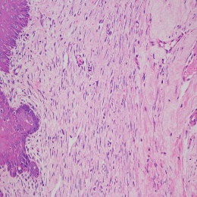
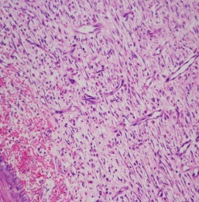
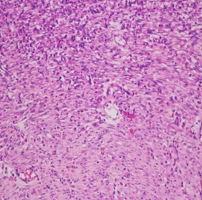
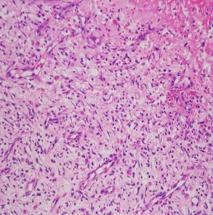
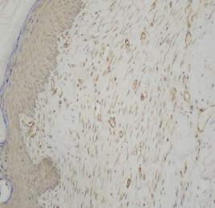
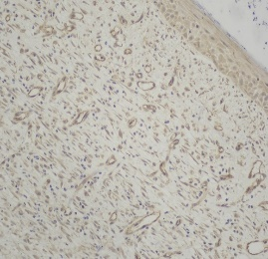
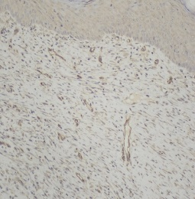
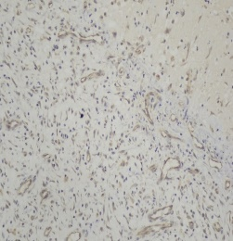
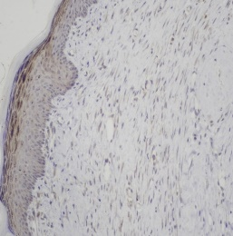
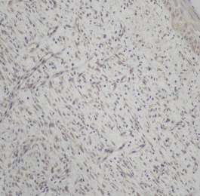
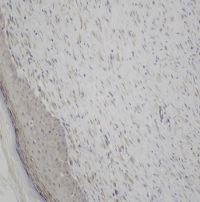
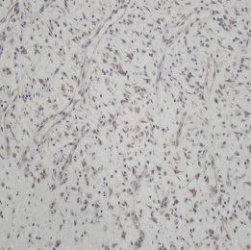
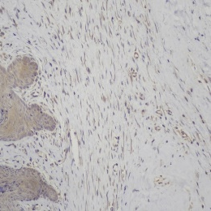
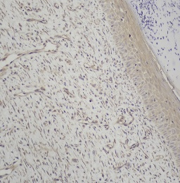
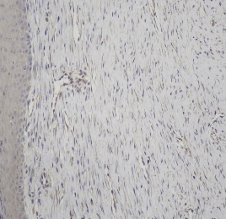
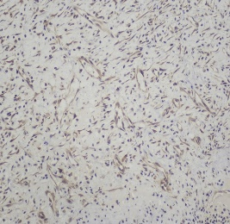
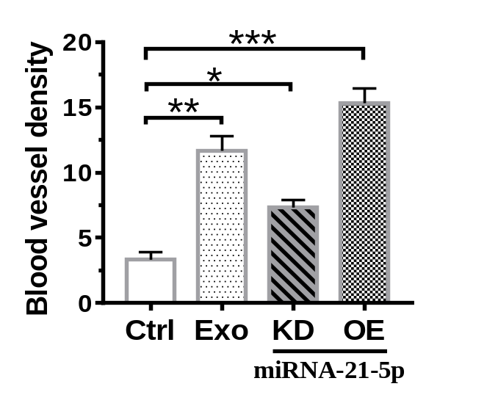
Supplementary Figure
(A)
Exo-miR-21-
5p-KD
Exo-miR-21-
5p-OE
Ctrl
Exo
Pathological
images
(B)
Ctrl
Exo
Exo-miR-21-
5p-KD
Exo-miR-21-
5p-OE
CD31
Immunohistochemical images
TGF-β
VEGF
(C)

Slide 3
(A) Representative pathology images through H&E staining of tissue sections, showing more angiogenesis on the foot ulcers in model rats treated with exosomes.
(B) Immunohistochemical staining of CD31, TGF-β, and VEGF of tissue sections, showing that more angiogenesis on the wound bed in rats treated with exosomes. Samples were collected after exosome treatment for 14 days.
(C) Relative blood vessel density of the ischemic hindlimb tissue revealed that exosome treatment could promote angiogenesis. Statistical analyses corresponding to results shown in (B). *P < 0.05, **P < 0.01, **P < 0.01.

