Slide 1
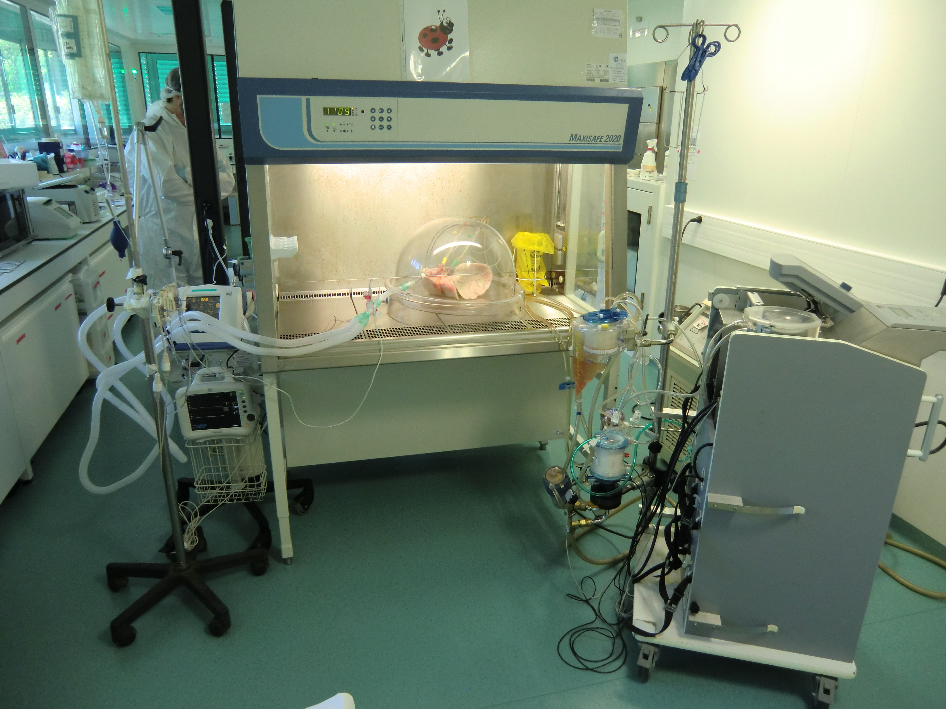
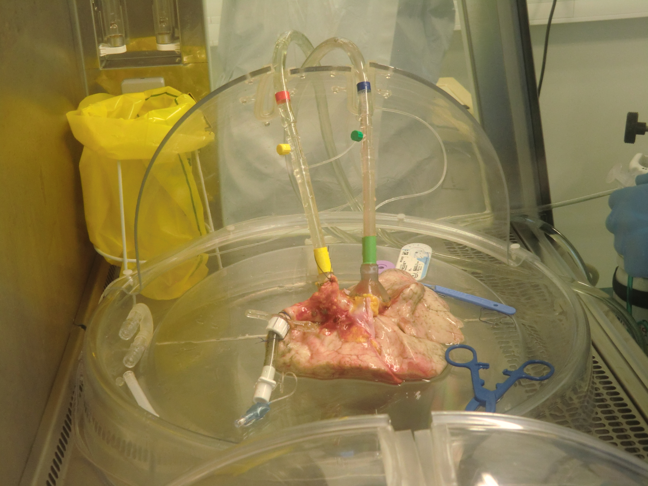
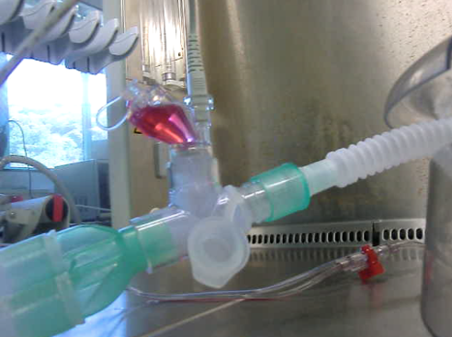
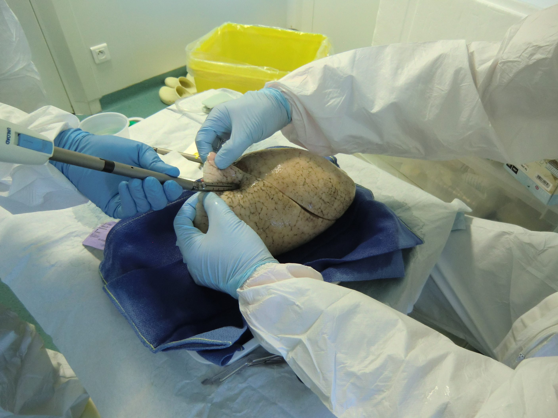
A
B
C
D
Additional file 2. Experimental set up for SARS-CoV-2 infection in EVLP. A. The right lung was ventilated and perfused at normothermia under a PSM-II cabinet in the BSL3 VIM laboratory. B. The right lung was connected to the respirator via a tracheal tubing for the ventilation and to a perfusion circuit via canula attached to the left atrium and pulmonary artery. C. A nebulizer containing the viral suspension was connected to the ventilator for infecting the lung. D. A piece of the left lung is taken as control for the scRNAseq,

