Slide 1
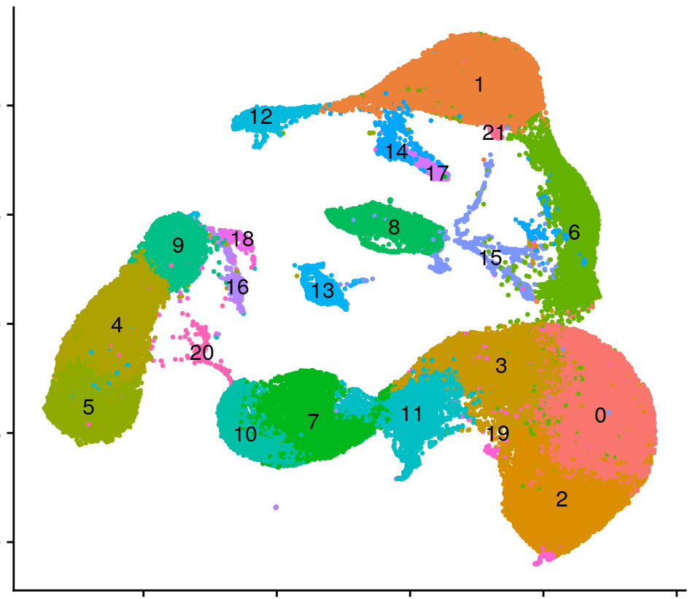
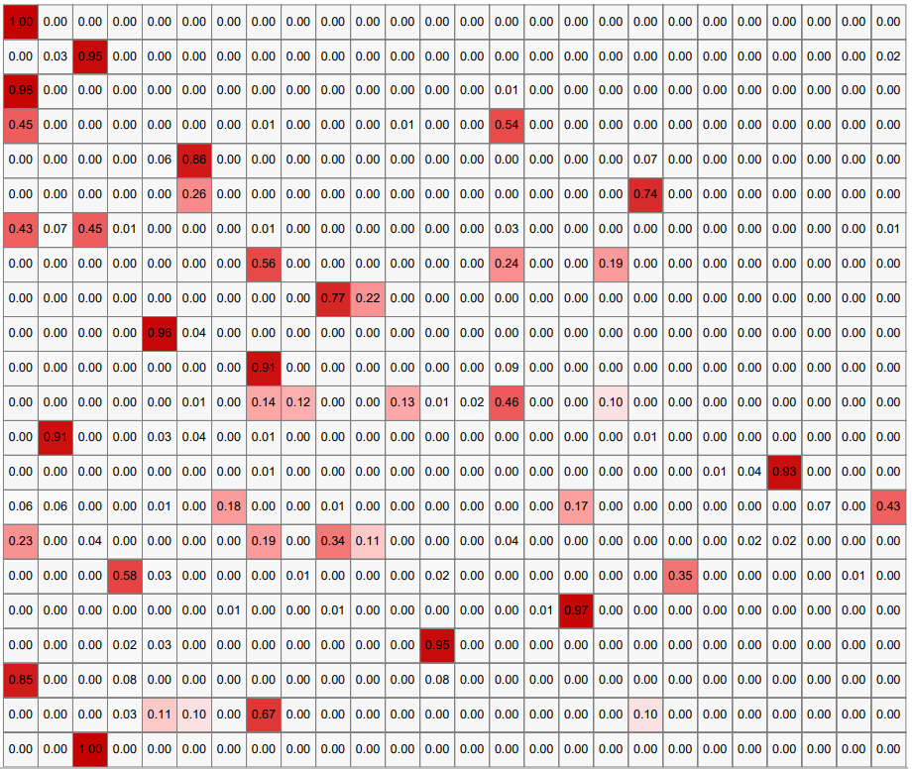
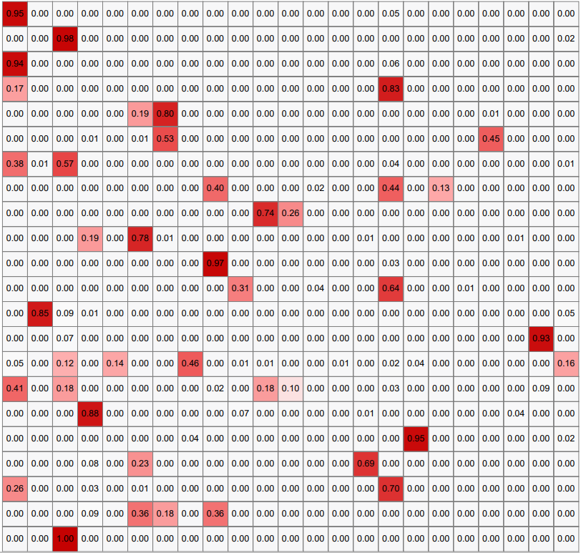
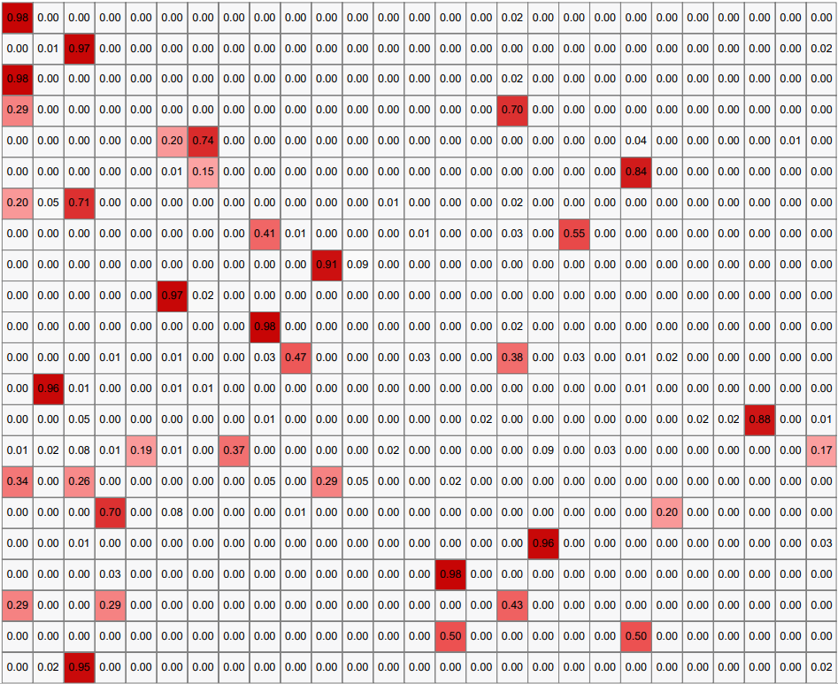
A. Integrated UMAP (initial, 5 donors)
86253 cells
10
C0-AMs
C8-ECs
C16-B cells
C1-AT2s
C9-CD4⁺ T cells
C17-Multiciliated cells
5
C2-AMs
C10-cMos
C18-Mast cells
UMAP 2
C3-AMs/MoMacs
C11-MoMacs/cDC2s
C19-AMs
0
C4-CD8⁺ T cells
C12-AT1s
C20-Mix undefined
C5-NK/CD8 ⁺ T cells
C13-Stromal cells
C21-AT2s
-5
C6-AT2s/AMs
C14-Club & Transitional_Club/AT2s
C7-ncMos/cMos
C15-AMs/ECs
-10
-10
-5
0
5
10
UMAP 1
B. Percent of Azimuth cell identities per cluster in donors 1, 2 and 3 (SARS-CoV-2 infection in EVLP)
Interstitial Macrophages_perivascular
Interstitial Macrophages_perivascular
Interstitial Macrophages_perivascular
AT2s/Transitionnal Club cells
AT2s/Transitionnal Club cells
AT2s/Transitionnal Club cells
SM activated stress response
SM activated stress response
Multiciliated cells (non-nasal)
Multiciliated cells (non-nasal)
Multiciliated cells (nasal)
Neuroendocrine cells
NK cells
pDCs
Stromal cells
Neuroendocrine cells
T cells proliferating
NK cells
pDCs
NK cells
Stromal cells
pDCs
Stromal cells
Suprabasal cells
T cells proliferating
Blood ECs
Lymph ECs
Blood ECs
Goblet cells
Blood ECs
Lymph ECs
Lymph ECs
Club cells (non-nasal)
Club cells (non-nasal)
Club cells (non-nasal)
Pericytes
Basal resting cells
Basal resting cells
Pericytes
Multiciliated cells
ncMos
ncMos
ncMos
Migratory DCs
CD4⁺ T cells
Mesothelium
CD4⁺ T cells
CD8⁺ T cells
CD4⁺ T cells
CD8⁺ T cells
CD8⁺ T cells
Mast cells
Ionocytes
MoMacs
Mast cells
Mast cells
MoMacs
B cells
MoMacs
B cells
B cells
cMos
cMos
cDC2s
cMos
cDC2s
cDC2s
AMs
AT1s
AMs
AT2s
AT1s
AMs
AT2s
AT1s
C0
AT2s
C0
C0
C1
C1
C1
C2
C2
C2
C3
C3
C3
C4
C4
C4
C5
C5
C5
C6
C6
C6
C7
C7
C7
C8
C8
C8
C9
C9
C9
C10
C10
C10
Donor 1
Donor 2
Donor 3
C11
C11
C11
C12
C12
C12
C13
C13
C13
C14
C14
C14
C15
C15
C15
C16
C16
C16
C17
C17
C17
C18
C18
C18
C19
C19
C19
C20
C20
C20
C21
C21
C21
Additional file 6. Cell identity determination. A. The preprocessed scRNA-seq data (86253 cells) were and plotted into an initial "integrated UMAP" with 22 clusters (C0 to C21) as described in the Methods. B. the normalized expression values for each donor data sets before integration were analyzed using Azimuth algorithm and the Human lung v2 reference database, to attribute an identity score to each cell. Only cells with scores > 0.6 were selected. The proportion of Azimuth identities in each of the 22 clusters is indicated on the heat maps (100% = 1) for the 3 donor lungs with SARS-CoV-2 infection in EVLP (donor 1, 2, 3). For the next steps, identities representing < 10% per cluster in the 3 donors (< 0.1 on the heat map) as well as identities-clusters not shared by the 3 donors were eliminated, leading to 66737 selected cells. From there, 17 cell identities were selected for downstream analyses: AMs, MoMacs, cMos, ncMos, DC2, mast cells, stromal cells, CD4-T, CD8-T, NK, B, blood endothelial cells, AT1, AT2, Transitional_Club-AT2, Club (non-nasal), multiciliated_(non-nasal).

