Slide 1
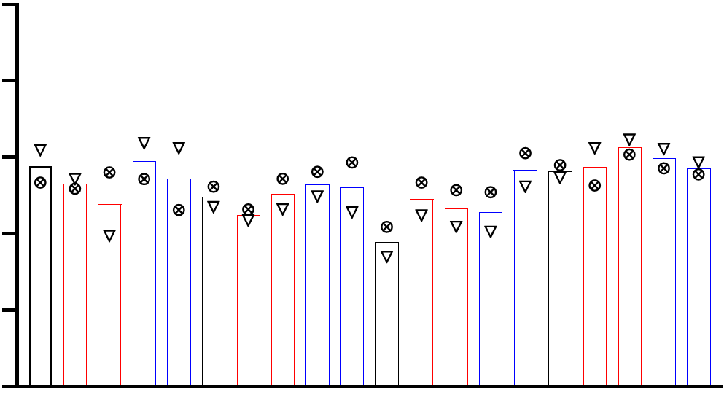
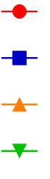
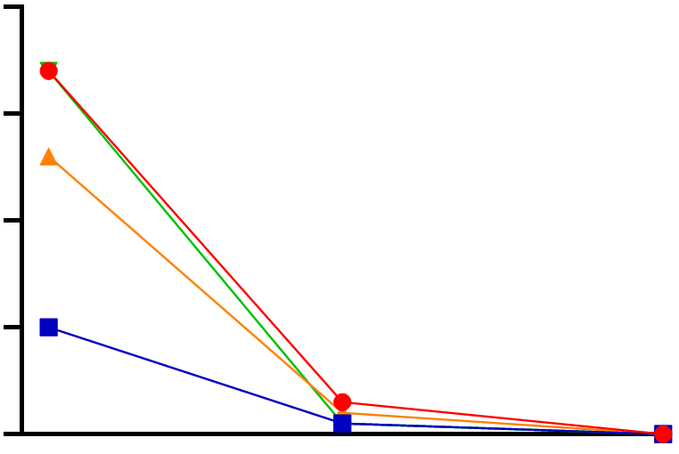

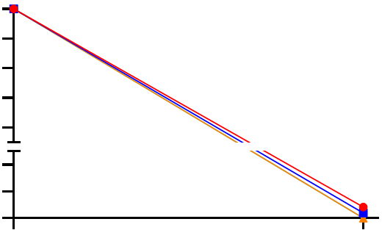
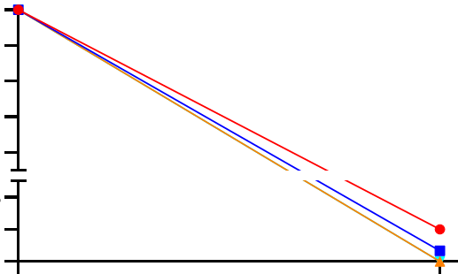
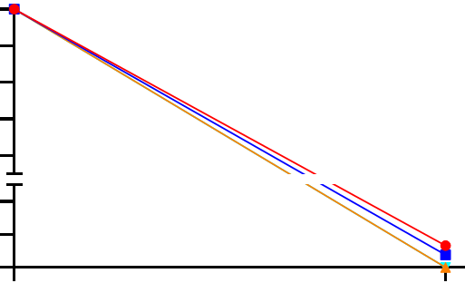
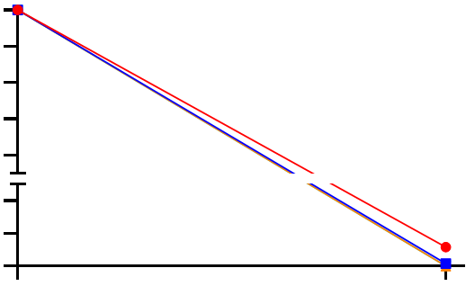
A
100
Patient 4
80
Patient 7
Mortality rate at 24 h (%)
60
40
20
0
no MOI
no MOI
no MOI
no MOI
WL MOI 0.1
WL MOI 0.1
WL MOI 0.1
D614G-a MOI 0.1
D614G-a MOI 0.1
WL MOI 0.001
WL MOI 0.1
WL MOI 0.001
WL MOI 0.001
D614G-a MOI 0.1
WL MOI 0.001
D614G-a MOI 0.001
D614G-a MOI 0.001
D614G-a MOI 0.001
D614G-a MOI 0.1
D614G-a MOI 0.001
B
AMs
MoMacs
cMos
ncMos
Infection WL MOI 0.1
AMs
4000
MoMacs
cMos
3000
ncMos
PFUs/ml
2000
1000
0
24
48
0
AMs
MoMacs
WL MOI 0.1
cMos
ncMos
D614G-a MOI 0.1
100
100
100
100
WL MOI 0.001
80
80
80
80
D614G-a MOI 0.001
60
60
60
60
Percentage of PFUs/ml over time
40
40
40
40
20
20
20
20
4
4
4
4
2
2
2
2
0
0
0
0
0
24
0
24
0
24
0
24
Additional file 13. Cell survival and viral production for monocyte/macrophage subsets exposed to SARS-CoV-2. A. The purified monocyte/macrophages of 2 patients were analyzed for cell death at the end of the 24 h incubation with SARS-CoV-2 WL and D624G at MOI 0.1 and 0.001, or in mock conditions, using a sytox assay (see Methods). Images of wells incubated with Sytox or control solution were captured with a ZOE fluorescent imager and the images were analyzed with the Image J software for determining the percentage of dead cells that stain with Sytox. A minimum of 200 cells in total (live+dead) were counted per well. B. Detection of viral production by the lung monocyte/macrophage subsets cultured with WL and D614G at 0.1 and 0.001 MOI. Cell culture supernatants were collected at 2h, 24 h and 48 h (top panel, one patient) and at 2 h and 24 h (bottom panel, mean of 2 patients) and assayed in a plaque assay.

