Slide 1
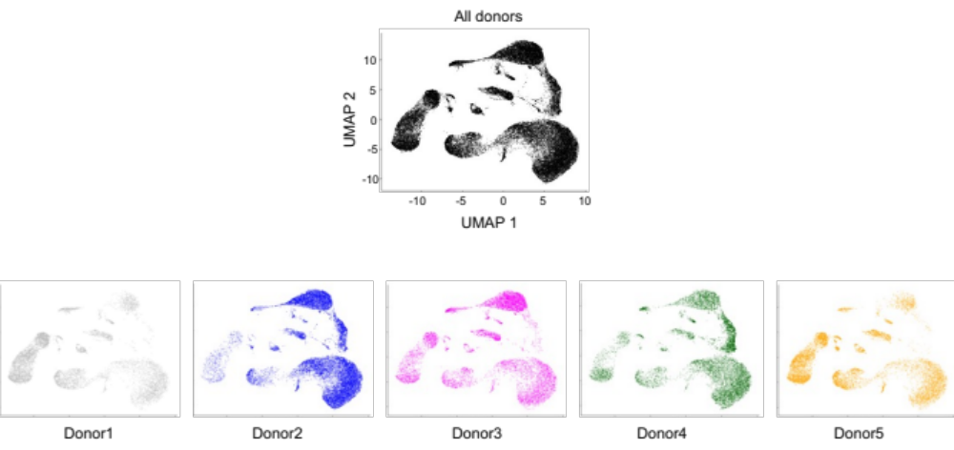
Additional file 7. Representation of the five donors in the integrated UMAP-filtered. The whole "integrated UMAP-filtered" shown in Figure 3A and B, that includes the filtered scRNA-seq data of the 5 donors is represented in black. The contribution of the cells of each donor is shown separately in a different color. The number of cells per donor in each cell identity is reported in the excel sheet Additional file 7.

