Slide 1
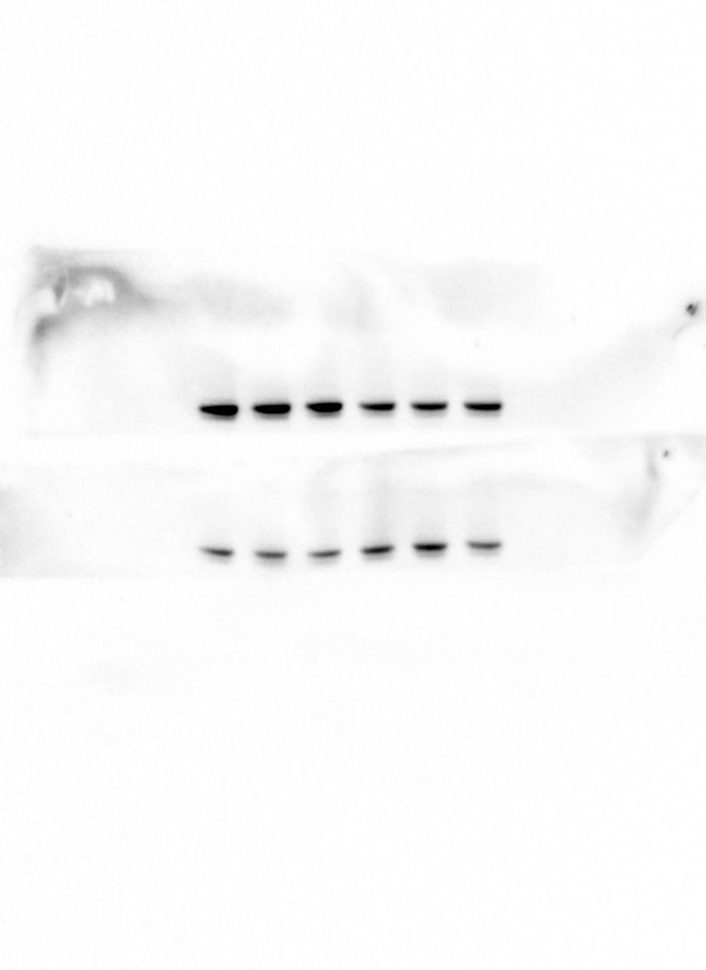
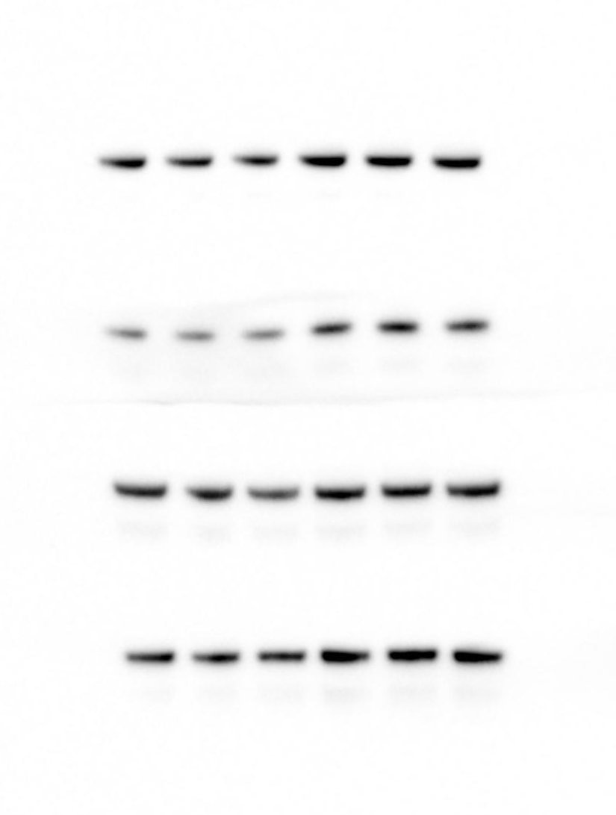
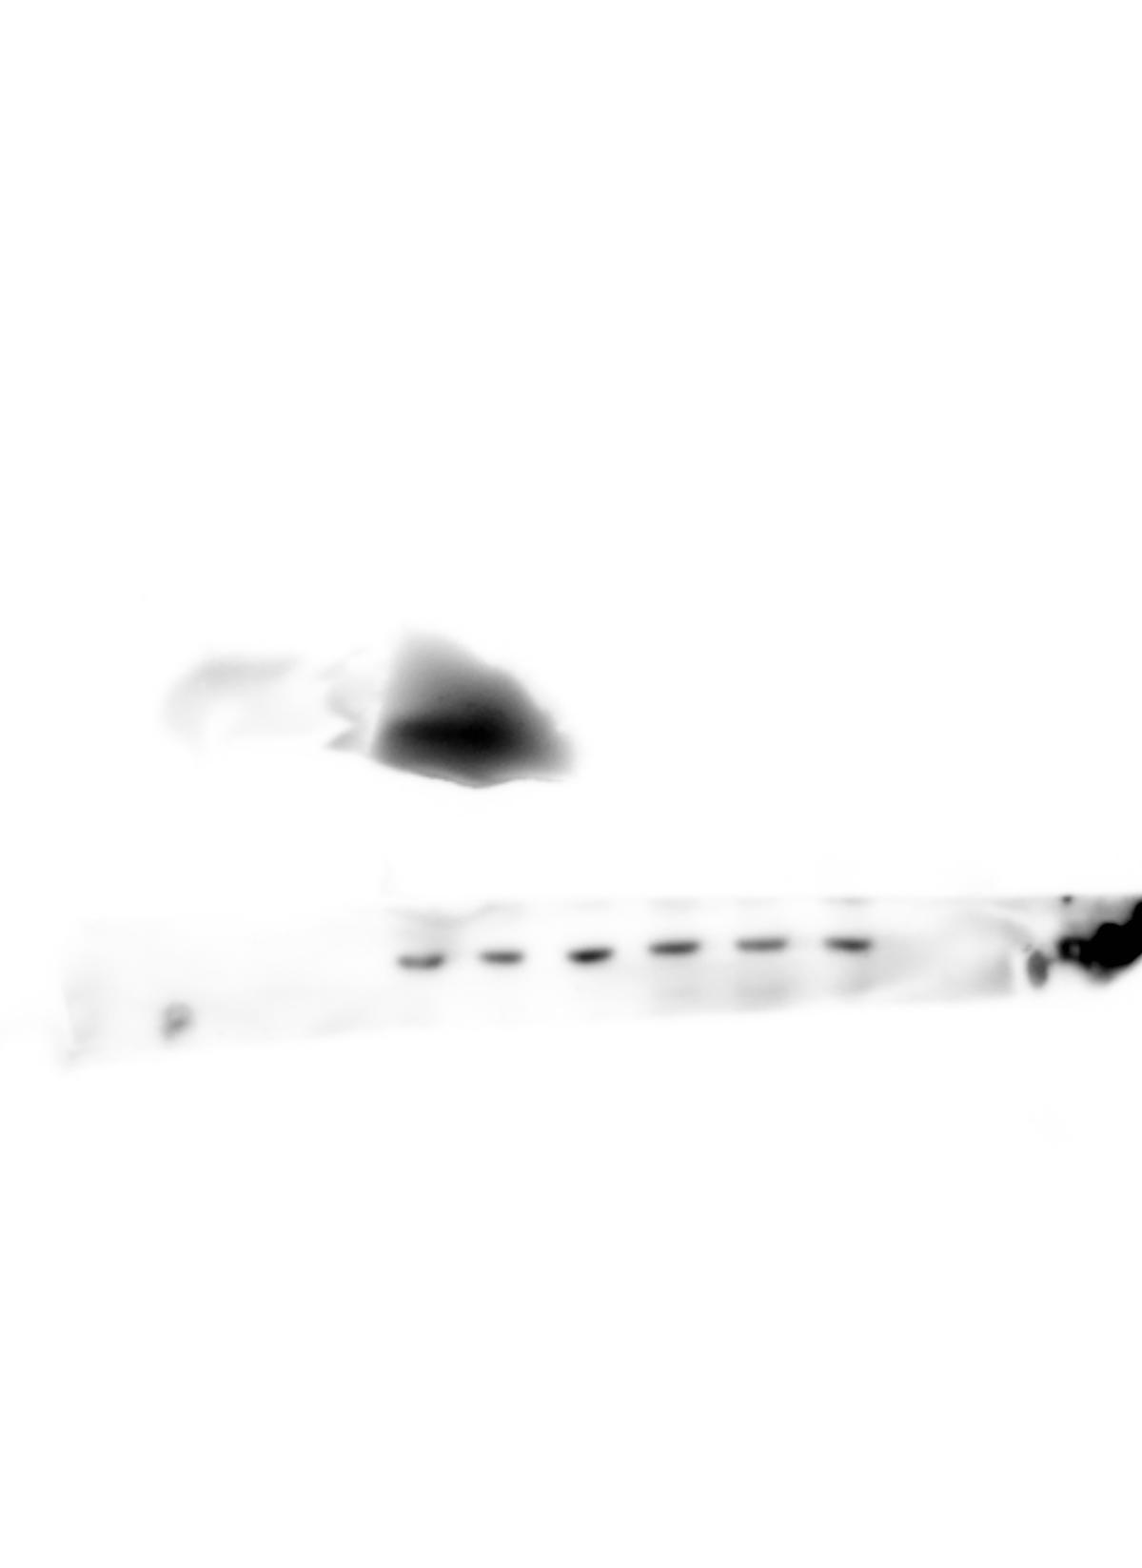
Figure 2a
P-RelA (S536) (MEFs)
P-STAT3 (Y705)
(MEFs)
β-actin (MEFs)

Slide 2
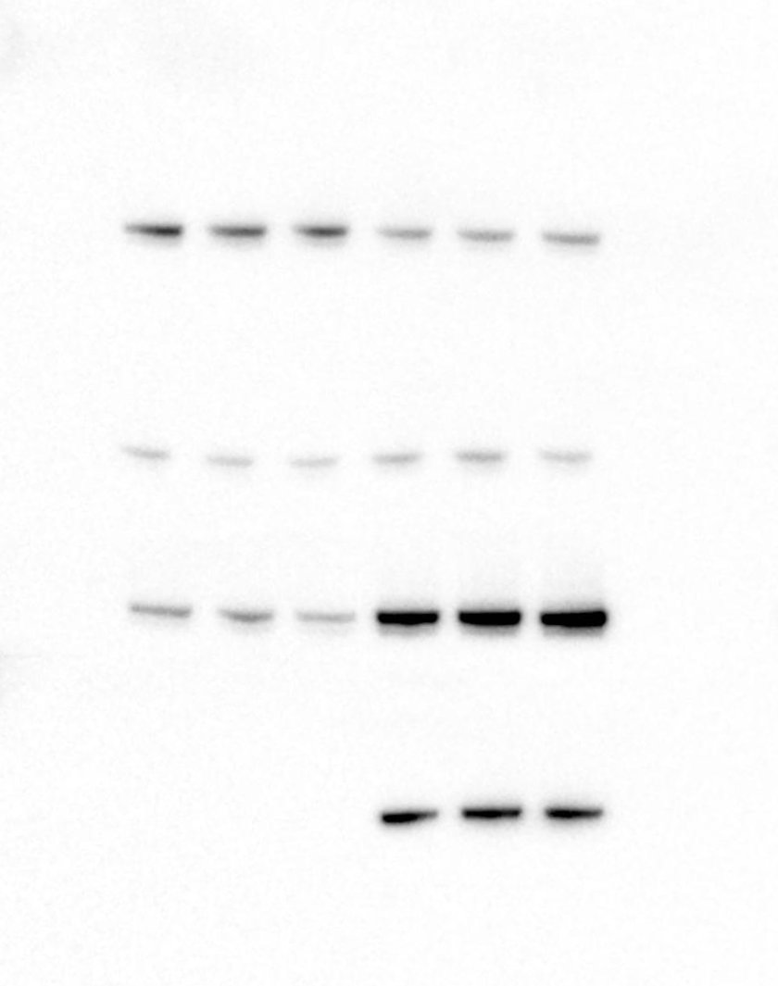
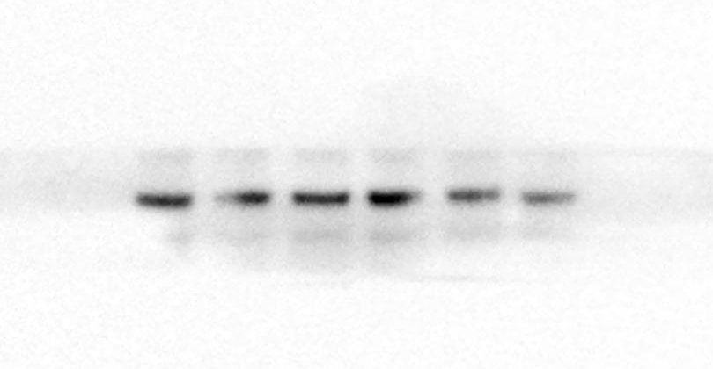
Figure 2a cont.
β-actin
(AMLs)
P-STAT3 (Y705)
(AMLs)
P-RelA (S536)
(AMLs)

Slide 3
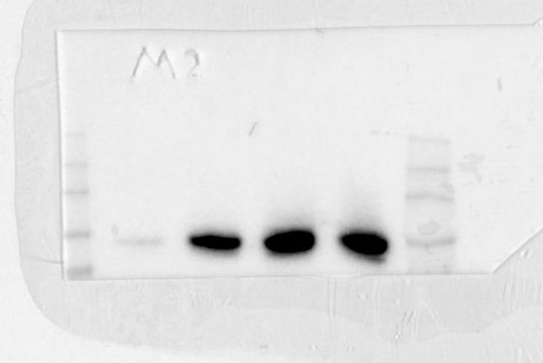
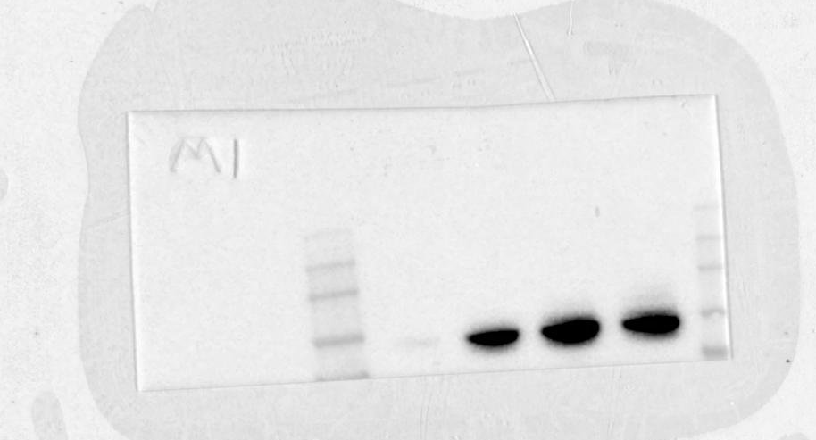
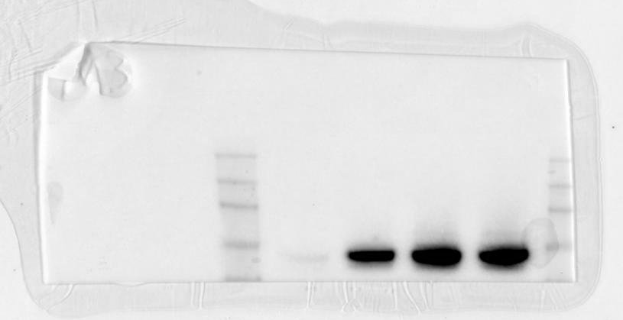
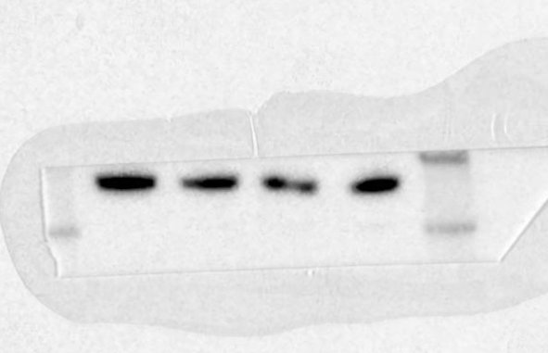
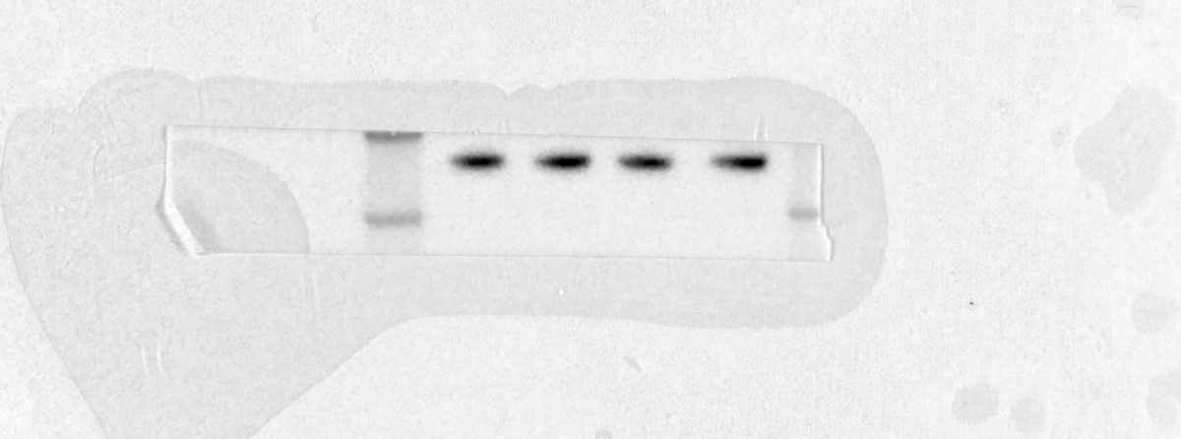
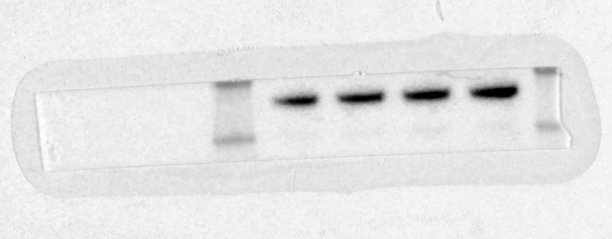
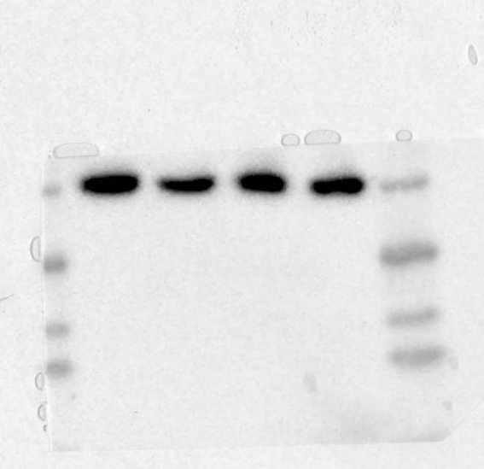
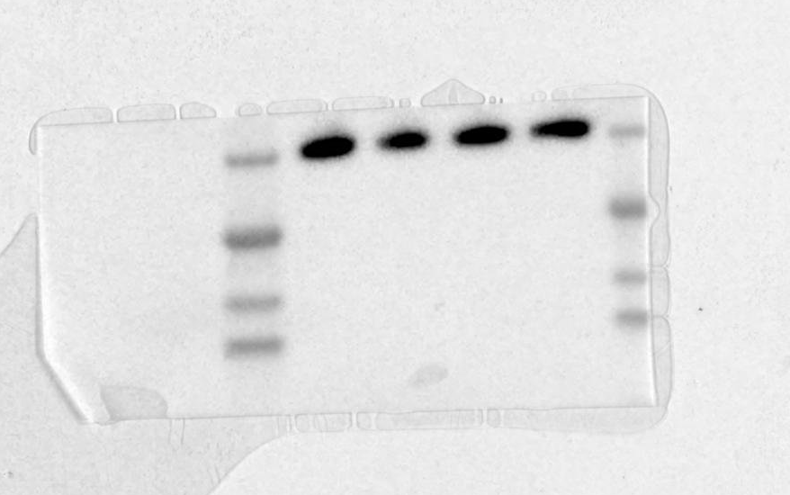
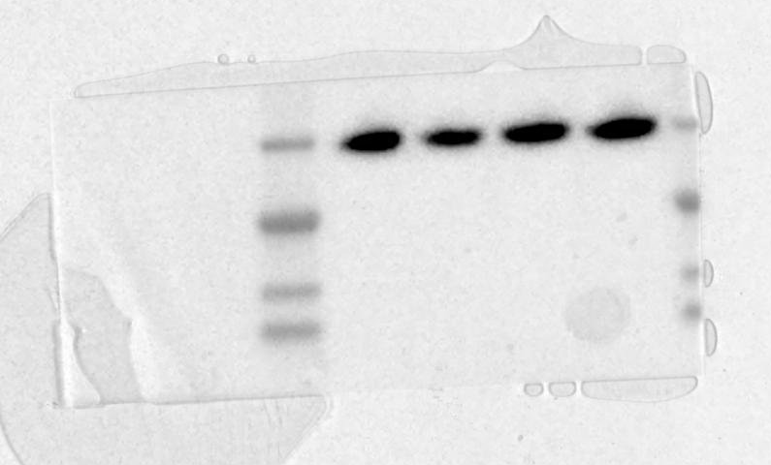
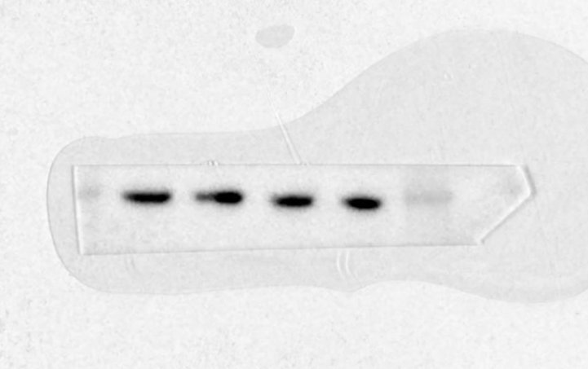
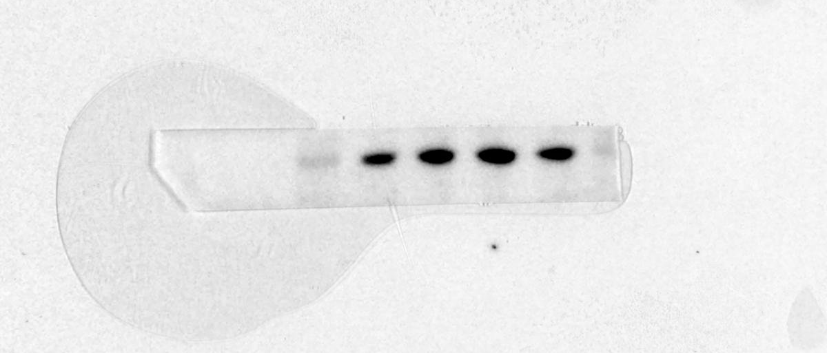
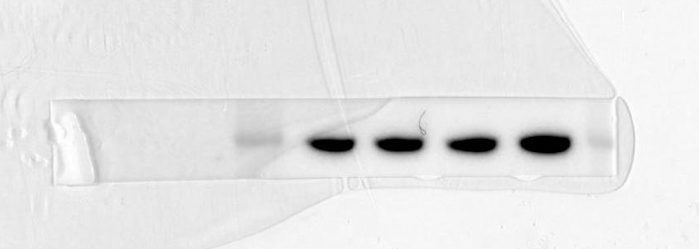
Figure 2b
Figure 2 - MEFs Tsc2 −/−
Repeat 1 (densitometry)
Repeat 3 (densitometry)
Repeat 2 (shown)
P-STAT3 (Y705)
P-STAT3 (Y705)
P-STAT3 (Y705)
P-RelA (S536)
P-RelA (S536)
P-RelA (S536)
P-RpS6 (S235/236)
P-RpS6 (S235/236)
P-RpS6
(S235/236)
β-actin
β-actin
β-actin

Slide 4
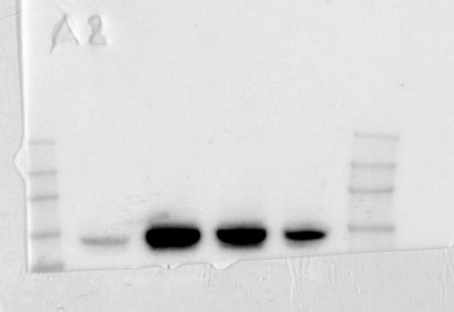
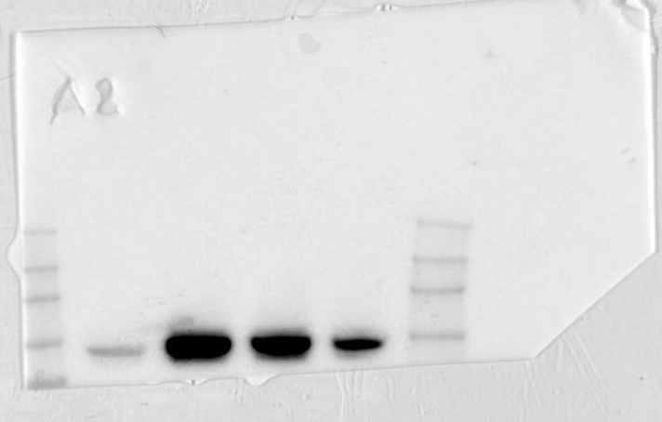
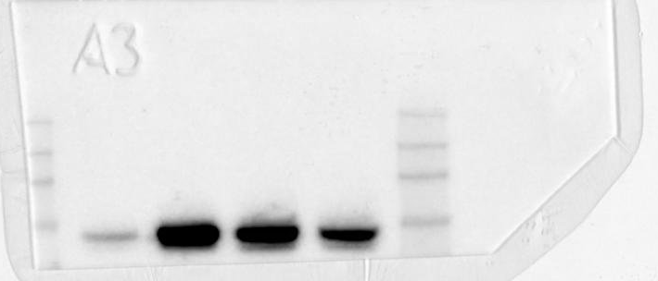
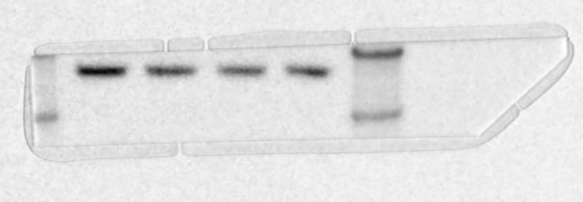
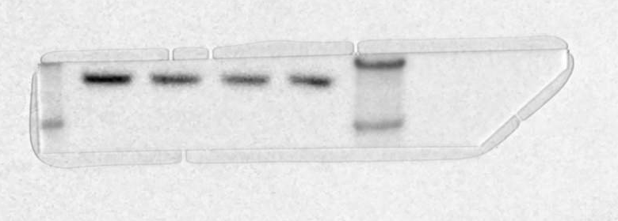
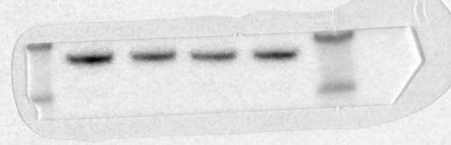
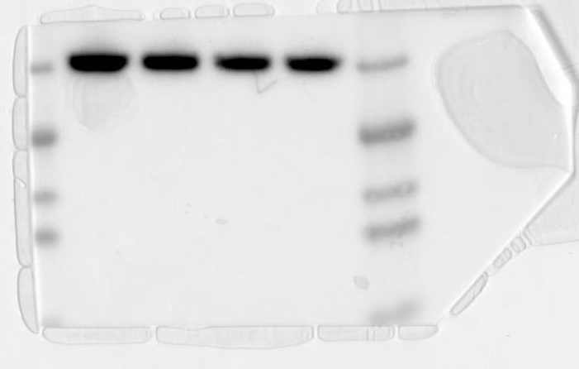
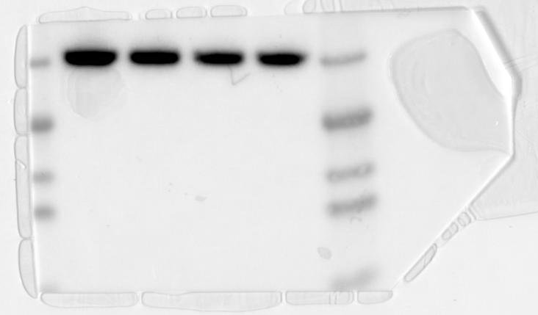
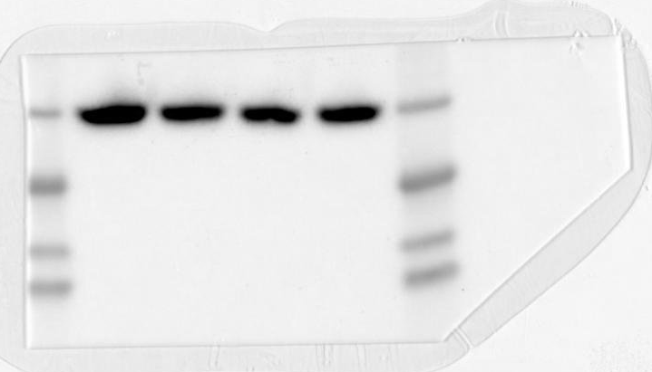
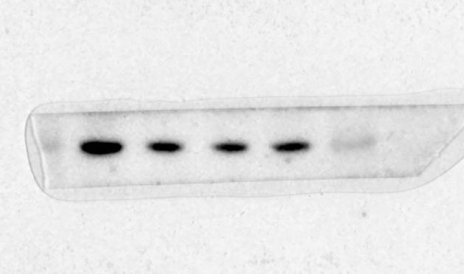
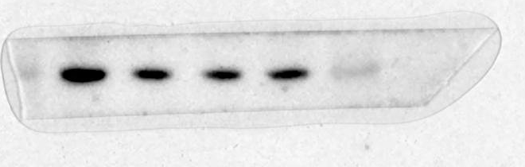
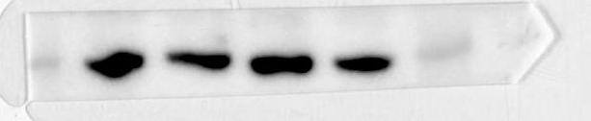
Figure 2b cont.
Figure 2 – AML TSC2 (−)
Repeat 1 (Densitometry)
Repeat 3 (Densitometry)
Repeat 2 (shown)
P-STAT3 (Y705)
P-STAT3 (Y705)
P-STAT3 (Y705)
P-RelA (S536)
P-RelA (S536)
P-RelA (S536)
P-RpS6 (S235/236)
P-RpS6 (S235/236)
P-RpS6
(S235/236)
β-actin
β-actin
β-actin

Slide 5
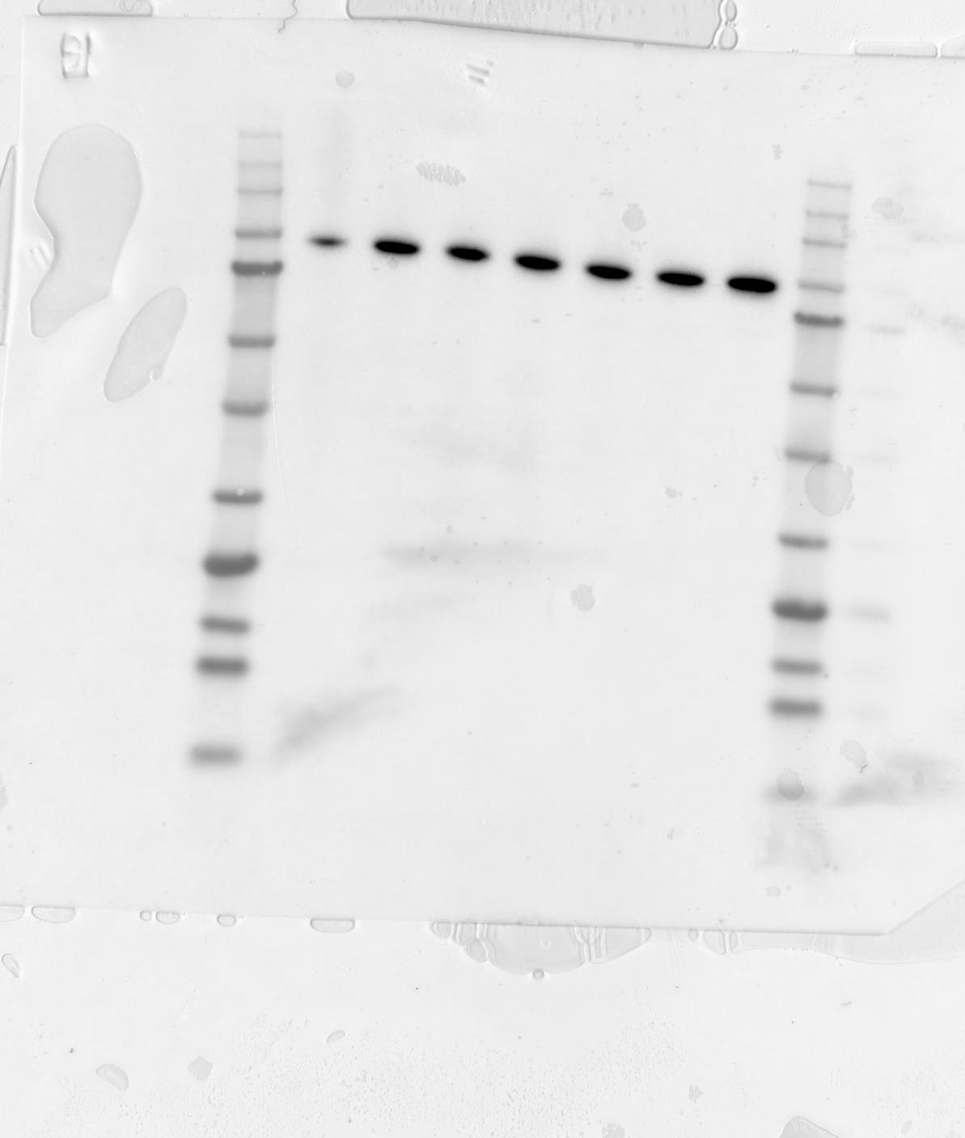
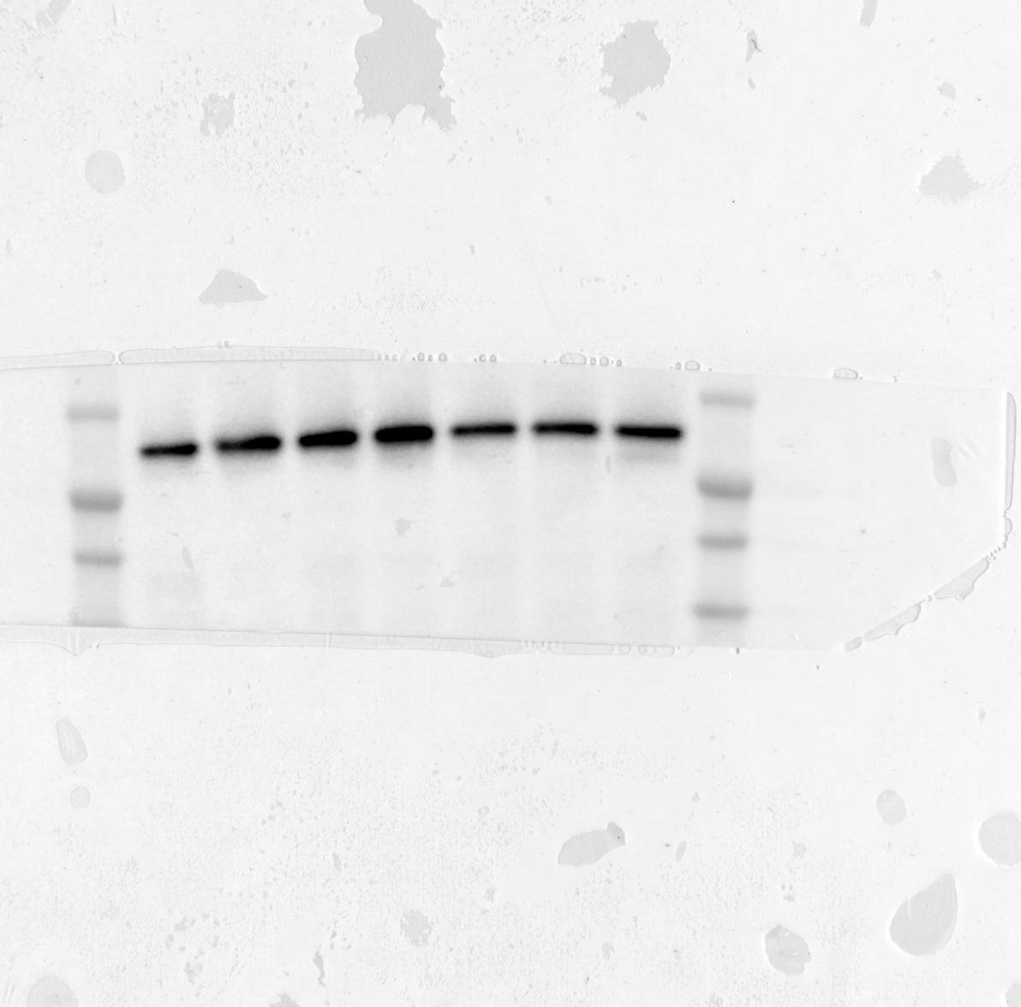
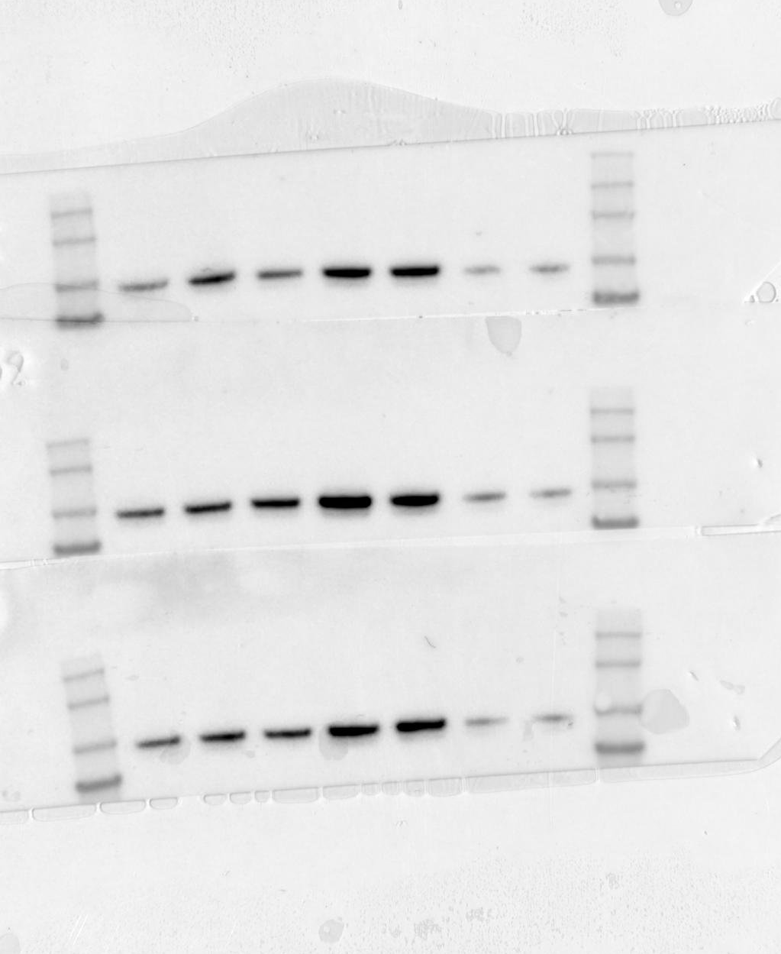
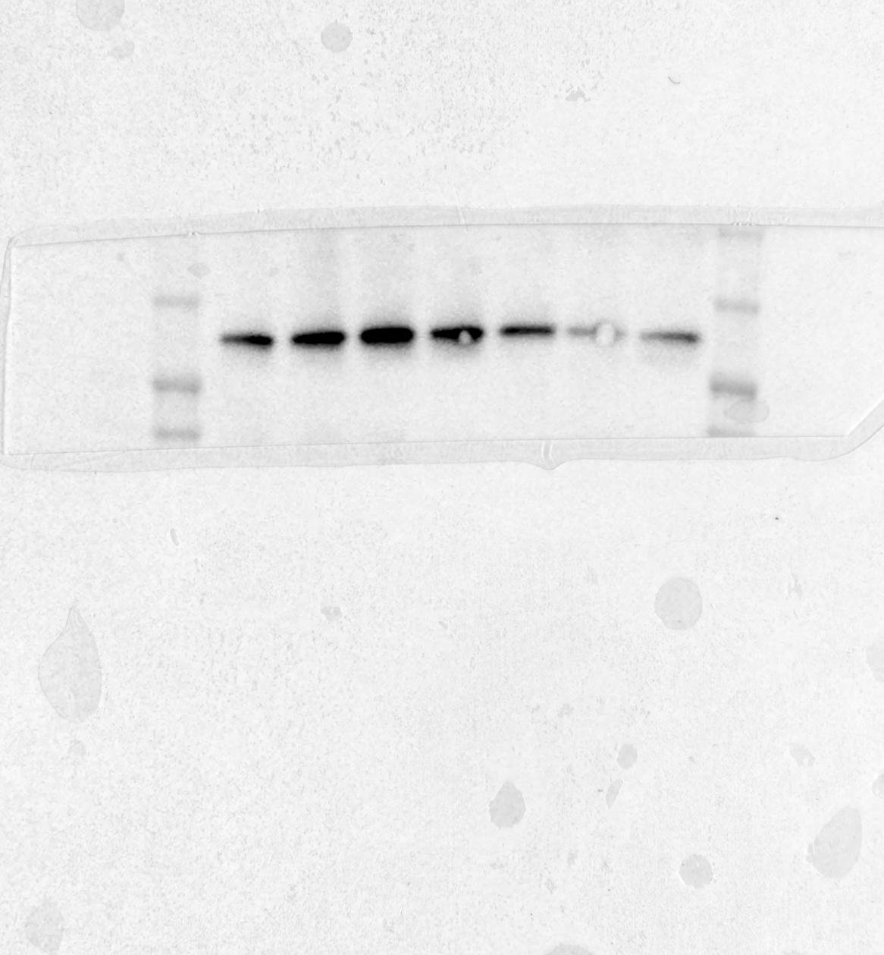
Figure 3d
BMS345541 Treatments
R1
STAT3
R2 (used)
STAT3
R1
P-STAT3 (Y705)
R2 (used)
P-STAT3 (Y705)
R3
STAT3
R3
P-STAT3 (Y705)

Slide 6
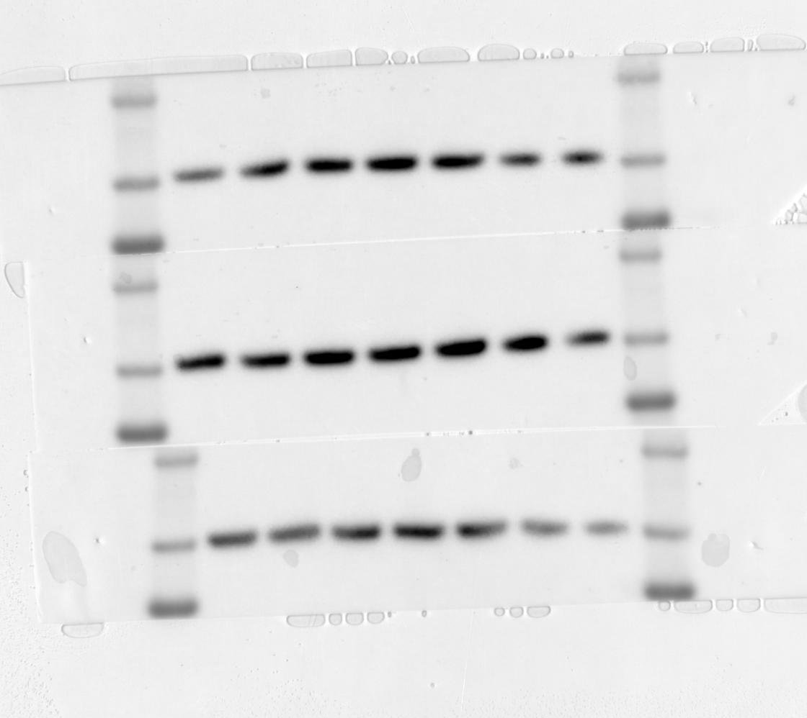
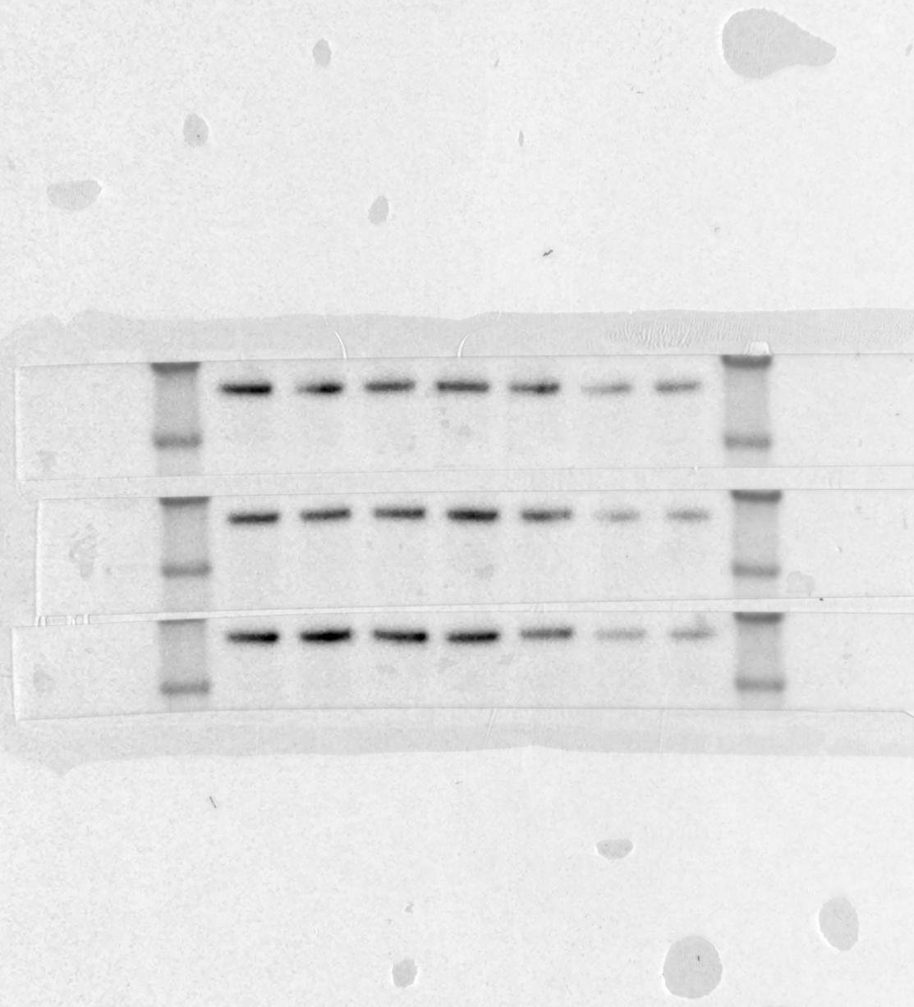
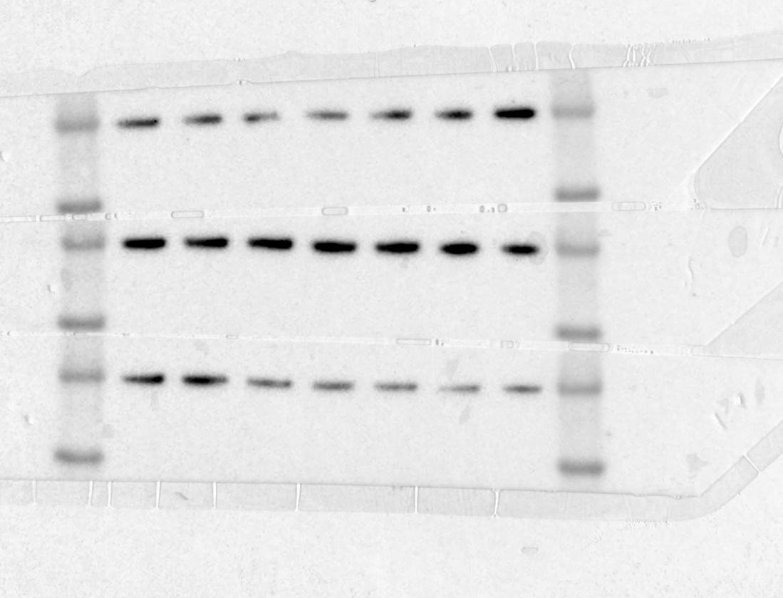
Figure 3d cont.
P-RpS6 (S235/236)
BMS345541 Treatments
R1
R2 (used)
P-RpS6 (S235/236)
R3
P-RpS6 (S235/236)
R1
P-RelA (S536)
R2 (used)
P-RelA (S536)
R3
P-RelA (S536)
R1
β-actin
R2 (used)
β-actin
R3
β-actin

Slide 7
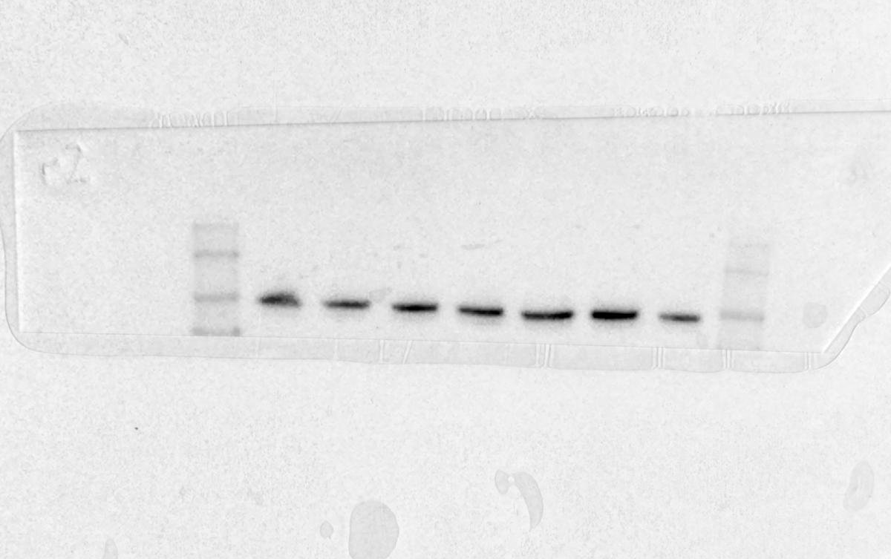
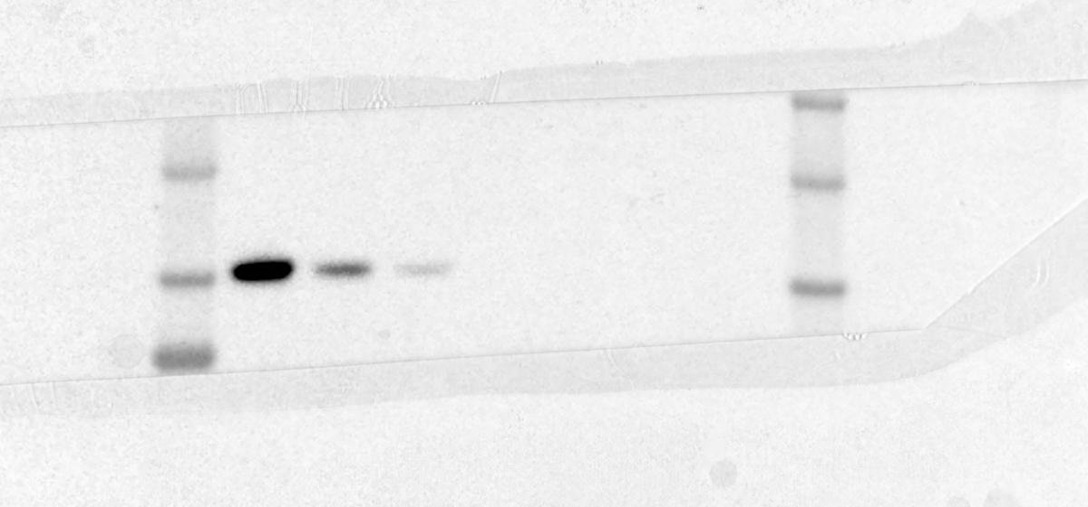
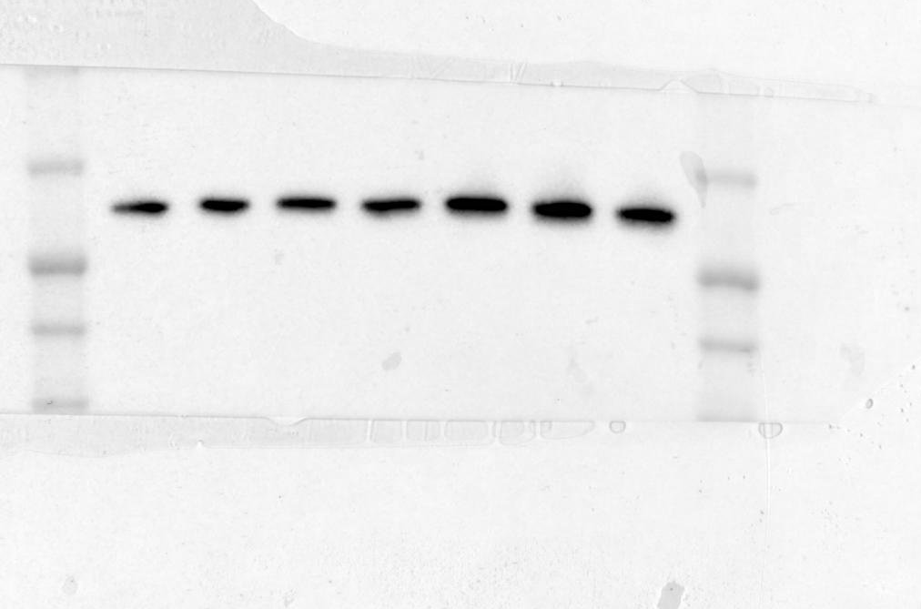
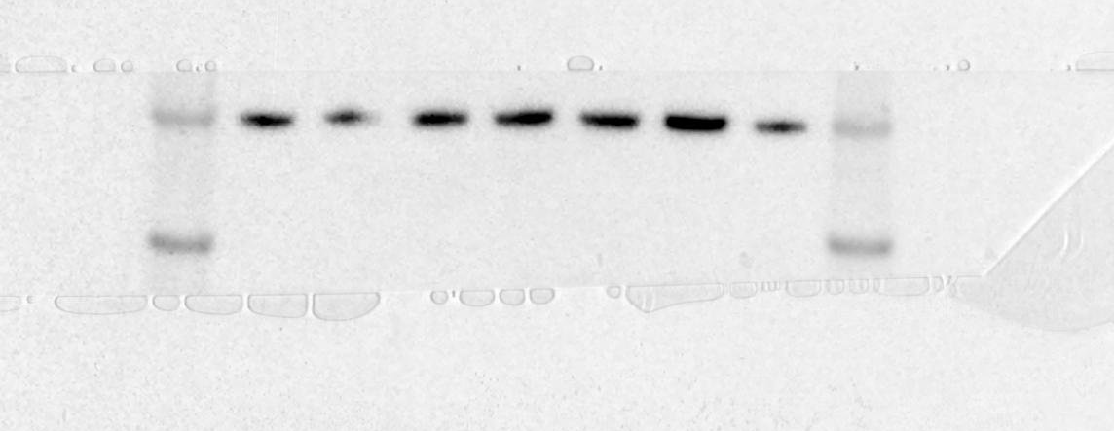
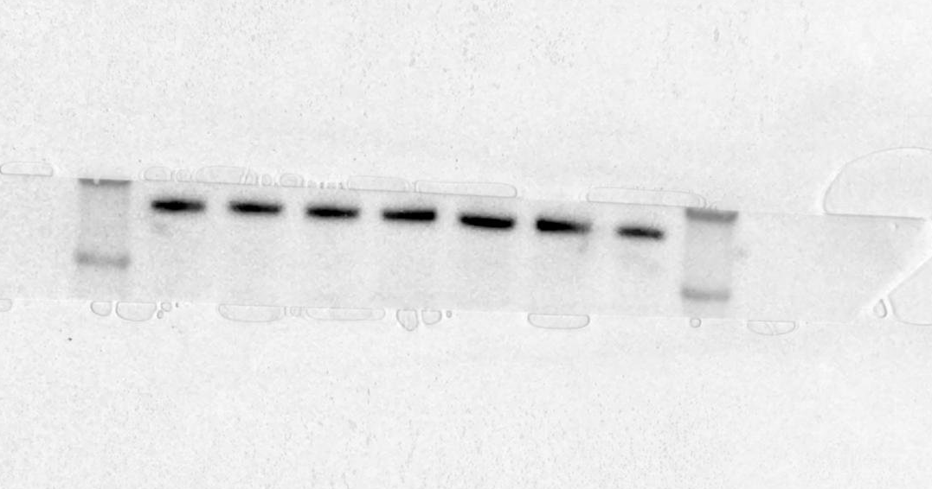
Figure 3d cont.
Rapamycin
Repeat 2 (used in figure)
P-STAT3 (Y705)
P-RpS6 (S235/236)
β-actin
STAT3
P-RelA (S536)

Slide 8
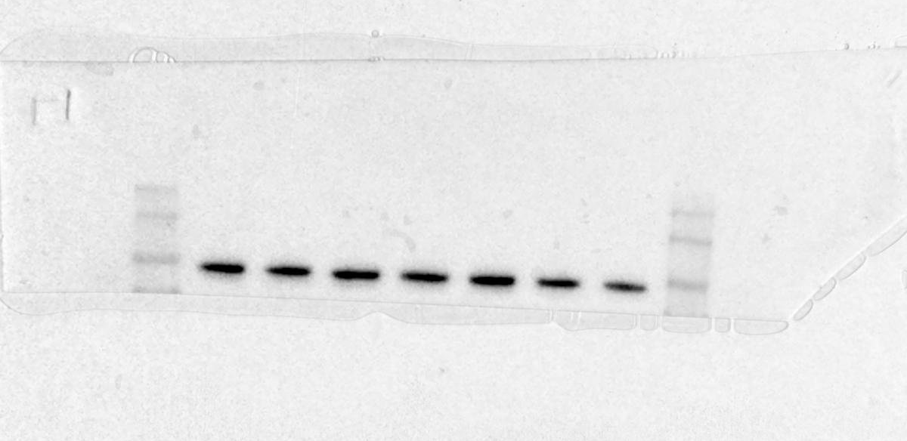
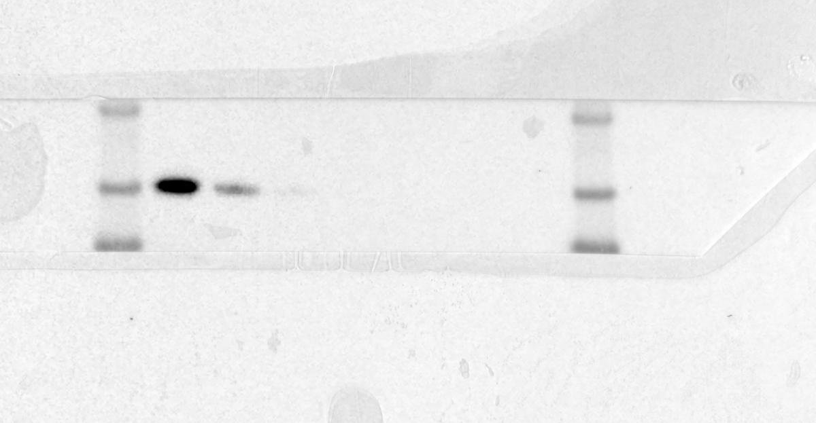
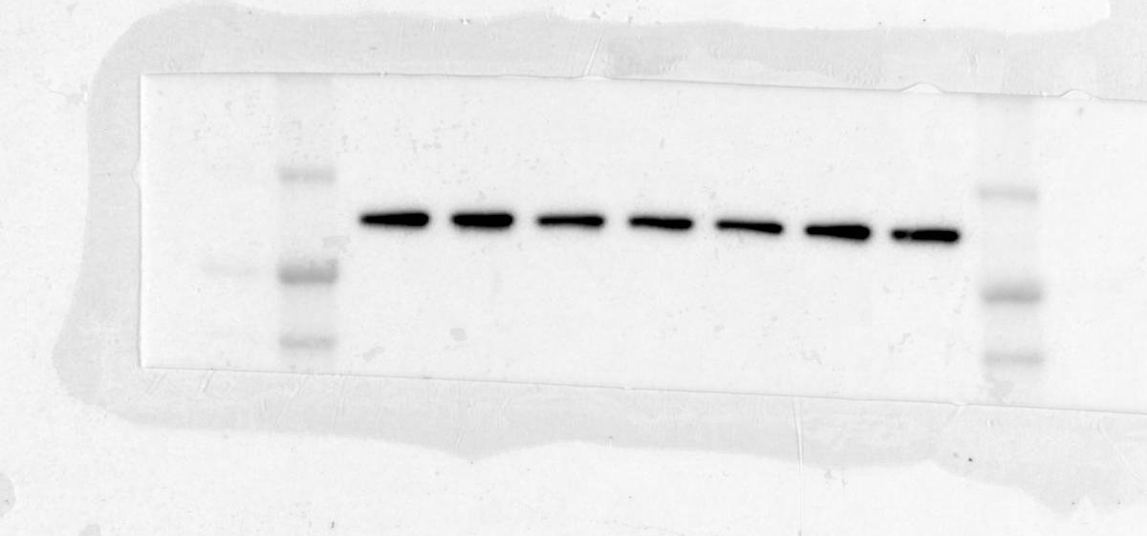
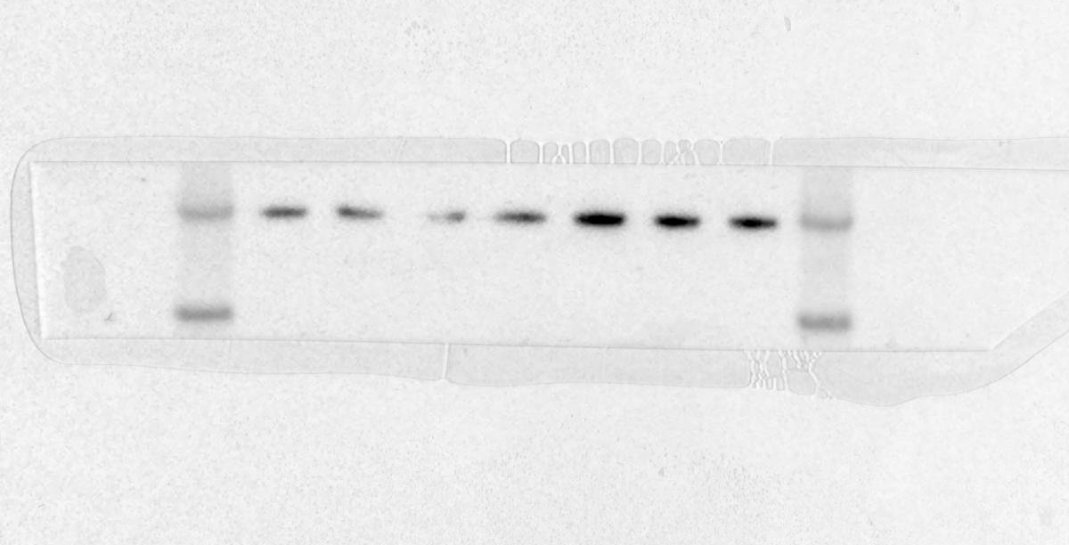
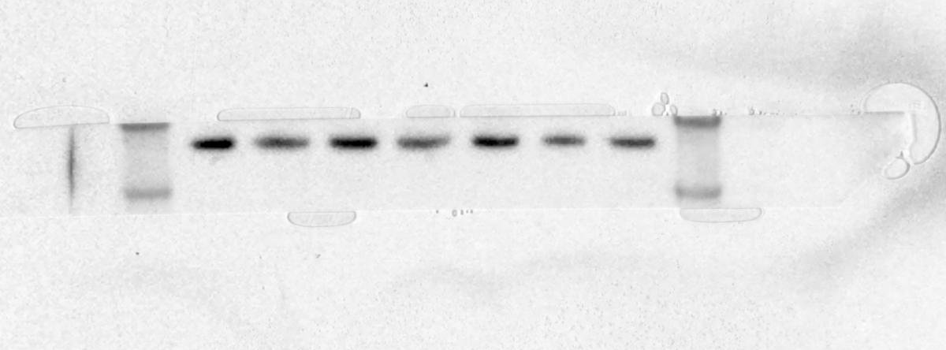
Figure 3d cont.
Rapamycin
Repeat 1 (densitometry)
P-RpS6 (S235/236)
P-STAT3 (Y705)
STAT3
β-actin
P-RelA (S536)

Slide 9
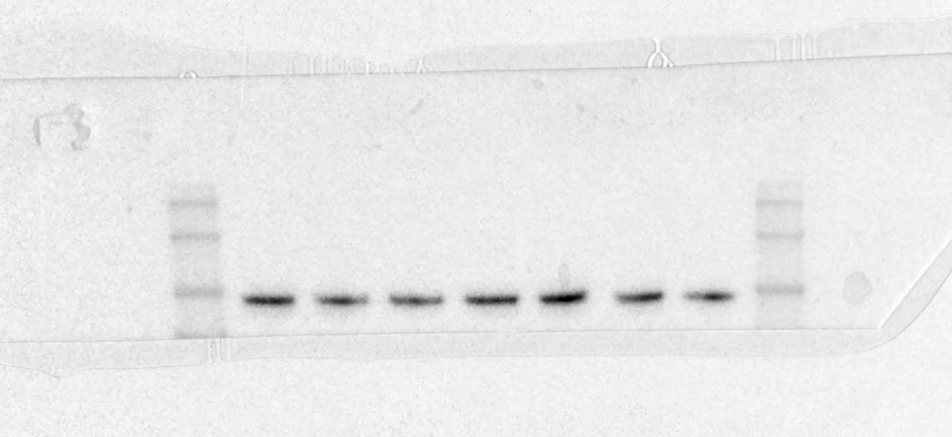
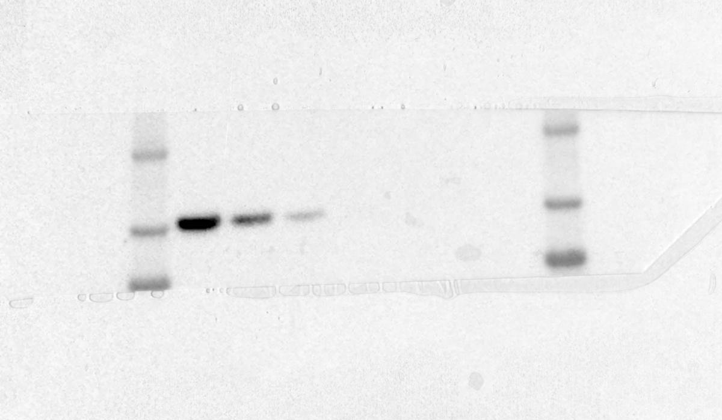
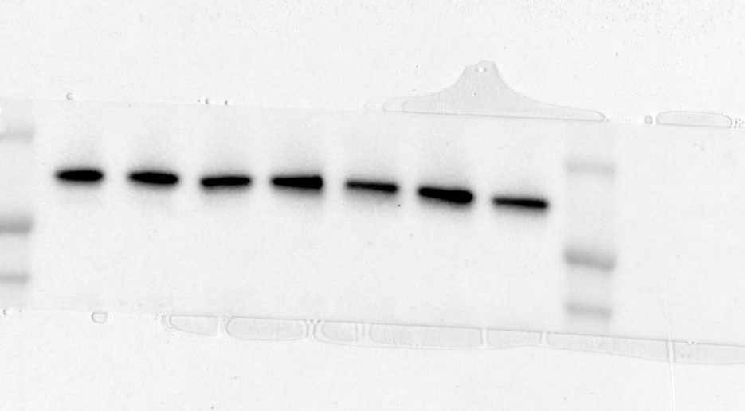
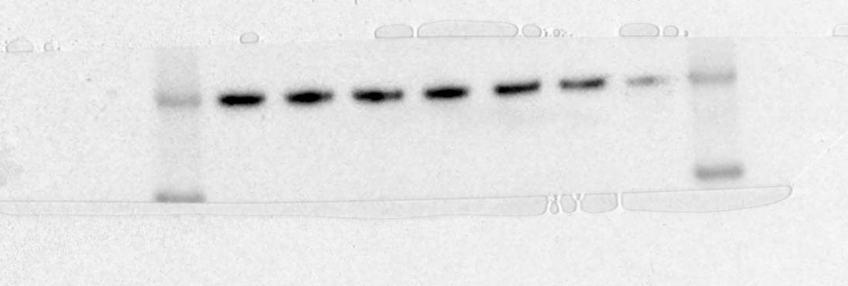

Figure 3d cont.
Rapamycin
Repeat 3 (densitometry)
P-RpS6 (S235/236)
P-STAT3 (Y705)
STAT3
β-actin
P-RelA (S536)

Slide 10






Figure 3d cont.
BMS345541 + Rapamycin
Repeat 2 (used in figure)
P-STAT3 (Y705)
P-RpS6 (S235/236)
β-actin
STAT3
P-RelA (S536)
P-RelA (S536)
Lower exposure with ladder
(Not used in figure)

Slide 11




Figure 3d cont.
BMS345541 + Rapamycin
Repeat 1 (used in densitometry)
P-STAT3 (Y705)
P-RpS6 (S235/236)
STAT3
β-actin
P-RelA (S536)

Slide 12





Figure 3d cont.
BMS345541 + Rapamycin
Repeat 3 (used in densitometry)
P-RpS6 (S235/236)
P-STAT3 (Y705)
STAT3
β-actin
P-RelA (S536)

Slide 13


Figure 5c
PD-L2
β-actin
TSC2

Slide 14








Figure 5d – repeat 4 (used in figure)
STAT3
P-STAT3
(Y705)
PD-L2
P-RelA
(S536)
P-STAT3
(S727)
P-rpS6
(S235/236)
rpS6
β-actin

Slide 15








Figure 5d – repeat 1/repeat2 (used in densitometry)
STAT3
P-STAT3
(Y705)
PD-L2
P-RelA
(S536)
P-STAT3
(S727)
P-rpS6
(S235/236)
β-actin
rpS6

Slide 16








Figure 5d – repeat 3 (used in densitometry)
P-RelA
(S536)
P-STAT3
(Y705)
PD-L2
STAT3
rpS6
P-rpS6
(S235/236)
P-STAT3
(S727)
β-actin

